Slide 1
Modeling Inference Rules
Roger L. Costello
March 26, 2018

Slide 2
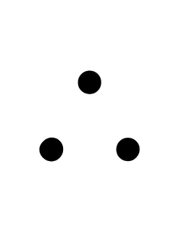
Modus Ponens
P => Q
P ----------
Q
All men are mortals.
Socrates is a man.
Therefore, Socrates is a mortal.

Slide 3
assert Socrates_is_mortal {
all Socrates: univ, Man, Mortal: set univ |
-- All men are mortals.
Man in Mortal
-- Socrates is a man.
and (Socrates in Man)
-- Therefore, Socrates is a mortal.
implies Socrates in Mortal
}
check Socrates_is_mortal
When the Alloy Analyzer checks the assertion, it finds no counterexamples.
Mortal
univ (universe)
Man
Socrates

Slide 4
Model consists of just an assert
This example shows that an Alloy model may consist of just an assert (and check command).
The model does not contain any signatures, facts, or predicates.

Slide 5
Example #2
If you cared about your dog, Fifi, you would take her for a walk every day after work. But you don't do that, so you don't care about her.

Slide 6
assert You_do_not_care_about_Fifi {
all You: univ, Caring_person, Walks_his_dog_after_work: set univ |
-- Every caring person walks his dog after work.
Caring_person in Walks_his_dog_after_work
-- You do not walk Fifi after work.
and (You not in Walks_his_dog_after_work)
-- Therefore, you are not a caring person
implies You not in Caring_person
}
check You_do_not_care_about_Fifi
When the Alloy Analyzer checks the assertion, it finds no counterexamples.
Walks his dog after work
univ (universe)
Caring person
You
Do Lab6

