Slide 1
Modeling a remote-controlled bathtub and identifying vulnerabilities
Roger L. Costello
August 29, 2018

Slide 2
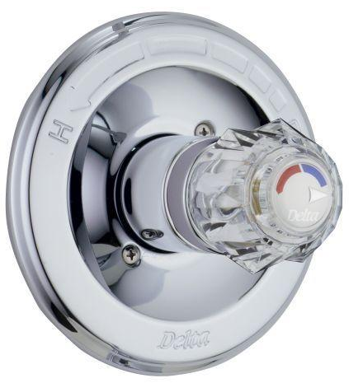
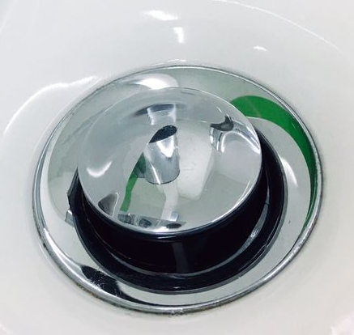
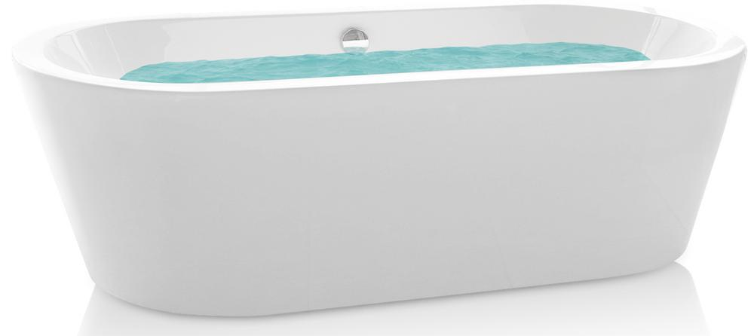

Smartphone app controls bathtub
Using a Smartphone app you can control the water into and out of the bathtub, so the bath will be all ready for you when you get home.

Slide 3
App controls water valve and drain
Electronic devices in the water valve and in the drain enable the app to (wirelessly) control the flow of water into and out of the bathtub.

Slide 4
App receives water level sensor data
Water level sensor
A water level sensor on the bathtub transmits these water level values:
{empty, LL, L, M1, M2, H, HH, OF}
OF = OverFlow

Slide 5
Behavior of the bathtub “system”
When the water valve is turned on and the drain is closed, the water level in the tub increases.
When the water valve is turned off and the drain is open, the water level in the tub decreases.
When the water valve is turned on and the drain is open, the water level in the tub remains the same.
When the water valve is turned off and the drain is closed, the water level in the tub remains the same.

Slide 6
Alarm goes off if …
An alarm goes off on the app if the water in the tub is about to overflow.
The bathtub is overflowing when the water level = OF for 3 consecutive time steps.

Slide 7
Attacker capabilities
The smartphone app interacts with the bathtub system wirelessly.
An attacker is able to intercept and replace signals sent between the smartphone app and the bathtub system.

Slide 8
Can an attacker cause the tub to overflow?
An attacker wants to cause the tub to overflow.
Note that the fewer things that the attacker has the compromise, the more likely the attack. For example, if the attacker has to compromise the link to the water valve and the link to the drain and the link from the water level sensor, then that greatly reduces the likelihood of an attack than if, say, the attacker just needs to compromise the water level sensor.

Slide 9
Alloy Analyzer searches for vulnerabilities
I created an Alloy model of the system and had the Alloy Analyzer explore all possible attack configurations and enumerate ones that lead into an unsafe state, i.e., a configuration which results in the bathtub overflowing.
The Analyzer found multiple ways that an attacker can cause the bathtub to overflow.
The simplest way (for the attacker) is to compromise the data transmissions from the water level sensor to the app.

Slide 10

App receives water level data from attacker
Water level sensor
X
water
level
Attacker

Slide 11
The app thinks everything is fine
Bathtub
App
Time
Valve
Level
Drain
Time
Valve
Level
Drain
Time0
Off
empty
Open
Time0
Off
empty
Open
Time1
On
empty
Closed
Time1
On
empty
Closed
Time2
On
LL
Closed
Time2
On
LL
Closed
Time3
On
L
Closed
Time3
On
L
Closed
Time4
On
M1
Closed
Time4
On
M1
Closed
Time5
On
M2
Closed
Time5
On
M1
Closed
Time6
On
H
Closed
Time6
On
M1
Closed
Time7
On
HH
Closed
Time7
On
M1
Closed
Time8
On
OF
Closed
Time8
On
M1
Closes
Time9
On
OF
Closed
Time9
On
M1
Closed
Time10
On
OF
Closed
Time10
On
M1
Closed
Time11
On
OF
Closed
Time11
On
M1
Closed
Actual water level, as measured by the water level sensor
Water level values sent by attacker
Compromised: water level sensor

Slide 12
Alloy Model

Slide 13
One Bathtub, one App
one sig Bathtub {
valve: WaterValve one -> Time,
level: WaterLevel one -> Time,
drain: Drain one -> Time
}
one sig App {
valve: WaterValve one -> Time,
level: WaterLevel one -> Time,
drain: Drain one -> Time
}

Slide 14
One value at each time
one sig Bathtub {
valve: WaterValve one -> Time,
level: WaterLevel one -> Time,
drain: Drain one -> Time
}
one sig App {
valve: WaterValve one -> Time,
level: WaterLevel one -> Time,
drain: Drain one -> Time
}
At each time step the bathtub has exactly one WaterValve value, one WaterLevel value, and one Drain value. Ditto for the App.

Slide 15
Enumerate the allowable values
enum Drain {Open, Closed}
enum WaterValve {On, Off}
enum WaterLevel {empty, LL, L, M1, M2, H, HH, OF}

Slide 16
App tells the water valve to turn on/off
The App determines whether the water valve should be on or off. So, Bathtub.valve equals App.valve, if the connection is not compromised (more precisely, if the water valve actuator is not compromised).

Slide 17
Enumerate the devices that might be compromised
enum Device {DrainActuator, WaterValveActuator, WaterLevelSensor}
sig Compromised in Device {}

Slide 18
Threat model
A threat model describes a set of actions that an attacker may perform in an attempt to compromise a security property of a system. Building a threat model is an important step in any secure system design; it allows us to identify (possibly invalid) assumptions that we have about the system and its environment and prioritize different types of risks that need to be mitigated.
Acknowledgement: Eunsuk Kang

Slide 19
App tells the drain to open/close
The App determines whether the drain should be open or closed. So, Bathtub.drain equals App.drain, if the connection is not compromised (more precisely, if the drain actuator is not compromised).

Slide 20
Behavior of the bathtub “system”
Bathtub.valve equals App.valve, if the WaterValveActuator is not compromised.
Bathtub.drain equals App.drain, if the DrainActuator is not compromised.
When the water valve is turned on and the drain is closed, the water level in the tub increases.
When the water valve is turned off and the drain is open, the water level in the tub decreases.
When the water valve is turned on and the drain is open, the water level in the tub remains the same.
When the water valve is turned off and the drain is closed, the water level in the tub remains the same.

Slide 21
one sig Bathtub {
valve: WaterValve one -> Time,
level: WaterLevel one -> Time,
drain: Drain one -> Time
}{
all t : Time {
-- If the data packets controlling the water valve actuator are not compromised,
-- then the bathtub's water valve is the value provided by the App.
(WaterValveActuator not in Compromised) implies valve.t = App.valve.t
-- If the data packets controlling the drain actuator are not compromised,
-- then the bathtub's drain is the value provided by the App.
(DrainActuator not in Compromised) implies drain.t = App.drain.t
}
-- However the water valve and drain obtain their values (via the App or via an attacker),
-- the bathtub's water level is determined by their settings.
all t : Time - last |
let t' = t.next {
(valve.t = On and drain.t = Open) implies (level.t' = level.t)
(valve.t = Off and drain.t = Closed) implies (level.t' = level.t)
(valve.t = On and drain.t = Closed) implies (level.t' = increaseLevel[level.t])
(valve.t = Off and drain.t = Open) implies (level.t' = decreaseLevel[level.t])
}
}

Slide 22
App receives water level data from sensor
Water level sensor
The App receives data from the water level sensor. So, App.level equals Bathtub.level, if the connection is not compromised (more precisely, if the water level sensor is not compromised).

Slide 23
App sends “on” command when …
Water level sensor
Send an “on” command when the App’s water level value indicates a low level or when the valve is already on and the water level is not high.

Slide 24
Behavior of the App
At each time step, the App’s water level reading equals the bathtub’s water level, provided WaterLevelSensor is not compromised.
If WaterLevelSensor is compromised, then the App still receives a water level value, but the value comes from the attacker, not the bathtub.
Send an “valve on” command when the level reading is empty, LL, or L. If the valve is already on, then leave it on provided the level is not H, HH, or OF.
To “send a valve on command” simply means “set App.valve equal to on”. We abstract away the operations of sending/receiving wireless packets.
Send a “valve off” command when the level reading is H, HH, or OF. If the drain is already off, then leave it off provided the level is not empty, LL, or L.
Continued →

Slide 25
Behavior of the App (cont.)
Send an “open drain” command when the level reading is H, HH, or OF. If the drain is already open, then leave it open provided the level is not empty, LL, or L.
Send a “close drain” command when the level reading is empty, LL, or L. If the drain is already closed, then leave it closed provided the level is not H, HH, or OF.

Slide 26
one sig App {
valve: WaterValve one -> Time,
level: WaterLevel one -> Time,
drain: Drain one -> Time
}{
all t : Time {
-- If the data packets from the bathtub's water level sensor are not compromised,
-- then the app's water level reading is the value provided by the Bathtub.
(WaterLevelSensor not in Compromised) implies level.t = Bathtub.level.t
}
all t : Time - last |
let t' = t.next {
drain.t' = Open iff
(
(drain.t = Open and not (level.t in (empty + LL + L))) or
level.t in (H + HH + OF)
)
drain.t' = Closed iff
(
(drain.t = Closed and not (level.t in (H + HH + OF))) or
level.t in (empty + LL + L)
)
valve.t' = On iff
(
(valve.t = On and not (level.t in (H + HH + OF))) or
level.t in (empty + LL + L)
)
valve.t' = Off iff
(
(valve.t = Off and not (level.t in (empty + LL + L))) or
level.t in (H + HH + OF)
)
}
}

Slide 27

Overflow alarm raised when water level = OF
Water level sensor
The App raises an overflow alarm at time t if the App’s water level reading value is OF (OverFlow) at time t. Of course, an attacker wants to avoid the alarm being raised, so he will manipulate the signals such that the App never gets into an overflow condition.

Slide 28
Declare Alarm
abstract sig Alarm {
raised: Time
}
sig Overflow extends Alarm {}

Slide 29
Condition for generating alarm
fact {
// if the water level reads OF, raise the overflow alarm
all t : Time |
App.level.t = OF implies some Overflow & raised.t
else no Overflow & raised.t
}

Slide 30
Initial state of App and bathtub
fact init {
no Alarm & raised.first
App.valve.first = Off
App.drain.first = Open
Bathtub.level.first = empty
}

Slide 31
one sig Bathtub {
valve: WaterValve one -> Time,
level: WaterLevel one -> Time,
drain: Drain one -> Time
}{
all t : Time {
-- If the data packets controlling the water valve actuator are not compromised,
-- then the bathtub's water valve is the value provided by the App.
(WaterValveActuator not in Compromised) implies valve.t = App.valve.t
-- If the data packets controlling the drain actuator are not compromised,
-- then the bathtub's drain is the value provided by the App.
(DrainActuator not in Compromised) implies drain.t = App.drain.t
}
-- However the water valve and drain obtain their values (via the App or via an attacker),
-- the bathtub's water level is determined by their settings.
all t : Time - last |
let t' = t.next {
(valve.t = On and drain.t = Open) implies (level.t' = level.t)
(valve.t = Off and drain.t = Closed) implies (level.t' = level.t)
(valve.t = On and drain.t = Closed) implies (level.t' = increaseLevel[level.t])
(valve.t = Off and drain.t = Open) implies (level.t' = decreaseLevel[level.t])
}
}
How to define these?

Slide 32
-- step function that takes a water level and returns the next higher one
fun increaseLevel : WaterLevel -> WaterLevel {
levelOrder + OF -> OF
}
-- step function that takes a water level and returns the next lower one
fun decreaseLevel : WaterLevel -> WaterLevel {
~levelOrder + empty -> empty
}
-- total ordering on the water levels: empty, LL, L, M1, M2, H, HH, OF
fun levelOrder : WaterLevel -> WaterLevel {
empty -> LL +
LL -> L +
L -> M1 +
M1 -> M2 +
M2 -> H +
H -> HH +
HH -> OF
}
Acknowledgement: Eunsuk Kang

Slide 33
3 consecutive time steps with level = OF
// Bathtub overflows if the water level is OF for 3 times
// and no alarm is raised
pred overflow[t : Time] {
let t0 = t.prev.prev,
t1 = t.prev,
t2 = t {
some t0 and some t1 and some t2
Bathtub.level.(t0 + t1 + t2) = OF and
no Overflow & raised.(t0 + t1 + t2)
}
}

Slide 34
Run the Alloy Analyzer
run generateOverflowAttack {
#Compromised <= 1
some t : Time | overflow[t]
} for 1 but 12 Time, 12 Alarm

Slide 35
Bathtub overflows!
Bathtub
App
Time
Valve
Level
Drain
Time
Valve
Level
Drain
Time0
Off
empty
Open
Time0
Off
empty
Open
Time1
On
empty
Closed
Time1
On
empty
Closed
Time2
On
LL
Closed
Time2
On
LL
Closed
Time3
On
L
Closed
Time3
On
L
Closed
Time4
On
M1
Closed
Time4
On
M1
Closed
Time5
On
M2
Closed
Time5
On
M1
Closed
Time6
On
H
Closed
Time6
On
M1
Closed
Time7
On
HH
Closed
Time7
On
M1
Closed
Time8
On
OF
Closed
Time8
On
M1
Closes
Time9
On
OF
Closed
Time9
On
M1
Closed
Time10
On
OF
Closed
Time10
On
M1
Closed
Time11
On
OF
Closed
Time11
On
M1
Closed
Compromised: water level sensor

Slide 36
Filling up and draining a bathtub is analogous to filling up and draining a water tank at a water treatment plant
Raw Water
Motorized
Valve
Raw Water
Tank
Pump
other stuff

Slide 37
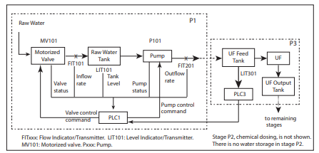
Water treatment plant

Slide 38
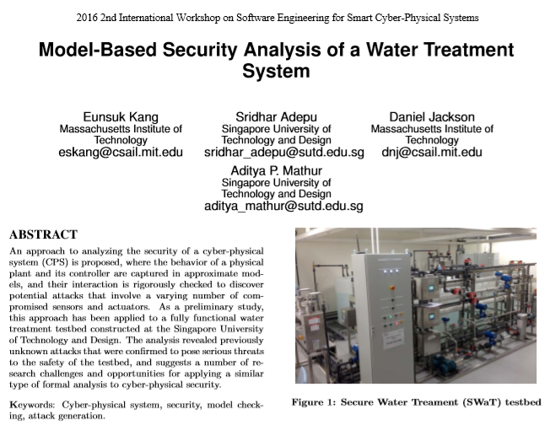
Check out this paper

