Slide 1
vbar_el1
Size (bytes) | Exception types | Exception occurred in CPU mode ...
128 (0x80) | Synchronous | EL1t (EL1, using SP_EL0)
128 (0x80) | IRQ/vIRQ
128 (0x80) | FIQ/vFIQ
128 (0x80) | SError/vSError
128 (0x80) | Synchronous | EL1h (EL1, using SP_EL1)
128 (0x80) | IRQ/vIRQ
128 (0x80) | FIQ/vFIQ
128 (0x80) | SError/vSError
128 (0x80) | Synchronous | EL0_64 (EL0, 64bit mode)
128 (0x80) | IRQ/vIRQ
128 (0x80) | FIQ/vFIQ
128 (0x80) | SError/vSError
128 (0x80) | Synchronous | EL0_32 (EL0, 32bit mode)
128 (0x80) | IRQ/vIRQ
128 (0x80) | FIQ/vFIQ
128 (0x80) | SError/vSError
Low addr
High addr

Slide 2
vbar_el1
Size (bytes) | Exception types | Exception taken from CPU states ...
128 (0x80) | Synchronous | EL1t (Current EL with SP0)
128 (0x80) | IRQ/vIRQ
128 (0x80) | FIQ/vFIQ
128 (0x80) | SError/vSError
128 (0x80) | Synchronous | EL1h (Current EL with SPx)
128 (0x80) | IRQ/vIRQ
128 (0x80) | FIQ/vFIQ
128 (0x80) | SError/vSError
128 (0x80) | Synchronous | EL0_64 (Lower EL using AArch64)
128 (0x80) | IRQ/vIRQ
128 (0x80) | FIQ/vFIQ
128 (0x80) | SError/vSError
128 (0x80) | Synchronous | EL0_32 (Lower EL using AArch32)
128 (0x80) | IRQ/vIRQ
128 (0x80) | FIQ/vFIQ
128 (0x80) | SError/vSError
Low addr
High addr

Slide 3
Vector table for EL1
Low addr
Exception types | CPU states
Synchronous | Current EL with SP0
IRQ/vIRQ
FIQ/vFIQ
SError/vSError
Synchronous | Current EL with SPx
IRQ/vIRQ
FIQ/vFIQ
SError/vSError
Synchronous | Lower EL using AArch64
IRQ/vIRQ
FIQ/vFIQ
SError/vSError
Synchronous | Lower EL using AArch32
IRQ/vIRQ
FIQ/vFIQ
SError/vSError
128 (0x80) bytes
High addr

Slide 4
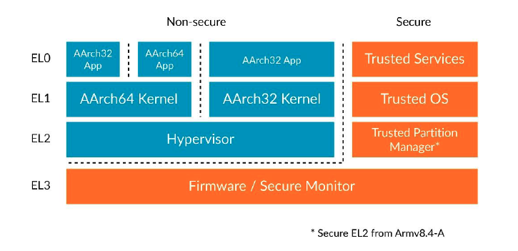

Slide 5
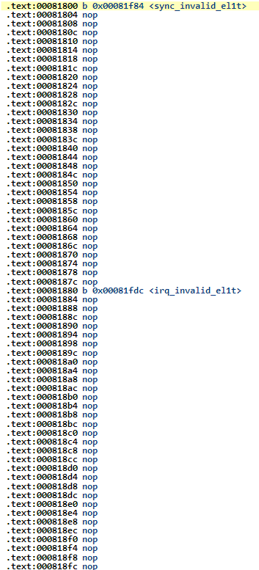
vbar_el1 = &vectors
(Vector Base Address Register for EL1)
Vector table for EL1
/*
* Exception vectors.
*/
.align 11
.globl vectors
vectors:
ventry sync_invalid_el1t // Synchronous EL1t
ventry irq_invalid_el1t // IRQ EL1t
ventry fiq_invalid_el1t // FIQ EL1t
ventry error_invalid_el1t // Error EL1t
ventry sync_invalid_el1h // Synchronous EL1h
ventry el1_irq // IRQ EL1h
ventry fiq_invalid_el1h // FIQ EL1h
ventry error_invalid_el1h // Error EL1h
ventry sync_invalid_el0_64 // Synchronous 64-bit EL0
ventry irq_invalid_el0_64 // IRQ 64-bit EL0
ventry fiq_invalid_el0_64 // FIQ 64-bit EL0
ventry error_invalid_el0_64 // Error 64-bit EL0
ventry sync_invalid_el0_32 // Synchronous 32-bit EL0
ventry irq_invalid_el0_32 // IRQ 32-bit EL0
ventry fiq_invalid_el0_32 // FIQ 32-bit EL0
ventry error_invalid_el0_32 // Error 32-bit EL0
.macro ventry label
.align 7
b \label
.endm
entry.S

Slide 6
(saved regs)
x30
x29
...
x0
LOW_MEMORY
LOW_MEMORY
LOW_MEMORY
0x0040:0000
0x0040:0000
0x0040:0000
kernel_main
uart_recv
kernel_main
uart_recv
(saved regs)
el1_irq
kernel_main
uart_recv
stack
bss
bss
bss
kernel img
kernel img
kernel img
1. kernel boots
2. irq strikes
3. having handled irq, about to return from exception
el1_irq:
kernel_entry
bl handle_irq
kernel_exit
void kernel_main(void)
{
uart_init();
init_printf(0, putc);
printf("kernel boots...\n"); ... while (1){
uart_send(uart_recv());
}
}
.macro kernel_exit
...
eret
.endm

Slide 7
