Slide 1
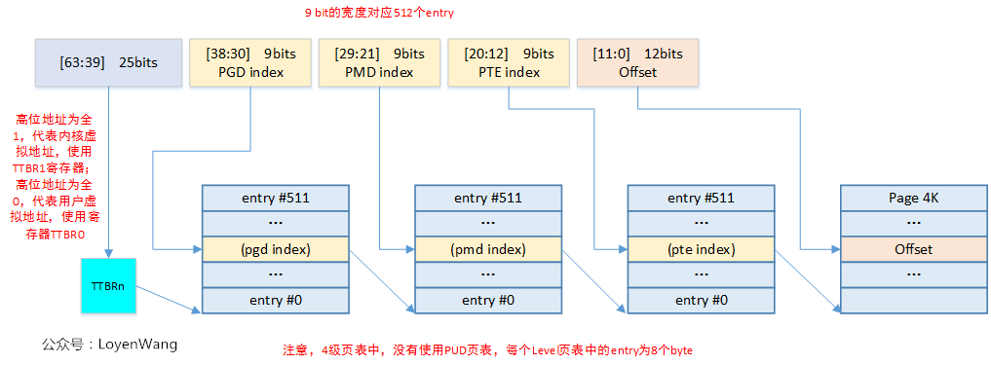
Notes:
https://imgs.developpaper.com/imgs/1771657-20190825003611986-1057243454.png

Slide 2
Each index: 9 bits. 2⁹ = 512 entries per page table
all 1s: using TTBR1 (kernel)
all 0s: using TTBR0 (for usr)
Notes:
https://imgs.developpaper.com/imgs/1771657-20190825003611986-1057243454.png

