Slide 1
05 O Notation
CS 143
David Anderson
Slides by Martin Hock

Slide 2
Last time
Last time, we compared two different approaches to expanding an array
The code was identical – the only change was how much we expanded it by when we overflowed it
One approach was super slow to add a million items (we waited around for what seemed like half a minute and gave up)
The other did it in a small fraction of a second

Slide 3
Characterizing behavior
We also showed that the slow algorithm was in effect copying as many ints as there were unit squares in a right triangle: to add n items, roughly (n*n)/2 were copied
The fast algorithm, on the other hand, fit all of its work into a subdivided square: roughly 2n ints were copied
Why does it make sense to characterize behavior in terms of “number of ints copied”?
We’ll start by talking about “constant time”

Slide 4
Identifying constant-time behavior
Generally speaking, the more data a program (algorithm) is working with, the slower it may get
You should be able to identify what parts of your program execute in an amount of time which is bounded by a constant, no matter how much data the program is working with
Let’s take a look at the IntArray class we wrote and identify which methods execute in constant time

Slide 5
Rule of thumb
If a method only executes basic Java operations (which include calculating expressions of primitive types, looking up data in an array using [] or an object using . ) and does not loop in any way or loops with fixed (non variable) limits, the method will execute in a constant amount of time
For example, even if int x could have large values, the calculation x*x is a constant time operation because x is a primitive type
So is for (int i = 0; i < 100; i++) x = x + i;
Also, the method can call other methods that also execute in a constant amount of time – most Math methods are like this (for example, sin ends up using a table of values)

Slide 6
O Notation
When we use notation O(something) (pronounced “O of something” or “big O of something”), the “something” in parentheses is a mathematical expression involving the mathematical variable n which represents the number of bits of data
O notation is designed to be both sloppy and mathematically rigorous
It accomplishes this by “overlooking minor details” which it accomplishes mathematically by “representing an infinite set of functions” following some rules
O(something) includes the set of all functions where “something” is multiplied by a fixed constant and added to a fixed constant

Slide 7
The simplest O expression: O(1)
Consider the expression O(1)
This expression encompasses “all constant values”
This means that as long as we have a method which runs in some constant amount of time, we say its runtime is O(1)
The idea is that “in the grand scheme of things”, as we add more and more data, this constant runtime will be inconsequential

Slide 8
O(n)
If a method executes in O(n) time, it takes time linear in the size of its input
Its behavior is categorized by a linear equation of the form y = mx+b that you have learned in math class (more like: f(n) = mn + b)
The extra constant multiplier and addition are similar to the m and b in the linear equation: of course, a linear equation multiplied by another constant multiplier and added to another constant is just another linear equation
A single call to add(x) may take constant time, if we don’t have to expand the array, or linear time if we do, so we would characterize its overall behavior as O(n) in the “worst case”
We saw that with the doubling behavior, calling add(x) n times would also take O(n) time (because we expand the array infrequently enough)

Slide 9
O(n²)
O(n²) time is quadratic time (an equation of the form f(n) = ax² + bx + c)
With the “expand by one at a time” behavior, add(x) takes O(n²) time
In the future, we’ll see some other interesting O(n²) algorithms as well as some different runtimes, most notably O(n log n)

Slide 10
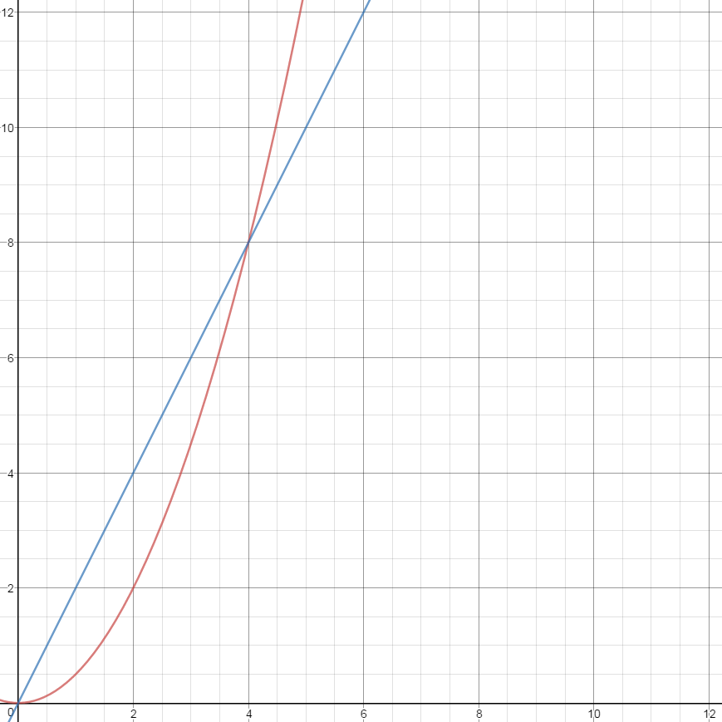
Asymptotic behavior
The graph to the right shows y=x*x/2 (in red) versus y = 2x (in blue)
Until y = 4, red is smaller than blue. But forever after that, red becomes larger and larger compared to blue.
This is why we consider the constant factors to be unimportant in O notation

Slide 11
Ω and Θ
In addition to O, there are the lesser used Ω and Θ
Ω is a lower bound for the running time
No matter how many items have been added, the add method sometimes takes constant time, so its running time is Ω(1)
Θ is a combination of O and Ω
If we perform n calls to the add method with the doubling algorithm, the running time of that sequence of calls is Θ(n)
These notations are more rarely used but occasionally useful (we won’t use them in this class again)
There are even less often used notations such as o(n)

