Slide 1
07 Recursion Part 1
CS 143
David Anderson
Slides by Martin Hock

Slide 2
From induction to recursion
The mathematical proof technique of induction begins from a base case and builds its way up to prove every other example, one step (or domino) at a time
Recursion as a programming technique works on exactly the same principle: as long as a program works for a base case and can always build upward from a previously solved case, it works for all cases
One key difference: because you call a method with an argument, a recursive method usually works backwards from the argument down to the base case

Slide 3
The key technique in recursion
The key technique in recursion is that a method can call itself
HOWEVER, the method should only call itself for a “smaller” example
At some point, the chain of calls to smaller examples must hit “bottom” at the base case, otherwise, you will have infinite recursion

Slide 4
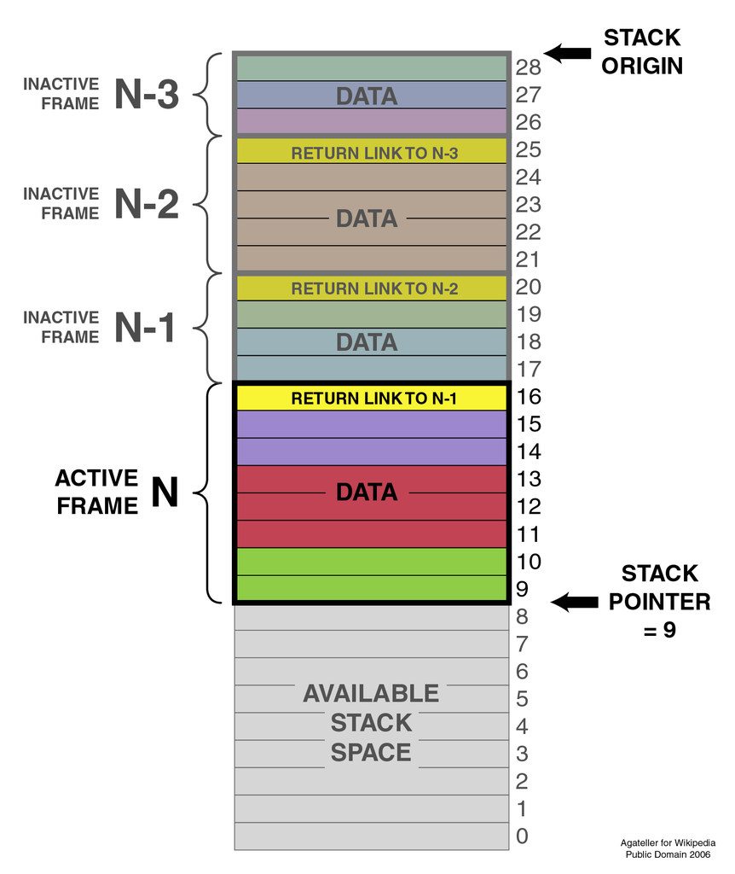
How Java implements recursion
Java implements recursion the same way it implements all method calls, using a call stack
We will learn more about stacks later
Successive calls to memory get placed onto the “top” of the stack (which grows downward in the illustration)
Too many calls will trigger a StackOverflowError
Also, StackOverflowError could occur if you recurse (call yourself) too many times, even if the example is finite – we can reconfigure Java but we’re probably better off finding a non-recursive solution

Slide 5
Simple example
Let’s use recursion to calculate n² using the inductive proof from class
Remember, we know the answer when n = 1
Otherwise, ask for the answer for the next smaller value for n
Use that answer to complete the calculation based on the proof
Let’s agree on the method prototype: public static int square(int n)

Slide 6
Code
public static int square(int n) {
if (n == 1) {
return 1; // 1 squared is 1!
}
return square(n-1) + n + n - 1;
}

Slide 7
A familiar problem: Exponentiation
public static int pow(int base, int exponent) {
// Assume positive base, non-negative exponent
// base to the exponent power =
// (base * base * ...) <- exponent-many times
// Can you use this to compute pow
// without any looping (while/for/do...while)?
// Do a little work, reduce to a smaller problem and use
// recursion to finish the job. But make sure you have
// a base case! a^0 = 1, a^b = a*a^(b-1) (if b > 0)
}
System.out.println(pow(2,0)); // 1
System.out.println(pow(2,1)); // 2
System.out.println(pow(2,2)); // 4
System.out.println(pow(2,3)); // 8
System.out.println(pow(3,2)); // 9
System.out.println(pow(5,4)); // 625

Slide 8
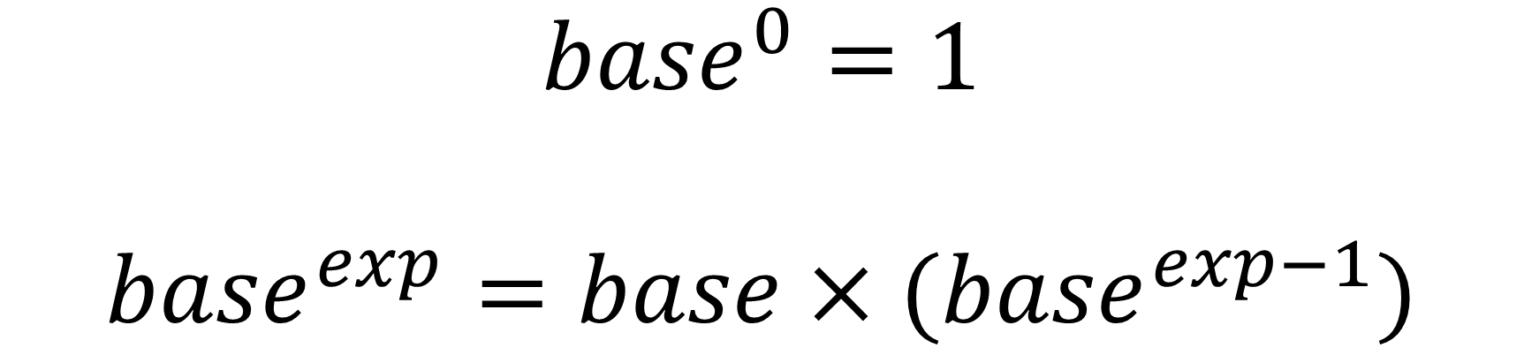
Key observation
$${base}^{0}=1$$
$${base}^{exp}=base×({base}^{exp−1})$$

Slide 9
Solution
public static int pow(int base, int exponent) {
// pow(base, exponent) =
// (base * base * ...) <- exponent-many times
// pow(base, 0) = 1
// pow(base, exp) = base * pow(base, exp-1)
if (exponent == 0) return 1;
return base * pow(base, exponent-1);
}

Slide 10
Another familiar problem: Factorial
public static int factorial(int n) {
// Assume n is positive
// n! = 1 * 2 * 3 * 4 ... * (n-1) * n
}
System.out.println(factorial(1)); // 1
System.out.println(factorial(2)); // 2
System.out.println(factorial(3)); // 6
System.out.println(factorial(4)); // 24
System.out.println(factorial(5)); // 120

Slide 11

Key observation
public static int factorial(int n) {
// Assume n is positive
// n! = 1 * 2 * 3 * 4 ... * (n-1) * n
}
$$1!=1$$
$$n!=n×\left(n−1\right)!$$

Slide 12
Solution
public static int factorial(int n) {
// n! = 1 * 2 * 3 * 4 ... * (n-1) * n
// 1! = 1
// n! = n * (n-1)!
// Example: 2 = 2, 3=6, 4=24, 5=120
if (n == 1) return 1;
return n * factorial(n-1);
}

