Slide 1
9 Recursion Part 3
CS 143
David Anderson
Slides by Martin Hock

Slide 2
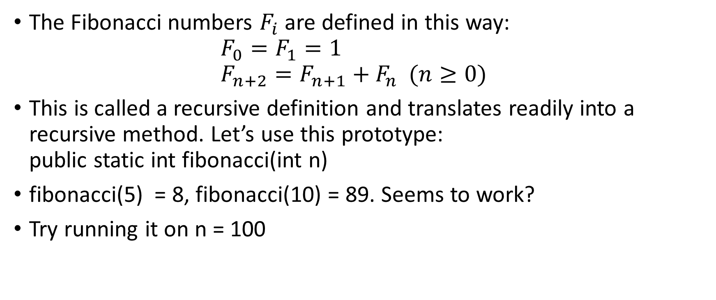
Another classic example: Fibonacci
The Fibonacci numbers $F_{i}$ are defined in this way: $F_{0}=F_{1}=1$ $F_{n+2}=F_{n+1}+F_{n} (n≥0)$
This is called a recursive definition and translates readily into a recursive method. Let’s use this prototype: public static int fibonacci(int n)
fibonacci(5) = 8, fibonacci(10) = 89. Seems to work?
Try running it on n = 100

Slide 3
First few elements
n | F(n)
0 | 1
1 | 1
2 | 2
3 | 3
4 | 5
5 | 8
6 | 13
7 | 21
8 | 34
9 | 55
10 | 89

Slide 4
Simple Java implementation
public static long fib(long n) {
if (n == 0 || n == 1) return 1;
return fib(n-1) + fib(n-2);
}

Slide 5
Multiple recursion can be slow
Notice that each of the two calls to fibonacci, each had two calls to fibonacci, which each had two calls to fibonacci…
In fact, the amount of work done is proportional to the Fibonacci number being computed, and the Fibonacci sequence grows at an exponential rate
The main problem is that we are recomputing each Fibonacci call many different times
To prevent this, calls either need to remember information or must be structured to avoid performing redundant work

Slide 6
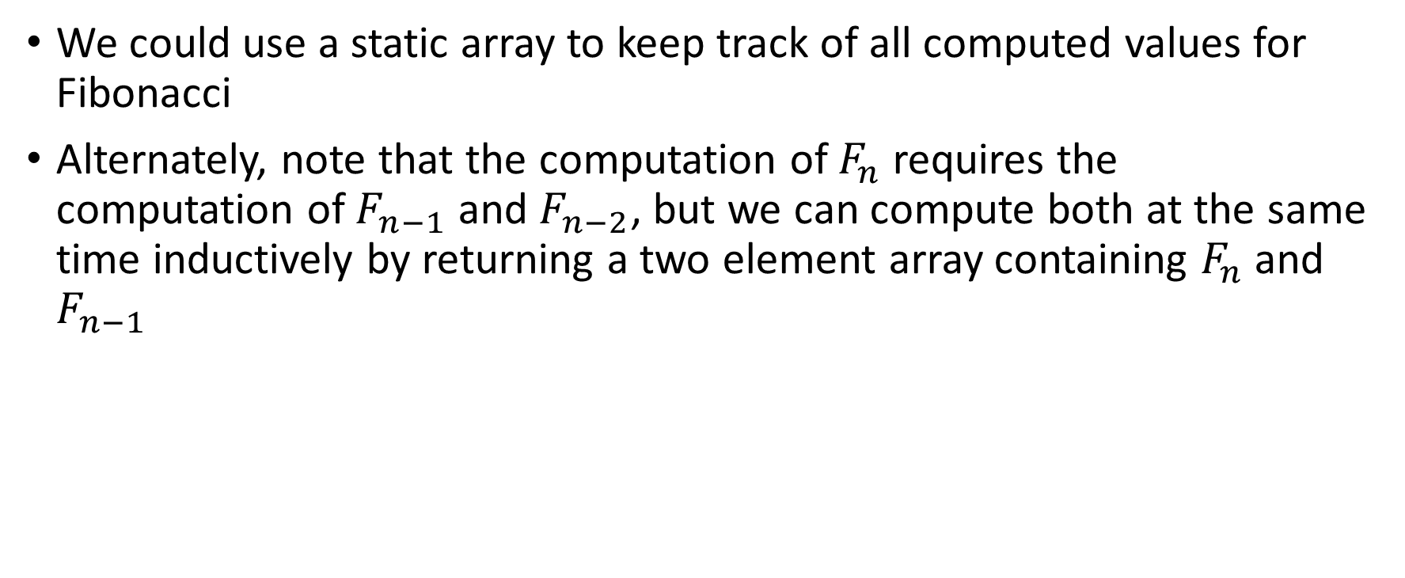
Remembering information
We could use a static array to keep track of all computed values for Fibonacci
Alternately, note that the computation of $F_{n}$ requires the computation of $F_{n−1}$ and $F_{n−2}$, but we can compute both at the same time inductively by returning a two element array containing $F_{n}$ and $F_{n−1}$

Slide 7
Remembering with a static array
private static long[] fibA = new long[1000];
public static long fib(int n) {
if (n == 0 || n == 1) {
return 1; // by definition
}
if (fibA[n] > 0) return fibA[n];
fibA[n] = fib(n-1) + fib(n-2);
return fibA[n];
}

Slide 8
Searching in a sorted array
We wrote a recursive find method yesterday, but let’s see a better way to search
We’ll understand how to search in an array which is sorted: each element in the array is greater than or equal to the element before it
To start with, we’ll generate a sorted array of a million ints (which randomly increase by 0, 1, or 2 for each element):
int[] a = new int[1000000];
for (int i = 1; i < 1000000; i++) {
a[i] = a[i-1] + (int)(Math.random()*3);
}

Slide 9
Let’s benchmark a simple search
long start = System.currentTimeMillis();
for (int x = 0; x < 10000; x++) { // search for x
for (int i = 0; i < a.length; i++) {
if (a[i] == x) break; // we found x
}
}
long end = System.currentTimeMillis();
System.out.println(end-start); // takes ~1.5 sec

Slide 10
A small optimization
Since we’re searching in a sorted array, we can stop looking if we ever see an element bigger than what we’re looking for!
The original example only takes roughly 30 milliseconds with this optimization
We can look at 10 times as many values
Because the values are bigger, we’re also looking further in the array for the elements, so it takes closer to 100 times longer to look for 10 times as many values

Slide 11
A small optimization
long start = System.currentTimeMillis();
for (int x = 0; x < 100000; x++) { // search for x
for (int i = 0; i < a.length; i++) {
if (a[i] == x) break; // we found x
if (a[i] > x) break; // x isn't there
}
}
long end = System.currentTimeMillis();
System.out.println(end-start); // takes ~2.7 sec

