Slide 1
Linked List Iteration and Removal
CS 143
David Anderson
Slides by Martin Hock

Slide 2
Iterating over a list
The get method could print all the elements of a DoublyLinkedList in a loop (we call this “visiting” or “iterating over the list”)
However, iterating over an entire list of n elements would take O(n²) time:
DoublyLinkedList list = new DoublyLinkedList();
int n = 40000; // gets slow!
for (int i = 0; i < n; i++) {
list.add(String.valueOf(i));
}
for (int i = 0; i < n; i++) {
if (!String.valueOf(i).equals(list.get(i))) {
throw new RuntimeException("oops"); // check that list looks OK
}
}

Slide 3
Java’s iteration syntax
We are used to the standard for loop syntax:
for (initializer; test; increment)
Java has a special syntax for any data structure that implements Iterable:
for (type t : structure)
“type t” is a declaration for things our structure: in our case, our DoublyLinkedList contains strings, so we might write String s
“structure” is the collection (a DoublyLinkedList object for us)
for (String s: list)

Slide 4
Implementing Iterable
We can start by writing “implement Iterable<String>” between the name of the class and the left brace in the class declaration:
public class DoublyLinkedList implements Iterable<String> {
We say <String> after Iterable because our DoublyLinkedList returns Strings – later, we will learn more about this syntax (Java generics)
When you do this, Eclipse will red underline your class because in order to be Iterable, you must have a standard way of retrieving your Iterator
Have Eclipse implement the method for you as a stub

Slide 5
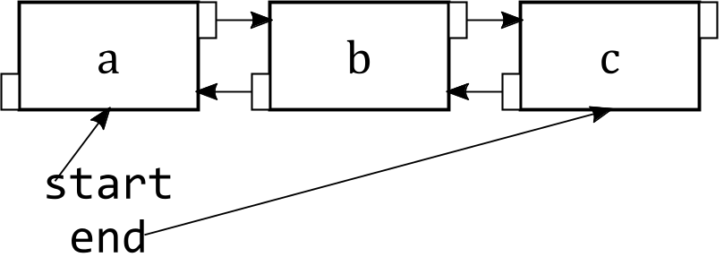
Conductor idea
Our conductor will start at the start of the train and will walk to the end of the train
She only has to walk down the train once, so iterating through a list of n elements takes O(n) time
The conductor remembers where she is at any given time

Slide 6
Implementing Conductor
We’ll create another private static inner class, Conductor
The static keyword prevents Conductor from having a “weird link” back to its parent DoublyLinkedList – in our case, we do need a link, but we’ll be explicit about it
Conductor must implement Iterator<String> to be compatible with the return type for the iterator method required by Iterable<String>
private static class Conductor implements Iterator<String> {
public boolean hasNext() { ????? }
public String next() { ????? }
}

Slide 7
Filling in Conductor
The Conductor needs to remember what car she is in:
private Node current;
We’ll write a constructor that initializes it:
public Conductor(Node n) {
current = n;
}
The iterator() method of DoublyLinkedList will initialize the Conductor to begin at the beginning:
public Iterator<String> iterator() {
return new Conductor(start);
}

Slide 8
Filling in the Iterator<String> methods
The Iterator methods include hasNext and next
The hasNext method sees if we are currently looking at a thing
The next method gets the thing we’re looking at and sets ourselves up for next time
public boolean hasNext() {
return current != null; // True if conductor is in a car
}
public String next() {
String s = current.data; // Retrieve passenger from current car
current = current.next; // Conductor advances to next car
return s;
}

Slide 9
Testing it
The test from earlier now runs much faster! We are only walking the list once.
DoublyLinkedList list = new DoublyLinkedList();
int n = 1000000; // still fast for a much bigger value!
for (int i = 0; i < n; i++) {
list.add(String.valueOf(i));
}
int i = 0; // generate test values; not needed if not testing
for (String s : list) { // for each String s in list, do the following:
if (!String.valueOf(i).equals(s)) {
throw new RuntimeException("oops"); // check that list looks OK
}
i++; // increment test value
}

Slide 10
Removal from a doubly linked list
In the illustration to the right, the third gold node (index 2) is being removed
When we remove a node, the adjacent nodes need to route around it (red references change to green references)
The remove method should also return the data value of the node being removed (so we can see what we removed)

Slide 11
The prev field
So far, our DoublyLinkedList class hasn’t used the prev data member, which is why it continues to have a yellow underline
The prev field would let us remove a Node from the middle of a list, even if you had no other information
Note that it is possible to remove an element from the middle of a single linked list, but you have to determine what its predecessor (previous node) is, which typically requires that you iterate (walk) through the list from the beginning

Slide 12
Starting from get
Our remove method will return the String at the index that we’re removing, or will return null if the index is invalid – this is very similar to what get does
First, we should fix get to deal with negative indexes:
public String get(int i) {
Node n = start;
if (i < 0) return null; // Check for negative index
try {
for (int j = 0; j < i; j++) n = n.next;
return n.data;
} catch (NullPointerException e) {
return null; // Not a valid index - not the cleanest way to do this!
}
}

Slide 13
Copy and paste and insert
Our remove method can start with the body of get, but inserting code at the right point:
public String remove(int i) {
Node n = start;
if (i < 0) return null; // Check for negative index
try {
for (int j = 0; j < i; j++) n = n.next;
// Delink n here
return n.data; // We will still return n here
} catch (NullPointerException e) {
return null; // Not a valid index - not the cleanest way to do this!
}
}

Slide 14
Linking the previous car forwards
The n variable refers to the car that we want to remove
We should have the car before it (previous car) point to the car after it (next car), if there is a previous car
In the code below, we describe the list as A-B-C (left is previous, right is next) and we are removing B (n is B in the description)
if (n.prev != null) {
// If there is such an A, change its next variable to C
n.prev.next = n.next;
} else {
// If there is no such A, we must be at the start of the list
assert n == start;
start = n.next;
}

Slide 15
Linking the next car backwards
The code for the next direction is exactly analogous due to the symmetry in our data structure
if (n.next != null) {
// If there is such a C, change its prev variable to A
n.next.prev = n.prev;
} else {
// If there is no such C, we must be at the end
assert n == end;
end = n.prev;
}

Slide 16
Notes
n could be null – this will only happen if we got to the end of the list
  In that case, an exception must happen before we do anything, and we will return null as we are supposed to
n could be the first or last thing in the list, which is why we have the “else” code
If n exists, the right hand side of our assignment statements could be null (n.next for linking previous forwards and n.prev for linking next backwards). This is OK!
  Note that it’s also linked to n being the first or last thing in the list

Slide 17
Testing
Take the code we wrote from last time and add to it (make sure to put i in its own scope)
The code repeatedly removes the second thing in the list
for (int i = 1; i < n; i++) {
// Make sure second element in list is
// what we expect it to be as we remove it
if (!String.valueOf(i).equals(list.remove(1))) {
throw new RuntimeException("oops 2"); // Should not happen!
}
}
// At this point there should be one thing left
System.out.println(list.remove(0)); // should be 0
list.add("a"); // should be the only thing in the list
System.out.println(list.get(0)); // should be a

