Slide 1
17 Introduction to Collections
CS 143
David Anderson
Slides by Martin Hock

Slide 2
Data paradigms
There are different ways to talk about collections of data
A collection could include zero, one, or many items
Collections
The word “collections” is carefully chosen because there are several synonyms that have different meanings from mathematical perspectives
We’ll present a few here and talk about Java’s approach to collections
Just as stack and queue are metaphors, so are these!

Slide 3
Mathematical sets
Sets are defined by membership: either a thing is part of a set, or it isn’t
Examples: The set of all lawyers. The set of all politicians. The set of all items you bought at the store.
You can consider the intersection of two sets, those things that are in both sets (some politicians are lawyers and some lawyers are politicians)
Sets don’t care about duplicates: “Did you buy an apple at the store?” vs “How many apples did you buy at the store”
Politicians
Lawyers

Slide 4
Multisets or bags
Sets are not always appropriate because they only consider membership, not count
For example, you may care that you bought two apples and one loaf of bread not just “an apple is a member of the set of all things that you bought at the store”
But if you told someone that you bought one loaf of bread and two apples, you would be describing the same stuff, because the information isn’t ordered
Consider putting all the items in one big bag where they get jumbled around: you would notice what was in the bag, but not where it was (eggs on the bottom of the bag aren’t relevant for this metaphor!)

Slide 5
Lists
A list of information allows duplicates and also includes an order (first thing on the list, second thing on the list, etc.)
For example, a to-do list that says “Go to the bank” followed by “Go to the store” is different than a to-do list that says “Go to the store” followed by “Go to the bank”
Another example: This bulleted list read from the top down
Arrays implement the list metaphor very efficiently
Our DoublyLinkedList class was another implementation of this metaphor that let us efficiently add items (and maybe insert them!)

Slide 6
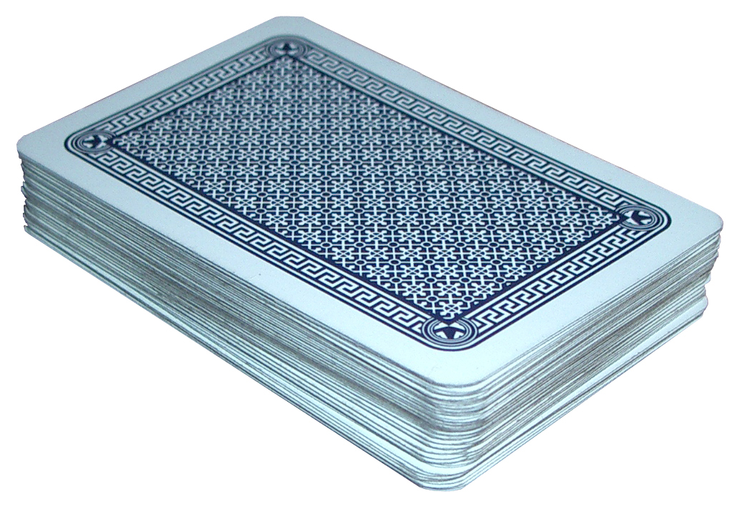
Doubly-ended queues (deques)
You might generalize the concept of a queue and a stack by considering the ability to add and remove at either end (but nothing in the middle)
A data structure supporting this access is known as a doubly ended queue, or deque (pronounced “deck” like a deck of cards)
It’s easy to add and remove cards from either end but not in the middle

Slide 7
Java Collections
The Javadoc for Collection is helpful
The Intro to Collections documentation is also helpful
Collection is a Java interface which defines a set of verbs
Every collection lets you add something to it, remove something from it, ask for the things in it, and a few more tasks
Collection
Set
Queue
List
Deque
SortedSet

Slide 8
Working with Java Sets
You can instantiate a Set of Strings in the following way: Set<String> s = new TreeSet<>();
Or, in the following way: Set<String> s = new HashSet<>();
Notice that the s variable is only declared as a Set
This means that Java will only let us call methods for it that are defined for any Set, not anything specific to TreeSet or HashSet
TreeSet and HashSet have very different implementations
We’ll learn more about the implementations later

Slide 9
Adding and printing
Consider some code which adds integers 0 through 100 as strings then prints the set:
int n = 100;
for (int i = n; i >= 50; i--) {
s.add(i+""); // First, 100 through 50 in backward order
}
for (int i = 0; i < 50; i++) {
s.add(i+""); // Then, 0 through 49 in forward order
}
// 101 total items
s.add("0"); // 0 is already in the set
System.out.println(s.size()); // doesn't include duplicate 0
System.out.println(s);

Slide 10
Order of elements in a set
Notice that the TreeSet version of Set will print out the elements in “alphabetical” order: 0, 1, 10, 100, 11 (similar to the words a, b, ba, baa, bb)
There is only one number that starts with the digit 0, and that’s 0 itself
On the other hand, HashSet prints them out in a weird order
TreeSet is a SortedSet, so it prints them in order
There is no order guaranteed by the Set interface, and different versions of HashSet may give the elements in a different order
Later on, we’ll see how HashSet represents and allows us to access information

