Slide 1
Circle Example
CS 142
David Anderson
Slides by Martin Hock

Slide 2
Overriding the built-in toString
The built-in toString method is kind of useless
You see it in action when you try to print out an array object: it prints out a type name, followed by an @ sign, followed by a weird hexadecimal string
We can write our own toString method that overrides the built-in toString
Think of overriding as a boss overriding a subordinate’s decision – our toString method overrides the default Object behavior

Slide 3
Comparing objects with ==
It can be useful to compare objects to each other
The == operator compares two object references to see if they refer to the same object
Strings have some built in facilities to reuse the same String object for multiple Strings so == can be extra confusing String s1 = "Hello"; String s2 = s1; System.out.println(s1 == s2); // true System.out.println(s1 == "Hello"); // maybe true System.out.println(s1 == new String("Hello")); // f

Slide 4
Object
Java considers all objects to also belong to the Object class
This can be useful because it lets us take an arbitrary Object as a parameter to a method
We can use the cast operator to convert an Object to another class
But Java will crash if the Object isn’t actually a member of the other class

Slide 5
Comparing objects for equivalence and order
The equals method should be implemented if you want to be able to compare objects to each other
The built in version is based on == (reference equality)
We’d like two objects that represent the same Person to be seen as equal, so we need to implement it ourselves
Person p1 = new Person("Alice", "Smith");
Person p2 = new Person("Alice", "Smith");
System.out.println(p1.equals(p2)); // returns false!

Slide 6
Implementing equals
We can declare an equals method for Person that takes a Person argument
However, this won’t override the built-in equals method which operates on any Object
Theoretically, you could consider two objects of different classes to be equal, e.g. a Person could equal a Teacher
We can check the parameter’s type and cast it
public boolean equals(Object o) {
// Next time, we will fill this in!
}

Slide 7
Circle class
Let’s write a class that represents a circle in the x-y plane (similar to the Rectangle class, but allowing floating point values)
We usually represent a circle in terms of its center (x, y) coordinate and its radius
How would you define the data members to do this?

Slide 8
Implementing the Circle class
public class Circle {
// Center and radius
double centerX, centerY;
double radius;
}

Slide 9
Adding a constructor
Let’s say we create a Circle object like this:
Circle c = new Circle();
By default, the fields (in this case, center and radius) are initialized to 0, meaning that they will be set up to something, but not what we want
Let’s write a constructor to initialize the fields
Let’s have the argument order x, y, radius, e.g. a circle at the origin with radius 3:
Circle c = new Circle(0, 0, 3);

Slide 10
Implementing the Circle constructor
public class Circle {
// Center and radius
double centerX, centerY;
double radius;
public Circle(double centerX, double centerY, double radius) {
this.centerX = centerX;
this.centerY = centerY;
this.radius = radius;
}
}

Slide 11
Defining the toString method
Let’s say we want to print a representation of the Circle to the console
Circle c = new Circle(0, 0, 3);
System.out.println(c); // Prints Circle@12ab34cd
All objects have a terrible default toString implementation
Let’s write our own toString which follows the following format:
(x, y) radius r
where x, y and r are the actual x, y, and radius values

Slide 12
Implementing the toString method
public String toString() {
return "("+centerX+", "+centerY+") radius "+radius;
}

Slide 13
Defining equals
In order to override the built in equals, we need to have our equals method take an Object argument
This lets us see if two objects of different classes are equal (e.g. if we had an Ellipse class, the Ellipse could be equal to a Circle with the same properties)
Let’s say we only care if the argument is a Circle for now
We will compare the current (this) object against the argument object
First, we need to use the instanceof operator to check if the argument is a circle
Then, we can cast the Object to a Circle and assign it to an alias

Slide 14
instanceof
instanceof is a binary boolean comparison operator kind of like ==
a == b evaluates to true if a and b are the “same” (e.g. the same int)
a instanceof Classname checks if a is an instance of class Classname
Since an instance of any class can be treated as an instance of Object, if you’re given a generic Object (which is all equals knows), you need to use instanceof to see what class it really is

Slide 15
Implementing equals
public boolean equals(Object object) {
if (object instanceof Circle) {
Circle c = (Circle)object;
return centerX == c.centerX && centerY == c.centerY && radius == c.radius;
}
// TODO: check if object is an ellipse
return false;
}

Slide 16
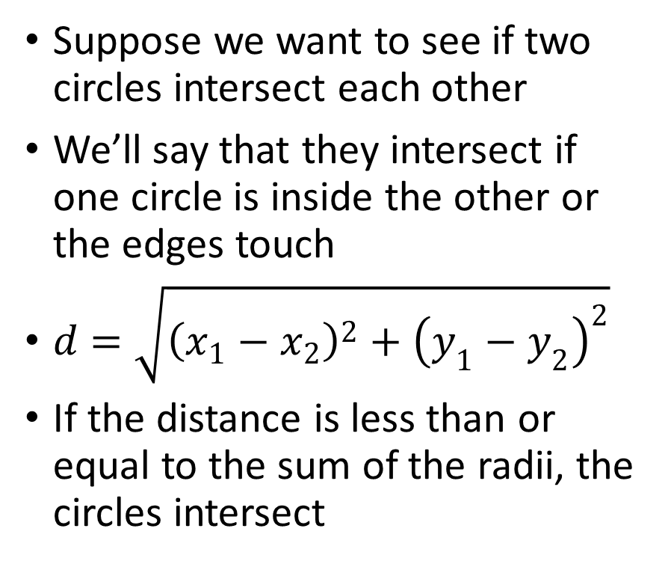
intersects
Suppose we want to see if two circles intersect each other
We’ll say that they intersect if one circle is inside the other or the edges touch
If the distance is less than or equal to the sum of the radii, the circles intersect

Slide 17
Implementing intersects
public boolean intersects(Circle c) {
double dx = centerX - c.centerX;
double dy = centerY - c.centerY;
double d = Math.sqrt(dx*dx + dy*dy);
return d <= radius + c.radius;
}

Slide 18
Testing the Circle class
Our Circle class didn’t have a main method
We can implement another class with a main method to test and use the Circle class
You can’t run the Circle class without a main method! Either add a main method to the Circle class (which could be seen as cluttering the Circle class), or create a separate class

Slide 19
Test class
public class CircleTester {
public static void main(String[] args) {
Circle c = new Circle(0, 0, .415);
System.out.println(c);
Circle c2 = new Circle(0, 0, .415);
Circle c3 = new Circle(1, 1, 1.0);
Circle c4 = new Circle(1, 1, 0.99);
System.out.println(c.equals(c2)); // true
System.out.println(c.equals(c3)); // false
System.out.println(c.intersects(c3)); // true
System.out.println(c.intersects(c4)); // false}
}

