Slide 1
CSCE-221 Asymptotic Analysis of Code
Emil Thomas
01/31/19
Edited by Zhipei Yan
2019.09
Source : Based on Prof Lupoli’s Notes

Slide 2
What is Algorithmic Complexity
How fast or slow particular algorithm performs
Usually measured as a function of input size (n)

Slide 3
How to efficiently measure the time complexity?
Does just profiling (timing ) works ? Why?
Measure should be independent of hardware details(processor, cache etc)
How about different patterns of inputs of same size?
Best Case, Worst case, Average case
The Best way to measure is to do it theoretically using asymptotic analysis (i.e Big-O)
means, for very large problem size

Slide 4
Why do we care about runtimes?
can you imagine if Facebook took a minute to log in!!
finding clever ways to do the exact same thing but in shorter time will yield results, and happier clients
The eye ball test just to get the point across
Summation Algorithm 1 | Summation Algo. 2
int sum1(int N) { int s = 0; for(int i = 1; i <= N; i++) { s = s + i; } return s; } | int sum2(int N) { int s = 0; s = N * (N + 1)/2; return s; }

Slide 5
Basic Idea : Count the no. of operations
Code Analysis – Declarations
don’t count at all (not worth counting)
different than assignment!!!
Assignments/Increment/return/Math
are considered 1 “unit” per each occurrence
Assignments
count = 1; i = i + 1; // declaration + assignment return counter; | count = 1; 1 i = i + 1; 0 + 1 // declaration + assignment return counter; 1
No. of operations = 1 or O(1)
Declarations
int count; float average; | int count; 0 float average; 0
No. of operations = 0

Slide 6
Code Analysis – For loops (Part 1)
running time of a for loop is at MOST the run time of the statements INSIDE the loop (including tests) TIMES the number iterations
variable “n” is used for calculations in loops
remember, your answer will have an “n” somewhere in it
For loops Example #1
for(int i = 0; i < n; i++) { count += i*i; }
No. of Iterations : n, No. of operations = 1, Total = O(n)

Slide 7
Code Analysis – For loops (Part 2)
watch incrementation portion
there are applications where the incrementation will be other than i++
j += 1 will equal n for that loop (or -= too )
j = j + 1
j *= 2 will equal log₂n for that loop
j != 0
j = j * 2
j /= 2 will equal log₂n for that loop
j != 0
j = j / 2
usually wants to approach integer 0
j > 0; j \= 2
For loops Example #2
for(int i = 1; i < n; i *= 2) { count += i*i; }
No. of Iterations : log(n), No. of operations = 1, Total = O(log(n))

Slide 8
What’s the difference in log bases?
The base determines how many children the node can have
The higher the base, the more children, the higher/faster the growth
Level | I *= 2 | I *= 8
0 | 1 | 1
1 | 2 | 8
2 | 4 | 64
3 | 8 | 512
4 | 16 | 4096
5 | 32 | 32768
6 | 64 | 262144
7 | 128 | 2097152
 | for(int i = 0; i < n; i*=2) | for(int i = 0; i < n; i*=8)

Slide 9
Code Analysis – Nested loops
Analyze these inner loop to outer loop
running time determined by the product of all sizes of all the loops
if an inner loop depends on an outer one, then they must be considered together!!!
Look for a variables being used in another loop
For loops Example #1
for(int i = 0; i < n; i++) { for (int j = 0; j < n; j++ ) // this loop does not { // depend on the other cout << "looped" << endl; } }
Total Iterations = n * n. No. of operations inside = 1, so O(n^2)

Slide 10
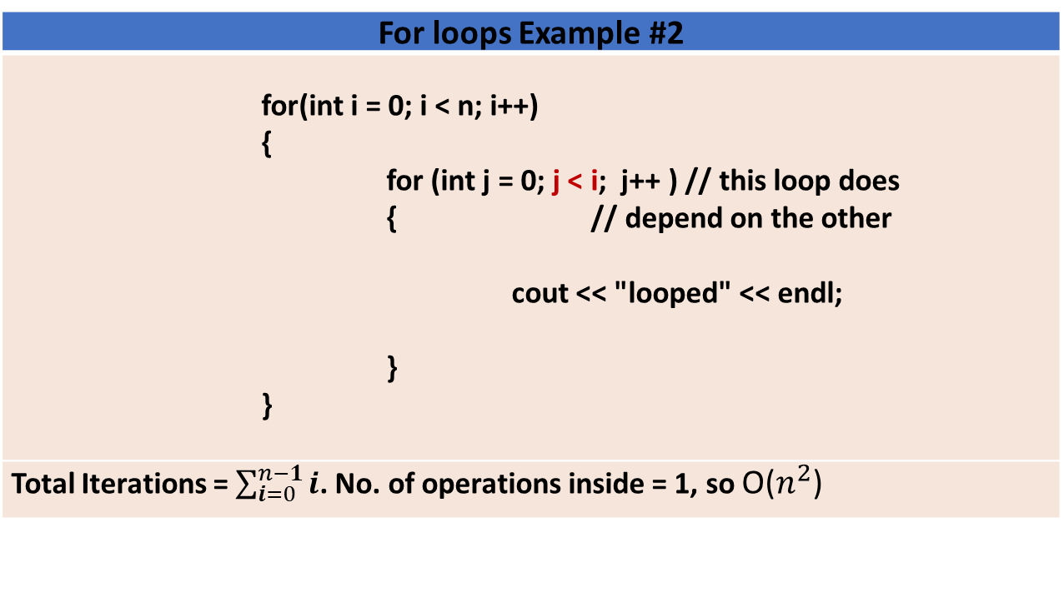
Beware of dependency in nested loops
For loops Example #2
for(int i = 0; i < n; i++) { for (int j = 0; j < i; j++ ) // this loop does { // depend on the other cout << "looped" << endl; } }
Total Iterations = $\sum_{i=0}^{n−1}{i}$. No. of operations inside = 1, so O($n^{2}$)
i=0 | 1 | 2 | 3 | 4
 | j=0 | 0 | 0 | 0
 |  | 1 | 1 | 1
 |  |  | 2 | 2
 |  |  |  | 3

Slide 11
For Loops Analysis, Example 3
sum1 = 0;
for (k = 1; k < n; k *= 2) {
for (j = 0; j < n; j++) {
sum1++;
}
}
Outer loop runs log(n) times
For each of these runs, the inner loop runs n times
Loop variable k and j does not depend each other
So total iterations = n * log(n)
No. of operations executed inside the loop = 1 or O(1)
So total complexity = O(n log(n))

Slide 12
In Lab discussion of Example 4 Find the Big-O for the code !!
sum1 = 0;
for (i = n; i > 0; i /= 2) {
for (j = 1; j < n; j *= 2) {
for (k = 0; k < n; k += 2) {
sum1++;
}
}
}

Slide 13
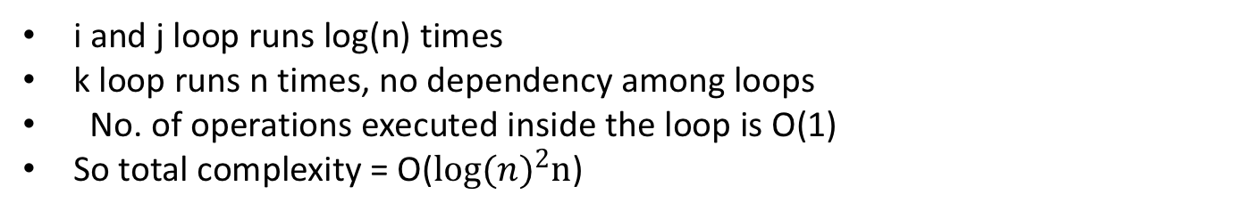
In Lab discussion of Example 4 Find the Big-O for the code !!
sum1 = 0;
for (i = n; i > 0; i /= 2) {
for (j = 1; j < n; j *= 2) {
for (k = 0; k < n; k+ = 2) {
//Const. no. of operations
}
}
}
i and j loop runs log(n) times
k loop runs n times, no dependency among loops
No. of operations executed inside the loop is O(1)
So total complexity = O(${log⁡(n)}^{2}n$)

Slide 14
In Lab Discussion 2 (Tricky)
sum1 = 0;
for (i = n; i > 0; i --) {
for (j = 1; j < n; j *= 2) {
for (k = 0; k < j; k++) {
sum1++;
}
}
}

Slide 15
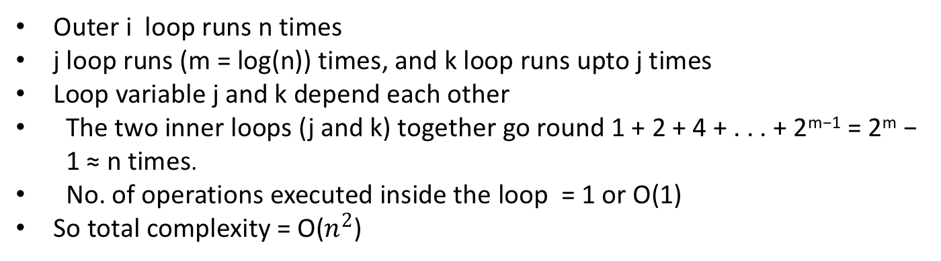
In Lab Discussion 2 (Tricky)
sum1 = 0;
for (i = n; i > 0; i --) {
for (j = 1; j < n; j *= 2) {
for (k = 0; k < j; k++) {
sum1++;
}
}
}
Outer i loop runs n times
j loop runs (m = log(n)) times, and k loop runs upto j times
Loop variable j and k depend each other
The two inner loops (j and k) together go round 1 + 2 + 4 + . . . + 2^{m−1} = 2^{m} − 1 ≈ n times.
No. of operations executed inside the loop = 1 or O(1)
So total complexity = O($n^{2}$)

Slide 16
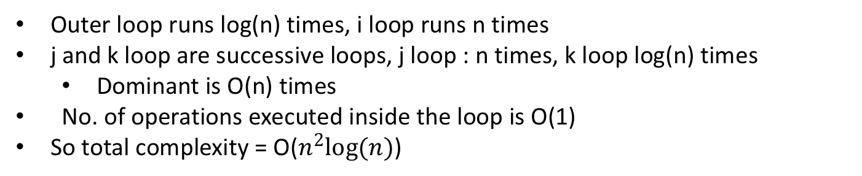
Successive inner loops
sum1 = 0;
for (int bound = 1; bound < n; bound *= 2) {
for (i = 0; i < n; i++) {
for (j = 0; j < n; j += 2) {
// O(1) operations
}
for (k= 1; k < n; k *= 2) {
//constant no. of operations
}
}
}
Outer loop runs log(n) times, i loop runs n times
j and k loop are successive loops, j loop : n times, k loop log(n) times
Dominant is O(n) times
No. of operations executed inside the loop is O(1)
So total complexity = O($n^{2}log⁡(n)$)

Slide 17
Exercise(Handout) & Google Survey
Exercise here if not printed
Questions?

