Slide 1
CSCE-221 Hashing Strings
Emil Thomas
04/10/19
Based on Prof. Shawn Lupoli’s Notes(TAMU)

Slide 2
Hashing with string keys
Idea is to use string-valued keys in hash table
Most real world keys would be strings
The challenge is to come up with good hash function
Done in TWO Steps:
Use the characters in the string to compute an integer
Take the above integer % TABLESIZE
Each Character has an decimal value corresponding to its ASCII code.

Slide 3
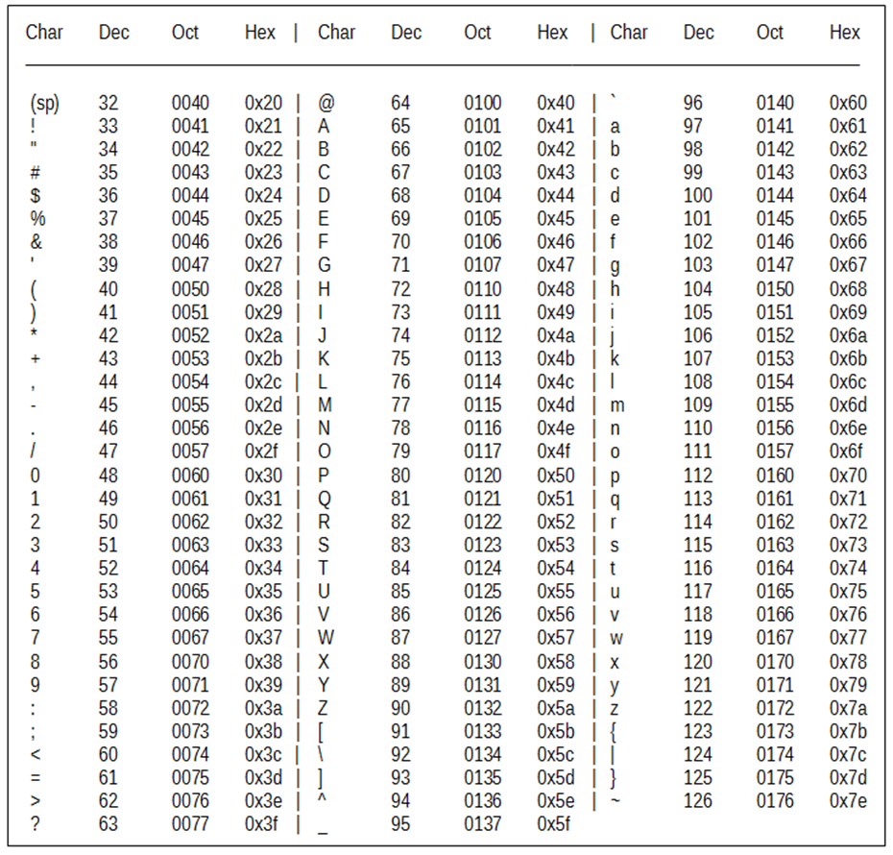
Ascii Table
'5' has the int value 53
if we write '5'-'0' it evaluates to 53-48, or the int 5
if we write char c = 'B'+32; then c stores 'b'
Source : ibm.com, cmu.cs.edu

Slide 4
Hash Function Example1 (BAD) Sum all the characters in the string % TABLESIZE
unsigned int hash(const std::string &key, unsigned int TableSIZE)
{
unsigned int hashval = 0;
for(int i = 0; i < key.size(); ++i) {
hashval += key[i];
}
return hashval % TableSIZE;
}

Slide 5
Hash Function Example1 (BAD) Sum all the characters in the string % TABLESIZE

Slide 6
Issues with summing hash function
If the table size is LARGE (N), many strings that are smaller will be placed in the first half of the table!
Will there be any values at 0?
What would the MIN value for a 3 CAPITAL letter word?
What would the MAX value for a 3 CAPITAL letter word?
Would distribution be uniform?

Slide 7
Discussion in Lab

Slide 8
Bad hash codes on Strings (English Words)
some letters come up more than other in our English Dictionary example a few bad hash codes sum ASCII value of characters most words are short w/ 70000 buckets, there will be many collisions since most will only fit the first 500 or so buckets adding just does not thinking about the order the letters appear pat, apt, tap, all collide choose first 3 letters of a word with 26^3 buckets biases in English words like “pre-“ but no words with some other letters like “xzq” will not have an even distribution of key

Slide 9
Hash Function Example2 (Good)
unsigned int hash(const std::string &key, unsigned int TableSIZE)
{
unsigned int hashval = 0;
for(int i = 0; i < key.size(); ++i) {
hashval = 37 * hashval + key[i];
}
return hashval % TableSIZE;
}

Slide 10
Hash Function Example3 (Good)
unsigned int hash(const std::string &key, unsigned int TableSIZE)
{
unsigned int hashval = 0;
for(int i = 0; i < key.size(); ++i) {
hashval = (127 * hashval + key[i]) % 16908799;
}
return hashval % TableSIZE;
}

Slide 11
Designing a Hash Table
Determine possible size of data set
Does the data size grow?
Determine possible N with 20% compression
Determine load factor

Slide 12
Why not always use a hash table?
Does not support ordered output. (No findMin or findMax)
Does not support finding all elements in a given range
How to design the hash function is not always clear.
Too many duplicate keys (O(N) complexity to find all of its values)

Slide 13
Exercise && Survey
http://people.tamu.edu/~yanzp/courses/csce221/notes/Lab12_UIN_First_Last.docx

Slide 14
Questions?

