Slide 1
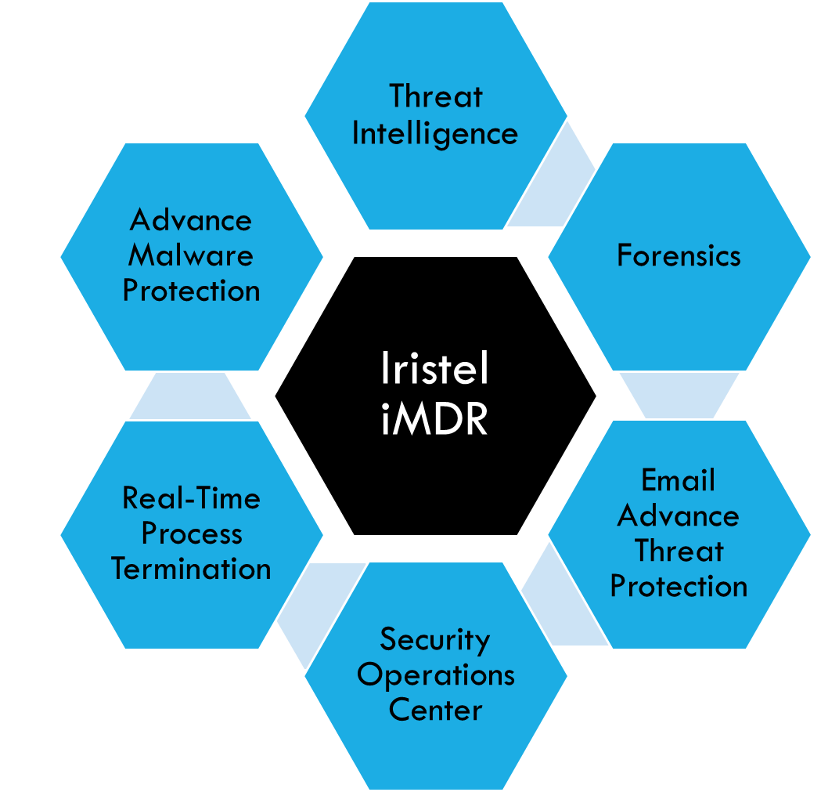







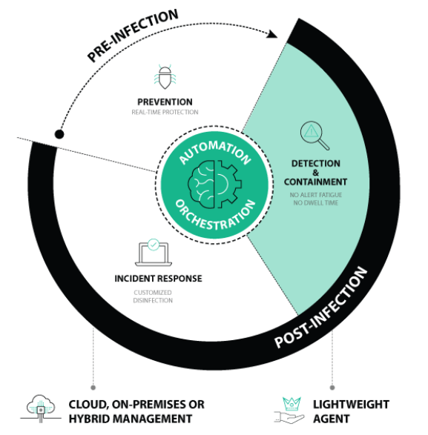
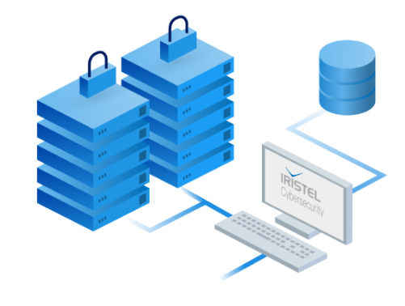

a
Intelligent Managed Detect & Response (iMDR)
Iristel SOC
Your web console

Slide 2
a
Intelligent Managed Detect & Response (iMDR)
Protection - Utilize an array of pre- and post-infection defense capabilities to stop malware from breaching your organization, backed by Iristel’s 24x7 Security Operation Center (SOC)
Kernel Visibility
Post-Infection Protection
Real-time, 24x7 SOC and dedicated security team
Prevent Data Exfiltration
Management - Access cloud management platform anywhere and anytime. Experience a highly intuitive interface that eliminates alert fatigue and consolidates all the instrumentation you need to protect your endpoints
Cloud/On-Premise
One Alert/Kill
Intuitive Interface
Hunt/IR/Virtual Patch
Scalability - Meet large enterprise deployment requirements and interconnect to existing security investments with a powerful REST API
Large Enterprise Deployments
HQ/Remote Users
Virtual Path
Rich API Framework
Flexibility - Quickly deploy across a broad set of operating systems and provide those systems online and offline protection
Hybrid Architecture
Online/Offline
Legacy OS Support
Turnkey or Complementary to Existing EPP/EDR
Cost - Exponentially reduce your potential breach-related costs associated with advanced malware with a multi-layered, pre- and post-infection protection. Let the platform automate and orchestrate in a closed loop remedial tasks to reduce your operational expense so you can do more with your people
No Dwell Time
Business Continuity
Automated EDR
Lower Op-Ex
No Breach

