Slide 1

Using data analysis to extract security threats.
Zhiqing Feng 08.03.2023

Slide 2
Agenda
What is my presentation about?
Why is this important or useful to audience?
Who am I ?
DEMO?

Slide 3
Who am I ?
Second-year Business Information Technology student in Haaga-Helia.
Working as an Application Analyst in the IT company.
Daily work with Linux to extract and analyse the data.

Slide 4
Security Data Analyst
Responsible for collecting, analyzing, and interpreting data related to the security of an organization’s IT systems and networks.
Using variety of tools and techniques to identify and investigate anomalies, trends, and patterns related to security threats.
Monitoring security systems and preparing reports on security incidents.
Analytical and problem-solving skills.

Slide 5
Analyst tools
Data analysis is an important part of uncovering security issues.
Log analysis → detect suspicious activity and attacks.
Network analysis
Traffic analysis, which looks for patterns in network traffic.
Port scanning, which looks for open ports on a network. It involves sending requests to a range of ports on a network and analyzing the responses to determine which ports are open. The attackers used it to identify open ports that can be used to gain access to a network.

Slide 6
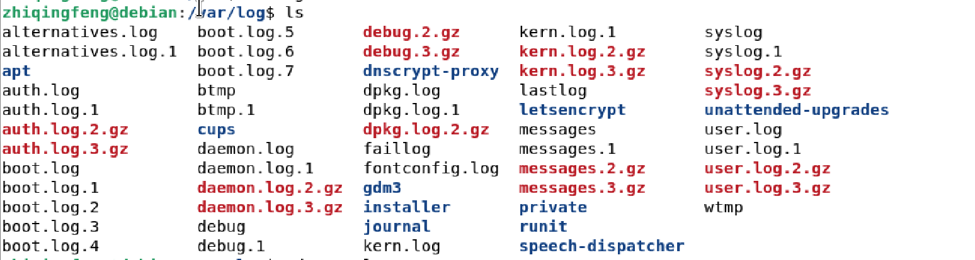
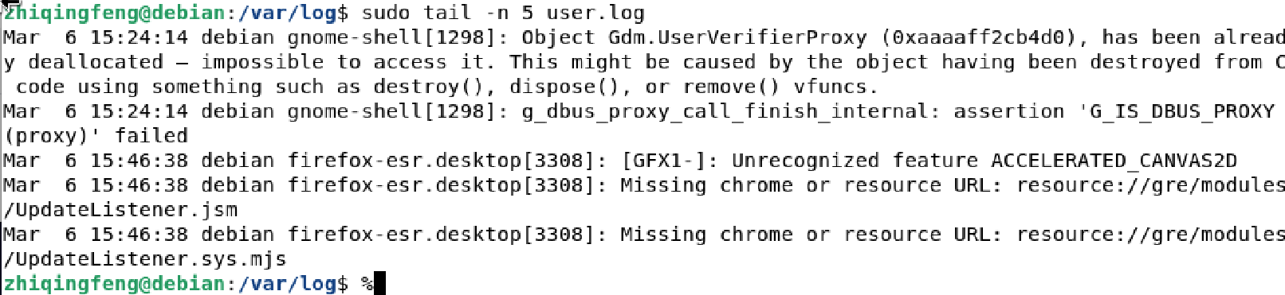
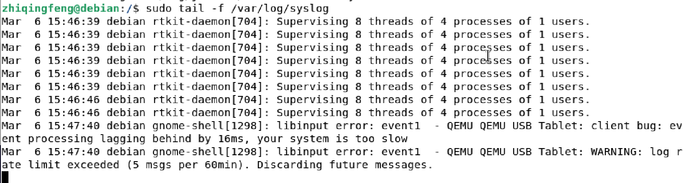
Log analyst

Slide 7
Port scanning

Slide 8
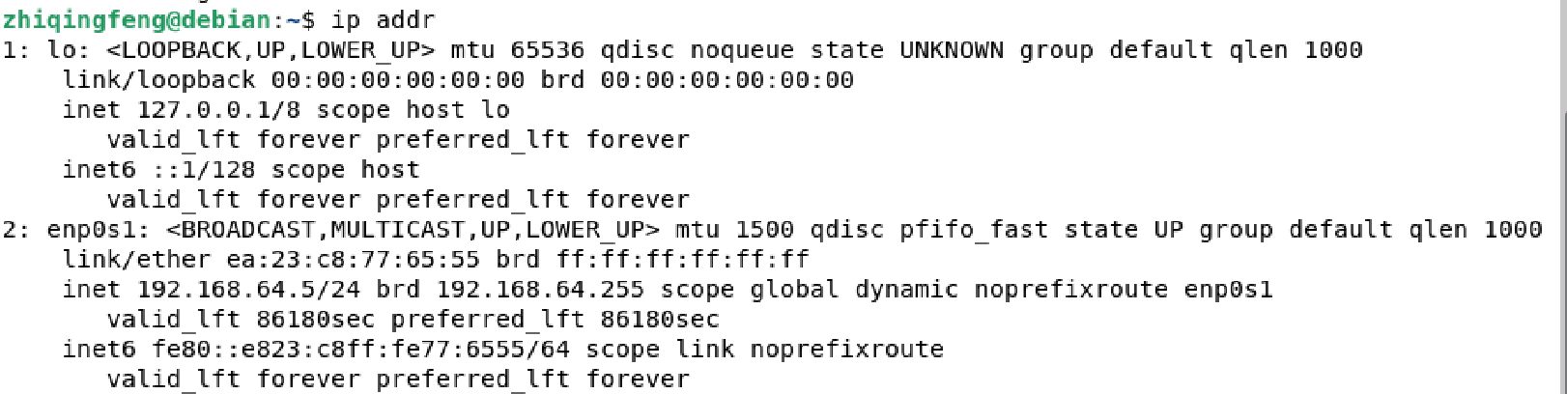
Through the use of tools like NMAP, you can figure out which ports are open on your Linux system, stop unwanted and unused services, and possibly close those ports altogether with iptables.
Install NMAP
Find your computer IP address
sudo apt install nmap
Ip addr

Slide 9
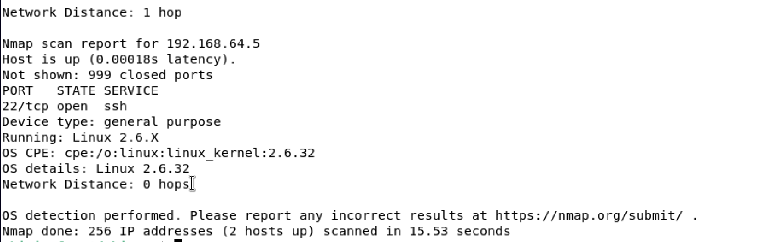
Here will display which services are running on which ports and whether or not those ports are open.
Perform a Scan
22/tcp open ssh → The port is used for Secure Shell(SSH) communication and allows remote administration access to the VM. Traffic is encrypted using password authentication.
For acttacker?
If you leave port 22 open there are high possibilities of unauthorized login attempts by the hackers in order to gain access to your data using your username and password.
sudo nmap –sS –O 192.168.1.100

Slide 10
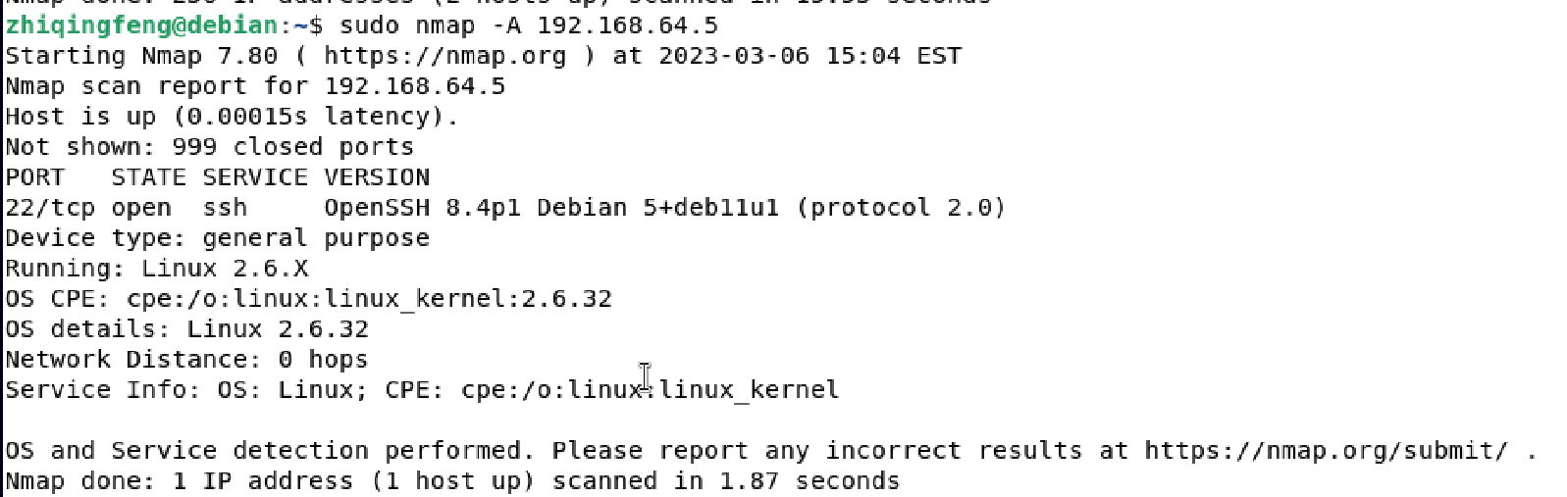
Here are some of the most common ports in use on Linux systems:
21 – FTP
22 – SSH
25 – SMTP (sending email)
53 – DNS (domain name service)
80 – HTTP (web server)
110 – POP3 (email inbox)
123 – NTP (Network Time Protocol)
143 – IMAP (email inbox)
443 – HTTPS (secure web server)
465 – SMTPS (send secure email)
631 – CUPS (print server)
993 – IMAPS (secure email inbox)
995 – POP3 (secure email inbox)
If you want more information about your computer from NMAP.
sudo nmap –A 192.168.1.100

Slide 11
Traffic analysis attack
A attacker tries to access the same network as you to listen and capture all your network traffic. The hacker can analyze that traffic to learn something about you or your company.
Network monitoring tools → NETHOGS

Slide 12
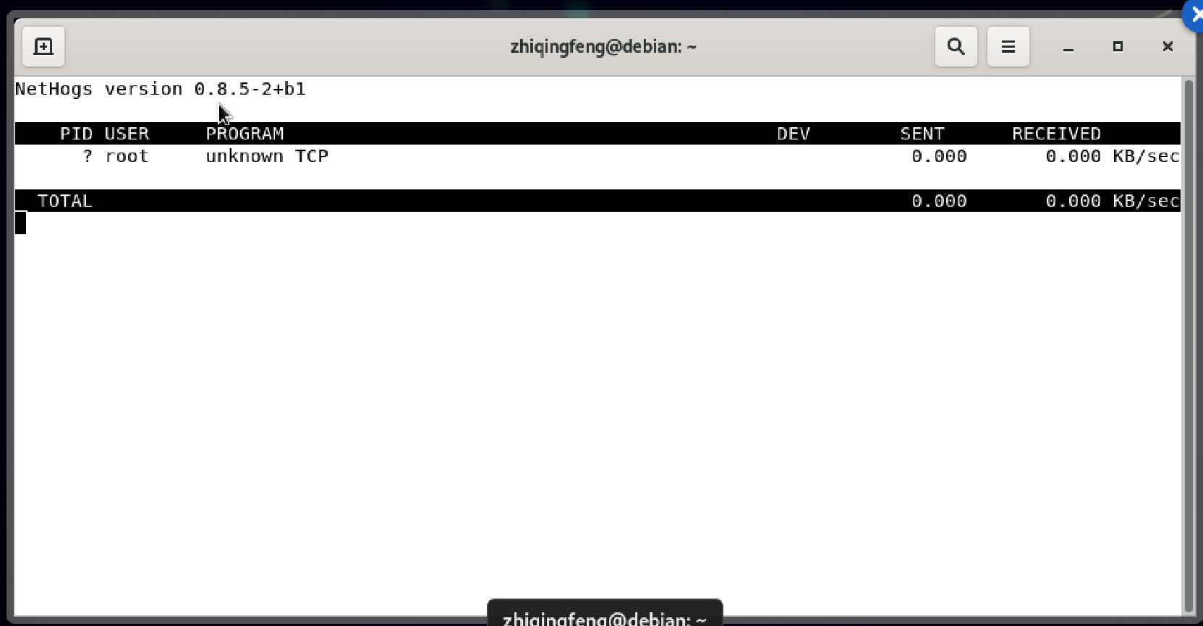
Install NETHOGS
Using nethogs
sudo apt install nethogs
sudo nethogs -a

Slide 13
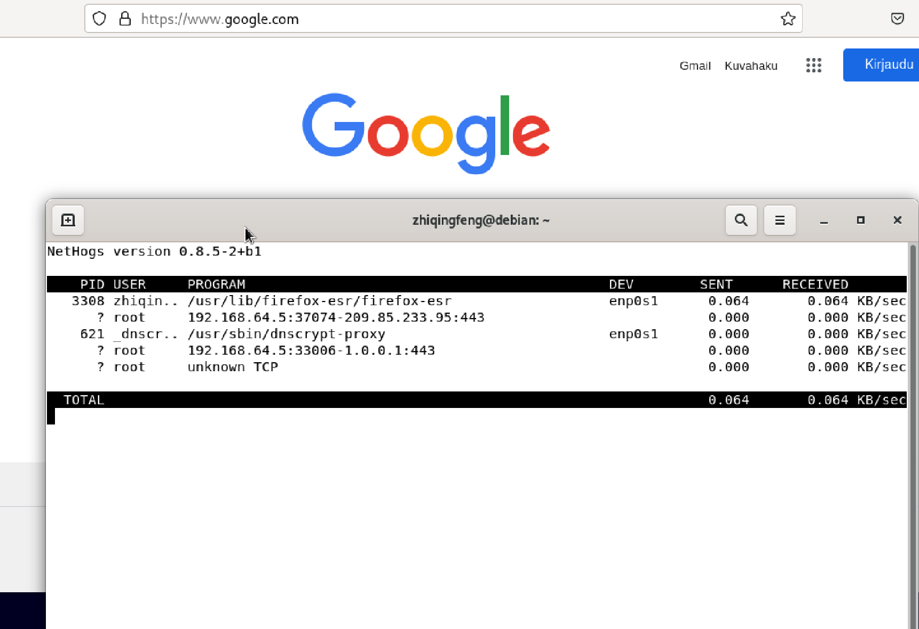
The network upload(sent) and download(received) speeds( kilobytes/s (kb/s) for each process is listed. The owner of the process and the PID is listed here. Nethogs is automatically update the information.
You can close nethogs network monitor with <Ctrl> + c.

Slide 14
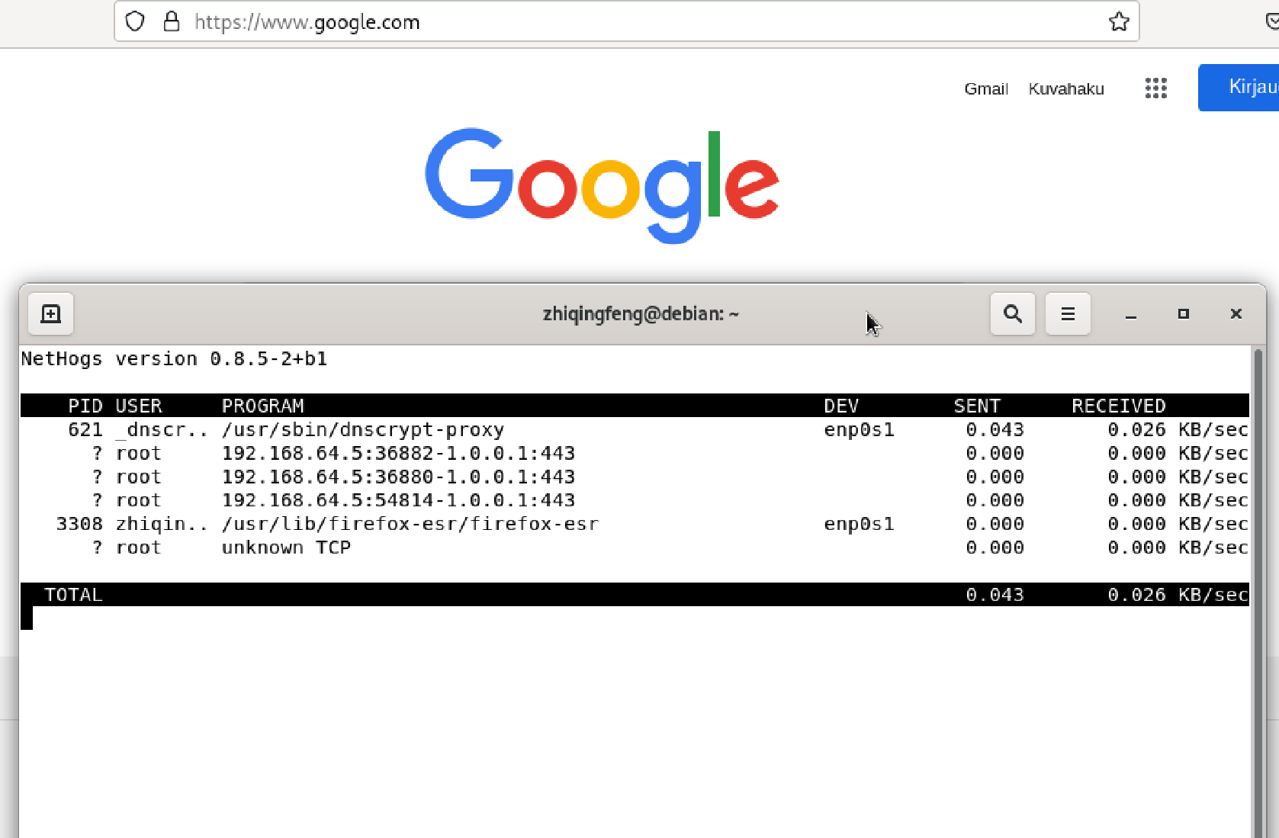
If you want to monitor a specific network interface using nethogs, you can easily do it.
sudo nethogs enp0s1
Now, only the enp0s1 interface should be monitored.

Slide 15

References
How to Use NMap to Check Your Linux Computer for Open Ports, Nick Congleton 16.08.2017
https://www.maketecheasier.com/use-nmap-check-linux-open-ports/
Is it OK to have port 22 open?
https://www.thehealthyjournal.com/faq/is-port-22-vulnerable
How to Monitor Network Traffic using nethogs, Shahriar Shovon 2019
https://linuxhint.com/monitor_network_traffic_nethogs/
Analyzing Linux Logs
https://www.loggly.com/ultimate-guide/analyzing-linux-logs/

