Slide 3
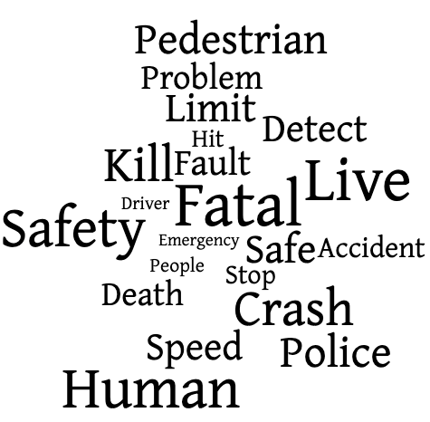
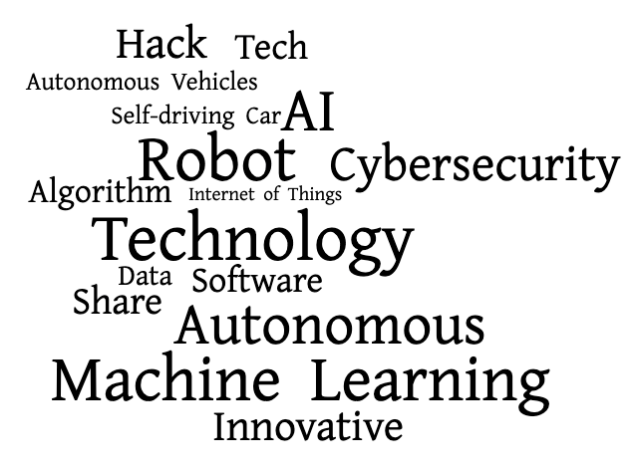
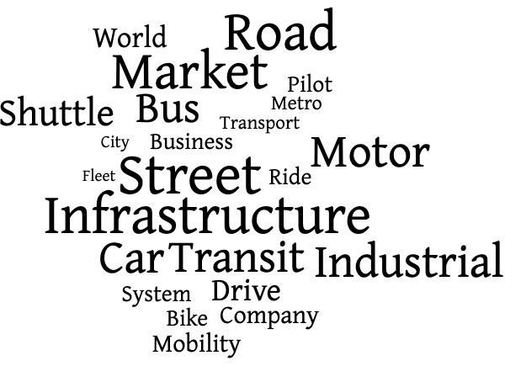
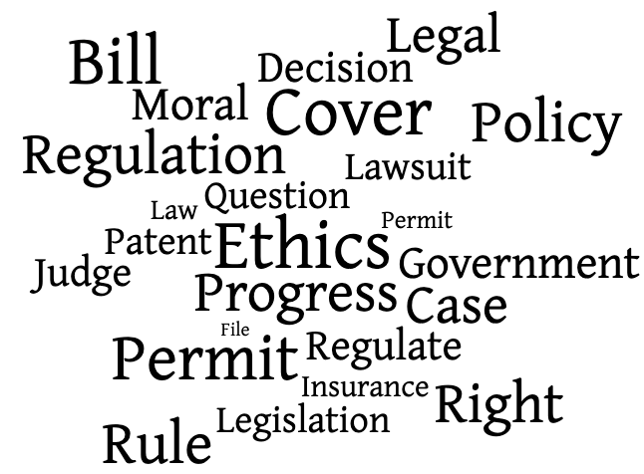
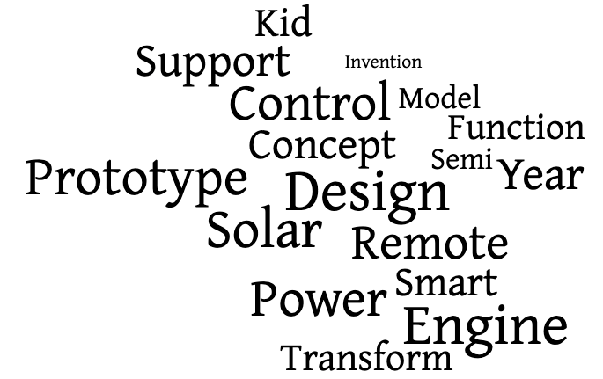
What does the public care about?
Safety Perception
Technology Development
Industrial Integration
Design and Functionality
Ethics and Policy
Notes:
First, I find 5 topics of driverless technologies are most relevant to the public.
They care about safety, technology development, industrial integration, design and functionality, and ethics and policy.
Besides the overlapping concerns with experts in safety, tech, and ethics, it is interesting to see the public discuss a lot about AV designs and prototypes, they cares about design for kids and want to include solar and remote control in the prototype.
With respect to the industrial integration, the public also cares how other transportation modes can better integrate with AVs on the road, they mention terms such as shuttle, bus, transit, bike, city in this topic, which suggests the public also has their visions towards autonomous driving.

