Slide 2
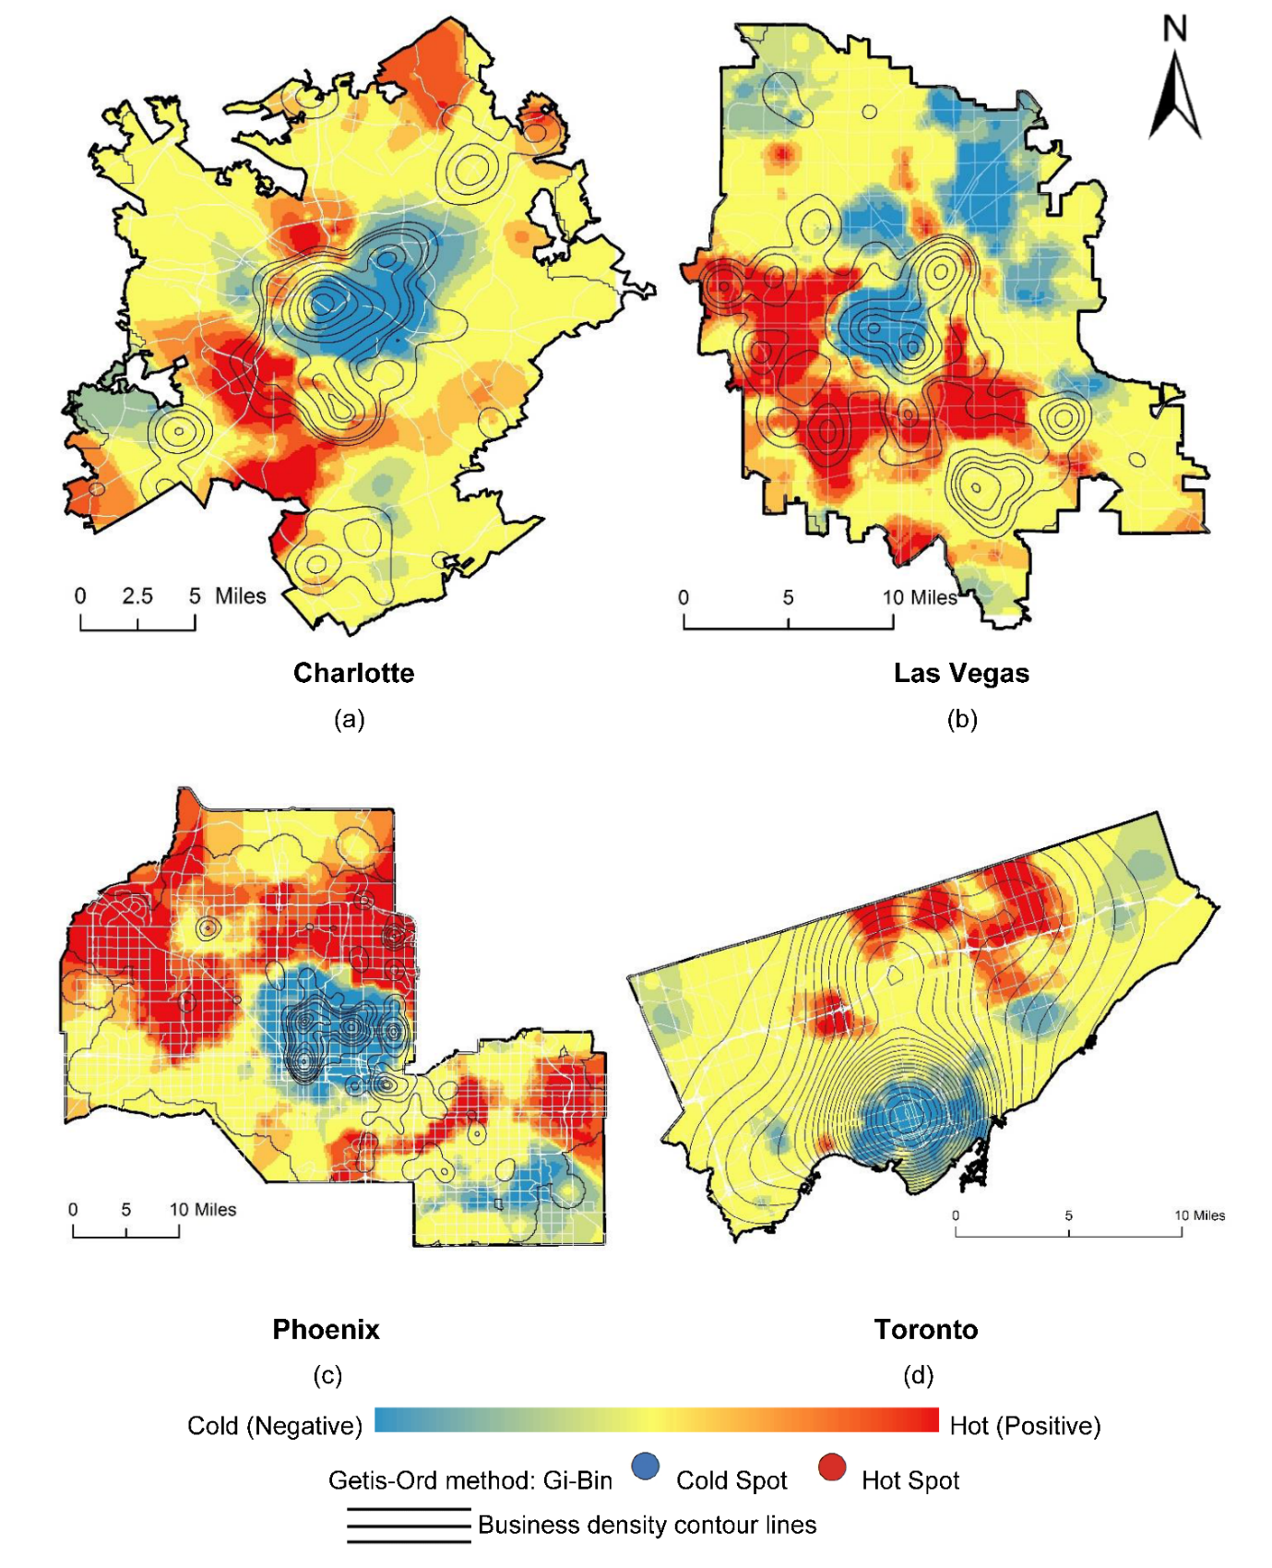
Yelp Reviews: Heatmap of “Positive”, “Neutral” and “Negative” Parking Sentiments

