Slide 1

Plant Identification with NEON Remote Sensing Data
Zhiqi Yu
12/2/2019

Slide 2
Background (Data Challenge)
Name:
NIST DSE Plant Identification with NEON Remote Sensing Data
Motivation:
“Understanding and managing forests is crucial to understanding and potentially mitigating the effects of climate change, invasive species, and shifting land use on natural systems and human society”
Goals:
Using airborne high-resolution hyperspectral images and ground level data to classify the species of trees, which can help understand the factors governing the individual-level behavior of eco-systems that can only be achieved by field-level measurement
https://nist-neon-dse.github.io/

Slide 3
Data
Collected by National Ecological Observatory Network (NEON) from the Ordway-Swisher Biological Station (OSBS) NEON site and by researchers at the University of Florida.
Hyperspectral dataset:
~43 scenes, each 80 x 80
Spatial resolution: 1m
Spectral resolution: 426 bands covering 380-2510 nm
Already atmospherically corrected (reflectance data) and georeferenced.
TODO:
Bad band list
Add wavelength

Slide 4
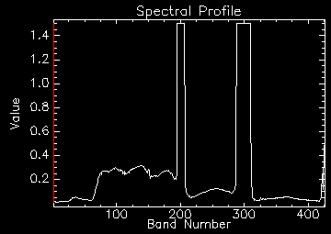
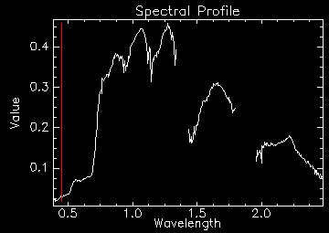
Data - Hyperspectral

Slide 5
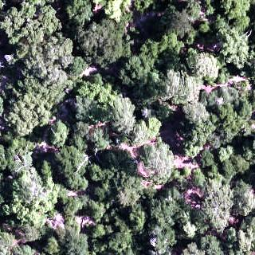



Data
True Color | Canopy Height Model
Hyperspectral | Mask

Slide 6
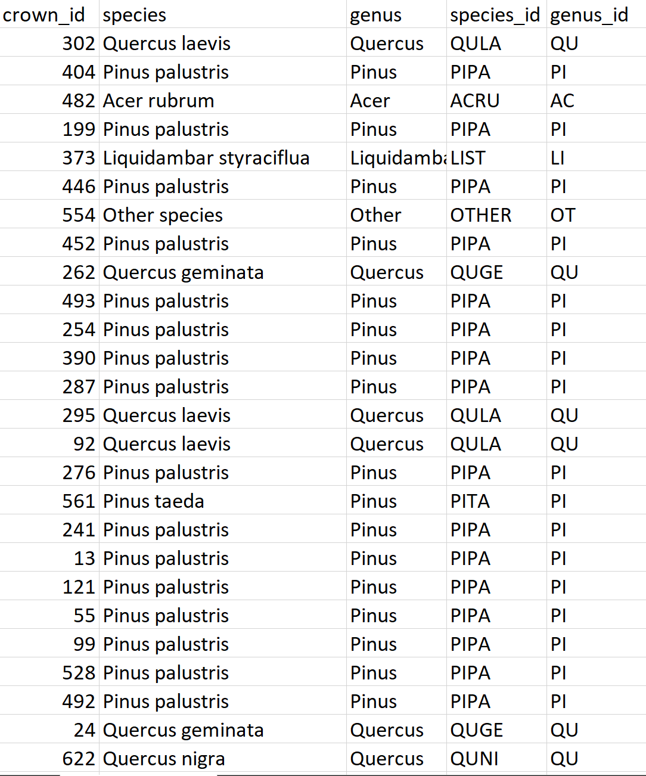
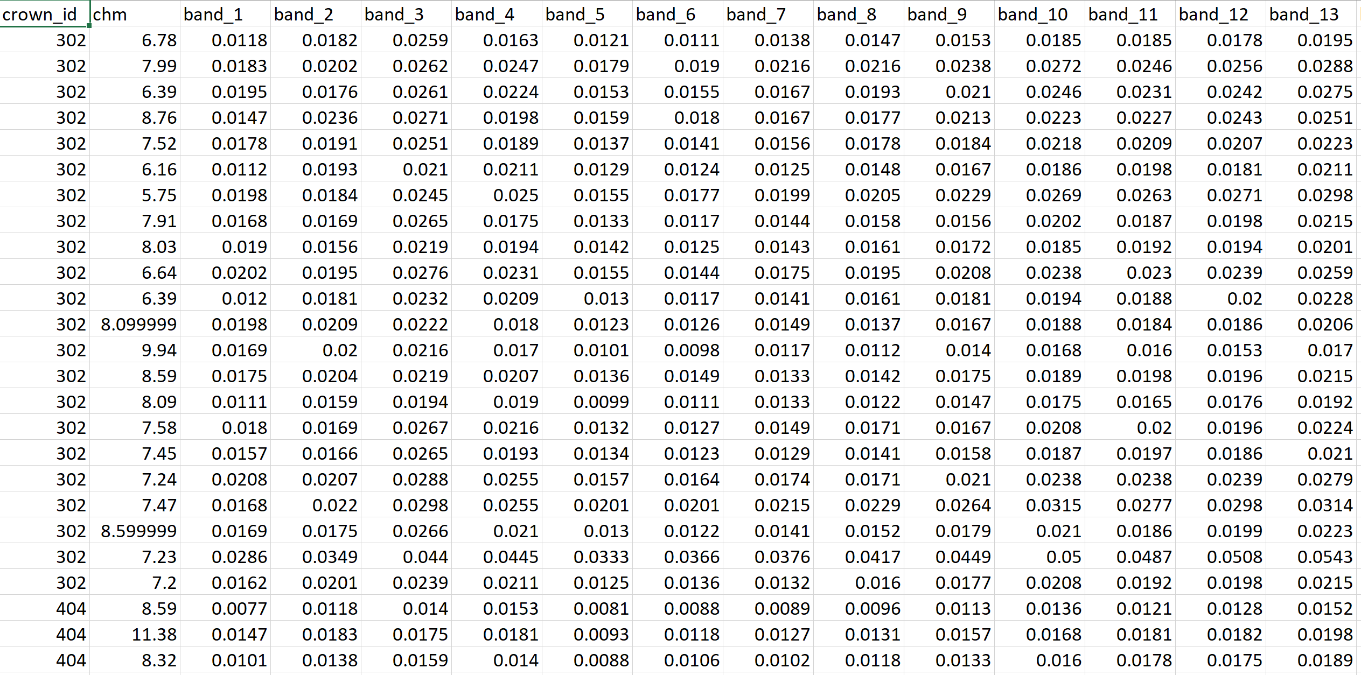
Data - Other

Slide 7
Method1 - SAM
Build a spectral library from provided training data tables
Build mask from CHM data
Classify images with SAM

Slide 8
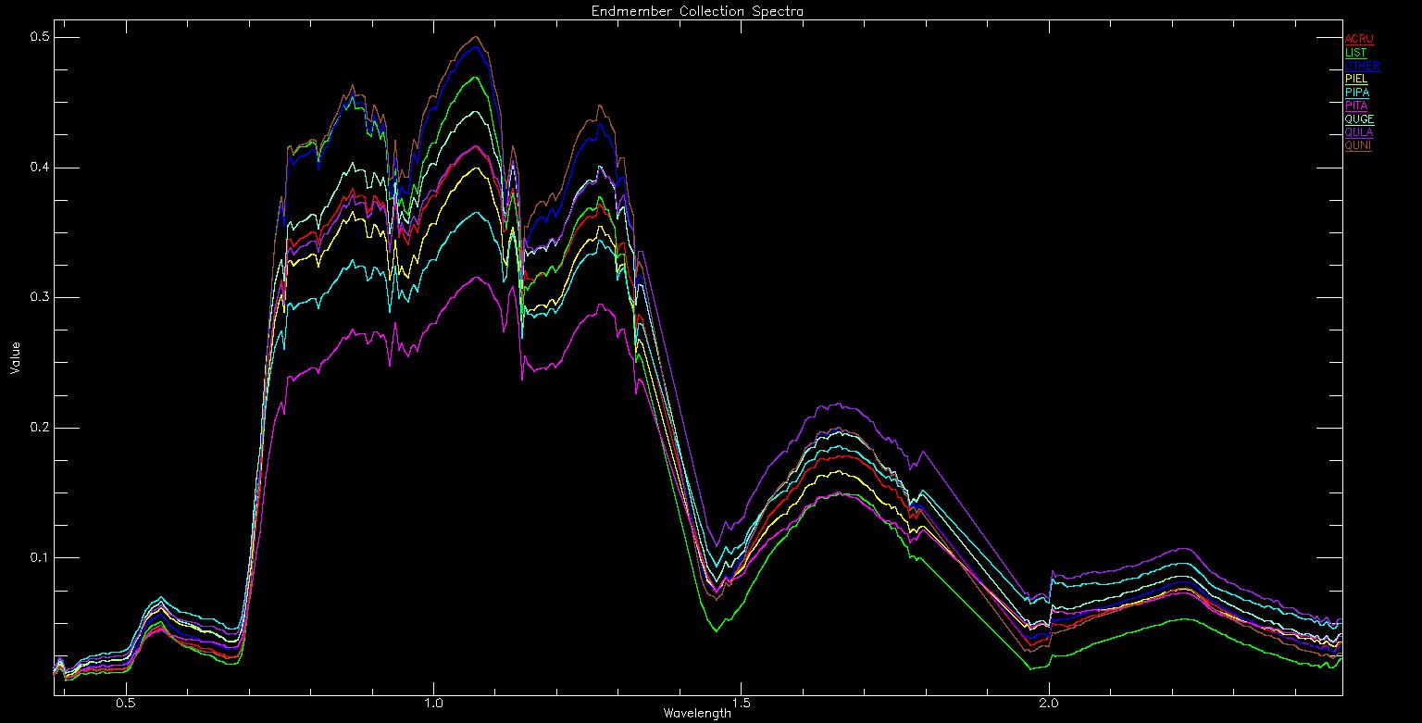
Method1 - SAM
Label | Name
ACRU | Acer rubrum
LIST | Liquidambar styraciflua
OTHER | Other species
PIEL | Pinus elliottii
PIPA | Pinus palustris
PITA | Pinus taeda
QUGE | Quercus geminata
QULA | Quercus laevis
QUNI | Quercus nigra

Slide 9


Result1 - SAM

Slide 10
Method2 - Supervised classification
426 bands are probably too many for supervised classification
Build MNF statistics from raw hyperspectral image.
Determine how many bands to use.
Use MNF statistics to transform training spectra
Add Canopy height model feature
Build a Random Forest model
Classify MNF image

Slide 11
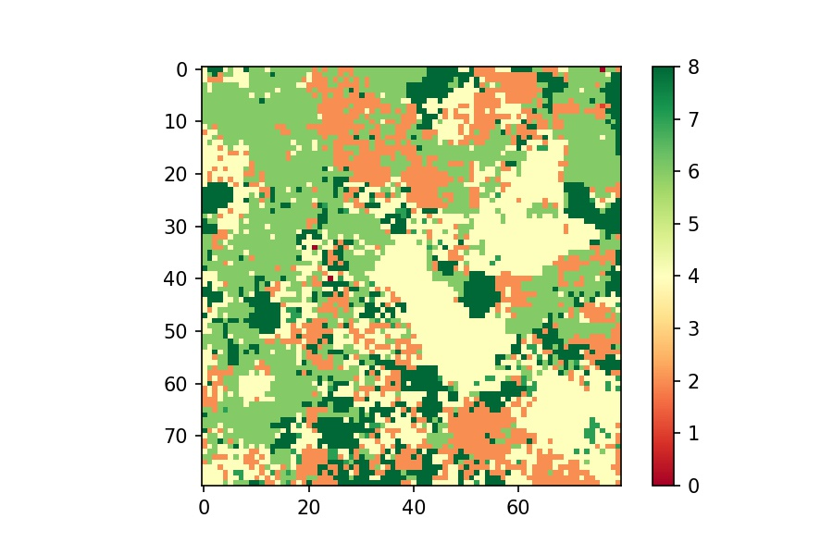

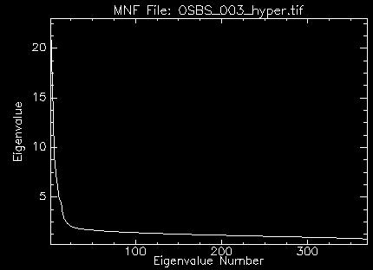
Result2 – Supervised Classification
0 | 1 | 2 | 3 | 4 | 5 | 6 | 7 | 8
ACRU | LIST | OTHER | PIEL | PIPA | PITA | QUGE | QULA | QUNI

Slide 12

Thanks!
https://github.com/zhiqiyu/Plant-Identification-
with-NEON-Remote-Sensing-Data

