Slide 1

Computer Security Laboratory
Confidential Computing in the Era of Data Economy
Zhiqiang Lin
zlin@cse.ohio-state.edu
09/04/2020
THE OHIO STATE UNIVERSITY

Slide 2




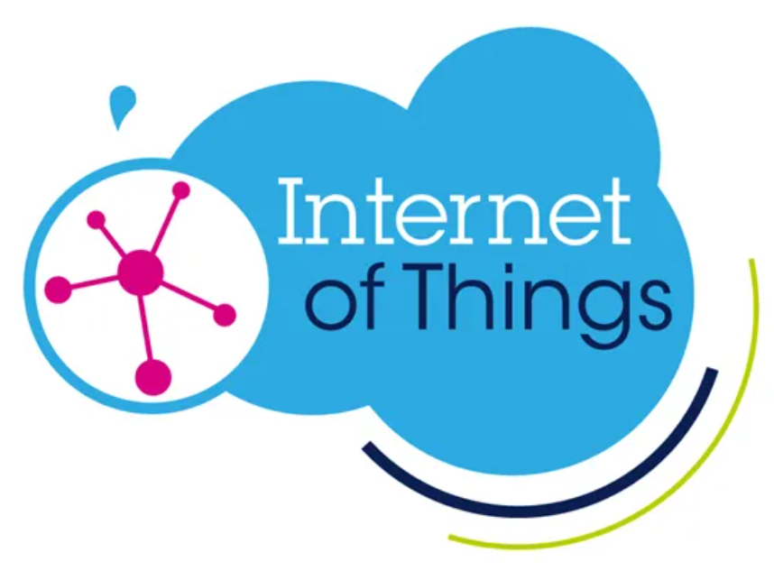
Evolution of the Research Problems in Cybersecurity
Desktop
Internet
Cloud
Mobile
IoT
Virus
Worms
Botnets
DDoS
Attack
Data Leakages
Side Channels
Location Privacy
Payment Security
IoT botnets
Sensors Attacks
Anti-virus
Intrusion Detection
Web Security
Virtualization
Security
Data Security & Privacy
Data Security & Privacy

Slide 3
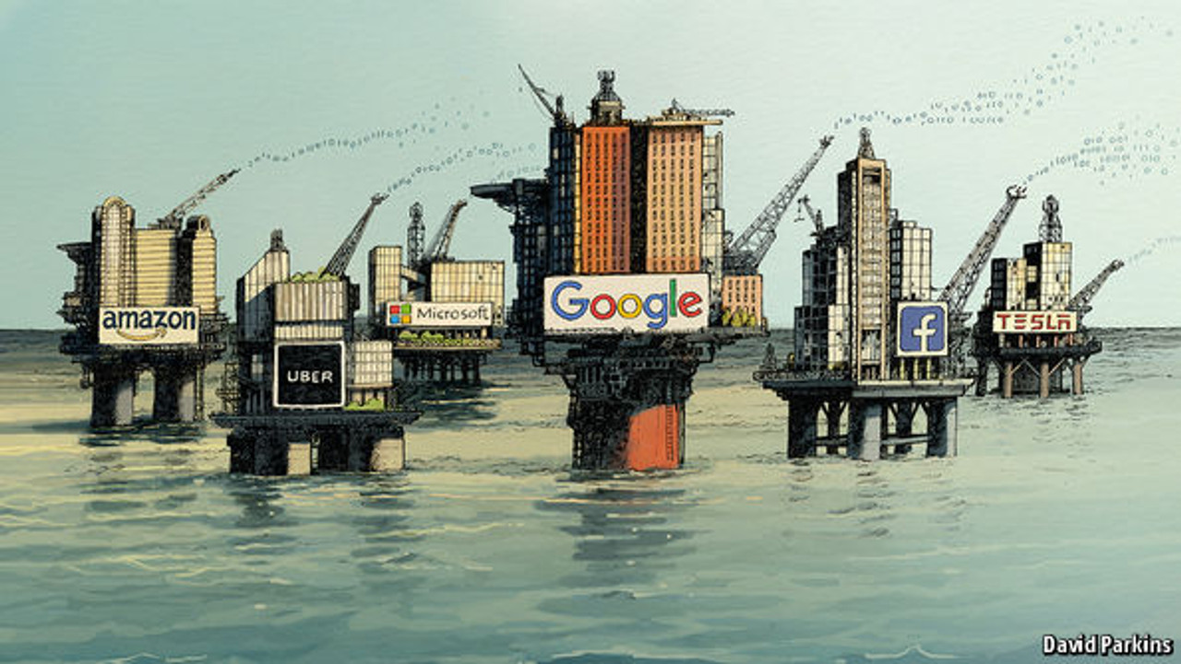
Data Has Become the World’s Most Valuable Resource
"The world’s most valuable resource is no longer oil, but data." The Economist: New York, NY, USA (2017).

Slide 4





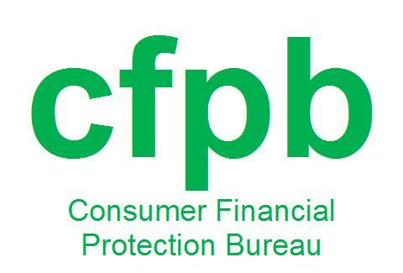




How to Protect Data: Security, Privacy, Trustworthiness
Equifax
Date: July, 2017 Impact: 147.9 million consumers
Forfeit: $575 million
Marriott
Date: November, 2018 Impact: 500 million guests
Forfeit: £100m
Yahoo
Date: 2013 Impact: 3 billion accounts Forfeit: $85 million
Uber
Date: October, 2016 Impact: 57 million drivers and customers
Forfeit: $150 million
British Airways
Date: September, 2018 Impact: 500,000 customers
Forfeit: £183m

Slide 5
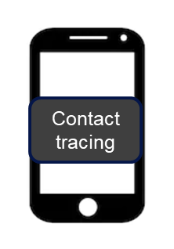

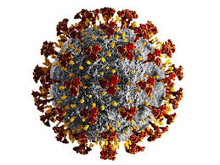


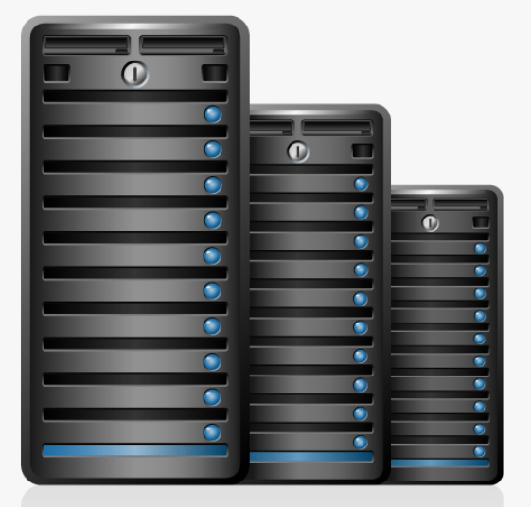
Digital Contact Tracing
Contact tracing
Identity privacy
Malware
Unauthorized access
location privacy
Sybil attacks
AI Security

Slide 6
Key Research Thrusts
Privacy
Security
Trust
Fairness
Confidential Computing Algorithms
Homomorphic encryption Multi-party computation Differential privacy Federated learning
Practical Confidential Computing Systems
Trusted Execution Environments (TEE) (e.g.,Intel Software Guard Extensions, ARM TrustZone, AMD SEV)
Distributed Ledger
Blockchain Ethereum Hyperledger

Slide 7
Thank You
Computer Security Laboratory
Confidential Computing in the Era of Data Economy
Zhiqiang Lin
zlin@cse.ohio-state.edu
09/04/2020
THE OHIO STATE UNIVERSITY

