Slide 1
Seattle Rainfall
Cristian Galvan & Zhirong Bi

Slide 2
System Description
We created an application that allows users to view rainfall statistics from the city of Seattle, WA
We got the information from a dataset on Kaggle
Contains data from January 1st, 1948 to December 12, 2017
One CSV file with 5 columns: Date, amount of precipitation in inches, max and min temperature that day, and T/F indicating if it rained that day

Slide 3
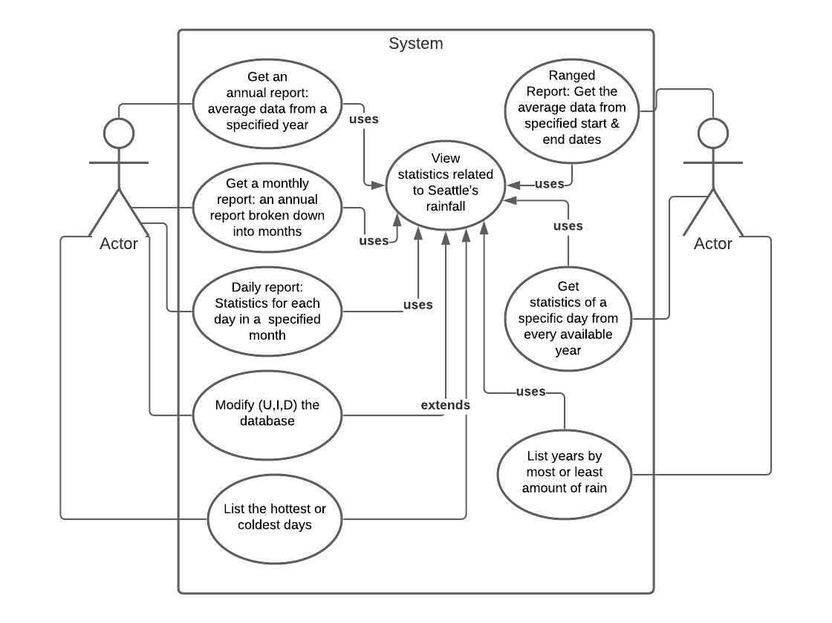
Use Case Diagram

Slide 4
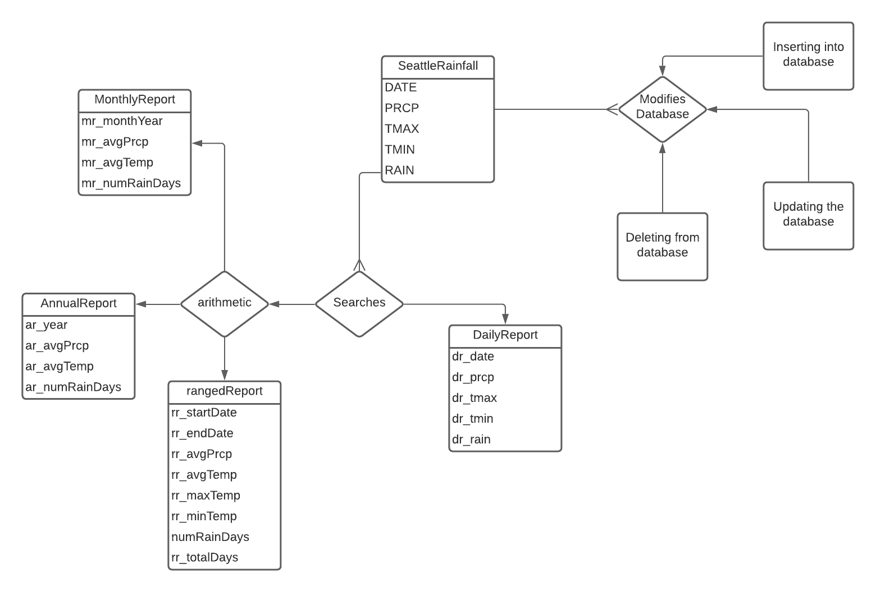
ER Diagram

Slide 5
Relational Schema
SeattleRainfall: date DATE, real PRCP, int TMAX, int TMIN, char RAIN
AnnualReport: int ar_year, real ar_avgPrcp, real ar_avgTemp, int ar_numRainDays
rangedReport: date rr_startDate, date rr_endDate, real rr_avgPrcp, real rr_avgTemp, real rr_maxTemp, real rr_minTemp, int numRainDays, int rr_totalDays
MonthlyReport: date mr_monthYear, real mr_avgPrcp, real mr_avgTemp, int mr_numRainDays
DailyReport: date dr_date, real dr_prcp, int dr_tmax, int dr_tmin, char dr_rain

Slide 6


Coding Language(s) used
The project’s database will be constructed using SQLite3
Comfortability due to its use within the course
Portability across all operating system
User Interface
Used Python to comfortably work with SQLite
The application will compile through command line
The python interface consist of options and if-else statements that guides the user to their intended functionality of the application
https://github.com/Cristian54/CSE111-Project

