Slide 1
CS143 Map Reduce (Spark)
Professor Junghoo “John” Cho

Slide 2
Distributed Analytics using Cluster
Often, our data is non-relational (e.g., flat file) and huge
Billions of query logs
Billions of web pages
...
Q: Can we perform analytics on large data quickly using thousands of machines?

Slide 3
Example 1: Search Log Analysis
Log of billions of queries. Count frequency of each query
Input query log:
cat,time,userid1,ip1,referrer1
dog,time,userid2,ip2,referrer2
...
Output query frequency:
cat 200000
dog 120000
...
Q: How can we perform this task? How can we parallelize it?

Slide 4
Example 1: Search Log Analysis (1)
Step 1: “Transform” each line of query log into (query, 1)
Cat, 12:30, 1.34.24.6, …
Dog, 12:30, 193.42.34.5, …
Pig, 12:31, 213.12.6.26, …
Dog, 12:32, 31.63.34.23, …
Cat, 12:33, 1.46.23.642, ..
(Cat, 1)
(Dog, 1)
(Pig, 1)
(Dog, 1)
(Cat, 1)

Slide 5
Example 1: Search Log Analysis (2)
Step 2: Collect all tuples with the same query and “aggregate” them
Q: How can we parallelize the two steps?
(Cat, 1)
(Cat, 1)
(Cat, 1)
(Dog, 1)
(Pig, 1)
(Dog, 1)
(Cat, 1)
(Cat, 2)
(Dog, 1)
(Dog, 1)
(Dog, 2)
(Pig, 1)
(Pig, 1)

Slide 6
Example 1: Search Log Analysis (3)
Step 1: “Transform” each line of query log into (query, 1)
Q: Can the transformation of each line done independently of each other?
Cat, 12:30, 1.34.24.6, …
Dog, 12:30, 193.42.34.5, …
Pig, 12:31, 213.12.6.26, …
Dog, 12:32, 31.63.34.23, …
Cat, 12:33, 1.46.23.642, ..
(Cat, 1)
(Dog, 1)
(Pig, 1)
(Dog, 1)
(Cat, 1)

Slide 7
Example 1: Search Log Analysis (4)
Step 1: For parallel processing
Split input data into multiple independent chunks
Move each chunk to separate machine
Perform “transformation” on multiple machines in parallel
Cat, 12:30, 1.34.24.6, …
Dog, 12:30, 193.42.34.5, …
Pig, 12:31, 213.12.6.26, …
(Cat, 1)
(Dog, 1)
(Pig, 1)
Cat, 12:30, 1.34.24.6, …
Dog, 12:30, 193.42.34.5, …
Pig, 12:31, 213.12.6.26, …
Dog, 12:32, 31.63.34.23, …
Cat, 12:33, 1.46.23.642, ..
Dog, 12:32, 31.63.34.23, …
Cat, 12:33, 1.46.23.642, …
(Dog, 1)
(Cat, 1)

Slide 8
Example 1: Search Log Analysis (5)
Step 2: For parallel processing
Move the tuples with the same query to the same machine
Perform aggregation on multiple machine in parallel
(Cat, 1)
(Dog, 1)
(Pig, 1)
(Cat, 1)
(Cat, 1)
(Cat, 2)
(Dog, 1)
(Dog, 1)
(Pig, 1)
(Dog, 1)
(Cat, 1)
(Dog, 2)
(Pig, 1)

Slide 9
Example 2: Web Indexing
1 billion pages. Build “inverted index”
Input documents:
1: cat chases dog
2: dog loves cat
...
Output index:
cat 1,2,5,10,20
dog 1,2,3,8,9
Q: How can we do this?

Slide 10
Example 2: Web Indexing (1)
Step 1: “Transform” every document into (word, doc_id) tuples
(cat, 1)
(chases, 1)
(dog, 1)
(dog, 2)
(loves, 2)
(cat, 2)
1: cat chases dog
2: dog loves cat

Slide 11
Example 2: Web Indexing (2)
Step 2: Collect all tuples with the same word and “aggregate” (or concatenate) the doc_id’s
Q: How can we parallelize the two steps on multiple machines?
(cat, 1)
(cat, 2)
(cat, [1, 2])
(cat, 1)
(chases, 1)
(dog, 1)
(dog, 2)
(loves, 2)
(cat, 2)
(dog, 1)
(dog, 2)
(dog, [1, 2])
(chases, 1)
(chases, [1])
(loves, 2)
(loves, [2])

Slide 12
Example 2: Web Indexing (3)
Step 1: “Transform” every document into (word, doc_id) tuples
Q: Can the transformation of each document be done independently of each other?
(cat, 1)
(chases, 1)
(dog, 1)
(dog, 2)
(loves, 2)
(cat, 2)
1: cat chases dog
2: dog loves cat

Slide 13
Example 2: Web Indexing (4)
Step 1: For parallel processing
Split input data into multiple independent chunks
Move each chunk to separate machine
Perform “transformation” on multiple machines in parallel
(cat, 1)
(chases, 1)
(dog, 1)
1: cat chases dog
1: cat chases dog
2: dog loves cat
(dog, 2)
(loves, 2)
(cat, 2)
2: dog loves cat

Slide 14
Example 2: Web Indexing (5)
Step 2: For parallel processing
Move the tuples with the same word to the same machine
Perform aggregation on multiple machine in parallel
(cat, 1)
(chases, 1)
(dog, 1)
(cat, 1)
(cat, 2)
(chases, 1)
(cat, [1, 2])
(chases, [1])
(dog, 2)
(loves, 2)
(cat, 2)
(dog, 1)
(dog, 2)
(loves, 2)
(dog, [1, 2])
(loves, [2])

Slide 15
Generalization (1)
Input data consists of multiple independent units
Each line of query log
Each web page
Partition input data into multiple “chunks” and distribute them to multiple machines
Transformation/map input into (key, value) tuples
Query log: query_log_line -> (query, 1)
Indexing: web_page -> (word₁, page_id), (word₂, page_id), …
Reshuffle tuples of the same key to the same machine
Aggregate/reduce the tuples of same keys
Query log: (query, 1), (query, 1), … -> (query, count)
Indexing: (word, 1), (word, 3), … -> (word, [1, 3, …])
Collect and output the aggregation results

Slide 16
Generalization (2)
The two examples are almost the same except
“The mapping function”
Query log: query_log_line -> (query, 1)
Indexing: web_page -> (word₁, page_id), (word₂, page_id), …
“The reduction function”
Query log: (query, 1), (query, 1), … -> (query, count)
Indexing: (word, 1), (word, 3), … -> (word, [1, 3, …])

Slide 17
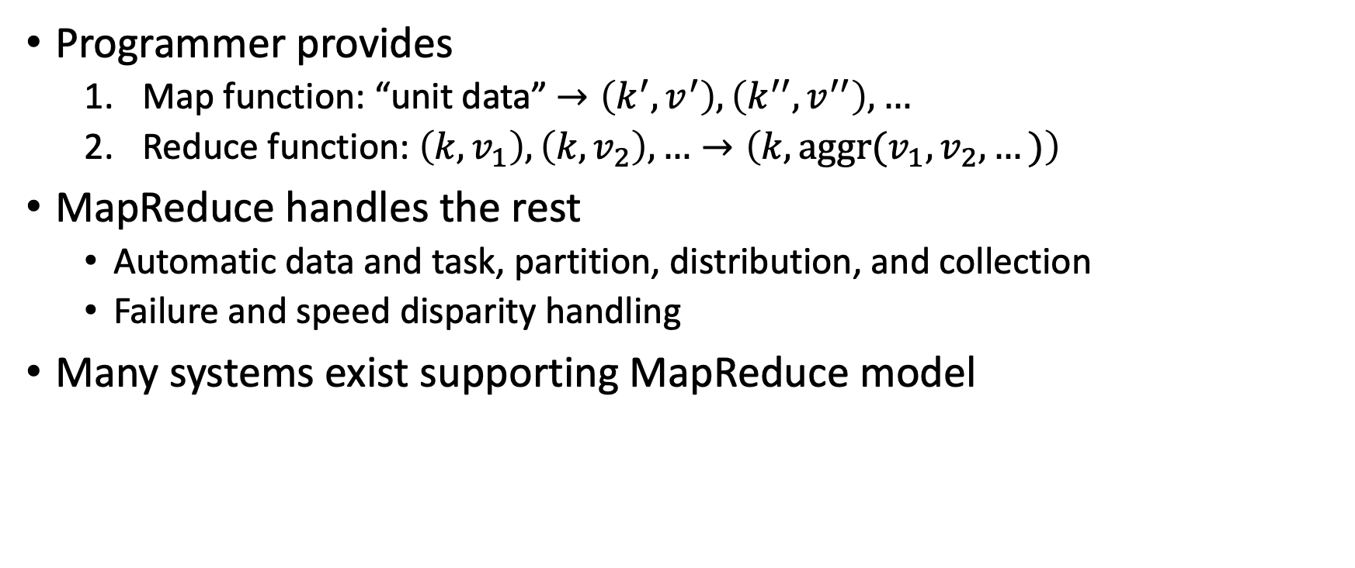
MapReduce Model
Programmer provides
Map function: “unit data” $→\left(k^{′}, v^{′}\right), \left(k^{′′}, v^{′′}\right),…$
Reduce function: $\left(k, v_{1}\right),\left(k,v_{2}\right),…→\left(k,aggr(v_{1},v_{2},…)\right)$
MapReduce handles the rest
Automatic data and task, partition, distribution, and collection
Failure and speed disparity handling
Many systems exist supporting MapReduce model

Slide 18
Hadoop
First open source implementation of GFS (Google File System) and MapReduce
Implemented in Java
User implements map and reduce functions as:
Mapper.map(key, value, output, reporter)
Reducer.reduce(key, value, output, reporter)

Slide 19
Spark
Open source cluster computing infrastructure
Supports MapReduce and SQL
Supports data flow more general than simple MapReduce
Input data is converted into RDD (resilient distributed dataset)
A collection of independent tuples
The tuples are automatically distributed and shuffled by Spark
Supports multiple programming languages
Scala, Java, Python, …
Scala and Java are much more performant than others

Slide 20
Spark Example: Count words
lines = sc.textFile("input.txt")
words = lines.flatMap(lambda line: line.split(" "))
word1s = words.map(lambda word: (word, 1))
wordCounts = word1s.reduceByKey(lambda a,b: a+b)
wordCounts.saveAsTextFile("output")

Slide 21
Key Spark Functions
Transformation: Convert RDD tuple into RDD tuple(s)
map(): convert one input tuple into one output tuple
flatMap(): convert one input into multiple output tuples
reduceByKey(): specify how two input “values” should be aggregated
filter(): filter out tuples based on condition
Action: Perform “actions” on RDD
saveAsTextFile(): save RDD in a directory as text file(s)
collect(): create Python tuples from Spark RDD
textFile(): create RDD from text (each line becomes an RDD tuple)

Slide 22
What We Learned
Large-scale data analytics on distributed cluster
MapReduce model
Spark

