Slide 1
CS143 Non-Relational Database (MongoDB)
Professor Junghoo “John” Cho

Slide 2
RDBMS for JavaScript Object Persistence
JavaScript applications need a “persistence layer” to store and retrieve JavaScript object
Traditionally (until mid 2010) this was done with RDBMS
RDBMS as massive, safe, efficient, multi-user storage engine
Q: How can we store JavaScript object in RDB?
“Impedance mismatch”: Two choices
Store object’s JSON as a string in a column
“Normalize” the object into set of relations
Q: Pros and cons of each approach?
Q: Can we just create “native database” for JSON?

Slide 3
MongoDB
Database for JSON objects
Perfect as a simple persistence layer for JavaScript objects
“NoSQL database”
Data is stored as a collection of documents
Document: (almost) JSON object
Collection: group of “similar” documents
Analogy
Document in MongoDB ~ row in RDB
Collection in MongoDB ~ table in RDB

Slide 4
MongoDB “Document”
{
"_id": ObjectId(8df38ad8902c),
"title": "MongoDB",
"description": "MongoDB is NoSQL database",
"tags": ["mongodb", "database", "NoSQL"],
"likes": 100,
"comments": [
{ "user":"lover", "comment": "Perfect!" },
{ "user":"hater", "comment": "Worst!" }
]
}
_id field: primary key
May be of any type other than array
If not provided, automatically added with a unique ObjectId value
Stored as BSON (Binary representation of JSON)
Supports more data types than JSON
Does not require double quotes for field names

Slide 5
MongoDB “Philosophy”
Adopts JavaScript “laissez faire” philosophy
Don’t be too strict! Be accommodating! Handle user request in a “reasonable” way
Schema-less: no predefined schema
Give me anything. I will store it anywhere you want
One collection will store documents of any kind with no complaint
No need to “plan ahead”
A “database” is created when a first collection is created
A “collection” is created when a first document is inserted
Both blessing and curse

Slide 6
MongoDB Demo
show dbs;
use demo;
show collections;
db.books.insertOne({title: "MongoDB", likes: 100});
db.books.find();
show collections;
show dbs;
db.books.insertMany([{title: "a"}, {name: "b"}]);
db.books.find();
db.books.find({likes: 100});
db.books.find({likes: {$gt: 10}});
db.books.updateOne({title: "MongoDB"}, {$set: { likes: 200 }});
db.books.find();
db.books.deleteOne({title: "a"});
db.books.drop();
show collections;
show dbs;

Slide 7
Basic MongoDB Commands (1)
mongo: start MongoDB shell
use <dbName>: use the database
show dbs: show list of databases
show collections: show list of collections
db.colName.drop(): delete `colName` collection
db.dropDatabase(): delete current database

Slide 8
Basic MongoDB Commands (2)
CRUD operations
insertOne(), insertMany()
findOne(), find()
updateOne(), updateMany()
deleteOne(), deleteMany()
Insertion: insertX( doc(s) )
db.books.insertOne({title: "MongoDB", likes: 100})
db.books.insertMany([{title: "a"}, {title: "b"}])

Slide 9
Basic MongoDB Commands (3)
Retrieval: findX(condition)
db.books.findOne({likes: 100})
db.books.find({$and: [{likes: {$gte: 10}}, {likes: {$lt: 20}}]})
Other Boolean/comaprision operators: $or, $not, $gt, $ne, …
Update: updateX(condition, update_operation)
db.books.updateOne({title: "MongoDB"}, {$set: {title: "MongoDB II"}})
db.books.updateMany({title: "MongoDB"}, {$inc: {likes: 1}})
Other update operators: $mul (multiply), $unset (remove field), …
Deletion: deleteX(condition)
db.books.deleteOne({title: "MongoDB"})
db.books.deleteMany({likes: {$lt: 100}})

Slide 10
MongoDB Aggregates
MongoDB supports complex queries through “aggregates”
MongoDB aggregates are very much like SQL SELECT queries
stages – SQL SELECT clause
pipeline – SQL SELECT statement

Slide 11
MongoDB Aggregates: Example
{ _id: 1, cust_id: "a", status: "A", amount: 50 } { _id: 2, cust_id: ”a", status: "A", amount: 100 } { _id: 3, cust_id: ”c", status: "D", amount: 25 } { _id: 4, cust_id: ”d", status: ”C", amount: 125 } { _id: 5, cust_id: ”d", status: ”A", amount: 25 }
db.orders.aggregate([
{ $match: { status: "A" } },
{ $group: { _id: "$cust_id", total: { $sum: "$amount" }, count: { $sum: 1 } } },
{ $sort: { total: -1 } } ])
Equivalent to SQL SELECT
Just $match is fine, for example
In $group stage, _id is “group by attributes”

Slide 12
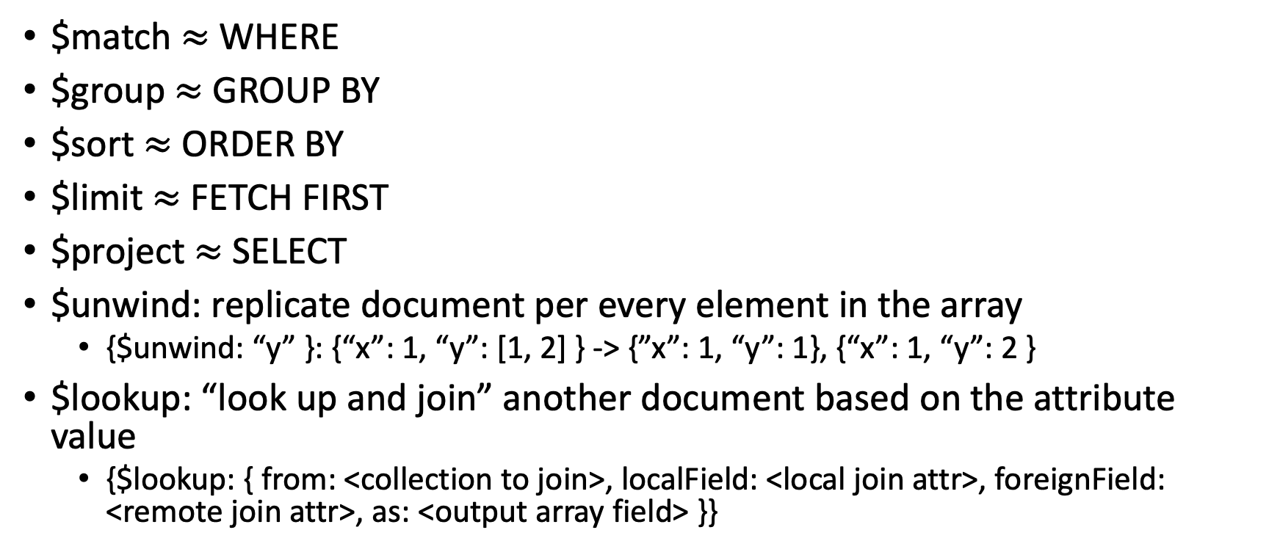
Common Aggregate Stages
$match $≈$ WHERE
$group $≈$ GROUP BY
$sort $≈$ ORDER BY
$limit $≈$ FETCH FIRST
$project $≈$ SELECT
$unwind: replicate document per every element in the array
{$unwind: “y” }: {“x”: 1, “y”: [1, 2] } -> {”x”: 1, “y”: 1}, {“x”: 1, “y”: 2 }
$lookup: “look up and join” another document based on the attribute value
{$lookup: { from: <collection to join>, localField: <local join attr>, foreignField: <remote join attr>, as: <output array field> }}

Slide 13
More on MongoDB aggregates
Short tutorial: https://studio3t.com/knowledge-base/articles/mongodb-aggregation-framework/
Reference: https://docs.mongodb.com/manual/reference/method/db.collection.aggregate/

Slide 14
MongoDB vs RDB
MongoDB document
Preserves structure
Nested objects
Potential redundancy
Restructuring or combining data is complex and inefficient
MongoDB: “laissez faire”
No explicit db/collection creation
No schema. Anything is fine
RDB tuple
“Flattens” data
Set of flat rows
Removes redundancy
Data can be easily “combined” using relational operators
RDB: “Straight-jacket”
Declare everything before use
Reject if not compliant

Slide 15
More on MongoDB
We learned just the basic
MongoDB has many more features
Transactions
Replication
(Auto)sharding
…
Read MongoDB documentation and online tutorials to learn more

