Slide 1
CS143: Joins
Professor Junghoo “John” Cho

Slide 2
Motivation
Q: How do we process SELECT * FROM Student WHERE sid > 30?
Q: How do we process SELECT * FROM Student S, Enroll E WHERE S.sid = E.sid?

Slide 3

$R⋈S$ ?
A
A
R
40 | T1
60 | T2
30 | T3
10 | T4
20 | T5
S
10 | T6
60 | T7
40 | T8
20 | T9

Slide 4
Four Join Algorithms
Nested-Loop Join (NLP)
Index Join (IJ)
Sort-Merge Join (SMJ)
Hash Join (HJ)

Slide 5
Nested-Loop Join (NLJ)
For each r ∈ R:
For each s ∈ S:
if r.A = s.A, then output (r,s)
R
S
40 | T1
60 | T2
30 | T3
10 | T4
20 | T5
10 | T6
60 | T7
40 | T8
20 | T9

Slide 6
Index Join (IJ)
(1) Create an index for S.A if needed
(2) For each r ∈ R:
X := lookup index on S.A with r.A value
For each s ∈ X, output (r,s)
R
40 | T1
60 | T2
30 | T3
10 | T4
20 | T5
S
10 | T6
60 | T7
40 | T8
20 | T9

Slide 7
Sort-Merge Join (SMJ)
Sort the relations first, then join
R
S
10 | T4
20 | T5
30 | T3
40 | T1
60 | T2
10 | T6
20 | T9
40 | T8
60 | T7

Slide 8
Sort-Merge Join (SMJ)
if not, sort R and S by A
i ← 1; j ← 1;
while (i ≤ |R|) ∧ (j ≤ |S|):
if (R[i].A = S[j].A) then output (R[i], S[j]); i ← i+1; j ← j+1;
else if (R[i].A > S[j].A) then j ← j+1
else if (R[i].A < S[j].A) then i ← i+1
R
S
10 | T4
20 | T5
30 | T3
40 | T1
60 | T2
10 | T6
20 | T9
40 | T8
60 | T7

Slide 9
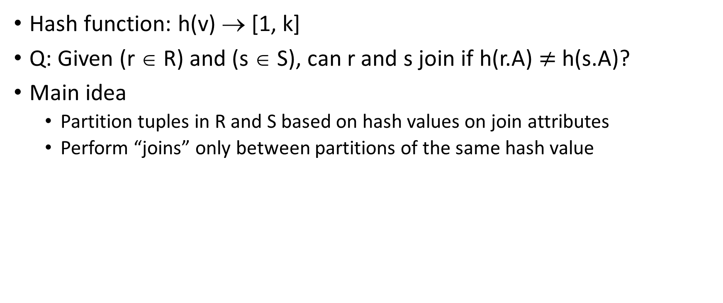
Hash Join (HJ)
Hash function: h(v) → [1, k]
Q: Given (r ∈ R) and (s ∈ S), can r and s join if h(r.A) $≠$h(s.A)?
Main idea
Partition tuples in R and S based on hash values on join attributes
Perform “joins” only between partitions of the same hash value

Slide 10
Hash Join (HJ)
Hash function: h(v) → [1, k]
Hashing stage (bucketizing): hash tuples into buckets
Hash R tuples into G1,…,Gk buckets
Hash S tuples into H1,…,Hk buckets
Join stage: join tuples in matching buckets
For i = 1 to k do
match tuples in Gi, Hi buckets
R
G1
H1
S
G2
H2
G3
H3
…
…
…

Slide 11
Hash Join (HJ)
H(k) = k mod 3
R
S
0
0
1
1
2
2
40 | T1
60 | T2
30 | T3
10 | T4
20 | T5
10 | T6
60 | T7
40 | T8
20 | T9

Slide 12
Comparison of Join Algorithms
Q: Which algorithm is better?
Q: What does “better” mean?
Ultimate bottom line: Which algorithm is the “fastest”?
Q: How does the system know which algorithm runs fast? Run all join algorithms and pick the fastest one?

Slide 13
Cost Model
A model to estimate the performance of a join algorithm
Multiple cost models are possible depending on their sophistication
Our cost model: # disk blocks that are read/written during join
Not perfect: ignores random vs sequential IO differnce, CPU cost, …
But simple to analyze
And “good enough” to pick the best join algorithm
Cost of join is dominated by disk IO
Most join algorithms have similar disk access pattern
Our cost model ignores the last IO for writing the final result
This cost is the same for all algorithms

Slide 14
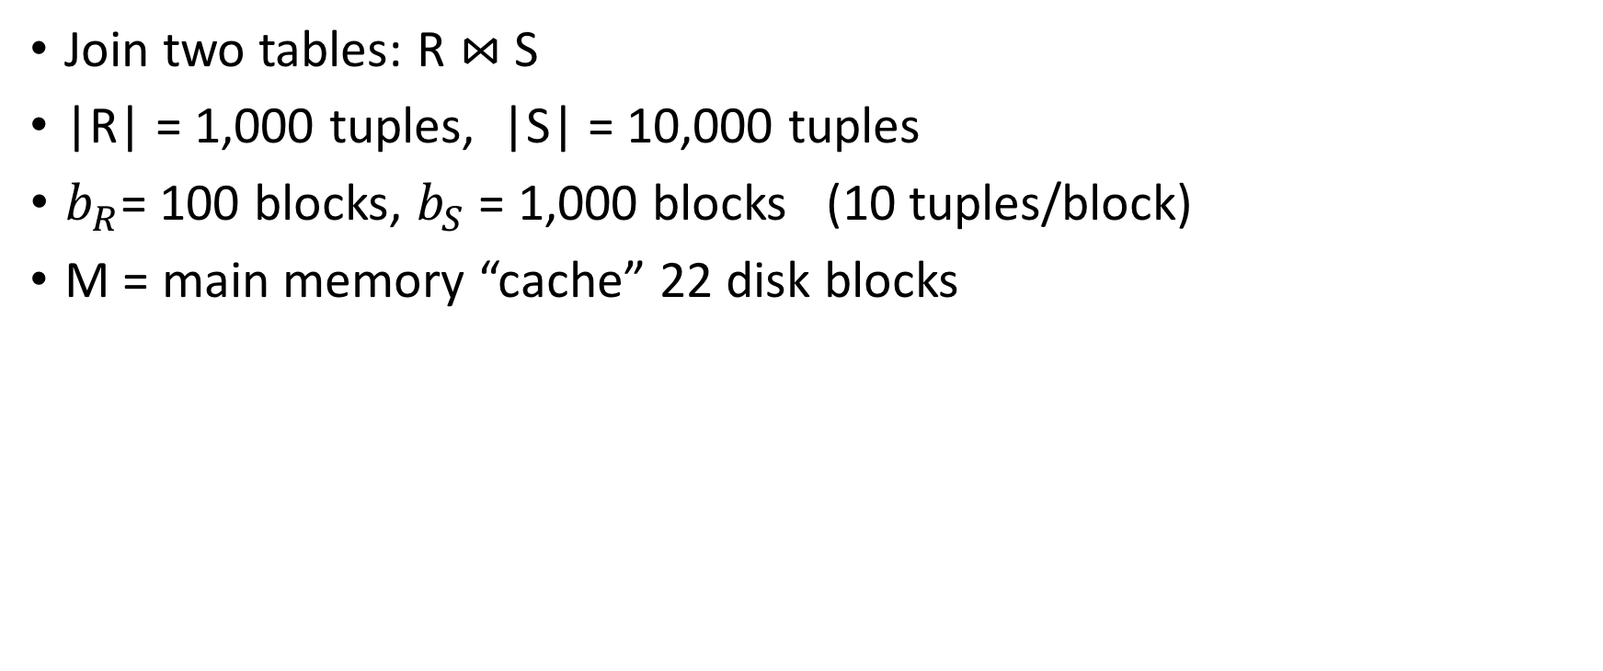
Running Example
Join two tables: R $⋈$S
|R| = 1,000 tuples, |S| = 10,000 tuples
$b_{R}$= 100 blocks, $b_{S}$ = 1,000 blocks (10 tuples/block)
M = main memory “cache” 22 disk blocks
Memory
10 tuples
. . .
. . .
R (100 blocks)
. . .
S (1000 blocks)
. . .
22 blocks

Slide 15
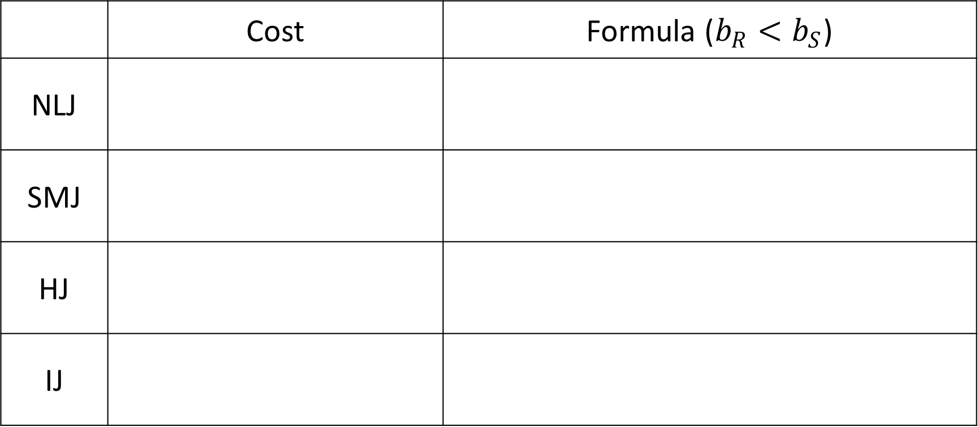
Cost of Join Algorithms
 | Cost | Formula ($b_{R}<b_{S}$)
NLJ
SMJ
HJ
IJ

Slide 16
Sort-Merge Join (SMJ)
if not, sort R and S by A
i ← 1; j ← 1;
while (i ≤ |R|) ∧ (j ≤ |S|):
if (R[i].A = S[j].A) then output (R[i], S[j]); i ← i+1; j ← j+1;
else if (R[i].A > S[j].A) then j ← j+1
else if (R[i].A < S[j].A) then i ← i+1
R
S
10 | T4
20 | T5
30 | T3
40 | T1
60 | T2
10 | T6
20 | T9
40 | T8
60 | T7

Slide 17
Cost of Join Stage of Sort-Merge Join
M = 22
. . .
R (100 blocks)
. . .
S (1000 blocks)

Slide 18
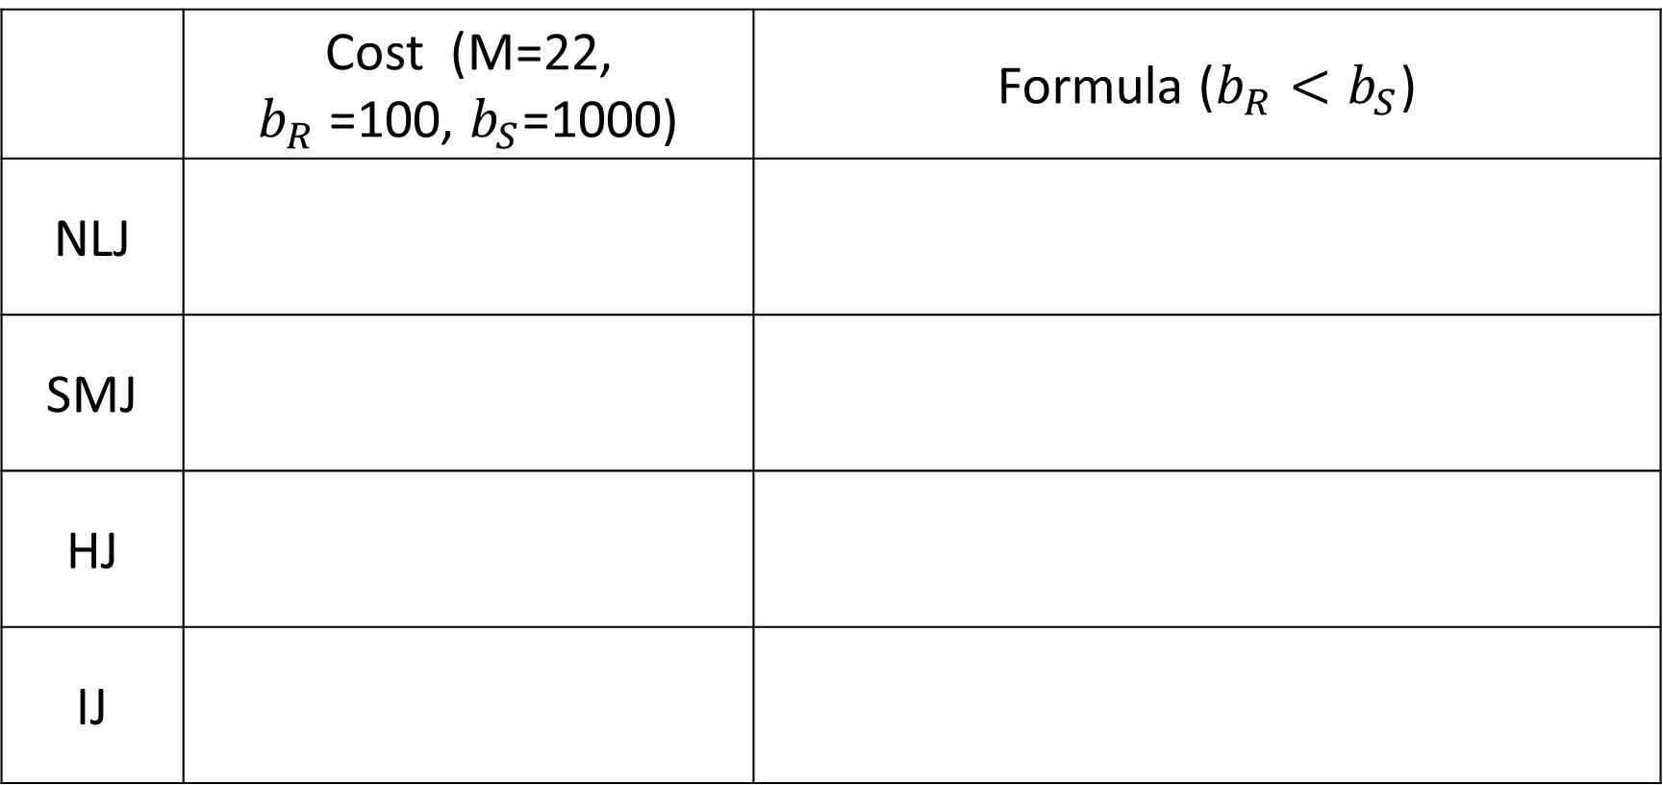
Cost of Join Algorithms
 | Cost (M=22, $b_{R}$ =100, $b_{S}$=1000) | Formula ($b_{R}<b_{S}$)
NLJ
SMJ
HJ
IJ

Slide 19

Nested-Loop Join (NLJ): R $⋈$S
For each r ∈ R:
For each s ∈ S:
if r.A = s.A, then output (r,s)
Scan S table once for every tuple of R
M = 22
. . .
R (100 blocks)
. . .
S (1000 blocks)

Slide 20
Nested Loop Join
Scan S table once for every tuple of R
Q: Can we do better?
M = 22
10 tuples
. . .
R (100 blocks)
. . .
S (1000 blocks)

Slide 21
Block Nested Loop Join
Scan S table once for every block of R
Q: Can we do even better? What is the maximum # of blocks that we can read in one batch from R?
M = 22
10 tuples
. . .
R (100 blocks)
. . .
S (1000 blocks)

Slide 22
Block Nested Loop Join
Scan S table once for every 20 blocks of R
Q: What if we read S first?
M = 22
20 blocks
10 tuples
...
. . .
R (100 blocks)
. . .
S (1000 blocks)

Slide 23
Block Nested Loop Join
Scan R table once for every 20 blocks of S
M = 22
20 blocks
10 tuples
...
. . .
S (1000 blocks)
. . .
R (100 blocks)

Slide 24
Cost of Join Algorithms
 | Cost (M=22, $b_{R}$ =100, $b_{S}$=1000) | Formula ($b_{R}<b_{S}$)
NLJ
SMJ
HJ
IJ

Slide 25
Nested Loop Join Summary
Always use block nested loop join (not the naïve algorithm)
Read as many blocks as possible for the left table in one iteration
Use the smaller table on the left (i.e., outer loop)

Slide 26

Hash Join (HJ)
Step (1): Hashing stage: h(v) $→$ [1, k]
Step (2): Join stage
Memory
buckets
G1
R
G2
...
...
Gk
Memory
S
R
G1
H1
G2
H2
G3
Gi
Hi
...
...

Slide 27
HJ: Bucketizing Stage
Read R table and hash them into k buckets
Q: Given M=22, what is the maximum k?
Q: How many disk IOs to bucketize R?
M = 22
G1
. . .
G2
. . .
. . .
R (100 blocks)
Gk
. . .

Slide 28
HJ: Bucketizing Stage
Read S table and hash them into k buckets
Q: In general, what is the cost for bucketizing R and S?
M = 22
H1
. . .
H2
. . .
. . .
S (1000 blocks)
Hk
. . .

Slide 29
HJ: Join Stage
Join tuples in Gi with those in Hi
Q: How can we join tuples in G1 with H1? How should we use memory?
5 blocks
M = 22
48 blocks
G1
. . .
. . .
H1
G2
. . .
. . .
H2
Gk
. . .
. . .
Hk

Slide 30
Cost of Join Algorithms
 | Cost (M=22, $b_{R}$ =100, $b_{S}$=1000) | Formula ($b_{R}<b_{S}$)
NLJ
SMJ
HJ
IJ

Slide 31

HJ: Join Stage
Q: What if R is large, say $b_{R}=1000$, and Gi > 20?
A: Exactly the same as standard join problem. Apply “hash join” algorithm to join H1 and G1
Apply “hash join” algorithm using a new hash function!
48 blocks
M = 22
48 blocks
G1
. . .
. . .
H1
G2
. . .
. . .
H2
Gk
. . .
. . .
Hk

Slide 32

HJ: Recursive Partitioning
Use a new hash function h’(v) $→$ [1, k] to recursively partition Gi and Hi to even smaller partitions (until one of them fit in main memory)
# of bucketizing steps needed for R: $\left\lceil \log_{M−1}{\frac{b_{R}}{M−2}}\right\rceil$
In each bucketing steps, we perform ${2(b}_{R}+b_{S})$ disk IOs

Slide 33
Cost of Join Algorithms
 | Cost (M=22, $b_{R}$ =100, $b_{S}$=1000) | Formula ($b_{R}<b_{S}$)
NLJ
SMJ
HJ
IJ

Slide 34

Index Join (IJ): R $⋈$S
For each r ∈ R:
X := lookup index on S.A with r.A value
For each s ∈ X, output (r,s)
Cost = IOs for (R scan + index look up + tuple read from S)
M = 22
. . .
R (100 blocks)
. . .
. . .
S (1000 blocks)

Slide 35
IJ Example (1)
15 blocks for index
1 root 14 leaf
On average, 1 matching S tuple per an R tuple
Q: How many disk IOs? How should we use the memory?
M = 22
. . .
R (100 blocks)
1 block
. . .
. . .
14 blocks
. . .
S (1000 blocks)

Slide 36
IJ Example (1)
Cost for R scan:
Cost for Index look up:
Cost for read matching S tuple:
M = 22
. . .
R (100 blocks)
1 block
. . .
. . .
14 blocks
. . .
S (1000 blocks)

Slide 37
IJ Example (2)
40 blocks for index
1 root 39 leaf
On average, 10 matching S tuple per an R tuple
Q: How many disk IOs? How should we use the memory?
M = 22
. . .
R (100 blocks)
1 block
. . .
. . .
39 block
18 blocks
. . .
S (1000 blocks)

Slide 38
IJ Example (2)
Cost for R scan:
Cost for Index look up:
Cost for read matching S tuple:
M = 22
. . .
R (100 blocks)
1 block
. . .
. . .
18 blocks
. . .
S (1000 blocks)

Slide 39
Cost of Join Algorithms
 | Cost (M=22, $b_{R}$ =100, $b_{S}$=1000) | Formula ($b_{R}<b_{S}$)
NLJ
SMJ
HJ
IJ

Slide 40
SMJ: Cost of Sorting
Sort-Merge Join
Sort stage: Sort R and S
Join stage: Join sorted R and S
Q: How many disk IOs during sort stage?

Slide 41
SMJ: Cost of Sorting
Q: How can we sort R?
Q: How many blocks can we sort in each batch?
Do we need to allocate one block for output?
Q: How many sorted runs?
Sorted runs
. . .
. . .
. . .
. . .
. . .
R (100 blocks)
. . .
M = 22

Slide 42
SMJ: Cost of Sorting
Q: What to do with sorted runs?
Q: How many disk IOs during the “merge step” of sort?
Q: Total IOs for sorting R?
Sorted runs
. . .
. . .
. . .
. . .
M = 22

Slide 43
SMJ: Cost of Sorting
Q: How can we sort S?
Q: How many sorted runs are produced from S?
Sorted runs
. . .
. . .
. . .
. . .
. . .
S (1000 blocks)
. . .
M = 22

Slide 44
SMJ: Cost of Sorting
Q: How many sorted runs can we merge at a time?
Q: What to do with the produced sorted runs?
Sorted runs
. . .
. . .
. . .
. . .
. . .
. . .
M = 22

Slide 45
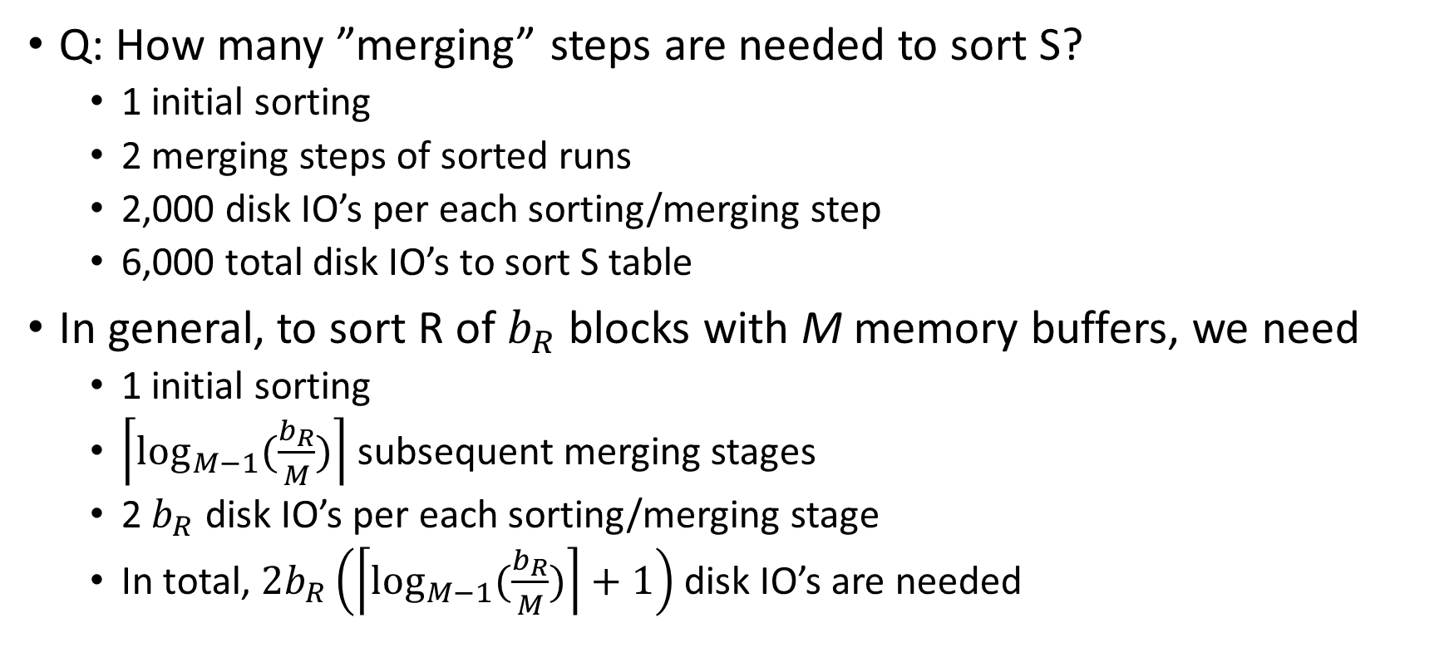
SMJ: Cost of Sorting
Q: How many ”merging” steps are needed to sort S?
1 initial sorting
2 merging steps of sorted runs
2,000 disk IO’s per each sorting/merging step
6,000 total disk IO’s to sort S table
In general, to sort R of $b_{R}$ blocks with M memory buffers, we need
1 initial sorting
$\left\lceil \log_{M−1}(\frac{b_{R}}{M})\right\rceil$ subsequent merging stages
2 $b_{R}$ disk IO’s per each sorting/merging stage
In total, $2b_{R}\left(\left\lceil \log_{M−1}(\frac{b_{R}}{M})\right\rceil +1\right)$ disk IO’s are needed

Slide 46
Cost of Join Algorithms
 | Cost (M=22, $b_{R}$ =100, $b_{S}$=1000) | Formula ($b_{R}<b_{S}$)
NLJ
SMJ
HJ
IJ

Slide 47
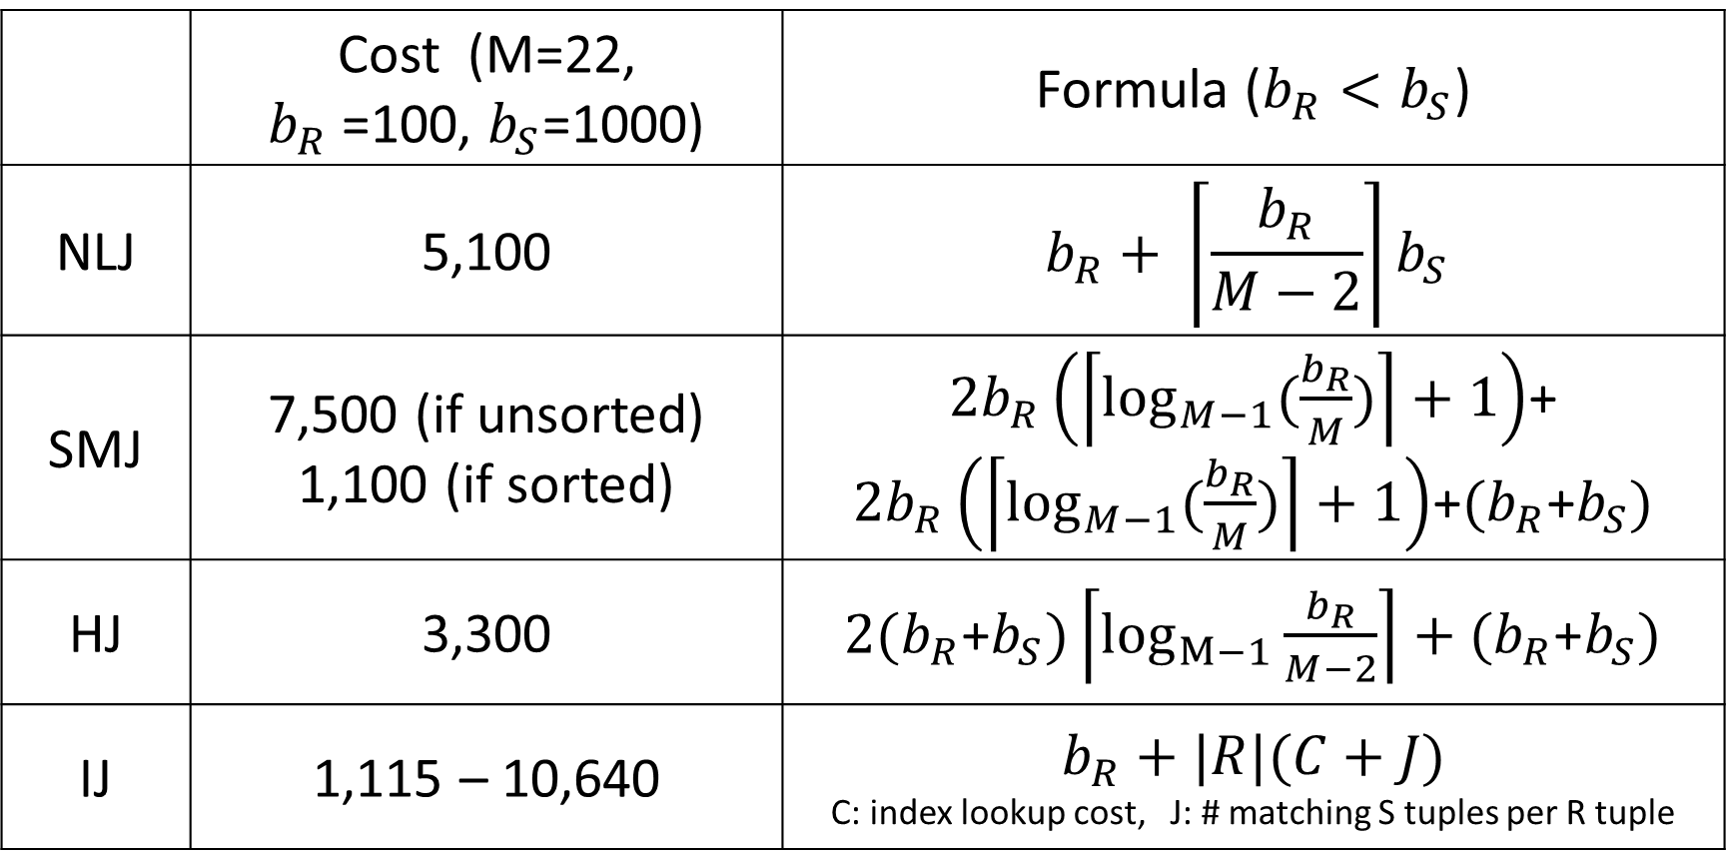
Cost of Join Algorithms
 | Cost (M=22, $b_{R}$ =100, $b_{S}$=1000) | Formula ($b_{R}<b_{S}$)
NLJ | 5,100 | $$b_{R}+ \left\lceil \frac{b_{R}}{M−2}\right\rceil b_{S}$$
SMJ | 7,500 (if unsorted) 1,100 (if sorted) | $2b_{R}\left(\left\lceil \log_{M−1}(\frac{b_{R}}{M})\right\rceil +1\right)$+ $2b_{R}\left(\left\lceil \log_{M−1}(\frac{b_{R}}{M})\right\rceil +1\right)$+${(b}_{R}$+$b_{S})$
HJ | 3,300 | ${2(b}_{R}$+$b_{S})\left\lceil \log_{M−1}{\frac{b_{R}}{M−2}}\right\rceil +{(b}_{R}\text{+}b_{S})$
IJ | 1,115 – 10,640 | $b_{R}+|R|(C+J)$ C: index lookup cost, J: # matching S tuples per R tuple

Slide 48
Summary of Joins
Nested-loop join is OK for “small” relations (relative to memory size)
Hash join is usually the best for equi-join
If tables have not been sorted and with no index
Consider merge join if tables have been sorted
Consider index join if index exists
To pick the best, DBMS needs to maintain data statistics

Slide 49












Query Optimization
R(A, B) S(B,C) T (C,D): SELECT * FROM R, S, T WHERE R.B = S.B AND S.C = T.C AND R.A = 10 and T.D < 30
Q: How can we process the above query?
$$σ_{T.D<30}$$
$$σ_{R.A=10}$$
$$σ_{R.A=10}$$
$$⋈$$
$$⋈$$
$$⋈$$
$$⋈$$
$$σ_{R.A=10}$$
$$⋈$$
$$⋈$$
$$σ_{T.D<30}$$
$$σ_{T.D<30}$$
R
S
T
T
S
R
R
S
T

Slide 50

Query Optimization
Q: Focusing on just $R⋈S⋈T$, how many different ways?
In general, for $n$ way joins, $\frac{\left(2\left(n−1\right)\right)!}{\left(n−1\right)!}$ ways
For $n=10$, $\frac{18!}{9!}=17×{10}^{9}$ different ways!!!

Slide 51
Query Optimization
In reality, picking the very best is too difficult
DBMS tries to avoid “obvious mistakes” using a number of heuristics to examine only those plans that are likely to be good
Put the smallest table on the left
“Left-deep” tree
Push selection as deep as possible
…
For 90% of queries, DBMS picks a good query execution plan
To optimize the remaining 10%, companies pay big money to database consultants

Slide 52
Statistics Collection for DBMS
“Cost-based optimizer”:
DBMS uses statistics on tables/indexes to pick the best query execution plan
Keeping correct stats is *very important.* Without correct stats, DBMS may do stupid things
Oracle
ANALYZE TABLE <table> COMPUTE STATISTCS
ANALYZE TABLE <table> ESTIMATE STATISTICS ---- cheaper than COMPUTE
DB2
RUN ON TABLE <userid>.<table> AND INDEXES ALL
MySQL does not have a cost-based optimizer
Rule-based optimizer: Use simple heuristics only without looking at the actual data

