Slide 1
CS143 Normalization
Professor Junghoo “John” Cho

Slide 2
Relational Design Theory
How do we design “good” tables for a relational database?
Typically, we start with E/R or UML and convert it into tables
Still, there are many choices to make in E/R (or UML) that lead to different tables. Which one is better? Which design should we choose?
Relational design theory (Normalization theory)
Theory on what are “good” table designs
Tries to minimize “redundancy” in table design
Algorithms that converts “bad” design into “good” design automatically

Slide 3
StudentClass Table
Q: Is this a good table design?
StudentClass
sid | name | addr | dept | cnum | title | unit
301 | James | 11 West | CS | 143 | Database | 04
105 | Elaine | 84 East | EE | 284 | Signal Processing | 03
301 | James | 11 West | ME | 143 | Mechanics | 05
105 | Elaine | 84 East | CS | 143 | Database | 04
207 | Susan | 12 North | EE | 128 | Microelectronics | 03

Slide 4
Redundancies in StudentClass Table
The same information is included multiple times
Redundancy leads to potential “anomalies” down the road
Update anomaly: Information may be updated partially and inconsistently
Q: What if a student changes the address?
Insertion anomaly: We may not include some information at all
Q: What if a student does not take any class?
Deletion anomaly: While deleting some information, we may delete others
Q: What if the only class that a student takes gets cancelled?
sid | name | addr | dept | cnum | title | unit
301 | James | 11 West | CS | 143 | Database | 04
105 | Elaine | 84 East | EE | 284 | Signal Processing | 03
301 | James | 11 West | ME | 143 | Mechanics | 05
105 | Elaine | 84 East | CS | 143 | Database | 04
207 | Susan | 12 North | EE | 128 | Microelectronics | 03

Slide 5
StudentClass Table
Q: Is there a better table design? What table(s) will you use?
StudentClass
sid | name | addr | dept | cnum | title | unit
301 | James | 11 West | CS | 143 | Database | 04
105 | Elaine | 84 East | EE | 284 | Signal Processing | 03
301 | James | 11 West | ME | 143 | Mechanics | 05
105 | Elaine | 84 East | CS | 143 | Database | 04
207 | Susan | 12 North | EE | 128 | Microelectronics | 03

Slide 6
Coming up with Better Tables
Q: Any way to arrive at the better design more systematically?
Q: Where is the redundancy from?
StudentClass
sid | name | addr | dept | cnum | title | unit
301 | James | 11 West | CS | 143 | Database | 04
105 | Elaine | 84 East | EE | 284 | Signal Processing | 03
301 | James | ? | ME | 143 | Mechanics | 05
105 | ? | 84 East | CS | 143 | ? | ?
207 | Susan | 12 North | EE | 128 | Microelectronics | 03

Slide 7
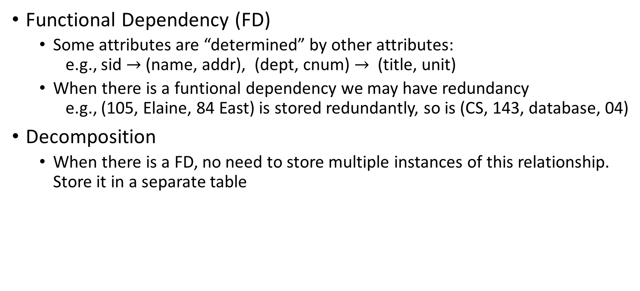
Intuition behind Normalization Theory
Functional Dependency (FD)
Some attributes are “determined” by other attributes: e.g., sid $→$ (name, addr), (dept, cnum) $→$ (title, unit)
When there is a funtional dependency we may have redundancy e.g., (105, Elaine, 84 East) is stored redundantly, so is (CS, 143, database, 04)
Decomposition
When there is a FD, no need to store multiple instances of this relationship. Store it in a separate table
sid | name | addr | dept | cnum | title | unit
301 | James | 11 West | CS | 143 | Database | 04
105 | Elaine | 84 East | EE | 284 | Signal Processing | 03
301 | James | 11 West | ME | 143 | Mechanics | 05
105 | Elaine | 84 East | CS | 143 | Database | 04
207 | Susan | 12 North | EE | 128 | Microelectronics | 03

Slide 8
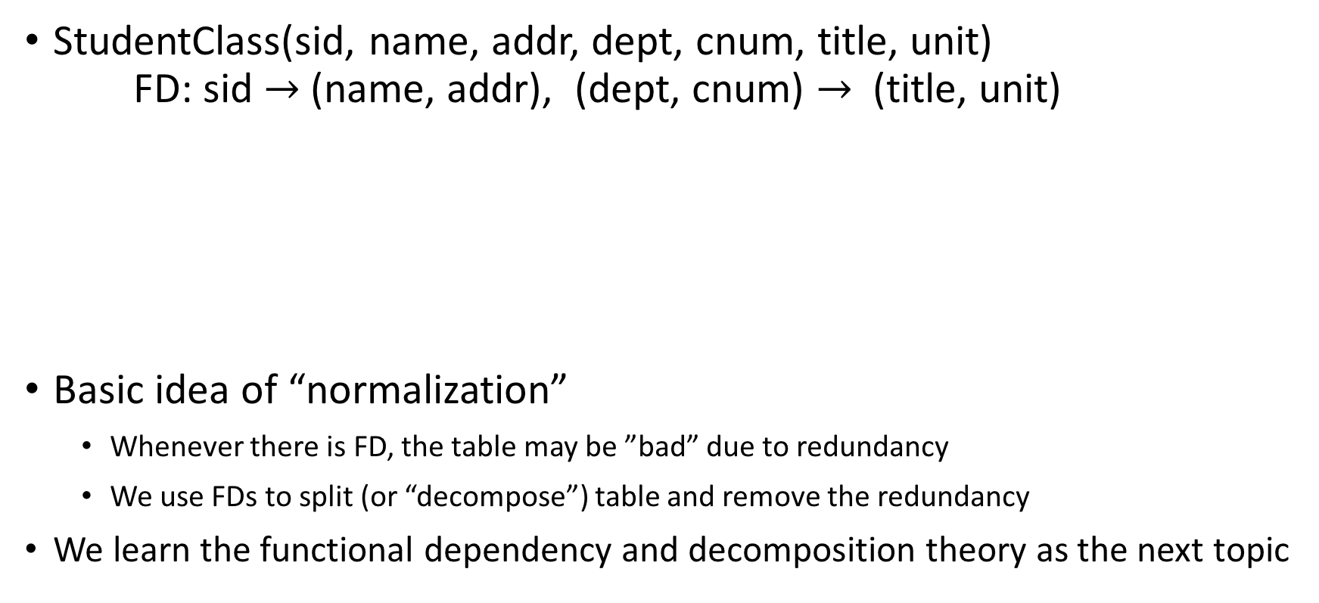
“Decomposing” StudentClass Table
StudentClass(sid, name, addr, dept, cnum, title, unit) FD: sid $→$ (name, addr), (dept, cnum) $→$ (title, unit)
Basic idea of “normalization”
Whenever there is FD, the table may be ”bad” due to redundancy
We use FDs to split (or “decompose”) table and remove the redundancy
We learn the functional dependency and decomposition theory as the next topic

Slide 9
Functional Dependency

Slide 10
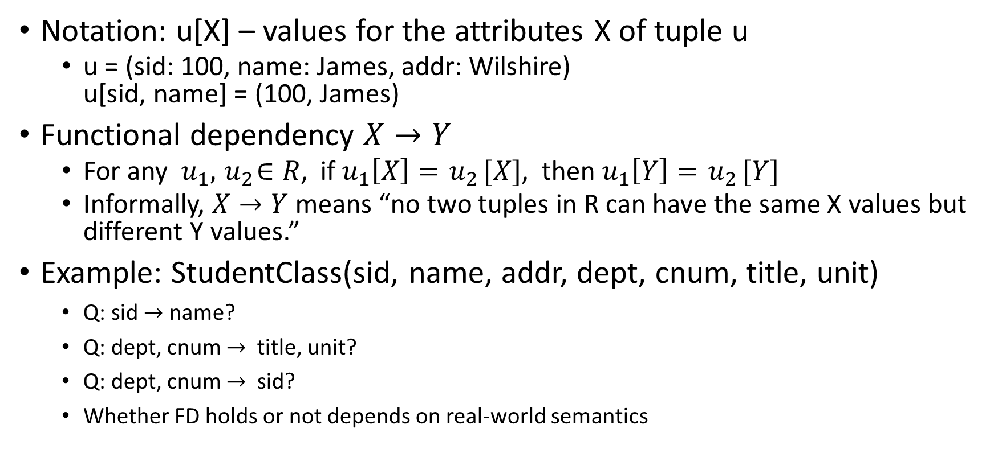
Functional Dependency (FD)
Notation: u[X] – values for the attributes X of tuple u
u = (sid: 100, name: James, addr: Wilshire) u[sid, name] = (100, James)
Functional dependency $X→Y$
For any $u_{1},{ u}_{2}∈R$, if $u_{1}\left[X\right]={ u}_{2}[X]$, then $u_{1}\left[Y\right]={ u}_{2}[Y]$
Informally, $X→Y$ means “no two tuples in R can have the same X values but different Y values.”
Example: StudentClass(sid, name, addr, dept, cnum, title, unit)
Q: sid $→$ name?
Q: dept, cnum $→$ title, unit?
Q: dept, cnum $→$ sid?
Whether FD holds or not depends on real-world semantics

Slide 11
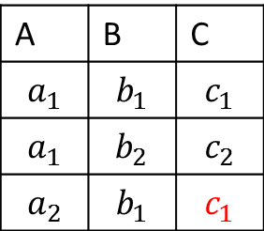
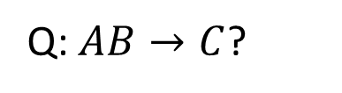
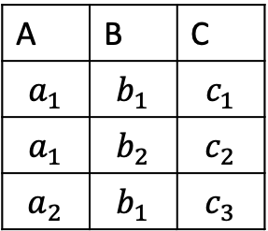
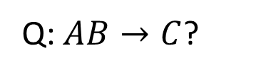
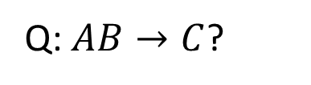
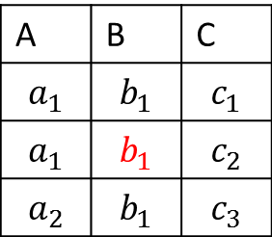
Functional Dependency (FD)
A | B | C
$$a_{1}$$ | $$b_{1}$$ | $$c_{1}$$
$$a_{1}$$ | $$b_{2}$$ | $$c_{2}$$
$$a_{2}$$ | $$b_{1}$$ | $$c_{3}$$
Q: $AB→C$?
A | B | C
$$a_{1}$$ | $$b_{1}$$ | $$c_{1}$$
$$a_{1}$$ | $$b_{2}$$ | $$c_{2}$$
$$a_{2}$$ | $$b_{1}$$ | $$c_{1}$$
Q: $AB→C$?
A | B | C
$$a_{1}$$ | $$b_{1}$$ | $$c_{1}$$
$$a_{1}$$ | $$b_{1}$$ | $$c_{2}$$
$$a_{2}$$ | $$b_{1}$$ | $$c_{3}$$
Q: $AB→C$?

Slide 12
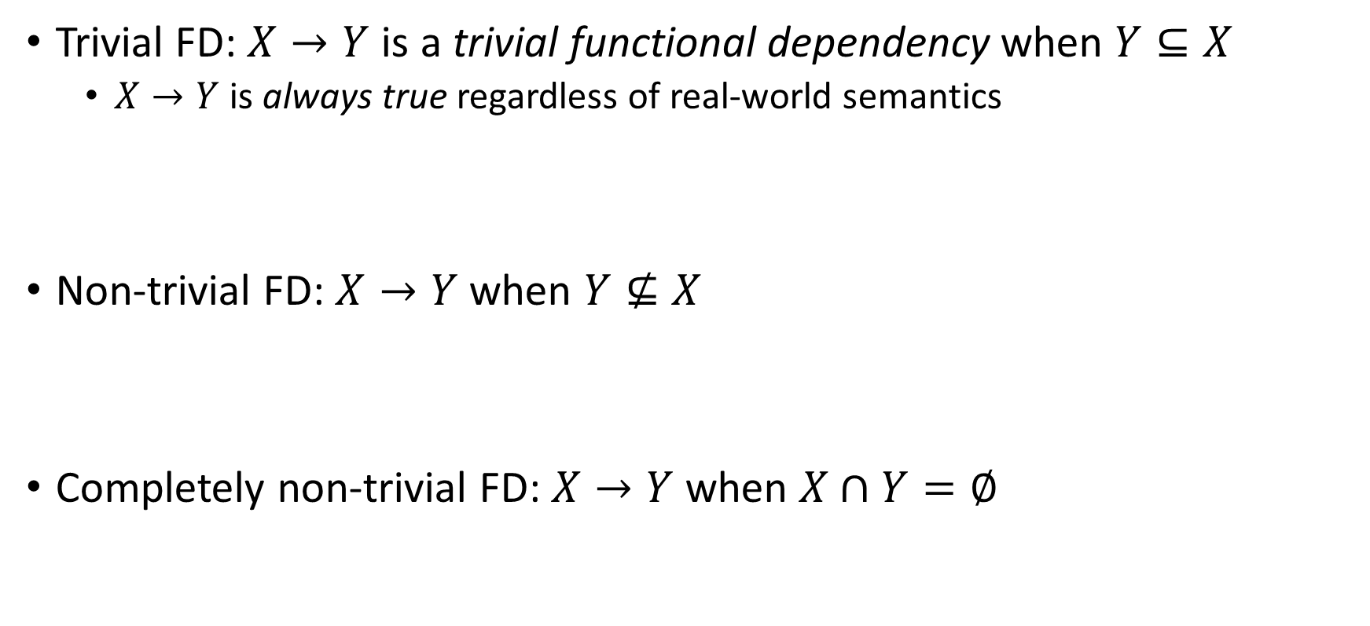
Trivial Functional Dependency
Trivial FD: $X→Y$ is a trivial functional dependency when $Y⊆X$
$X→Y$ is always true regardless of real-world semantics
Non-trivial FD: $X→Y$ when $Y⊈X$
Completely non-trivial FD: $X→Y$ when $X∩Y=∅$
X
Y
X
Y
X
Y

Slide 13
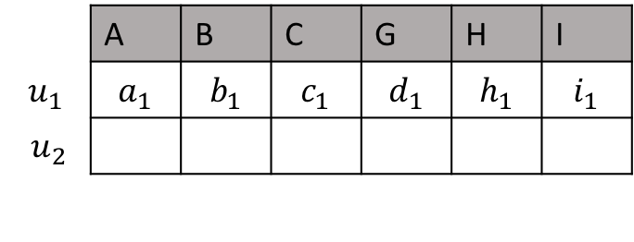

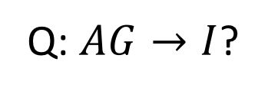
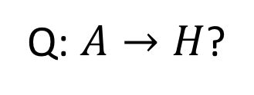

Logical Implication
$R(A, B, C, G, H, I)$ $F=\{A→B$, $A→C$, $CG→H$, $CG→I$, $B→H$} Q: Is $A→H$true given F?
F logically implies $A→H$
Canonical database: a method to check logical implication
 | A | B | C | G | H | I
$$u_{1}$$ | $$a_{1}$$ | $$b_{1}$$ | $$c_{1}$$ | $$d_{1}$$ | $$h_{1}$$ | $$i_{1}$$
$${ u}_{2}$$
Q: $A→H$?
Q: $AG→I$?
 | A | B | C | G | H | I
$$u_{1}$$ | $$a_{1}$$ | $$b_{1}$$ | $$c_{1}$$ | $$d_{1}$$ | $$h_{1}$$ | $$i_{1}$$
$${ u}_{2}$$

Slide 14
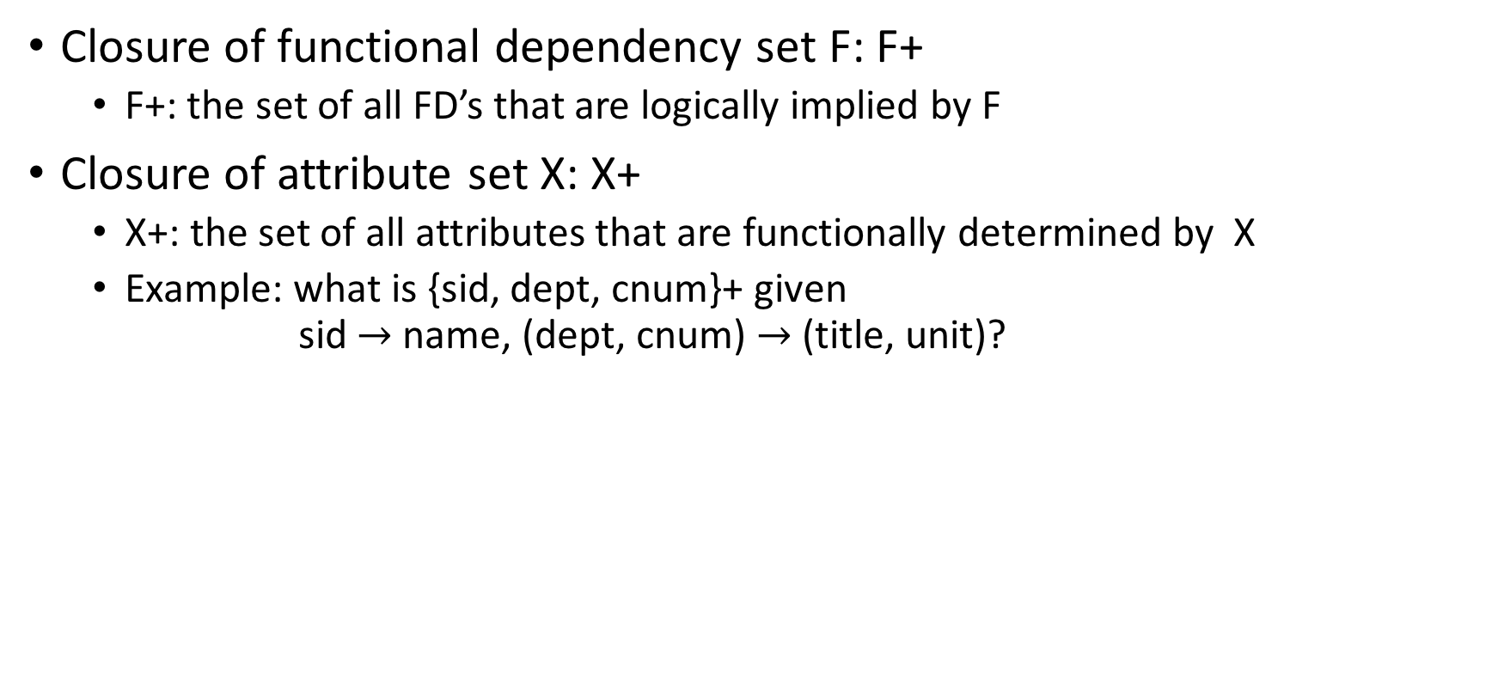
Closure
Closure of functional dependency set F: F+
F+: the set of all FD’s that are logically implied by F
Closure of attribute set X: X+
X+: the set of all attributes that are functionally determined by X
Example: what is {sid, dept, cnum}+ given sid $→$name, (dept, cnum) $→$(title, unit)?

Slide 15

Closure X+ Computation Algorithm
Start with X+ = X
Repeat until no change in X+:
If there is $Y→Z$ with Y ⊂ X+, then X+ $←$ (X+ $∪$Z)

Slide 16

Attribute Closure Example
$R(A, B, C, G, H, I)$ $F=\{A→B$, $A→C$, $CG→H$, $CG→I$, $B→H$}
Q: {A}+?
Q: {A, G}+?

Slide 17
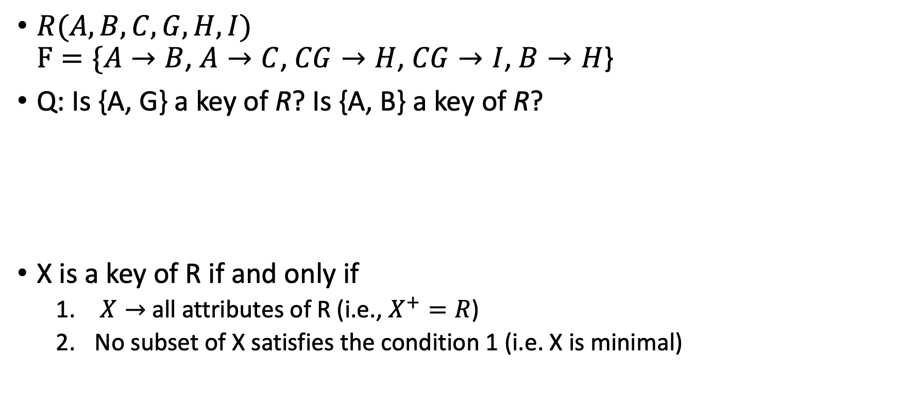
Functional Dependency and Key
$R(A, B, C, G, H, I)$ $F=\{A→B$, $A→C$, $CG→H$, $CG→I$, $B→H$}
Q: Is {A, G} a key of R? Is {A, B} a key of R?
X is a key of R if and only if
$X→$all attributes of R (i.e., $X^{+}=R$)
No subset of X satisfies the condition 1 (i.e. X is minimal)

Slide 18
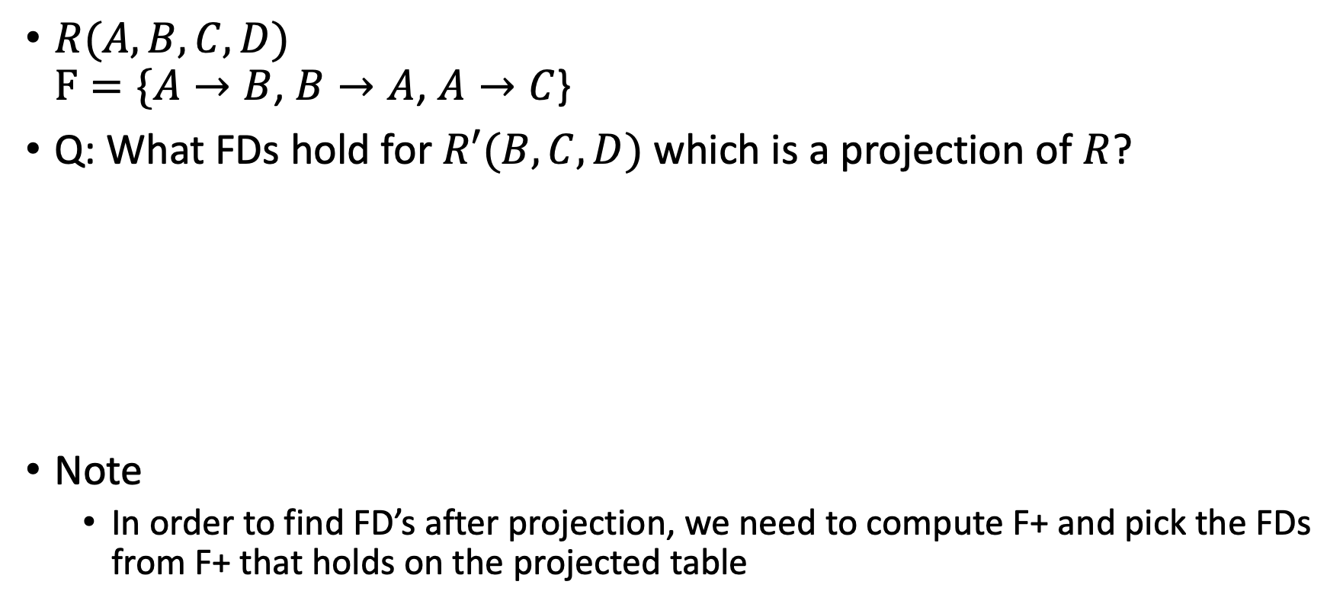
Projecting Functional Dependency
$R(A, B, C, D)$ $F=\{A→B$, $B→A$, $A→C$}
Q: What FDs hold for $R′(B, C, D)$ which is a projection of $R$?
Note
In order to find FD’s after projection, we need to compute F+ and pick the FDs from F+ that holds on the projected table

Slide 19
Decomposition

Slide 20
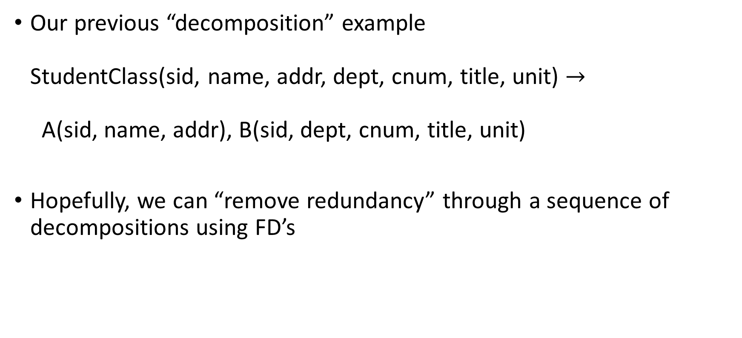
Decomposition
Our previous “decomposition” example StudentClass(sid, name, addr, dept, cnum, title, unit) $→$ A(sid, name, addr), B(sid, dept, cnum, title, unit)
Hopefully, we can “remove redundancy” through a sequence of decompositions using FD’s

Slide 21











General Decomposition
Split $R(A_{1}, …, A_{n})$ $→$ $R_{1}\left(A_{1}, …, A_{i}\right)$, $R_{2}\left(A_{j}, …, A_{n}\right)$ $\left\{A_{1},…, A_{n}\right\}= \left\{A_{1},…, A_{i}\right\} ∪ \left\{A_{j}, …, A_{n}\right\}$
$$R( )$$
$$X$$
$$Y$$
$$Z$$
$$X$$
$$Y$$
$$R_{1}( )$$
$$Y$$
$$Z$$
$$R_{2}( )$$

Slide 22
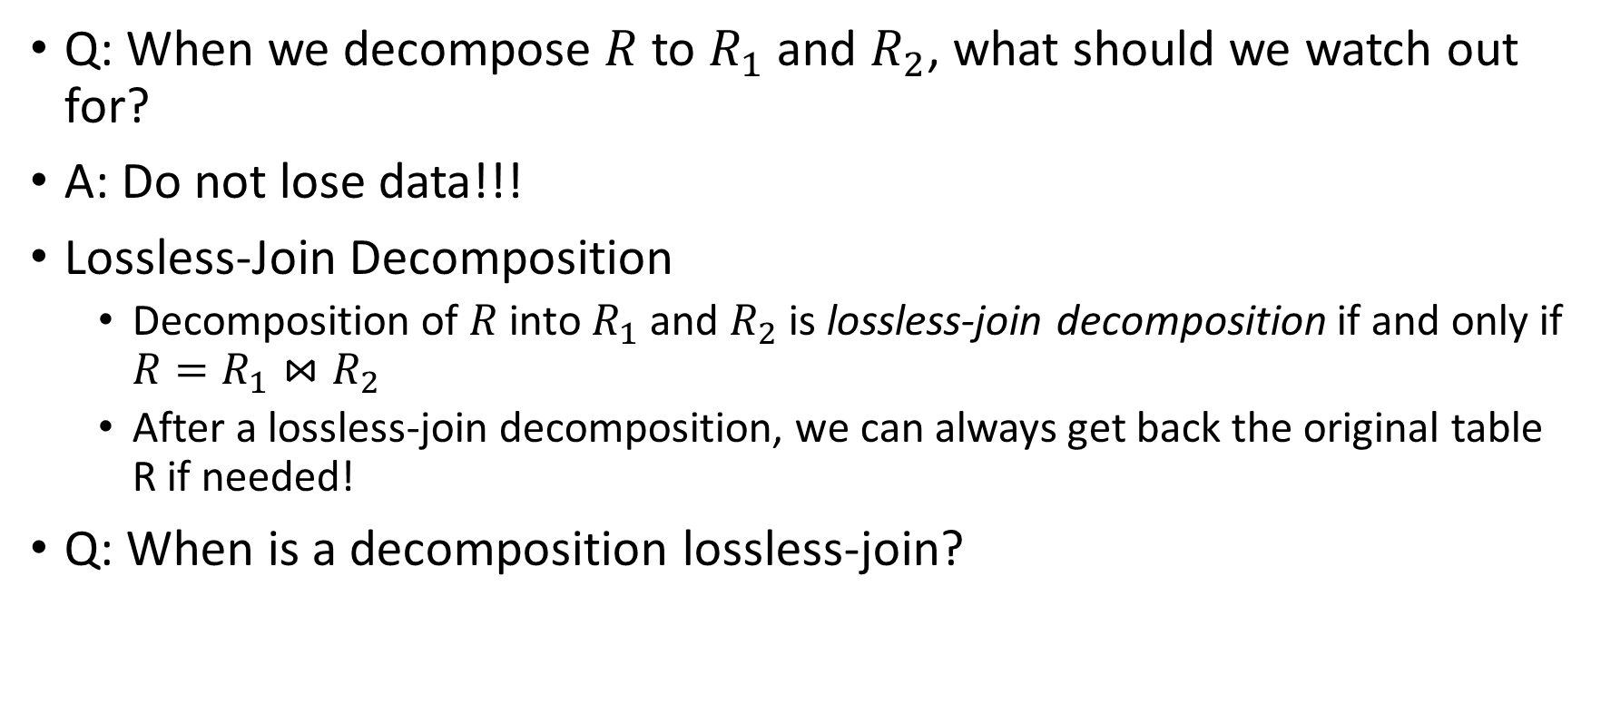
Lossless Decomposition
Q: When we decompose $R$ to $R_{1}$and $R_{2}$, what should we watch out for?
A: Do not lose data!!!
Lossless-Join Decomposition
Decomposition of $R$ into $R_{1}$ and $R_{2}$ is lossless-join decomposition if and only if ${R=R}_{1}{⋈R}_{2}$
After a lossless-join decomposition, we can always get back the original table R if needed!
Q: When is a decomposition lossless-join?

Slide 23
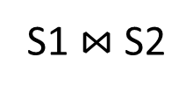
Lossless-Join Decomposition
cnum | sid | name
143 | 1 | James
143 | 2 | Elaine
325 | 3 | Susan
Q: Decompositoin into S1(cnum, sid), S2(cnum, name). Lossless?
S1 $⋈$S2
S1
S2
cnum | sid
143 | 1
143 | 2
325 | 3
cnum | name
143 | James
143 | Elaine
325 | Susan
cnum | sid | name
143 | 1 | James
143 | 1 | Elaine
143 | 2 | James
143 | 2 | Elaine
325 | 3 | Susan

Slide 24
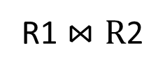
Lossless-Join Decomposition
cnum | sid | name
143 | 1 | James
143 | 2 | Elaine
325 | 3 | Susan
Q: Decompositoin into R1(cnum, sid), R2(sid, name). Lossless?
R1 $⋈R$2
R1
R2
cnum | sid
143 | 1
143 | 2
325 | 3
sid | name
1 | James
2 | Elaine
3 | Susan
cnum | sid | name
143 | 1 | James
143 | 2 | Elaine
325 | 3 | Susan

Slide 25
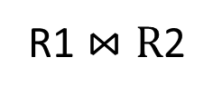
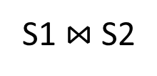
Lossless-Join Decomposition
Q: Why is S1(cnum, sid), S2(cnum, name) lossy, but R1(cnum, sid), R2(sid, name) is not?
S1
S2
R1
R2
cnum | sid
143 | 1
143 | 2
325 | 3
cnum | name
143 | James
143 | Elaine
325 | Susan
cnum | sid
143 | 1
143 | 2
325 | 3
sid | name
1 | James
2 | Elaine
3 | Susan
cnum | sid | name
143 | 1 | James
143 | 1 | Elaine
143 | 2 | James
143 | 2 | Elaine
325 | 3 | Susan
cnum | sid | name
143 | 1 | James
143 | 2 | Elaine
325 | 3 | Susan
S1 $⋈$S2
R1 $⋈R$2

Slide 26
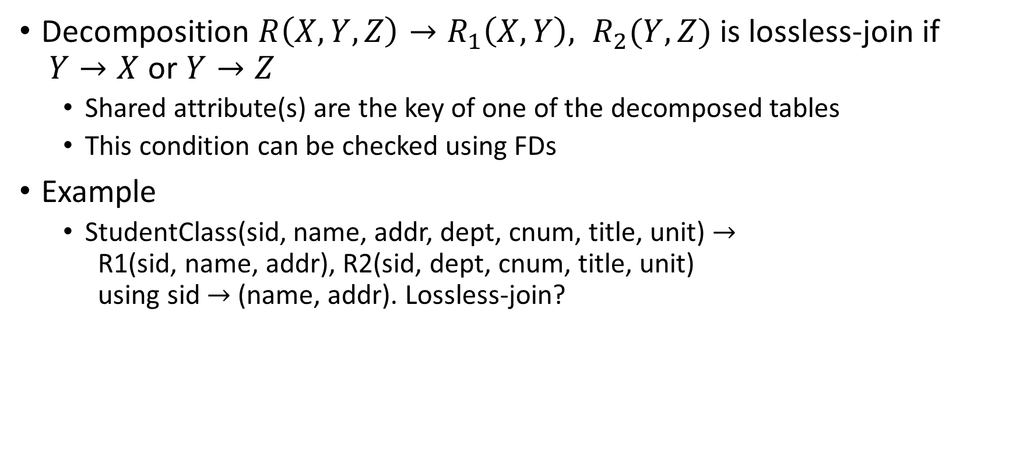
Lossless-Join Decomposition
Decomposition $R\left(X,Y,Z\right)→R_{1}\left(X, Y\right), R_{2}(Y, Z)$ is lossless-join if $Y→X$ or $Y→Z$
Shared attribute(s) are the key of one of the decomposed tables
This condition can be checked using FDs
Example
StudentClass(sid, name, addr, dept, cnum, title, unit) $→$ R1(sid, name, addr), R2(sid, dept, cnum, title, unit) using sid $→$ (name, addr). Lossless-join?

Slide 27
Boyce-Codd Normal Form

Slide 28
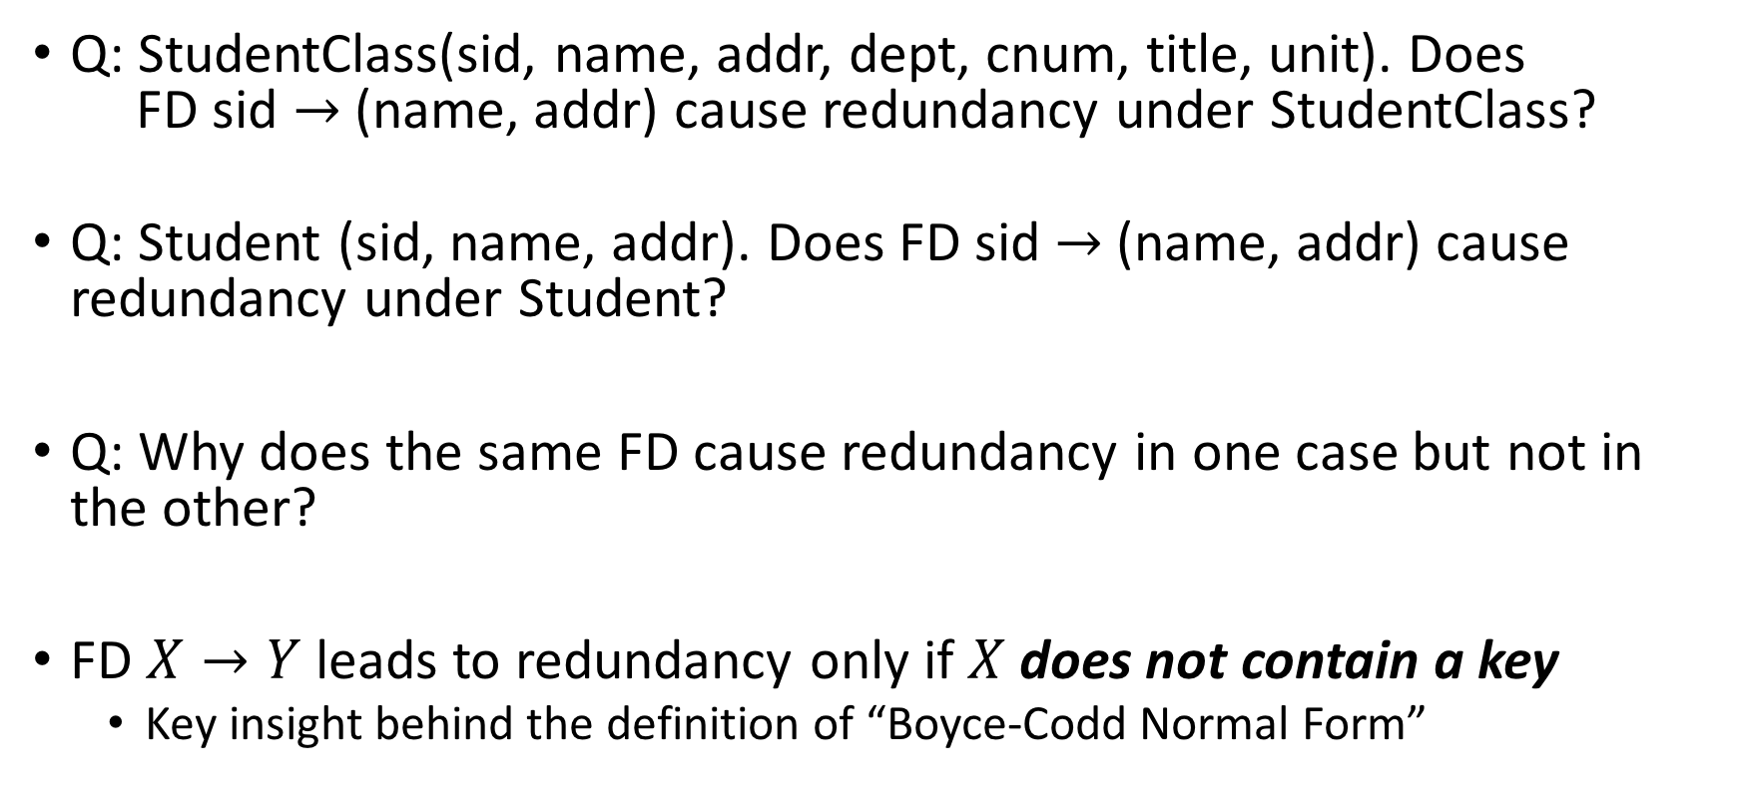
FD, Key, and Redundancy
Q: StudentClass(sid, name, addr, dept, cnum, title, unit). Does FD sid $→$(name, addr) cause redundancy under StudentClass?
Q: Student (sid, name, addr). Does FD sid $→$(name, addr) cause redundancy under Student?
Q: Why does the same FD cause redundancy in one case but not in the other?
FD $X→Y$ leads to redundancy only if $X$does not contain a key
Key insight behind the definition of “Boyce-Codd Normal Form”

Slide 29
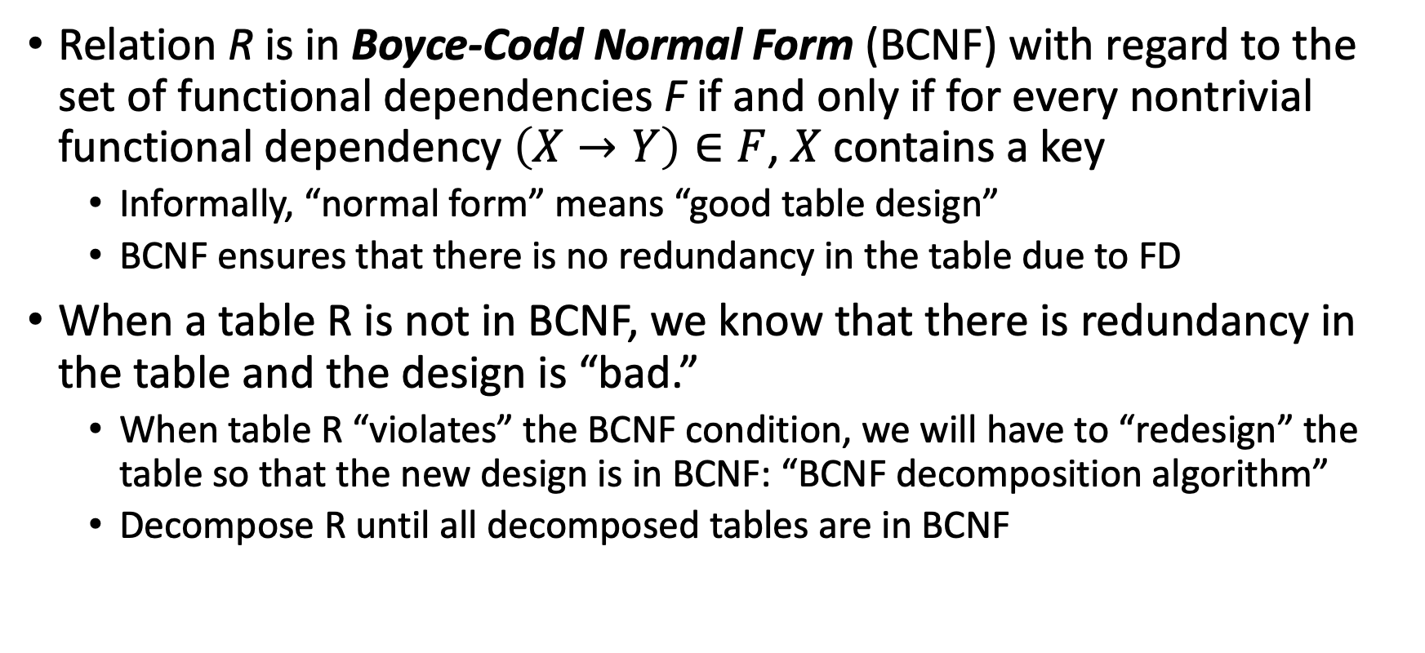
Boyce-Codd Normal Form (BCNF)
Relation R is in Boyce-Codd Normal Form (BCNF) with regard to the set of functional dependencies F if and only if for every nontrivial functional dependency $\left(X→Y\right)∈F$, $X$ contains a key
Informally, “normal form” means “good table design”
BCNF ensures that there is no redundancy in the table due to FD
When a table R is not in BCNF, we know that there is redundancy in the table and the design is “bad.”
When table R “violates” the BCNF condition, we will have to “redesign” the table so that the new design is in BCNF: “BCNF decomposition algorithm”
Decompose R until all decomposed tables are in BCNF

Slide 30

BCNF Example (1)
Class(dept, cnum, title, unit). FD (dept,cnum) $→$ (title, unit)
Q: Intuitively, is it a good table design? Any redundancy? Any better design?
Q: Is it in BCNF?

Slide 31
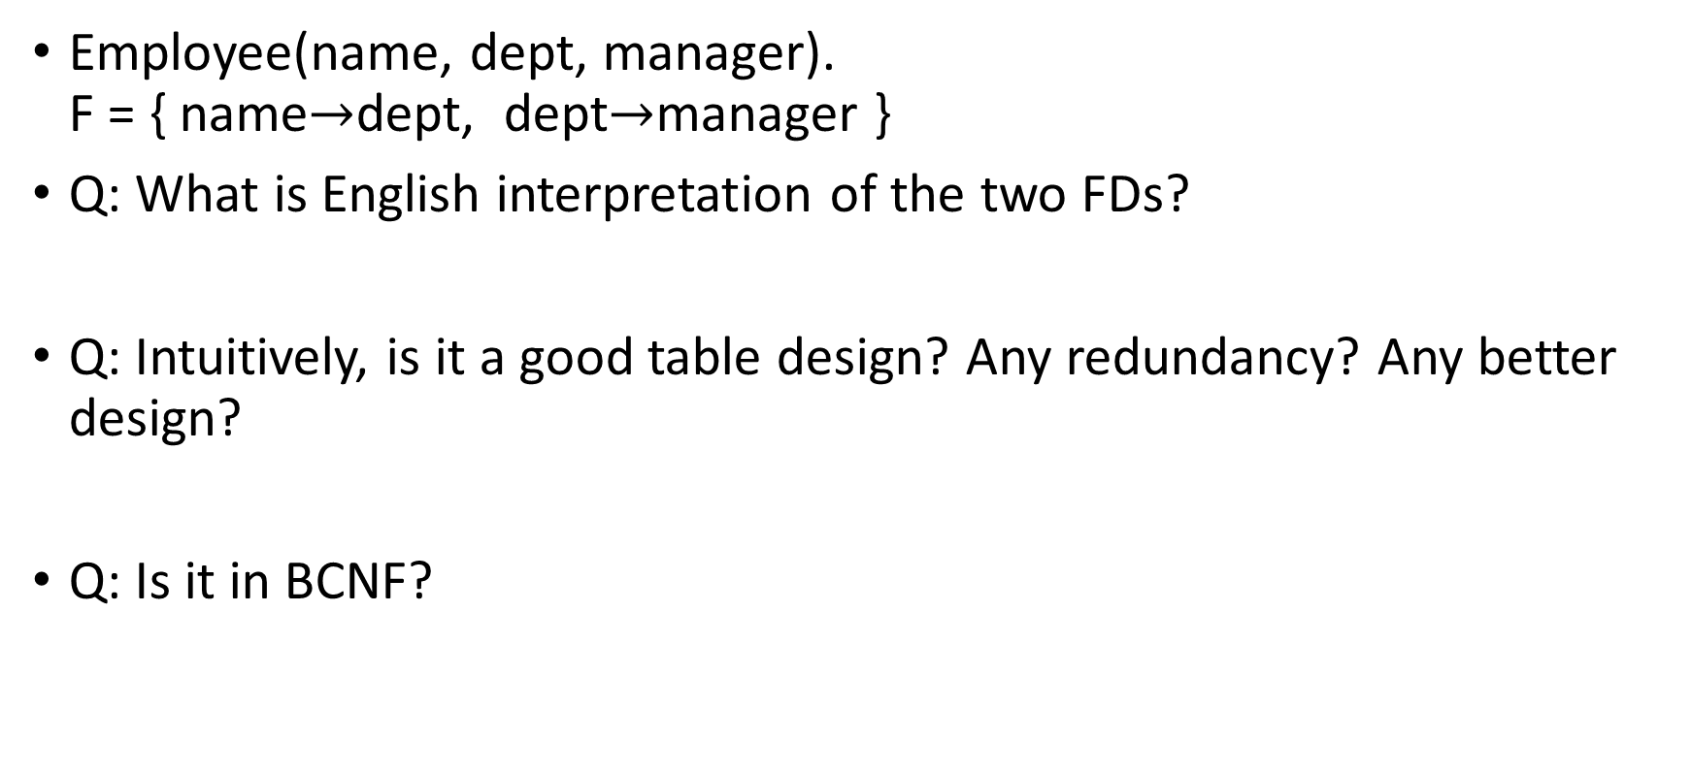
BCNF Example (2)
Employee(name, dept, manager). F = { name$→$dept, dept$→$manager }
Q: What is English interpretation of the two FDs?
Q: Intuitively, is it a good table design? Any redundancy? Any better design?
Q: Is it in BCNF?

Slide 32

BCNF Violation and Table Decomposition
Decompose tables until all tables are in BCNF
For each FD $X→Y$ that violates BCNF condition, separate those attributes out into another table to remove redundancy
We also have to ensure that this decomposition is lossless

Slide 33
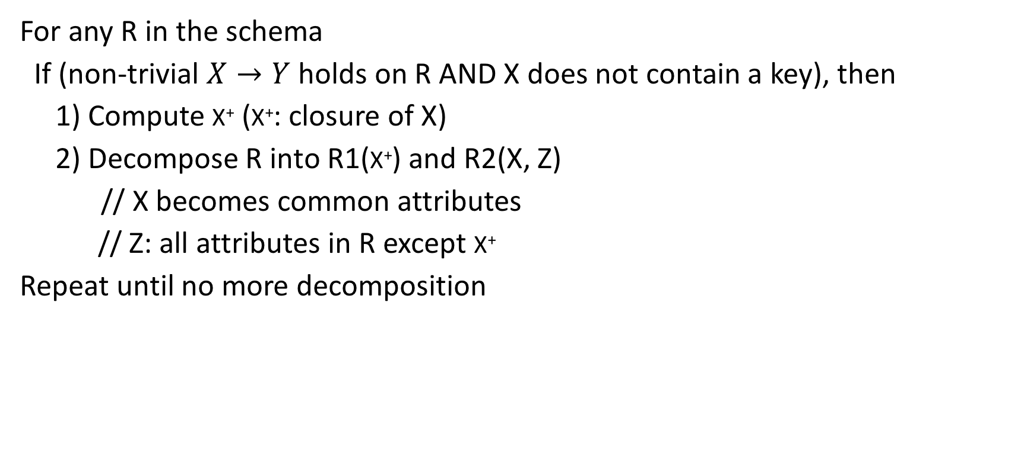
BCNF Decomposition Algorithm
For any R in the schema
If (non-trivial $X→Y$holds on R AND X does not contain a key), then
1) Compute X⁺ (X⁺: closure of X)
2) Decompose R into R1(X⁺) and R2(X, Z)
// X becomes common attributes
// Z: all attributes in R except X⁺
Repeat until no more decomposition

Slide 34
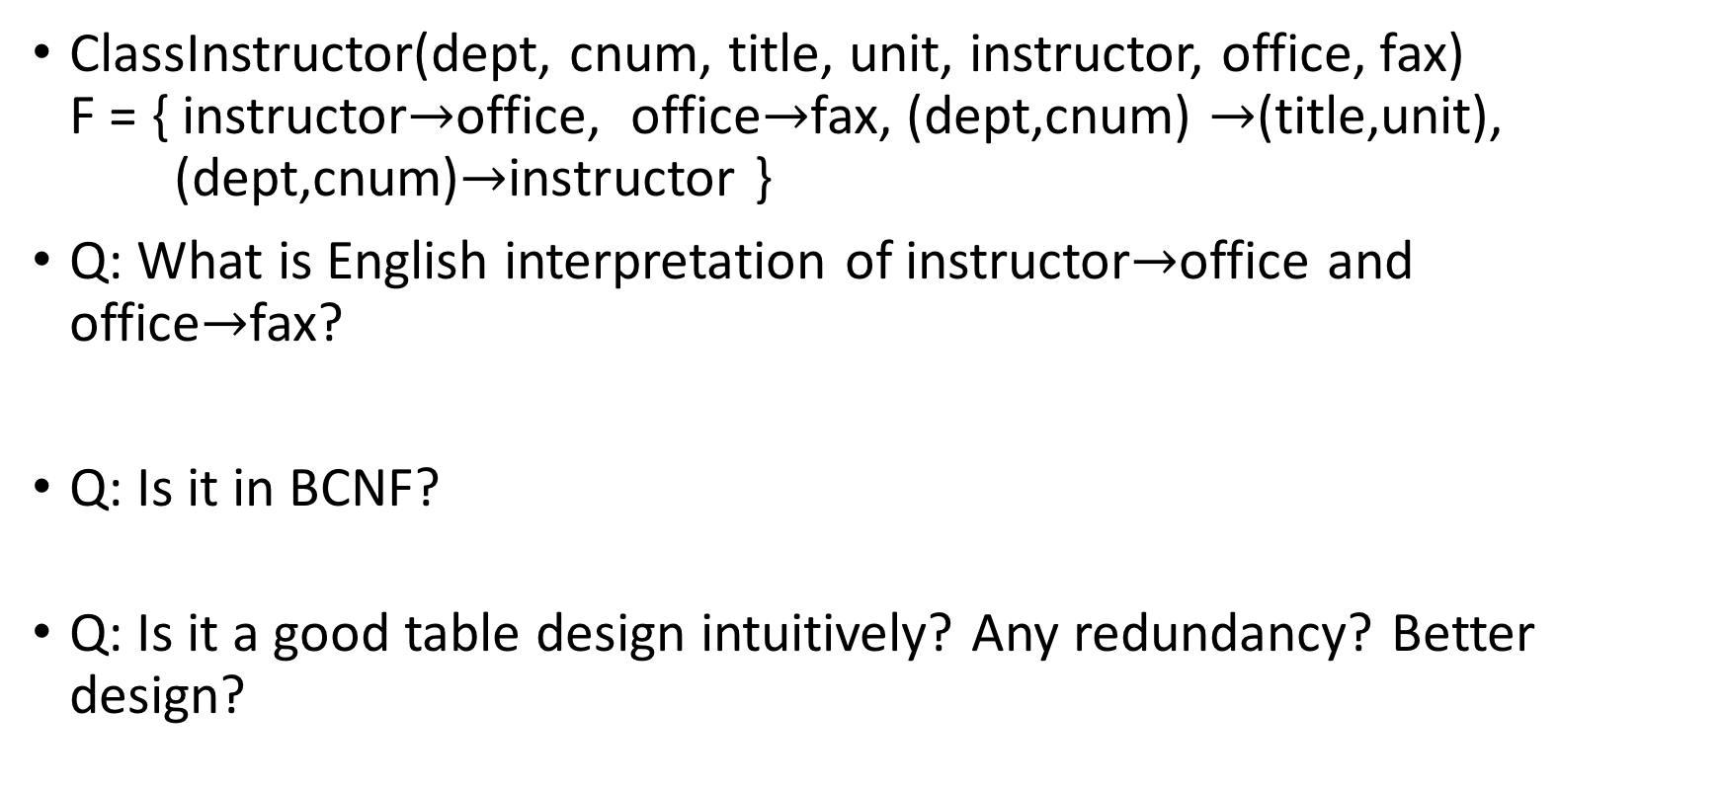
BCNF Decomposition Example (1)
ClassInstructor(dept, cnum, title, unit, instructor, office, fax) F = { instructor$→$office, office$→$fax, (dept,cnum) $→$(title,unit), (dept,cnum)$→$instructor }
Q: What is English interpretation of instructor$→$office and office$→$fax?
Q: Is it in BCNF?
Q: Is it a good table design intuitively? Any redundancy? Better design?

Slide 35

BCNF Decomposition Example (1)
ClassInstructor(dept, cnum, title, unit, instructor, office, fax) F = { instructor$→$office, office$→$fax, (dept,cnum) $→$(title,unit), (dept,cnum)$→$instructor }
Normalize ClassInstructor into BCNF using the BCNF decomposition algorithm:

Slide 36

BCNF Decomposition Example (2)
$R(A, B, C, G, H, I)$ $F=\{A→B$, $A→C$, $CG→H$, $CG→I$, $B→H$}
Q: Is it in BCNF?
Normalize R into BCNF

Slide 37
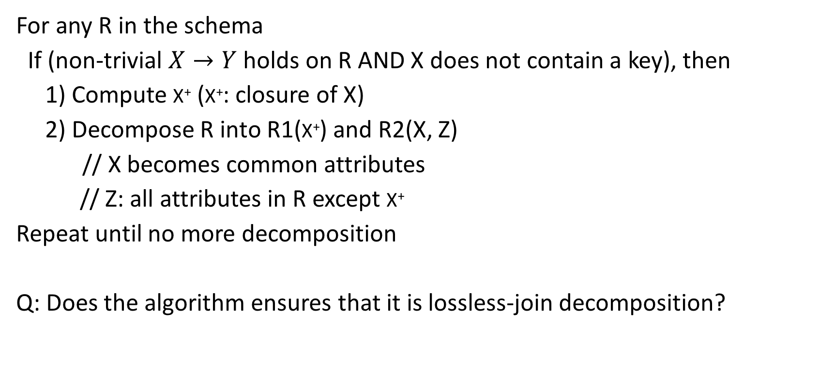
Revisiting BCNF Decomposition Algorithm
For any R in the schema
If (non-trivial $X→Y$holds on R AND X does not contain a key), then
1) Compute X⁺ (X⁺: closure of X)
2) Decompose R into R1(X⁺) and R2(X, Z)
// X becomes common attributes
// Z: all attributes in R except X⁺
Repeat until no more decomposition
Q: Does the algorithm ensures that it is lossless-join decomposition?

Slide 38
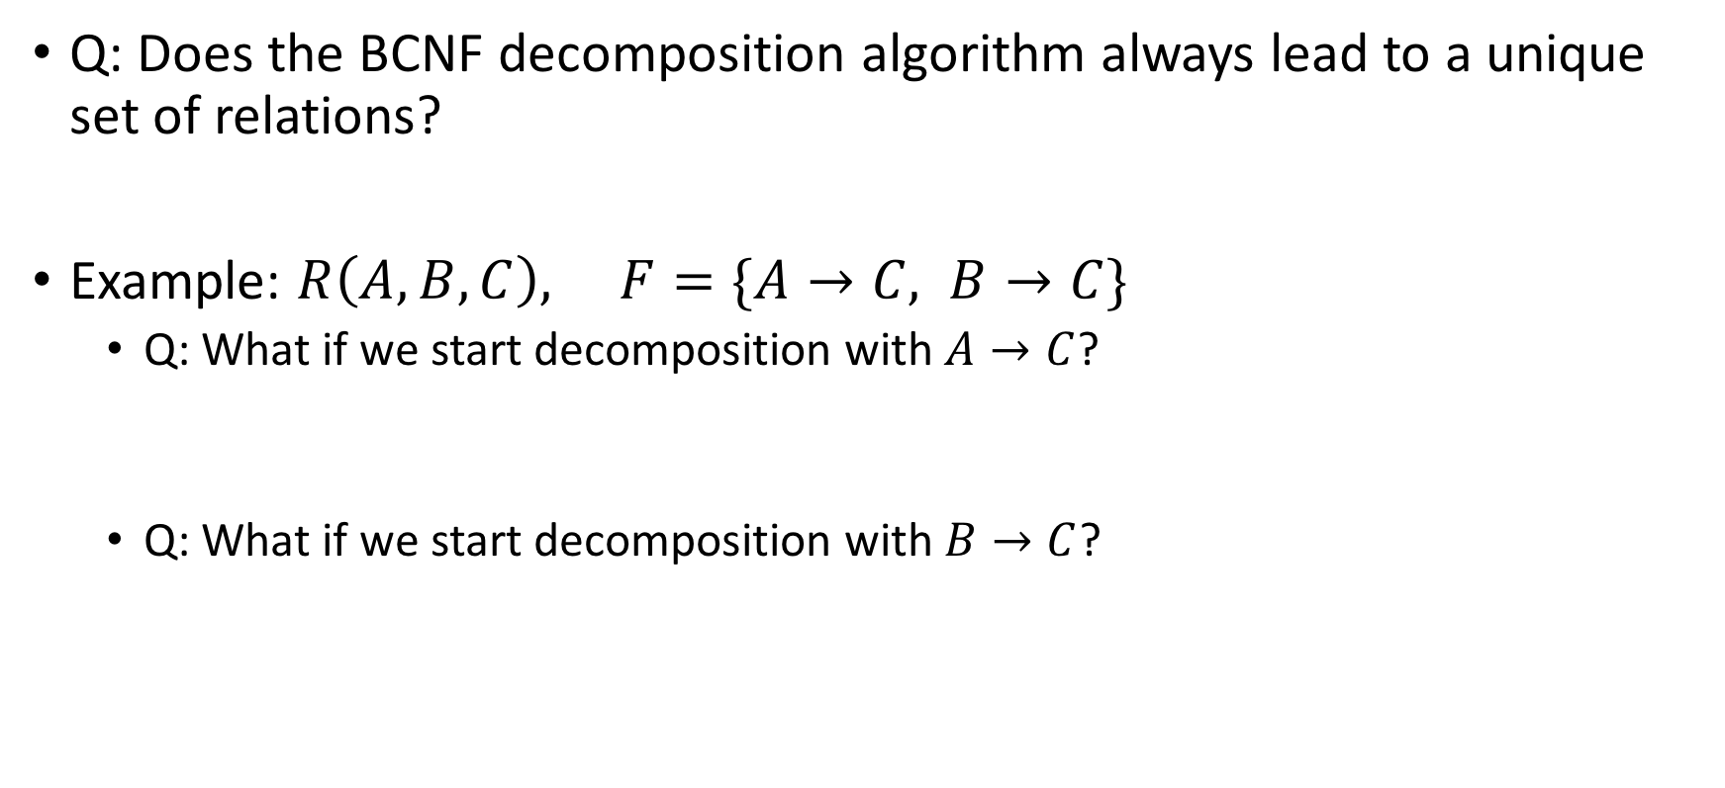
Uniqueness of BCNF Decomposition
Q: Does the BCNF decomposition algorithm always lead to a unique set of relations?
Example: $R\left(A, B, C\right), F=\{A→C, B→C\}$
Q: What if we start decomposition with $A→C$?
Q: What if we start decomposition with $B→C$?

Slide 39
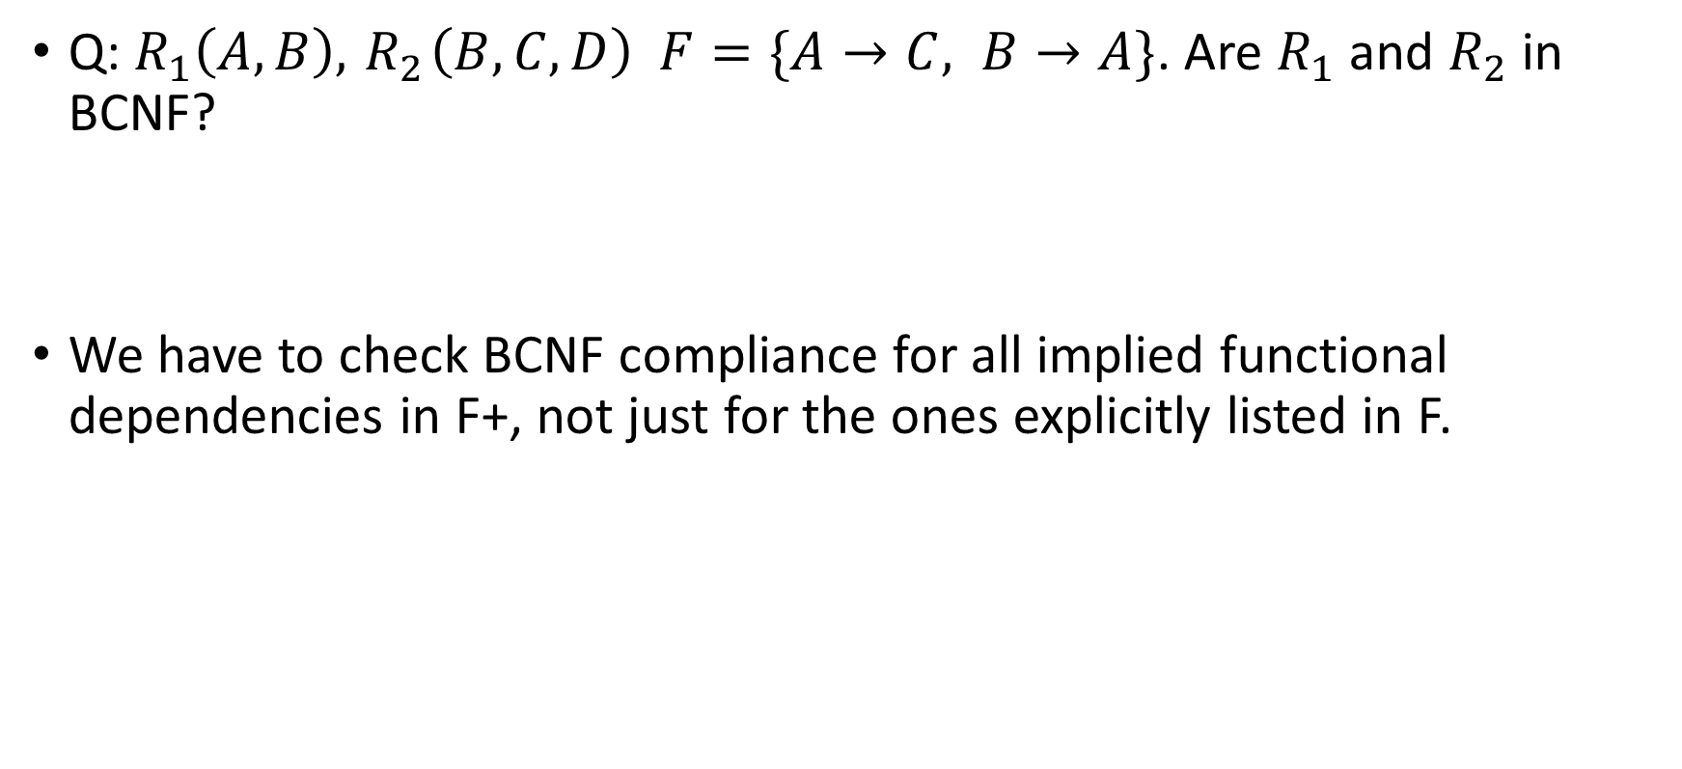
Checking BCNF Condition
Q: $R_{1}\left(A, B\right), { R}_{2}\left(B, C, D\right) F=\{A→C, B→A\}$. Are $R_{1}$ and $R_{2}$ in BCNF?
We have to check BCNF compliance for all implied functional dependencies in F+, not just for the ones explicitly listed in F.

Slide 40
Good Table Design in Practice
Normalization splits tables to reduce redundancy.
However, splitting tables has negative performance implication
Example: Instructor: name, office, phone, fax name → office, office → (phone,fax)
(design 1) Instructor(name, office, phone, fax)
(design 2) Instructor(name, office), Office(offce, phone, fax)
Q: Retrieve (name, office, phone) from Instructor. Which design is better?
As a rule of thumb, start with normalized tables and merge them if performance is not good enough

Slide 41
What We Learned
Relational design theory
Functional dependency
Trivial functional dependency
Logical implication
Closure
Decomposition
Lossless-join decomposition
Boyce-Codd Normal Form (BCNF)

Slide 42
Thank You!
We hope you learned something useful from this class
Let us know if you have any questions or feedback

