Slide 1
CS143 SQL (1)
Professor Junghoo “John” Cho

Slide 2
SQL (Structured Query Language)
The query language for RDBMS
SQL has many aspects
DDL, DML, transactions, …
In this lecture, we learn DML part of SQL
How to query and modify existing database
SQL and DBMS
SQL is a high-level description of what a user wants
Given SQL query, DBMS figures out how best to execute it automatically
Beauty and success of DBMS

Slide 3
Example Database: School Information
Student(sid, name, addr, age, GPA)
Class(dept, cnum, sec, unit, title, instructor)
sid | name | addr | age | GPA
301 | Andy | 183 Westwood | 19 | 2.1
303 | Elaine | 301 Wilshire | 17 | 3.9
401 | James | 183 Westwood | 17 | 3.5
208 | Esther | 421 Wilshire | 20 | 3.1
dept | cnum | sec | unit | title | instructor
CS | 112 | 01 | 03 | Modeling | Dick Muntz
CS | 143 | 01 | 04 | DB Systems | John Cho
EE | 143 | 01 | 03 | Signal | Dick Muntz
ME | 183 | 02 | 05 | Mechanics | Susan Tracey
Enroll(sid, dept, cnum, sec)
sid | dept | cnum | sec
301 | CS | 112 | 01
301 | CS | 143 | 01
303 | EE | 143 | 01
303 | CS | 112 | 01
401 | CS | 112 | 01

Slide 4
Q1: Titles and instructors of all CS classes
Student(sid, name, addr, age, GPA)
Class(dept, cnum, sec, unit, title, instructor)
sid | name | addr | age | GPA
301 | Andy | 183 Westwood | 19 | 2.1
303 | Elaine | 301 Wilshire | 17 | 3.9
401 | James | 183 Westwood | 17 | 3.5
208 | Esther | 421 Wilshire | 20 | 3.1
dept | cnum | sec | unit | title | instructor
CS | 112 | 01 | 03 | Modeling | Dick Muntz
CS | 143 | 01 | 04 | DB Systems | John Cho
EE | 143 | 01 | 03 | Signal | Dick Muntz
ME | 183 | 02 | 05 | Mechanics | Susan Tracey
Enroll(sid, dept, cnum, sec)
sid | dept | cnum | sec
301 | CS | 112 | 01
301 | CS | 143 | 01
303 | EE | 143 | 01
303 | CS | 112 | 01
401 | CS | 112 | 01

Slide 5
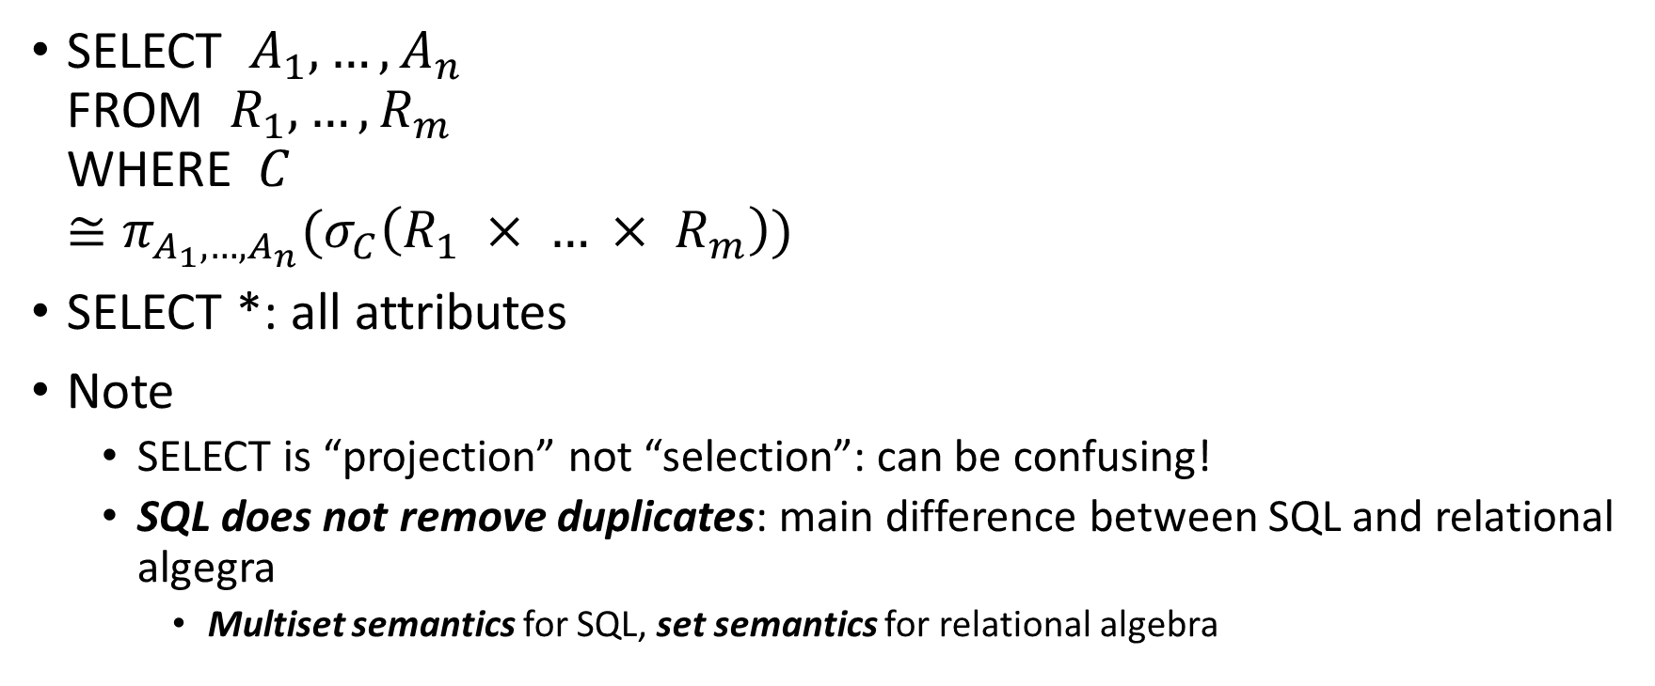
Basic SQL SELECT statement
SELECT $A_{1}, …, A_{n}$ FROM ${ R}_{1}, …, R_{m}$ WHERE $C$ $≅π_{A_{1},…,A_{n}}(σ_{C}\left(R_{1} × … × R_{m}\right))$
SELECT *: all attributes
Note
SELECT is “projection” not “selection”: can be confusing!
SQL does not remove duplicates: main difference between SQL and relational algegra
Multiset semantics for SQL, set semantics for relational algebra

Slide 6
Q2: Names and GPAs of all students who take CS class(es)
Student(sid, name, addr, age, GPA)
Class(dept, cnum, sec, unit, title, instructor)
sid | name | addr | age | GPA
301 | Andy | 183 Westwood | 19 | 2.1
303 | Elaine | 301 Wilshire | 17 | 3.9
401 | James | 183 Westwood | 17 | 3.5
208 | Esther | 421 Wilshire | 20 | 3.1
dept | cnum | sec | unit | title | instructor
CS | 112 | 01 | 03 | Modeling | Dick Muntz
CS | 143 | 01 | 04 | DB Systems | John Cho
EE | 143 | 01 | 03 | Signal | Dick Muntz
ME | 183 | 02 | 05 | Mechanics | Susan Tracey
Enroll(sid, dept, cnum, sec)
sid | dept | cnum | sec
301 | CS | 112 | 01
301 | CS | 143 | 01
303 | EE | 143 | 01
303 | CS | 112 | 01
401 | CS | 112 | 01

Slide 7
More on Q2
SELECT name, GPA FROM Student S, Enroll E WHERE S.sid = E.sid AND dept=‘CS’
S, E: tuple variable
“renaming operator” in relational algebra
S and E are “variables” that bind to every tuple pair from Student and Enroll
Attributes can be renamed
GPA (AS) grade
DISTINCT: remove duplicates in the result

Slide 8
Q3: All student names and GPAs who live on Wilshire
Student(sid, name, addr, age, GPA)
Class(dept, cnum, sec, unit, title, instructor)
sid | name | addr | age | GPA
301 | Andy | 183 Westwood | 19 | 2.1
303 | Elaine | 301 Wilshire | 17 | 3.9
401 | James | 183 Westwood | 17 | 3.5
208 | Esther | 421 Wilshire | 20 | 3.1
dept | cnum | sec | unit | title | instructor
CS | 112 | 01 | 03 | Modeling | Dick Muntz
CS | 143 | 01 | 04 | DB Systems | John Cho
EE | 143 | 01 | 03 | Signal | Dick Muntz
ME | 183 | 02 | 05 | Mechanics | Susan Tracey
Enroll(sid, dept, cnum, sec)
sid | dept | cnum | sec
301 | CS | 112 | 01
301 | CS | 143 | 01
303 | EE | 143 | 01
303 | CS | 112 | 01
401 | CS | 112 | 01

Slide 9
More on Q3
%: any length string (0 - ∞) _: one character ‘%Wilshire%’: any string containing Wilshire
Q: What does ‘_ _ _%’ mean?
Common string functions exist
UPPER(), LOWER(), CONCAT(), …

Slide 10
Set Operators
SQL Set operators: UNION, INTERSECT, EXCEPT
Can be applied to relations or to the result of SELECT statements
Schemas of input relations should be the same
In practice, just having the compatible types is fine
Set operators follow set semantics and remove duplicates
Most people do now know “multiset” semantic of set operators
No efficiency penalty for duplicate eliminate for set operation
To keep duplicates, use UNION ALL, INTERSECT ALL, EXCEPT ALL

Slide 11
Q4: Students’ and instructors’ names
Student(sid, name, addr, age, GPA)
Class(dept, cnum, sec, unit, title, instructor)
sid | name | addr | age | GPA
301 | Andy | 183 Westwood | 19 | 2.1
303 | Elaine | 301 Wilshire | 17 | 3.9
401 | James | 183 Westwood | 17 | 3.5
208 | Esther | 421 Wilshire | 20 | 3.1
dept | cnum | sec | unit | title | instructor
CS | 112 | 01 | 03 | Modeling | Dick Muntz
CS | 143 | 01 | 04 | DB Systems | John Cho
EE | 143 | 01 | 03 | Signal | Dick Muntz
ME | 183 | 02 | 05 | Mechanics | Susan Tracey
Enroll(sid, dept, cnum, sec)
sid | dept | cnum | sec
301 | CS | 112 | 01
301 | CS | 143 | 01
303 | EE | 143 | 01
303 | CS | 112 | 01
401 | CS | 112 | 01

Slide 12
Q5: Sids of students who do not take any CS class
Student(sid, name, addr, age, GPA)
Class(dept, cnum, sec, unit, title, instructor)
sid | name | addr | age | GPA
301 | Andy | 183 Westwood | 19 | 2.1
303 | Elaine | 301 Wilshire | 17 | 3.9
401 | James | 183 Westwood | 17 | 3.5
208 | Esther | 421 Wilshire | 20 | 3.1
dept | cnum | sec | unit | title | instructor
CS | 112 | 01 | 03 | Modeling | Dick Muntz
CS | 143 | 01 | 04 | DB Systems | John Cho
EE | 143 | 01 | 03 | Signal | Dick Muntz
ME | 183 | 02 | 05 | Mechanics | Susan Tracey
Enroll(sid, dept, cnum, sec)
sid | dept | cnum | sec
301 | CS | 112 | 01
301 | CS | 143 | 01
303 | EE | 143 | 01
303 | CS | 112 | 01
401 | CS | 112 | 01

Slide 13
Set Operators in MySQL
MySQL supports only UNION, but not INTERSECT or EXCEPT
A major pain point since EXCEPT is an essential operator
People often use a “subquery” to simulate EXCEPT
Use “NOT IN” operator in MySQL that we will learn soon
MariaDB supports INTERSECT and EXCEPT (starting from v10.3)
Our container uses MariaDB

Slide 14
What We Learned: Basic SELECT Query
SELECT … FROM … WHERE
Multiset semantic: Duplicates are preserved unless DISTINCT
Set operator

