Slide 1
CS143 SQL (3)
Junghoo “John” Cho

Slide 2
What to Learn
Window functions
Order by and Fetch first
Data modification
NULL and three-valued logic
Outer join
Multiset semantic for set operators
SQL expressive power and recursion

Slide 3
Q1: Per each student, return their name, GPA and the overall GPA average
sid | name | addr | age | GPA
301 | Andy | 183 Westwood | 19 | 2.1
303 | Elaine | 301 Wilshire | 17 | 3.9
401 | James | 183 Westwood | 17 | 3.5
208 | Esther | 421 Wilshire | 20 | 3.1
name | GPA | AVG(GPA)
Andy | 2.1 | 3.15
Elaine | 3.9 | 3.15
James | 3.5 | 3.15
Esther | 3.1 | 3.15
Q: Will this work? SELECT name, GPA, AVG(GPA) FROM Student
Correct answer: Use window function! SELECT name, GPA, AVG(GPA) OVER() FROM Student

Slide 4
Window Function
Introduced in SQL 2003
Syntax: FUNCTION(attr) OVER()
Use the same aggregate FUNCTION(attr), but append OVER()
Example: MAX(GPA) OVER()
Interpretation
Generate one output tuple per input tuple, but FUNCTION(attr) is computed over all input tuples

Slide 5
Q2: Per each student, return their name, GPA and the average of GPA their age group
sid | name | addr | age | GPA
301 | Andy | 183 Westwood | 19 | 2.1
303 | Elaine | 301 Wilshire | 17 | 3.9
401 | James | 183 Westwood | 17 | 3.5
208 | Esther | 421 Wilshire | 20 | 3.1
name | GPA | AVG(GPA)
Andy | 2.1 | 2.1
Elaine | 3.9 | 3.7
James | 3.5 | 3.7
Esther | 3.1 | 3.1
Apply AVG(GPA) within a “partition” not over the entire table
PARTITION BY
SELECT name, GPA, AVG(GPA) OVER(PARTITION BY age) FROM Student
PARTITION BY for window function ≅ GROUP BY for aggregate function

Slide 6
ORDER BY
SQL is based on multiset semantics
Duplicates are allowed
Tuple order is ignored
Still, for presentation purposes, it may be useful to order the result tuples by certain attribute(s)
Example: Order student tuples by GPA
SELECT sid, GPA FROM Student ORDER BY GPA DESC, sid ASC
Default is ASC if omitted
ORDER BY does not change SQL semantics. It is purely for presentation

Slide 7
Q3: Top-3 students ordered by their GPA
Sometimes we just want a few rows from the result. Is there a way to limit the result size?
A: SELECT * FROM Students ORDER BY GPA DESC FETCH FIRST 3 ROWS ONLY
FETCH FIRST Clause in SQL 2008
[ OFFSET <num> ROWS ] FETCH FIRST <count> ROWS ONLY
Skip the first <num> tuples and return the subsequent <count> rows
Unfortunately, this was standardized too late. Many variations are being used
MySQL: LIMIT <count> OFFSET <num>

Slide 8
General SQL SELECT
SELECT attributes, aggregates FROM relations WHERE conditions GROUP BY attributes HAVING aggregate condition ORDER BY attributes FETCH FIRST n ROWS ONLY
SELECT appears first, but is the last clause to be “interpreted”

Slide 9
SQL: Tricky Details
NULL values
Outer join
Bag semantics for set operators
Expressive power of SQL

Slide 10
Dealing with NULL
Q: What will be returned from the following query if GPA is NULL? SELECT name FROM Student WHERE GPA * 100/4 > 90
Q: What should be the result from GPA * 100?
If input to an arithmetic operator is NULL, its output is NULL
Q: What should be the result from NULL > 90?
Arithmetic comparison with NULL returns Unknown

Slide 11
3-Valued Logic
SQL is based on three-valued logic.
All conditions are evaluated to be: True, False or Unknown
SQL returns a tuple if the result from condition is True
False or Unknown tuples will not be returned
SELECT name FROM Student WHERE GPA * 100/4 > 90

Slide 12
Truth Table of Three-valued Logic
Assume GPA is NULL and age is 17
Q: GPA > 3.7 AND age > 18. What is the result of this condition?
Q: GPA > 3.7 OR age > 18. What is the result of this condition?
AND | True | False | Unknown
True | True | False
False | False | False
OR | True | False | Unknown
True | True | True
False | True | False

Slide 13
NULL and Aggregates
sid | GPA
1 | 3.0
2 | 3.6
3 | 2.4
4 | NULL
Q: What should be the result for the following queries?
SELECT SUM(GPA) FROM Student
SELECT AVG(GPA) FROM Student
SELECT COUNT(GPA) FROM Student
SELECT COUNT(*) FROM Student

Slide 14
NULL and Aggregates
Aggregate functions ignore NULL values
Except COUNT(*), which counts a NULL valued tuple as a “valid” tuple
Note that COUNT(attr) does ignore a NULL valued attr
When an input to an aggregate function is empty (= no input tuples):
COUNT() returns 0
All others return NULL

Slide 15
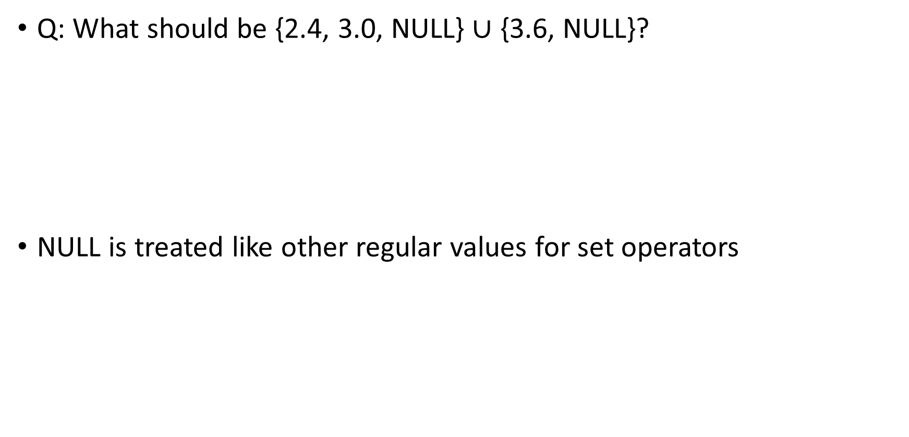
NULL and Set Operators
Q: What should be {2.4, 3.0, NULL} $∪$ {3.6, NULL}?
NULL is treated like other regular values for set operators

Slide 16
Checking NULL
In case we need to explicitly check whether an attribute value is NULL, we can use “IS NULL” or “IS NOT NULL” operator
Note that “= NULL” or “<> NULL” does not work!

Slide 17
Q: number of classes each student takes. return 0-class students as well
Student(sid, name, addr, age, GPA)
Class(dept, cnum, sec, unit, title, instructor)
sid | name | addr | age | GPA
301 | Andy | 183 Westwood | 19 | 2.1
303 | Elaine | 301 Wilshire | 17 | 3.9
401 | James | 183 Westwood | 17 | 3.5
208 | Esther | 421 Wilshire | 20 | 3.1
dept | cnum | sec | unit | title | instructor
CS | 112 | 01 | 03 | Modeling | Dick Muntz
CS | 143 | 01 | 04 | DB Systems | John Cho
EE | 143 | 01 | 03 | Signal | Dick Muntz
ME | 183 | 02 | 05 | Mechanics | Susan Tracey
Enroll(sid, dept, cnum, sec)
sid | dept | cnum | sec
301 | CS | 112 | 01
301 | CS | 143 | 01
303 | EE | 143 | 01
303 | CS | 112 | 01
401 | CS | 112 | 01
Outer join preserves dangling tuples

Slide 18
Outer Join
Student
Enroll
sid | name
301 | John
303 | Elaine
sid | cid
301 | CS143
401 | CS112
Student LEFT OUTER JOIN Enroll ON Student.sid = Enroll.sid
Student RIGHT OUTER JOIN Enroll ON Student.sid = Enroll.sid
Student FULL OUTER JOIN Enroll ON Student.sid = Enroll.sid

Slide 19
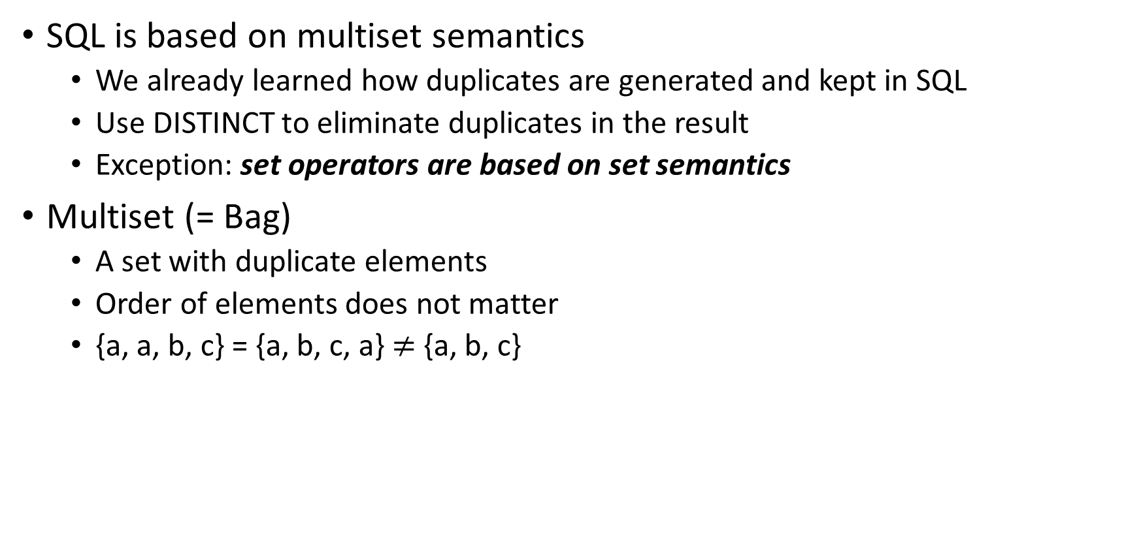
SQL and Multiset Semantics
SQL is based on multiset semantics
We already learned how duplicates are generated and kept in SQL
Use DISTINCT to eliminate duplicates in the result
Exception: set operators are based on set semantics
Multiset (= Bag)
A set with duplicate elements
Order of elements does not matter
{a, a, b, c} = {a, b, c, a} $≠$ {a, b, c}

Slide 20
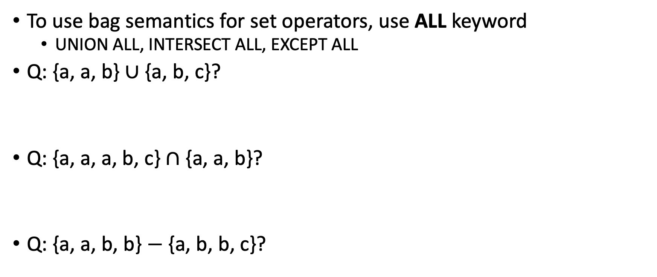
Multiset Semantics for Set Operators
To use bag semantics for set operators, use ALL keyword
UNION ALL, INTERSECT ALL, EXCEPT ALL
Q: {a, a, b} $∪$ {a, b, c}?
Q: {a, a, a, b, c} $∩$ {a, a, b}?
Q: {a, a, b, b} $−$ {a, b, b, c}?

Slide 21
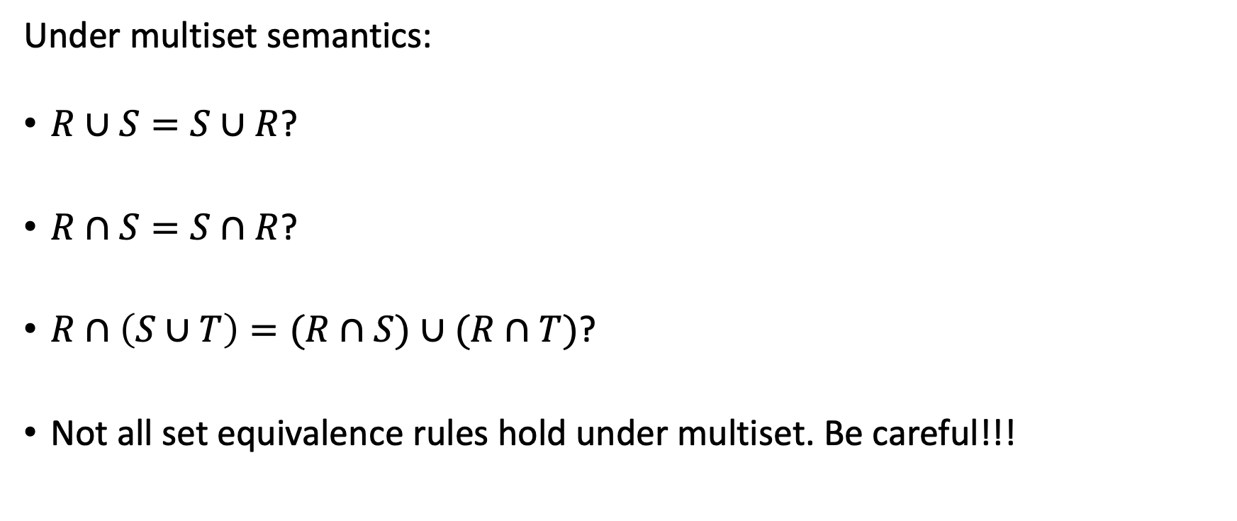
Multiset Semantics and Equivalence Rules
Under multiset semantics:
$R∪S=S∪R$?
$R∩S=S∩R$?
$R∩\left(S∪T\right)=(R∩S)∪(R∩T)$?
Not all set equivalence rules hold under multiset. Be careful!!!

Slide 22
Expressive Power of SQL
Q: Find all ancestors of Susan
Q: Find all cities reachable from A?
Parent
child | parent
Susan | John
John | James
James | Elaine
… | …
Reachable
City 1 | Citi 2
A | B
B | D
B | E
… | …

Slide 23
Expressive Power of SQL
SQL is a very expressive language, but its expressive power is limited
SQL is not a “Turing-complete” language
For example, the closure of a set cannot be computed using SQL92
Example: all ancestors, all reachable nodes
Support for recursion is needed to compute a closure
SQL99 added support for recursion
WITH RECURSIVE Ancestor(child, ancestor) AS ( (SELECT * FROM Parent) UNION (SELECT P.child, A.ancestor FROM Parent P, Ancestor A WHERE P.parent = A.child) ) SELECT ancestor FROM Ancestor WHERE child=‘Susan’;
Read textbook for more details on SQL99 Recursion

Slide 24
What We Learned
Window functions
Order by and Fetch first
Data modification
NULL and three-valued logic
Outer join
Multiset semantic for set operators
SQL expressive power and recursion

