Slide 1
CS143: Database Integrity
Professor Junghoo “John” Cho

Slide 2
What We Will Learn
Referential integrity constraint
CHECK constraint
SQL trigger (in SQL99)

Slide 3
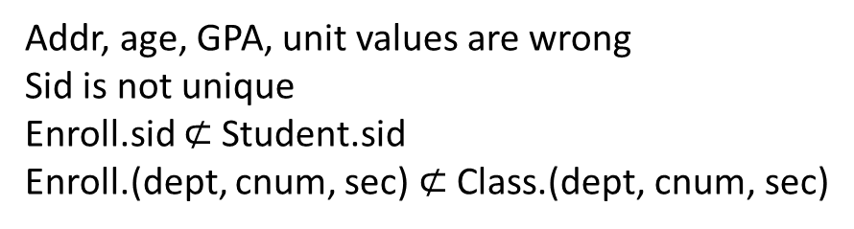
Example Database: What is Wrong?
Student(sid, name, addr, age, GPA)
Class(dept, cnum, sec, unit, title, instructor)
sid | name | addr | age | GPA
301 | Andy | Ki#Bu!GK.$@q | 19 | 2.1
301 | Elaine | 301 Wilshire | 263 | 3.9
401 | James | 183 Westwood | 17 | -1.0
208 | Esther | 421 Wilshire | 20 | 3.1
dept | cnum | sec | unit | title | instructor
CS | 112 | 01 | 03 | Modeling | Dick Muntz
CS | 143 | 01 | 04 | DB Systems | John Cho
EE | 143 | 01 | 134 | Signal | Dick Muntz
ME | 183 | 02 | 05 | Mechanics | Susan Tracey
Enroll(sid, dept, cnum, sec)
Addr, age, GPA, unit values are wrong
Sid is not unique
Enroll.sid $⊄$Student.sid
Enroll.(dept, cnum, sec) $⊄$Class.(dept, cnum, sec)
sid | dept | cnum | sec
301 | CS | 112 | 01
999 | CS | 143 | 01
401 | AT | 000 | 00
303 | EE | 143 | 01
303 | CS | 112 | 01

Slide 4
Three Places to Check Data Integrity
Q: Where should we check and ensure data validity?
DBMS
Application Server
User-facing
Client

Slide 5
Data Integrity Enforcement in RDBMS
Domain: GPA is real
Integrity constraints: If violated, generate an error and abort
Key
Referential integrity
CHECK
Trigger (SQL99)
Event-Condition-Action (ECA) rule
If a certain event happens, invoke an action to handle it

Slide 6
Key Constraint
A set of attributes should be unique in a table Class(dept, cnum, sec, unit, instructor, title) Class(dept, cnum, sec, unit, instroctur, title) CREATE TABLE Class( dept CHAR(2) NOT NULL, cnum INT NOT NULL, sec INT NOT NULL, unit INT, instructor VARCHAR(100), title VARCHAR(100), PRIMARY KEY(dept, cnum, sec), UNIQUE(dept, sec, title));
One PRIMARY KEY per table. Others should use UNIQUE.
PRIMARY KEY and UNIQUE are enforced through index (more on this later)

Slide 7
Referential Integrity (RI)
Examples
If sid appears in Enroll, it should also appear in Student
If (dept, cnum, sec) appears in Enroll, it should also appear in Class
Q: Is the reverse true?

Slide 8
Terminology
E
S
E.B references S.B
E.B: foreign key (= referencing attribute)
S.B: referenced attribute
Referential integrity
Referencing attribute should always exist in the referenced attribute
When foreign key is NULL, no referential integrity check is performed
A | B
B | C

Slide 9
SQL Referential Integrity Syntax
CREATE TABLE Enroll( sid INT, dept CHAR(2), cnum INT, sec INT);
Referenced attributes must be PRIMARY KEY or UNIQUE

Slide 10
Violation of Referential Integrity
E
S
Q: When can RI be violated?
A | B
B | C
INSERT INTO E | INSERT INTO S
DELETE FROM E | DELETE FROM S
UPDATE E | UPDATE S

Slide 11
Violation of Referential Integrity
E
S
A | B
B | C
RI violation from referencing table E is never allowed
DBMS rejects the statement
RI violation from referenced table S is not allowed by default, but we can instruct DBMS to “fix” the violation automatically
Q: DELETE FROM S. How to fix?
Q: UPDATE S. How to fix?

Slide 12
Automatic Fix of RI Violation
E
S
CREATE TABLE E( A INT, B INT, FOREIGN KEY(B) REFERENCES S );
A | B
 | 301
B | C
301

Slide 13
More Comments on Referential Integrity
Referential integrity is the only SQL constraint that can “fix itself”
Other constraints simply rejects the statement and generates an error
Some DBMS do not support all “fixing” actions
Oracle supports ON DELETE but not ON UPDATE, for example
Q: Why should referenced attributes be unique?
E
S
A | B
 | 301
B | C
301
301
??

Slide 14
Self-Referencing Table
R
CREATE TABLE R( A INT PRIMARY KEY, B INT, FOREIGN KEY(B) references R(A) ON DELETE CASCADE);
Self-referencing table: A table that references itself
Q: What will happen if we delete (1, NULL)?
A | B
1 | NULL
2 | 1
3 | 2
4 | 3
5 | 4

Slide 15
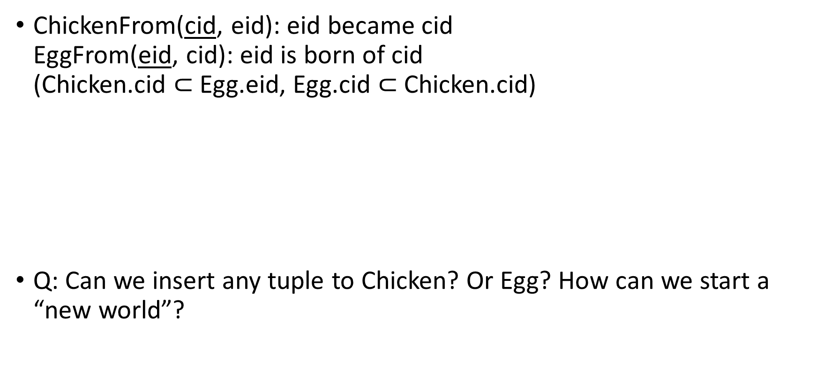
Circular Constraint
ChickenFrom(cid, eid): eid became cid EggFrom(eid, cid): eid is born of cid (Chicken.cid $⊂$ Egg.eid, Egg.cid $⊂$Chicken.cid)
Q: Can we insert any tuple to Chicken? Or Egg? How can we start a “new world”?
Chicken
Egg
cid | eid
eid | cid

Slide 16
CHECK Constraint
Example: GPA should be between 0.0 and 4.0 CREATE TABLE Student( sid INT, name VARCHAR(50), addr VARCHAR(50), GPA REAL,
);
CHECK(condition)
Condition can be complex and may include subqueries
Constraint is attached to a particular table
Whenever the table is updated, the statement is rejected if the condition is violated

Slide 17
Q1: class cnum should be < 600 and class units should be < 10
CREATE TABLE Class( dept CHAR(2), cnum INT, sec INT, unit INT, title VARCHAR(100), instructor VARCHAR(100) );

Slide 18
Q2: The units of all CS classes should be > 3
CREATE TABLE Class( dept CHAR(2), cnum INT, sec INT, unit INT, title VARCHAR(100), instructor VARCHAR(100) );

Slide 19
Q3: Students whose GPA < 2 cannot take CS class
CREATE TABLE Student( sid INT, name VARCHAR(50), GPA REAL, … ); CREATE TABLE Enroll( sid INT, dept CHAR(2), cnum INT, sec INT, );

Slide 20
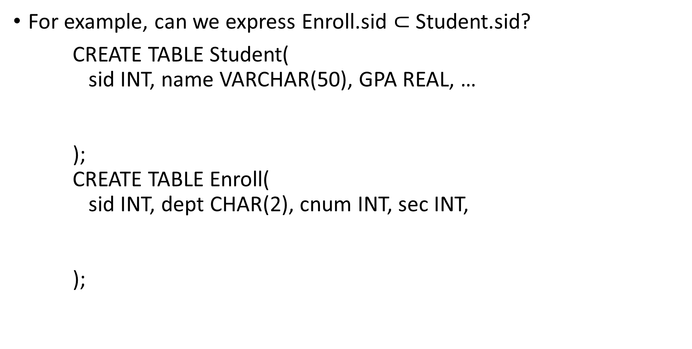
Q4: Can we express referential integrity constraint using CHECK constraint?
For example, can we express Enroll.sid $⊂$Student.sid?
CREATE TABLE Student( sid INT, name VARCHAR(50), GPA REAL, … ); CREATE TABLE Enroll( sid INT, dept CHAR(2), cnum INT, sec INT, );

Slide 21
Trigger
Event-Condition-Action (ECA) rule
Part of SQL3 standard
Allows to explicitly specify what events to monitor, what condition to check and what action to take if the condition is met

Slide 22
Q1: If a student’s GPA goes below 2.0, drop the student from all classes

Slide 23
Q2: All new students have to take CS143
For every insertion to Student, add corresponding tuple to Enroll

Slide 24
General Trigger Syntax
CREATE TRIGGER <name>
<event>
<referencing clause> // optional
WHEN (<condition>) // optional
<action>
<event>
BEFORE | AFTER INSERT ON R
BEFORE | AFTER DELETE ON R
BEFORE | AFTER UPDATE [OF A1, A2, ..., An] ON R
<referencing clause>
REFERENCING OLD|NEW TABLE|ROW AS <var>, ...
FOR EACH ROW: row-level trigger
FOR EACH STATEMENT (default): statement-level trigger
<action>
Any SQL statement
Multiple statements should be enclosed with BEGIN … END and be separated by ;

Slide 25
Q4: What happens if we execute “INSERT INTO R VALUES (1);”?
CREATE TRIGGER Recursion AFTER INSERT ON R BEGIN INSERT INTO R VALUES (1); END;

Slide 26
MySQL Support
Key constraint
Under InnoDB engine, referential integrity constraint
But not under MyISAM engine
No CHECK constraint support
MariaDB 10.2.1 added (limited) CHECK constraint support
Limited TRIGGER support
Does not allow updating the table that caused the trigger event

Slide 27
What We Learned
How to preserve database integrity
Key constraint: PRIMARY KEY, UNIQUE
Referential integrity constraint
FOREGIN KEY
Referenced attributes should be unique
Violation from referenced table may be fixed by DBMS
ON DELETE/UPDATE CASCADE/SET NULL
CHECK constraint
TRIGGER

