Slide 1
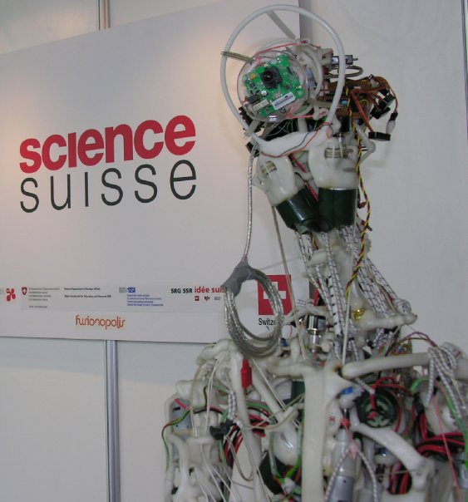
Evolution of NVIDIA GR00T
Foundation Models
From N1 to N1.7
Company Paper Reading
April 2026
Notes:
Groot是英伟达的vla模型，其中N1是第一个版本，现在更新到N1.7了。由于N1之后都没有专门的论文介绍，细节比较少，所以这次paper reading,我想主要和大家介绍一下N1的模型架构，已经后续版本的更新。

Slide 2



Executive Summary
Vision–Language–Action (VLA) foundation Dual system model couples perception, language understanding and action generation
From N1 to N1.7 Better VLM backbones and deeper diffusion transformers improve reasoning and motion
Human data matters 20k hours of human egocentric videos yield a dexterity scaling law for hands
[1] [2] [3] [4]

Slide 3
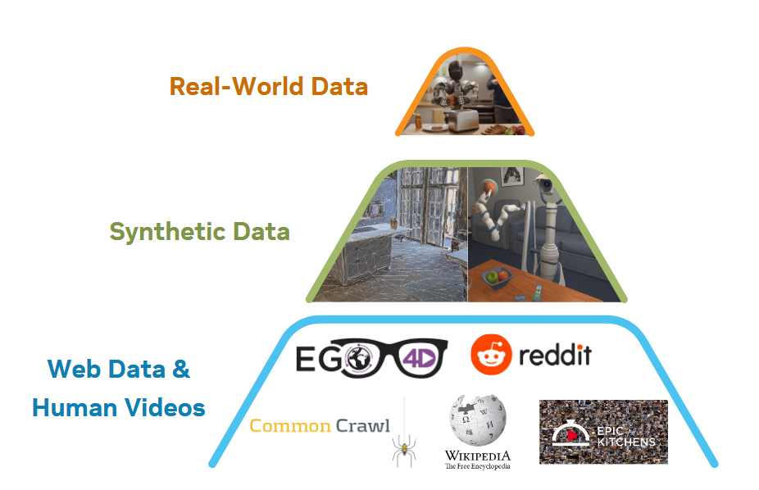
Background & Motivation
• General-purpose robots require a versatile body and an intelligent mind that can interpret images, language and proprioception.
• Traditional imitation learning struggles with variability; foundation models trained on diverse data enable transfer to new tasks and embodiments.
• GR00T N-series uses a dual-system Vision–Language–Action architecture to marry high-level reasoning with low-level motor control.
Human egocentric video
Rich manipulation priors for hands and objects
Dexterity scaling law
More human data → better dexterous skills
[5] [6]

Slide 4
GR00T N1: Architecture & Training
Dual system: a vision–language module interprets images and commands; a diffusion transformer synthesises smooth trajectories in real time.
Training data mixture: real robot trajectories, human videos and synthetic simulations yield strong generalisation.
System 2
(VLM)
Vision & language tokens
System 1
(DiT)
Action generation
Notes:
N1 learns a latent‑action codebook and trains an inverse dynamics model (IDM) to infer pseudo‑actions, enabling annotation of action‑less videos and treatment of human videos

Slide 5
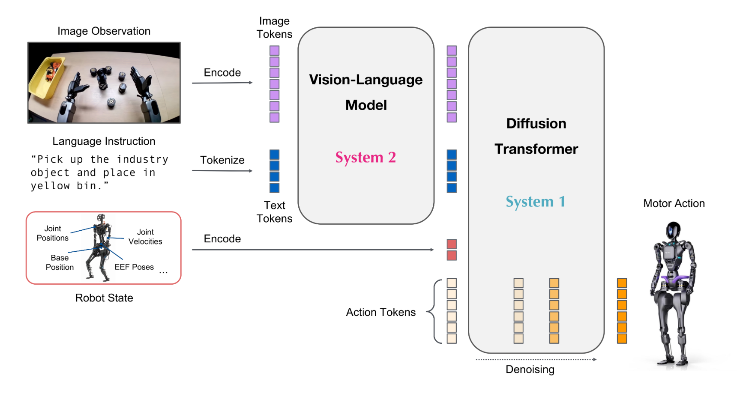
GR00T N1: Architecture & Training
[7] [8]

Slide 6
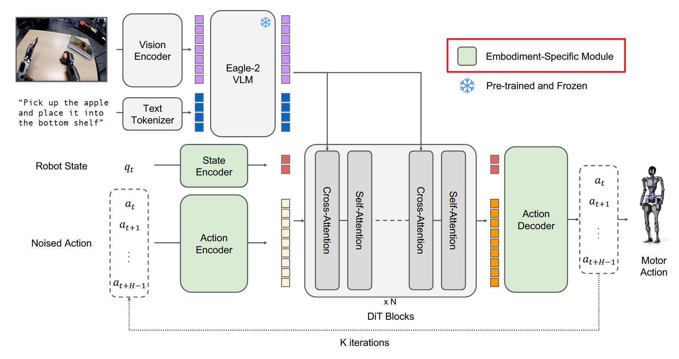
GR00T N1: Architecture & Training
[7] [8]
Notes:
To support multiple robot embodiments (e.g., single‑arm, bimanual, humanoid), state and action encoders project proprioceptive observations and actions into a shared latent space。

Slide 7
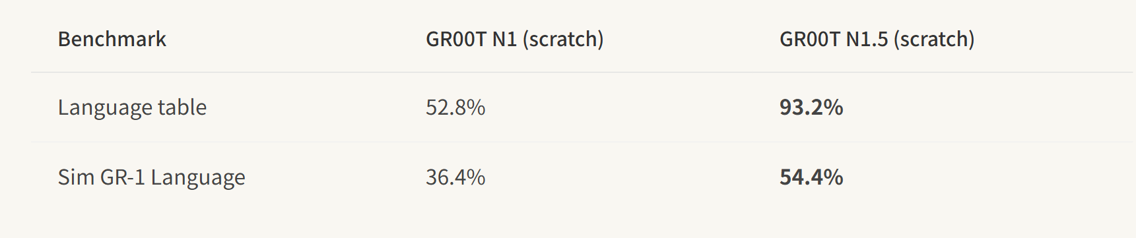
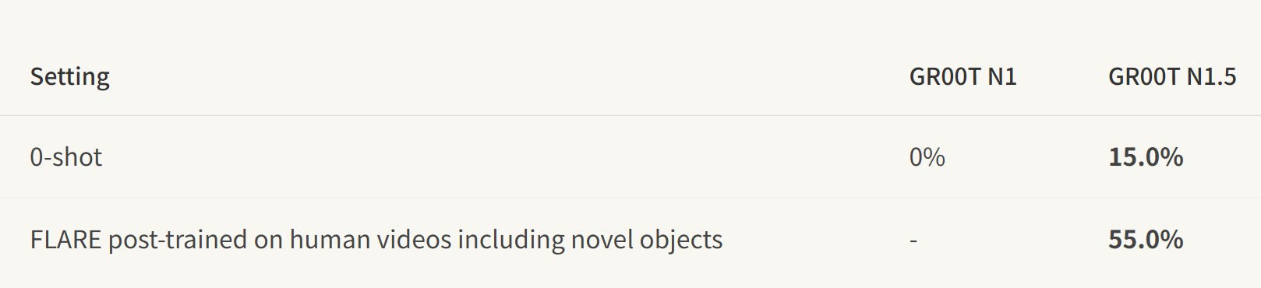
GR00T N1 → GR00T N1.5
 | N1(March 2025) | N1.5(June 2025) | 说明
训练方式 | Text tokenizer frozen/ vision encode unfrozen | freezes the VLM 简化连接vision和text embedding的MLP | 显著提升了语言跟随能力和泛化能力
backbone | Eagle 2.0 | Eagle 2.5 & finetune | Finutune之后的vlm的grounding能力更强
训练 |  | 添加了Future Latent Representation Alignment (FLARE) | 鼓励latent VLM output to align with future states
[7] [8]

Slide 8
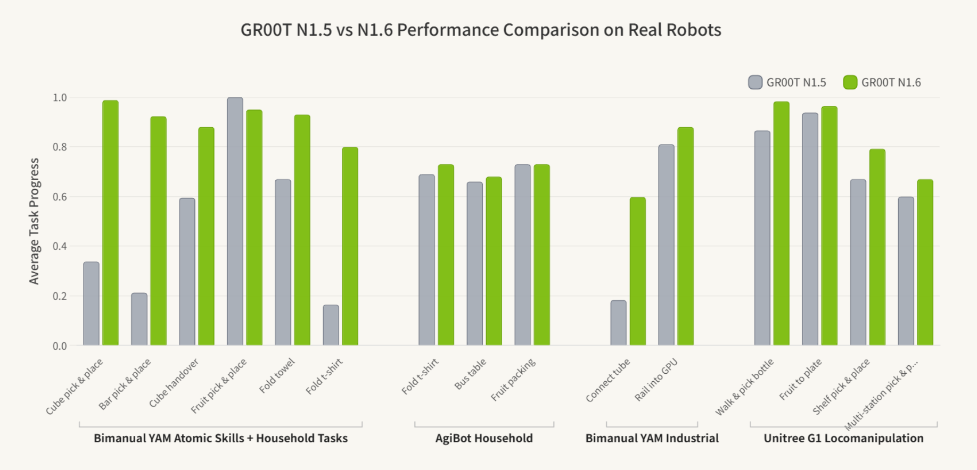
GR00T N1.5 → GR00T N1.6
 | N1.5(June 2025) | N1.6(Dec 2025) | 说明
backbone | Eagle 2.5 | NVIDIA Cosmos-2B VLM | supports flexible resolution
网络架构 | 16 layers | 32 layers | 2x larger DiT
学习目标 | 绝对值 | Predicts state-relative action chunks | smoother motions and better generalization.
[7] [8]
Notes:
机器人自身状态空间里的相对增量

Slide 9
GR00T N1.6 → GR00T N1.7
 | N1.6(Dec 2025) | N1.7(March 2026) | 说明
backbone | NVIDIA Cosmos-2B VLM | Cosmos-Reason2-2B / Qwen3-VL | 更新的VLM模型
数据训练 |  | 20K hours of EgoScale human video& diverse robot demonstrations | human video提供机器人操作先验
学习目标 | state-relative action | Relative EEF Action Space | 人类视频可以直接成为机器人 action pretraining 数据。
[7] [8]
Notes:
N1.6 的“relative action”更多是“机器人自身状态空间里的相对增量（state-relative）”，而 N1.7 的“relative EEF action space”是“统一到任务/操作语义层的末端执行器（EEF）相对运动空间，目标是跨机器人 + 跨人类数据统一。人类视频终于可以直接成为机器人 action pretraining 数据

Slide 10
Model Comparison
Feature | N1 | N1.6 | N1.7
Parameter size | ≈2.2B | ≈3B | 3B
Vision–Language backbone | Eagle‑2 | Cosmos‑2B | Cosmos‑Reason2‑2B
Diffusion transformer | 16‑layer | 32‑layer | 32‑layer
Data sources | Real robot, human video, synthetic | + Teleop (YAM, AGIBot, G1) | + 20k hrs human video (EgoScale)
Unique features | Dual system VLA | Relative actions, unfrozen VLM | Action cascade
[19] [20] [21]

Slide 11



Impact & Applications
Bimanual manipulation Language‑conditioned tasks on Fourier GR‑1 and bimanual YAM arms.
Material handling & packaging Factory floor ready for logistics, packing and inspection tasks.
Industrial coordination Multi‑robot handoffs and co‑ordination on humanoid platforms (Unitree G1, AGIBot).
Research & customisation Fine‑tune on your own robot using LeRobot datasets to adapt to new embodiments.
[22] [23] [24]

Slide 12

Conclusion & Outlook
• Foundation models are catalysing rapid progress in generalist robotics. • Progression from N1 → N1.6 → N1.7 shows consistent gains in perception, control and dexterity. • Human egocentric data unlocks scalable dexterity; more data translates to more capable hands. • N1.7 is commercially licensed and factory‑ready today, bridging research and industry. • Looking ahead: GR00T N2 (DreamZero) promises world action models that double success on unseen tasks.
Thank you!
[25] [26]

