Slide 1
Java程序设计
主讲教师：王波 讲师

Slide 2
What is Java?
Java Powers Our Digital World: Java is at the heart of our digital lifestyle. It's the platform for launching careers, exploring human-to-digital interfaces, architecting the world's best applications, and unlocking innovation everywhere—from garages to global organizations. – Oracle
Java is a general-purpose computer-programming language that is concurrent, class-based, object-oriented, and specifically designed to have as few implementation dependencies as possible.

Slide 3
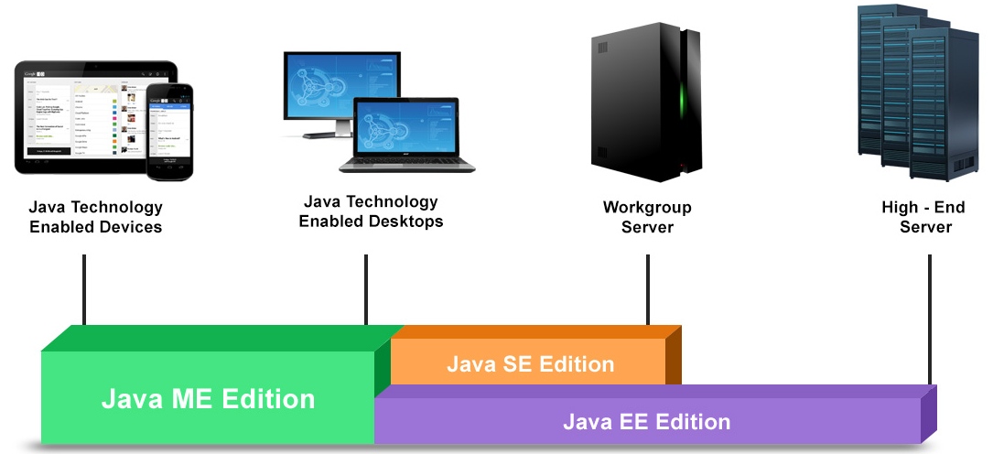
Java Platform
Java SE -- (Standard Edition) 标准版
Java EE – (Enterprise Edition) 企业版
Java ME – (Micro Edition) 微型版

Slide 4
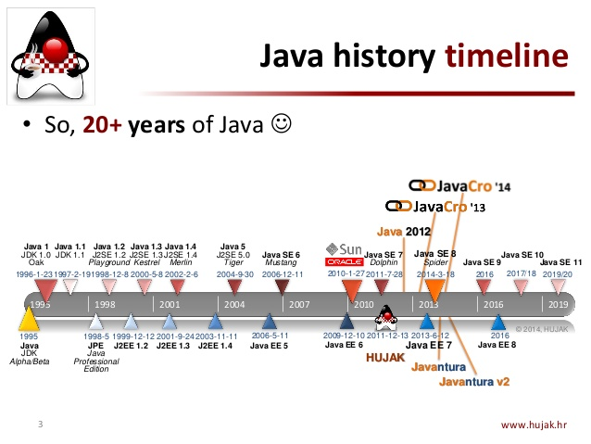
Java History Timeline

Slide 5
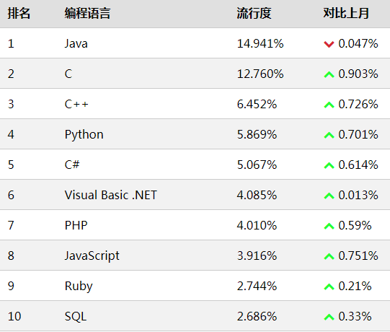
TIOBE index top 10 for 2018.03

Slide 6
JDK
The Java Development Kit (JDK) is an implementation of either one of the Java Platform, Standard Edition, Java Platform, Enterprise Edition, or Java Platform, Micro Edition platforms released by Oracle Corporation in the form of different system. The JDK includes a private JVM and a few other resources to finish the development of a Java Application.
JDK，Sun提供的，免费开源的Java应用开发工具包，包含Java工具(编译，调试，运行等)，工具库类(提供对线程，时间，文件，网络等的操作)，以及JRE，通过JDK编译java源码为字节码

Slide 7
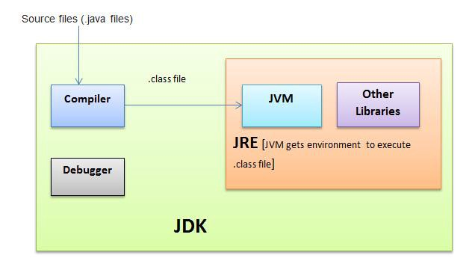
JDK JRE JVM Architecture
JRE=JVM+Library Classes
JDK=JRE + Development Tools

Slide 8
JRE
Java Runtime Environment(JRE ) is used to give runtime environment. It is the execution of JVM. It actually prevails. It contains set of collections + other information that JVM uses at runtime.
Implementation of JVMs are also definitely launched by other organizations besides Sun Small Systems.
JRE，Java运行时环境，包含对工具库类的支持，核心运行文件，以及JVM
JRE为每一个Java程序创建一个独立的JVM实例(容器)运行程序
通过在不同架构系统上安装不同的JRE，实现Java程序的跨平台运行(一次编译，处处运行)

Slide 9
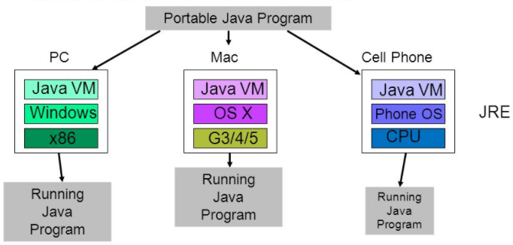
JRE Architecture

Slide 10
JVM
Java Virtual Machine(JVM) is a subjective machine. It is a requirement that provides runtime environment in which java byte code can be implemented.
Loads code
Verifies code
Executes code
Provides runtime environment separate.
JVM，Java虚拟机，模拟了包括CPU指令集，寄存器，堆栈等计算机架构，通过调用真实计算机环境，解析执行Java字节码

Slide 11
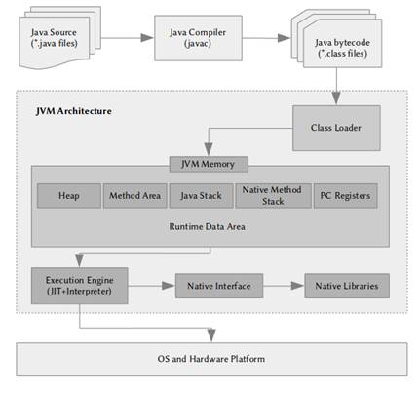
JVM Architecture

Slide 12
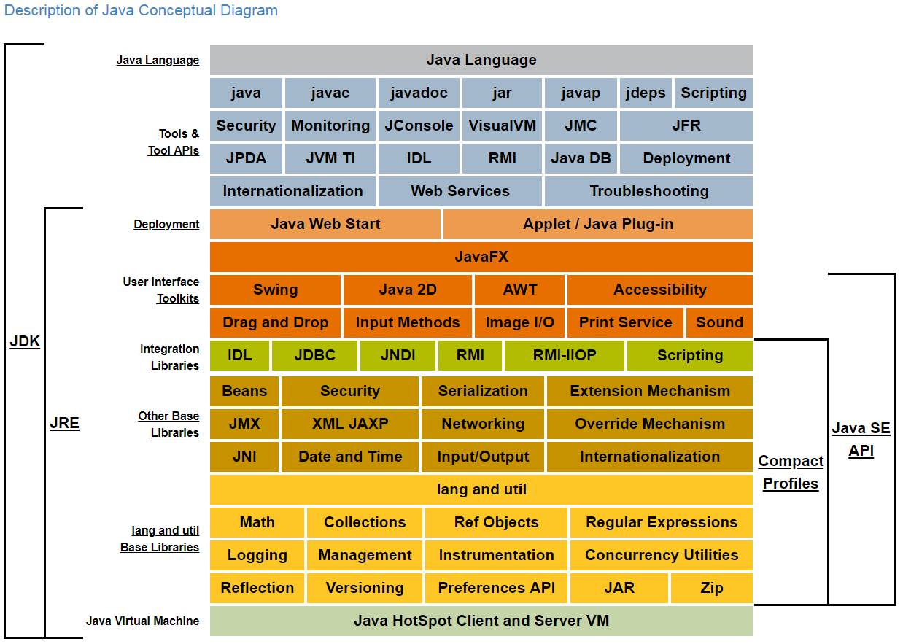
Java SE Platform

Slide 13

Java Features
Java 5
支持基本类型的自动拆/装箱
静态导入
泛型
枚举
For each迭代
注解
Java 6
Web Services
Java 7
类型推断
Try with resources资源处理
Catch异常合并
Switch支持字符串

Slide 14
Java 8
函数式编程
Lambda表达式
接口的默认方法
集合Stream API
新的Time API
多重注解
Java 9
模块系统
JShell互交式编程
增强集合stream API
集合工厂方法
兼容性
Java 10 ………

Slide 15
Why Learn Java?
Beginner Friendliness
Relatively Simple to Use
Easier to Maintain
Fast
Optimized Performance
Community
Career Opportunities
Future

Slide 16
Course Objectives
课程目标：掌握Java编程规范; 为后期Web应用开发、JavaEE企业级应用开发、Android开发等提供支持; 理解掌握多种设计模式的意义及实现，掌握基本程序设计思想
课程内容：当前Java语言的主要使用场景为，为JavaEE企业级应用服务器端技术提供支持，因此在JavaSE的学习中
无GUI(C#，非Java优势)
无Applet(官方已作废)

Slide 17
Development Environment
JDK 8.161 (8.0 above)
Eclipse for Java EE，Oxygen 4.7，包含编辑、调试、测试、编译、运行Java Web程序，以及Maven、Git、Junit等插件，的集成开发环境(IDE)
或其他IDE(IDEA等)

Slide 18
Tutorial
Online Java Tutorial:
https://docs.oracle.com/javase/tutorial/index.html
References:
Effective Java 3rd Edition(2017)
Java 8 in Action
Java Style Guide
Google： https://google.github.io/styleguide/javaguide.html
阿里Java开发手册：https://github.com/alibaba/p3c

Slide 19
简单基于文本编辑器编写，JDK编译运行的示例

