Slide 1
Java程序设计
Lecture 02

Slide 2
PART1 - Getting Started
"Hello World!" for Microsoft Windows
A Checklist
Creating Your First Application
Create a Source File
Compile the Source File into a .class File
Run the Program
A Closer Look at "Hello World!"

Slide 3
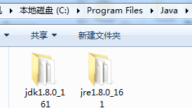
A Checklist
正确安装JDK1.8后
自动在windows环境中添加运行程序，但不包括编译程序

Slide 4
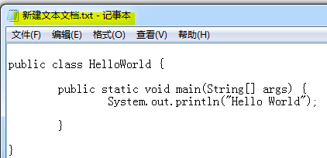
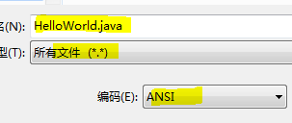
Create a Source File
创建普通文本文件，并输入代码
将文件另存为.java源码文件。文件名称必须与代码中声明的class名称相同，区分大小写

Slide 5
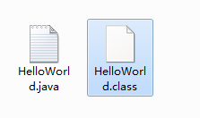

Compile the Source File
通过控制台进入JDK/bin目录，运行javac编译源码
源码文件位置出现编译后的.class字节码文件

Slide 6
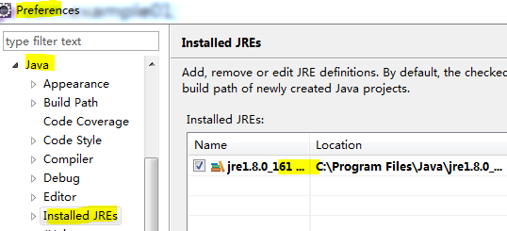
Eclipse启动时自动加载系统安装的JRE，无需设置；eclipse已包含JDK1.8编译程序，无需设置

Slide 7
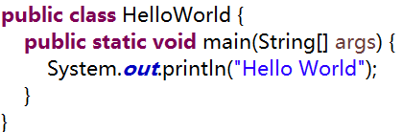
A Closer Look at the Application
Class definition
The main method

Slide 8
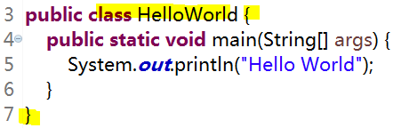
Class Definition
The keyword class begins the class definition for a class named name, and the code for each class appears between the opening and closing curly braces marked in bold above.
关键词“class”声明类的名称，类的代码在“{}”大括号之间

Slide 9
Coding Conventions
良好的编程规范，使代码更易于理解，增加代码的可读性与可维护性
CC00：基本通用命名规范。所有包/类/接口/方法/参数/变量等的命名，必须使用有意义的、无歧义的英文单词/缩写；禁止使用中文/拼音/拼音缩写/英文拼音混合命名；区分大小写
CC01：类命名规范。按驼峰式命名(Camel Case)，不能使用关键词；每个单词仅首字母大写，一般为单数，工具类等可以使用复数
CC02：大括号使用规范。所有使用“{}”大括号的代码，左括号必须置于起始语句末，右括号独立一行或在关联语句始

Slide 10
The main Method
In the Java programming language, every application must contain a main method whose signature is:
The main method is similar to the main function in C and C++; it's the entry point for your application and will subsequently invoke all the other methods required by your program.
主函数main()方法是每个java程序的入口，必须是public static修饰的，无返回值的，名称为“main”的方法。只有带主函数main()方法的类，可以直接运行

Slide 11



Slide 12

The main method accepts a single argument: an array of elements of type String. 可传入String字符串类型数组，作为main()方法的参数
uses the System class from the core library to print the “Hello World!” message to standard output. 使用核心库中System类打印输出

Slide 13
Local Java tutorials
Java程序设计-开发手册
课程教学工程名称：JavaExamples，每次课程累加学习代码。可每次删除原工程，导入新工程
个人工程建议名称：MyJavaExamples，包路径与课程教学工程相同，便于测试学习

Slide 14
Object-Oriented Programming Concepts
What Is an Object?
What Is a Class?
What Is Inheritance?
What Is a Package?
在NON-OOP中，通过使用数字、字符等基本数据类型描述和解决问题
在OOP中，通过使用在问题所处环境中出现的实体(entity)/对象(object)描述和解决问题，这从本质上影响了程序的设计思想和构建的过程

Slide 15
What Is an Object?
Objects are key to understanding object-oriented technology. Look around right now and you'll find many examples of real-world objects: your dog, your desk, your television set, your bicycle.
Real-world objects share two characteristics: They all have state and behavior. Identifying the state and behavior for real-world objects is a great way to begin thinking in terms of object-oriented programming.
真实世界的事物(客体，客观存在并可主观感知的任何事物)，都具有两种特性：状态和行为。面向对象编程就是从分析、识别、抽象真实世界的事物开始

Slide 16
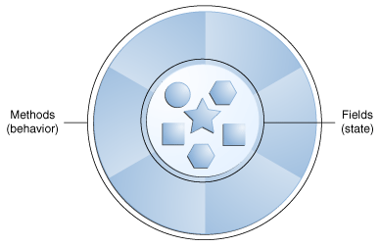
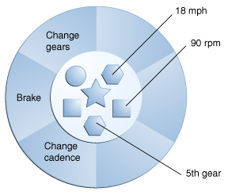
A software object
Bicycles also have
State: current gear, current pedal cadence, current speed
Behavior: changing gear, changing pedal cadence, applying brakes
方法/行为
域/状态
具有
换档
刹车
变速
行为的
当前处于
18英里/时
90转/分
第5档位
状态的
自行车

Slide 17
What Is a Class?
In the real world, you'll often find many individual objects all of the same kind. There may be thousands of other bicycles in existence, all of the same make and model. Each bicycle was built from the same set of blueprints and therefore contains the same components. In OO terms, we say that your bicycle is an instance of the class of objects known as bicycles. A class is the blueprint from which individual objects are created.
类是一个蓝图，一种规范，用来描述形容一类特定事物的内容。就是从具体事物中，抽象出事物的
状态(域，属性)
行为(方法)
类的实例(对象)，描述该类的一个具体的事物

Slide 18
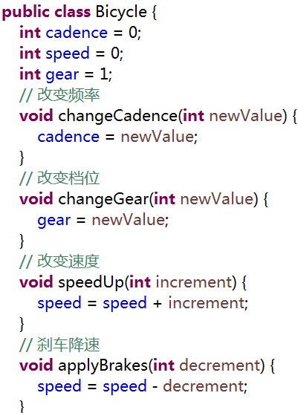
The following Bicycle class is one possible implementation of a bicycle:
域/状态
改变域/状态的
行为/方法

Slide 19
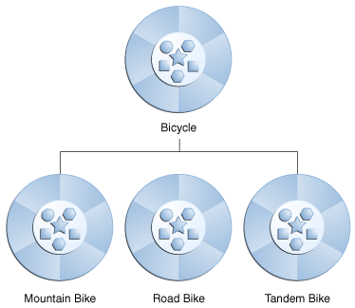
What Is Inheritance?
Different kinds of objects often have a certain amount in common with each other. Yet each also defines additional features that make them different. Object-oriented programming allows classes to inherit commonly used state and behavior from other classes.
不同类型的事物通常具有一定共同的特性，同时又拥有区别于其他事物的自有的特性，面向对象编程允许从其他类继承状态和行为

Slide 20
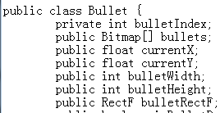

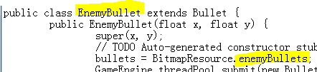
定义共有的子弹特性，包括
子弹当前动画图片索引
子弹动画图片数组
子弹当前X轴位置
子弹当前Y轴位置
子弹当前占用屏幕空间区域
英雄飞机使用
自己的子弹动画图片
敌人飞机使用
自己的子弹动画图片

Slide 21
What Is a Package?
A package is a namespace that organizes a set of related classes and interfaces. Conceptually you can think of packages as being similar to different folders on your computer. because software written in the Java programming language can make composed of several or thousands of individual classes, it makes sense to keep things organized by placing related classes and interfaces into packages.
包(package)，java程序由众多独立的文件(类/接口源文件，配置文件等)组成，包是用来组织相关文件，使程序结构更加清晰的命名空间，类似于系统中的文件夹
关键词“package”声明包的路径名称

Slide 22
CC03：包命名规范。以“.”点分隔符分隔，倒置的开发单位域名+项目名称+功能模块名称+层次名称等，全部小写的英文单数名词

Slide 23
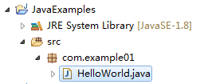
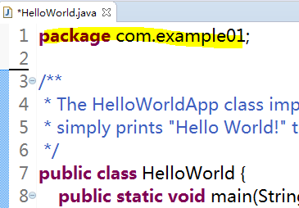
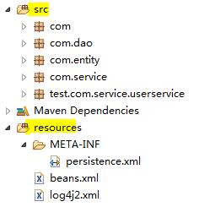
由不同层次的源文件组成的程序
在类中声明package路径
基于功能结构
由源码/测试/配置等文件
组成的更复杂的程序

Slide 24
Part1 - Summary
 | content
源文件 | .java文件
字节码文件 | .class文件
编译程序 | javac.exe
运行程序 | java.exe
命名规约 | 通用命名规范
包 | 命名规范；作用意义
类 | 命名规范；作用意义；定义类代码块
主函数 | 程序入口主函数的声明
大括号 | {}大括号使用规范
对象 | 什么是对象；作用意义
继承 | 基本使用继承的目的

Slide 25
PART2 - Language Basics
Variables
Operators
Expressions, Statements, and Blocks
Control Flow Statements

Slide 26

Variables
An object stores its state in fields.
The Java programming language is statically-typed, which means that all variables must first be declared before they can be used. This involves stating the variable's type and name, as you've already seen:
Doing so tells your program that a field named "gear" exists, holds numerical data, and has an initial value of "1".
存在名为gear的域
保存整数数值类型
初始化数值为1

Slide 27
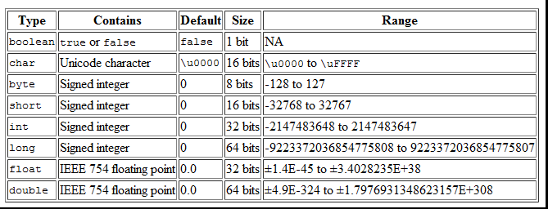
Primitive Data Types
The eight primitive data types supported by the Java programming language are:
布尔型值具体内存占用由具体虚拟机决定

Slide 28
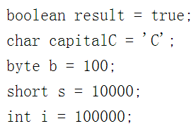
A primitive type is predefined by the language and is named by a reserved keyword. Primitive values do not share state with other primitive values.
A literal is the source code representation of a fixed value; literals are represented directly in your code without requiring computation.

Slide 29
变量是一段有名字的内存(键值对)，通过变量的名称，使用变量，对象将其状态保存在变量中
在程序中出现的显式数据值为字面量，在使用变量前，需要先声明变量类型以及变量名称
基本类型是内置于语言中的特殊数据类型，不是从类创建的对象；基本类型的名称均为关键词
CC：变量命名规范。基于基本命名规范，不能使用关键词，驼峰式命名，第一个单词的首字母小写，之后单词首字母大写

