Slide 1
CSX 433.3 Final Project
By Zhitao Qu & Kevin Etter

Slide 2
Project Goals
Big picture
Average rate increases ~ Profit margin
Calculate average rate increases to inform sales goal for upcoming year
Differentially apply service rate increases based on purchase volume and client plan
Project rate increases across calendar year based on customer anniversary
Simulate plan conversion of random sampling of “standard” plan customers

Slide 3
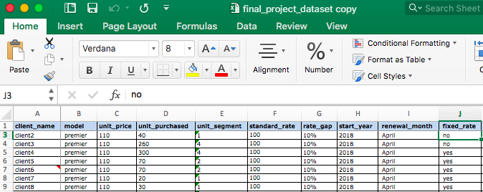
The Dataset
general customer database
describes plan, volume, and rate

Slide 4
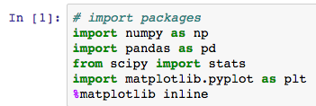
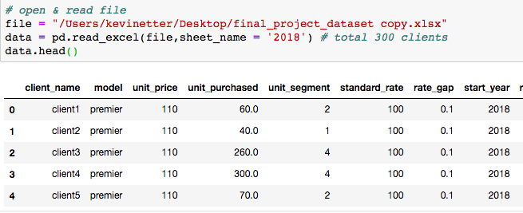
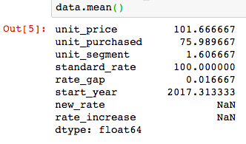
PANDAS Dataframes
Import Excel
⇒
Object with Rows and Columns
similar to Excel, SPSS, and R

Slide 5

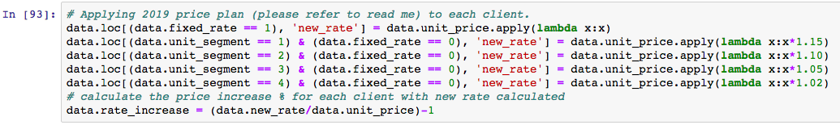
Conditional Statements
...differentially apply service rate increases based on purchase volume and client plan

Slide 6
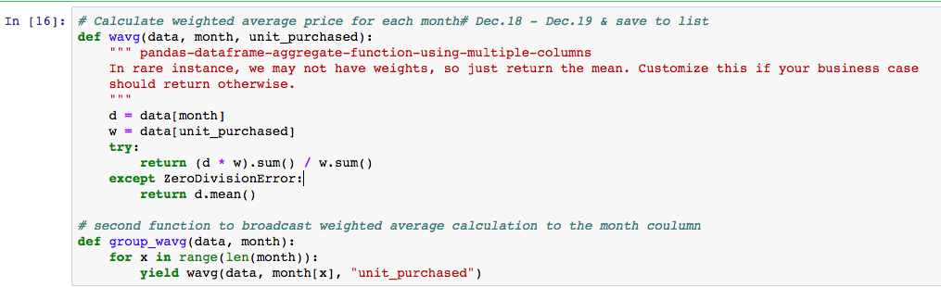
Broadcasting
...projecting rate increases across calendar year based on customer anniversary and plotting

Slide 7
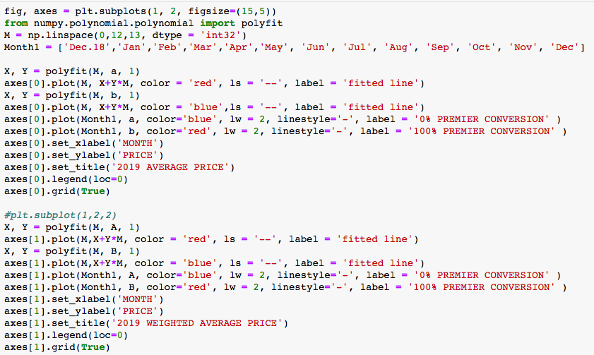
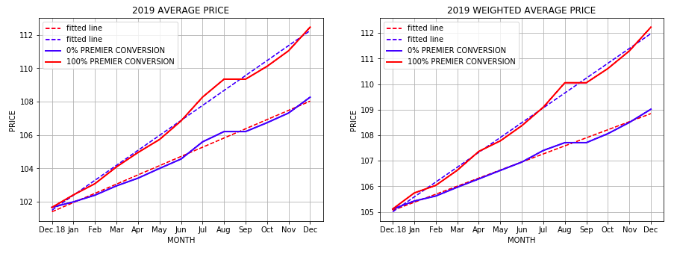
Plotting

Slide 8
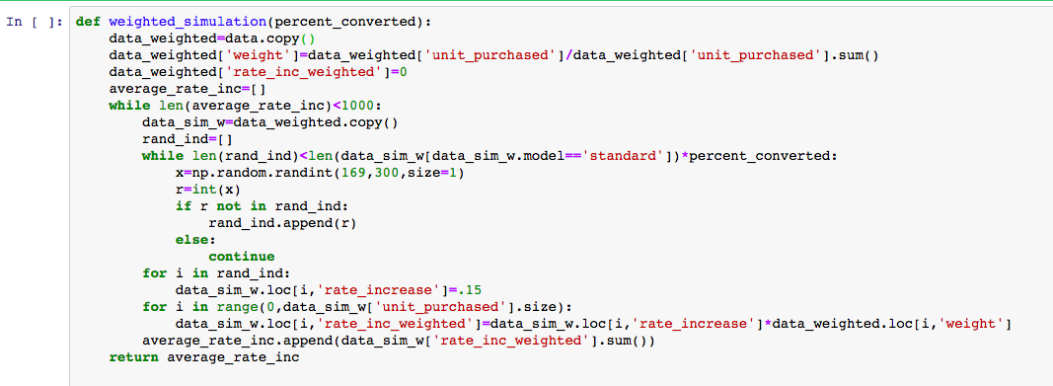
Simulations
...randomly sampled subsets of “standard” customers and converted them to “premium” and recorded the mean rate increase...1000 times

Slide 9
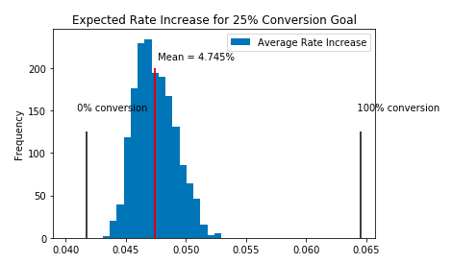
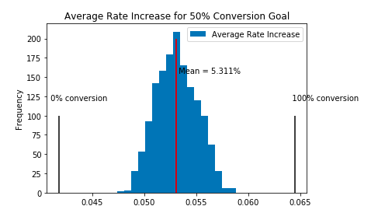
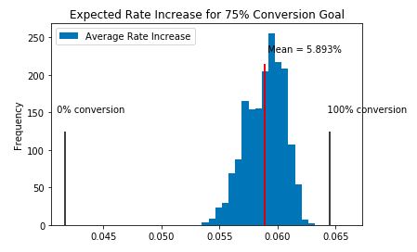
Plotting

Slide 10
Thank you!

