Slide 1
Writing cache-friendly code.
Object-oriented programming(OOP) vs
Data-oriented programming(DOP)
in game development.

Slide 2

Zhivko Petrov
Master Degree in Transport engineering
~ 2 years of experience as Civil Engineer
~ 3 years of experience as C/C++ developer
Today:
2D Game Engine developer

Slide 3
Agenda
What is cache memory? How to use it?
OOP and DOP source implementation examples;
Live demo;
Benchmarking;
Useful mechanism when writing code for cache optimization;

Slide 4


Slide 5


Slide 6



The Past

Slide 7
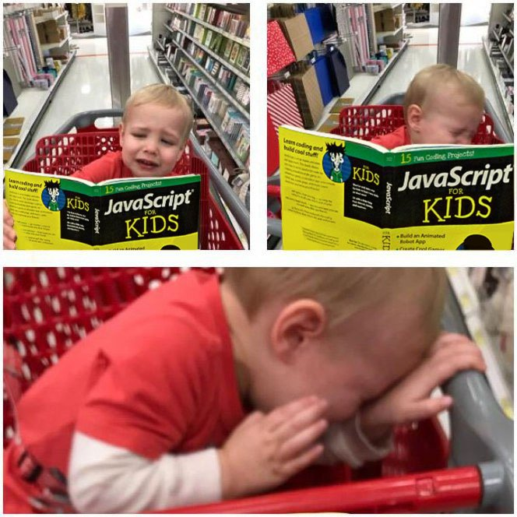
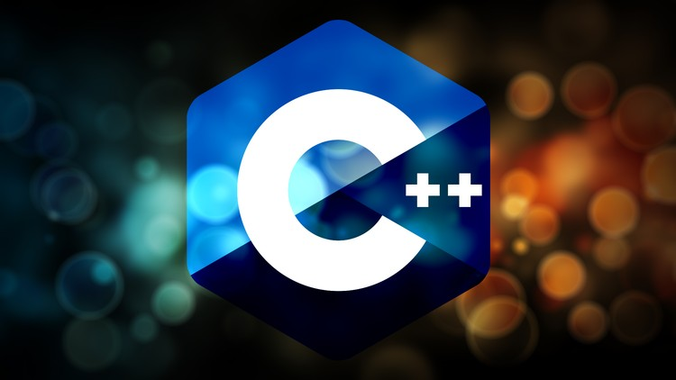

Slide 8

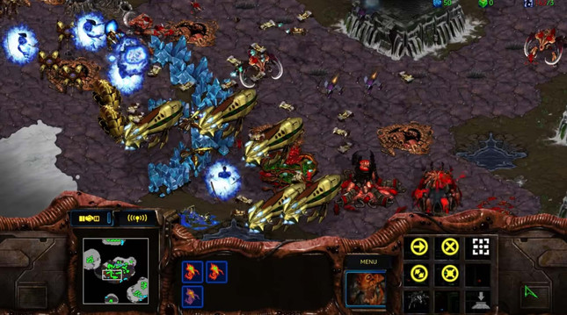
The Past

Slide 9
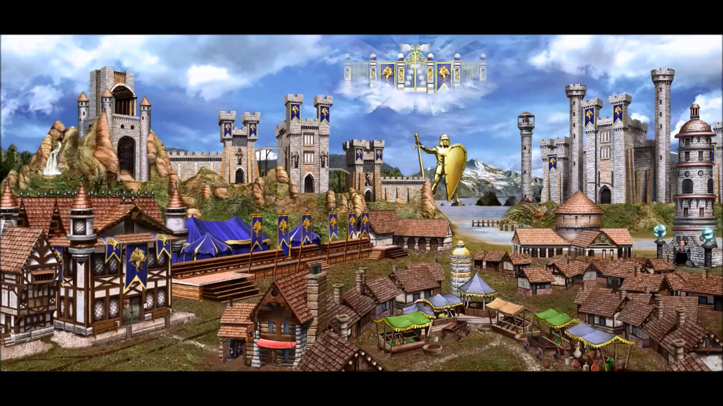
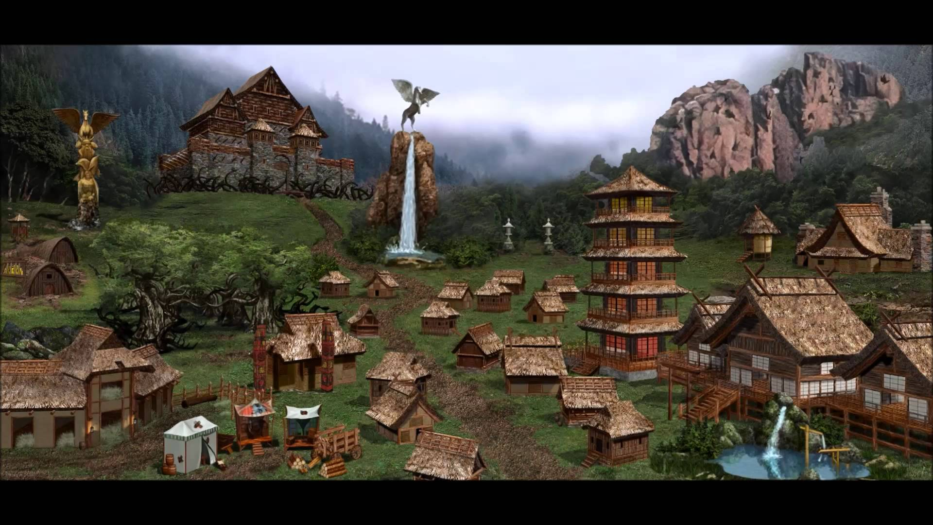


The Past
s

Slide 10

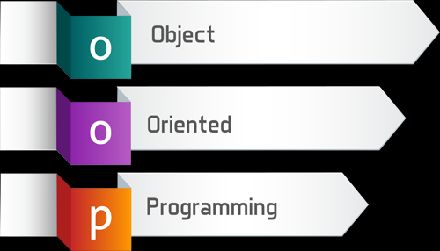
The Past

Slide 11
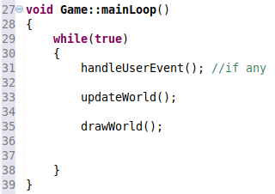
The Present
Basic game development concepts - “The game loop”
Limit the FPS by sleeping your game,
otherwise your CPU will die

Slide 12
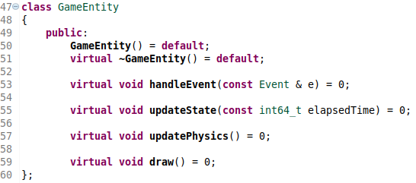
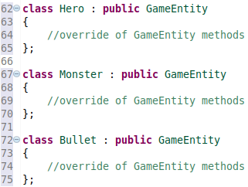
The Present
Some OOP implementation details:

Slide 13
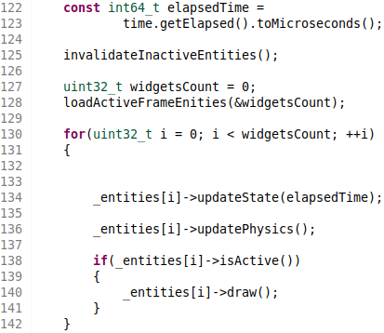

The Present
Some OOP implementation details (2):

Slide 14
The Present
OOP Demo

Slide 15
The Present
Some OOP implementation details (2):

Slide 16





The Present
CPU
The data
RAM memory
CPU registers
Cache memory
Memory bus

Slide 17
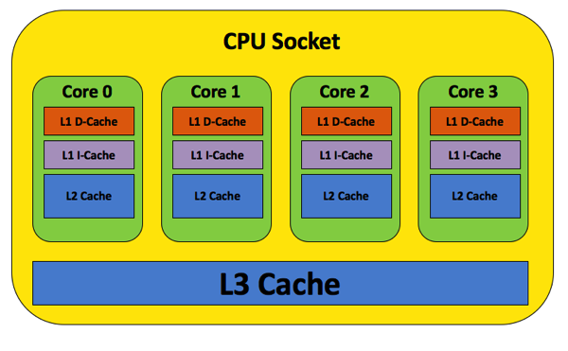
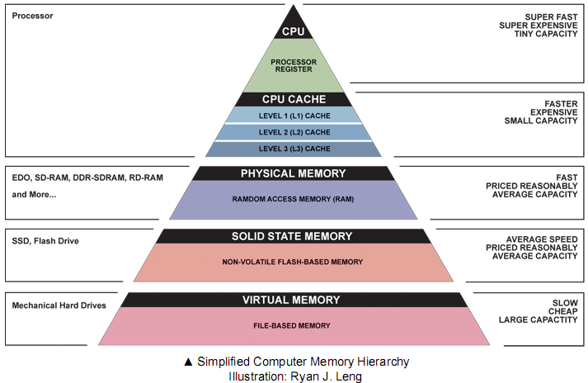
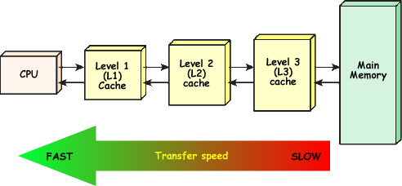
The Present

Slide 18
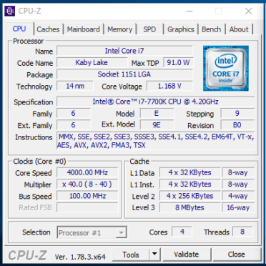
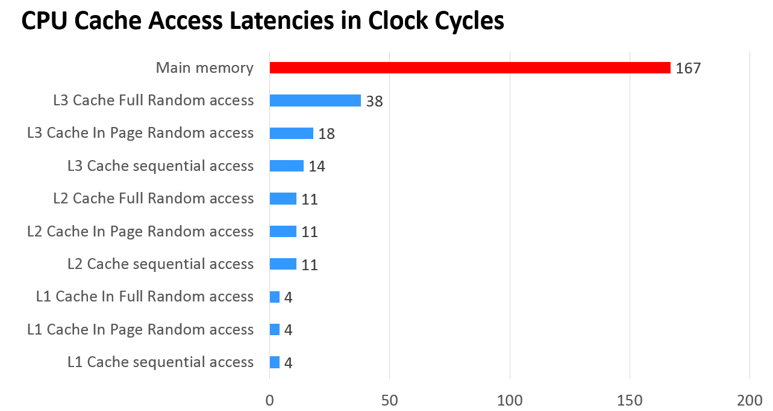
The Present

Slide 19
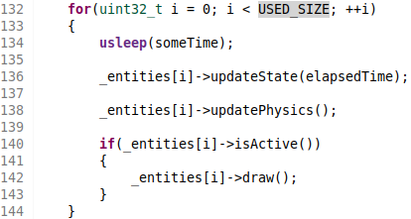
The Present

Slide 20
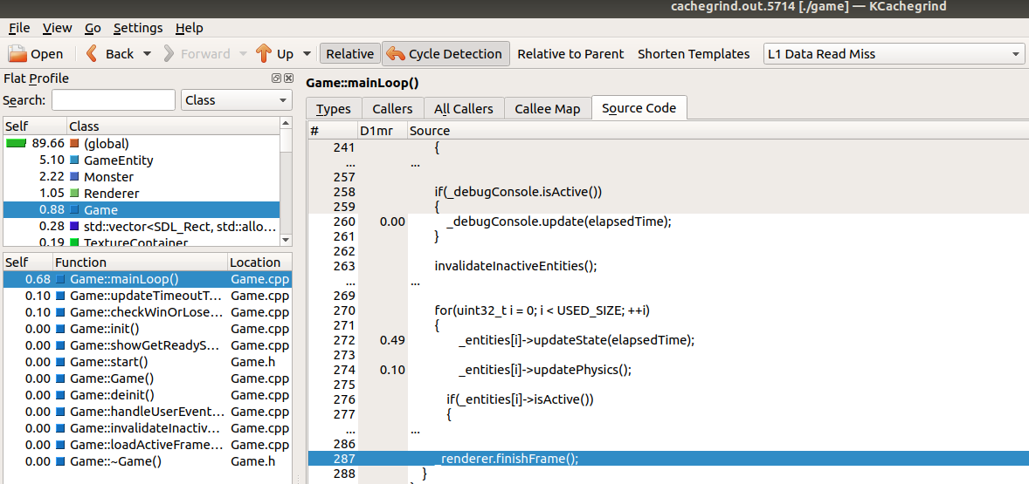
The Present

Slide 21
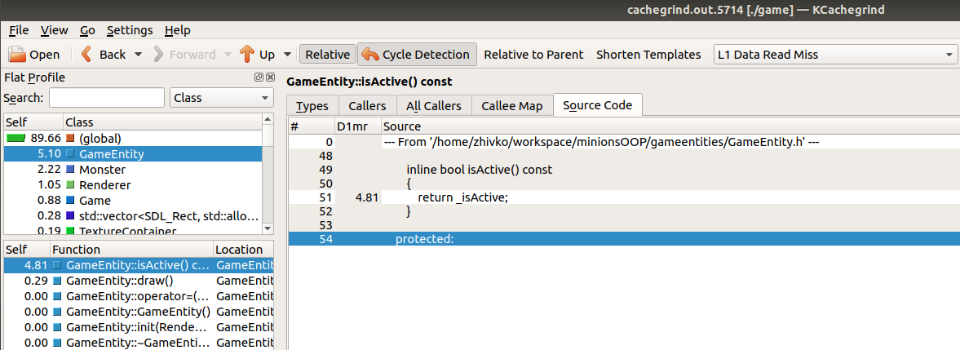
The Present

Slide 22
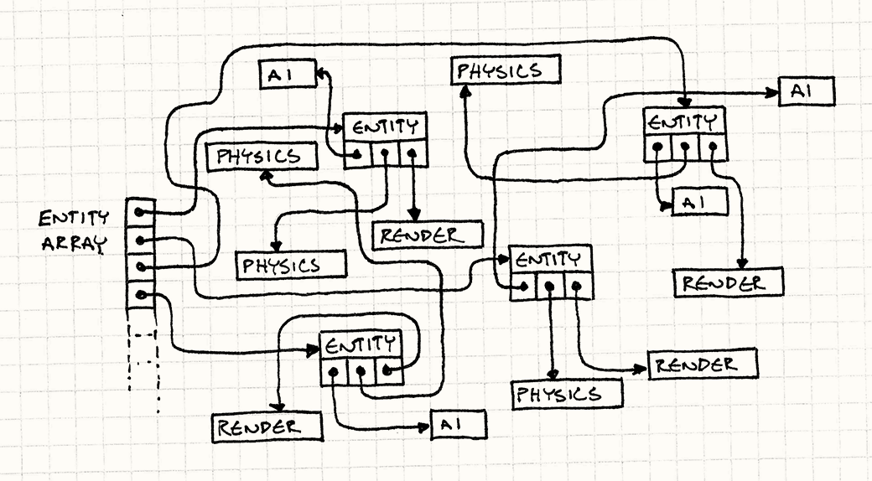
The Present

Slide 23
The Present
Change of mindset
Pointers are bad → tightly packed data is good;
How to handle polymorphism (or inheritance in general) → don’t;
Favor composition instead of inheritance;
Reduce the size of your variables (where you can);

Slide 24
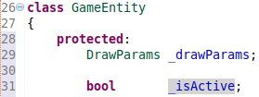
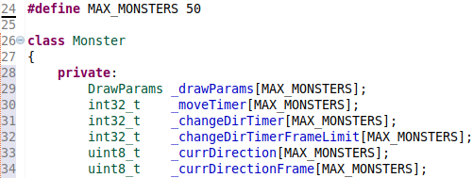
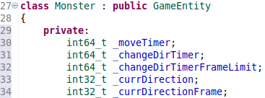
The Present
Let’s examine the class “Monster”
OOP
DOP
Array of Structures (AoS)
Structure of Arrays (SoA)

Slide 25
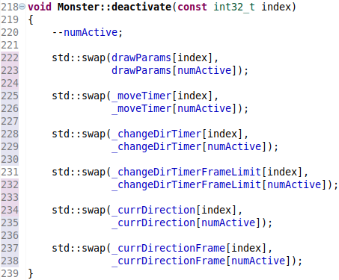
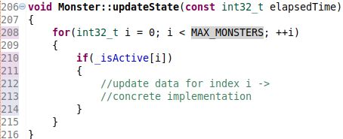
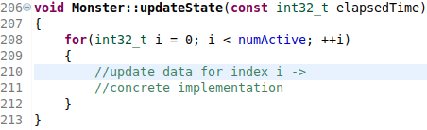
The Present
DOP Monster::updateState() method

Slide 26

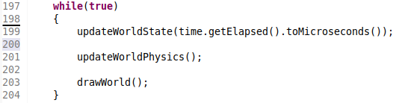
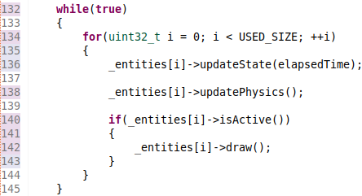
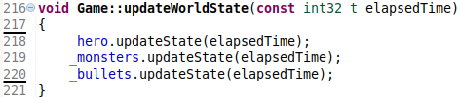
The Present
OOP
DOP

Slide 27
The Present
DOP Demo

Slide 28
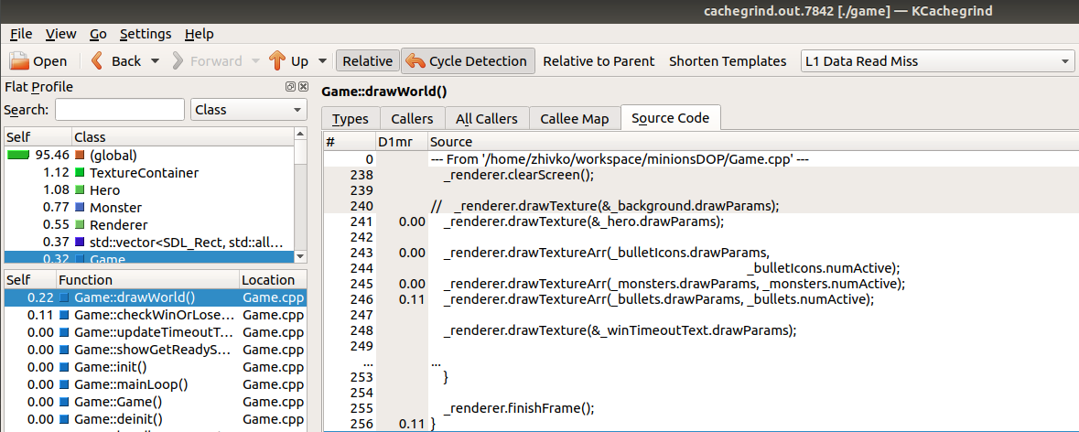
The Present

Slide 29
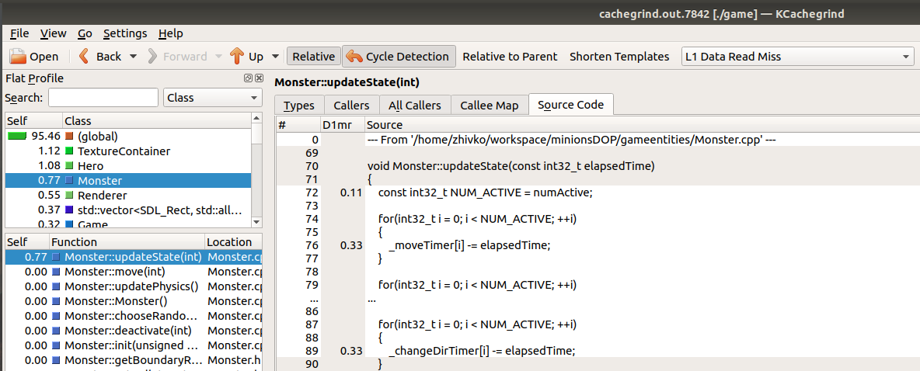
The Present

Slide 30
The Present
Why the DOP example was not fast enough?
Hardware and Software prefetching;
The program I’ve written is very very small;
The OOP example is written good;
Texture Container (Resource Manager);
The “draw” operation is magnitudes of times slower than everything else;

Slide 31
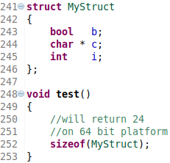
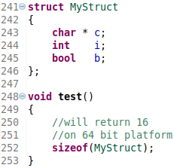
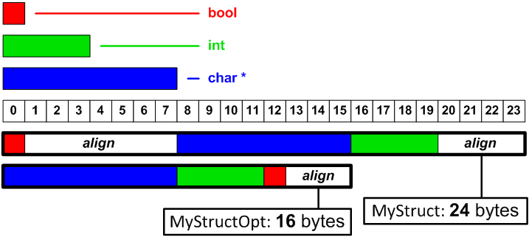
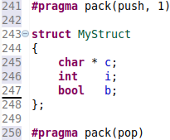
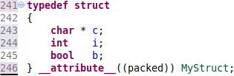
The Future
Some more DOP patterns not covered by the demo: Data alignment
//For GCC
//For Microsoft C++ compiler

Slide 32

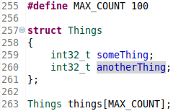
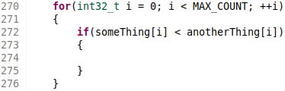
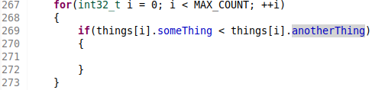
The Future
Some more DOP patterns not covered by the demo (2):
Spatial locality

Slide 33
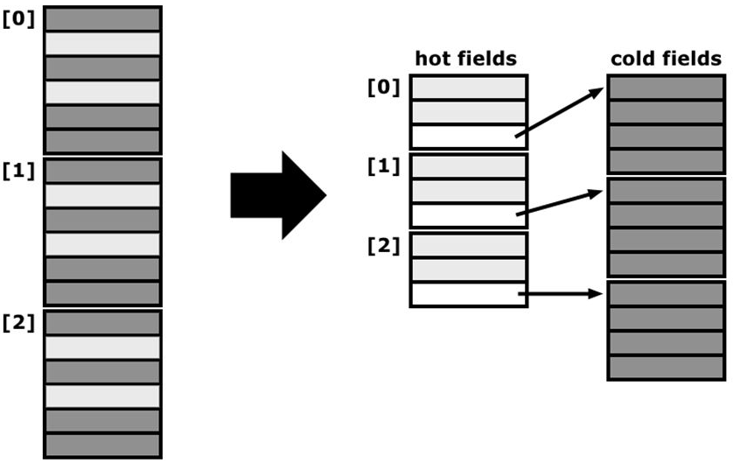
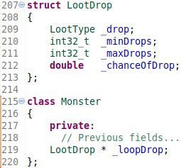
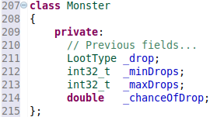
The Future
Some more DOP patterns not covered by the demo (3):
Hot-Cold Splitting

Slide 34


The Future
Contact me.
Say Hello.
/zhivko-petrov
/zhivko-petrov/CacheFriendlyCode

Slide 35
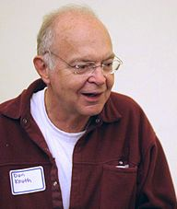
The Future
We should forget about small efficiencies, say about 97% of the time:
premature optimization is the root of all evil.
Yet we should not pass up our opportunities in that critical 3%.
Donald Knuth

