Slide 1
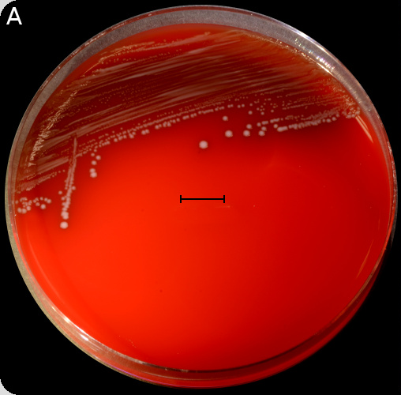
Paper: 1; “RNA-seq and Tn-seq reveal fitness determinants of vancomycin-resistant Enterococcus faecium during growth in human serum” (Zhang et al., 2017)
Erik Zhivkoplias
Genome Analysis 2019
29/05/2019
http://www.vetbact.org/popup/image.php?imgtable=vetbact_images&imgid=677

Slide 2
Analysis overview
Ilumina
Pacbio
Nanopore
RNA-Seq
Tn-Seq
Genome Assembly
Genome Annotation
Expression Data Analysis
SNPs calling
Illumina
McGann et al, 2016

Slide 3
Goals
Reproduce the results in the chosen paper (Paper 1: “RNA-seq and Tn-seq reveal fitness determinants of vancomycin-resistant Enterococcus faecium during growth in human serum”)
Learn how to assemble and annotate prokaryotic genomes, analyze RNA-Seq data, and make biological conclusions out of NGS data
Find any (novel?) candidate genes to target E. faecium in bloodstream

Slide 4
Genome Assembly: pipeline
Genome Assembly with Pacbio (canu)
Assembly Correction with Illumina (Pilon)
QC (Fastqc, Trimmomatic)
Genome Hybrid Assembly with Illumina + Nanopore (SPAdes)
Assembly Evaluation (quast) and Manual correction

Slide 5
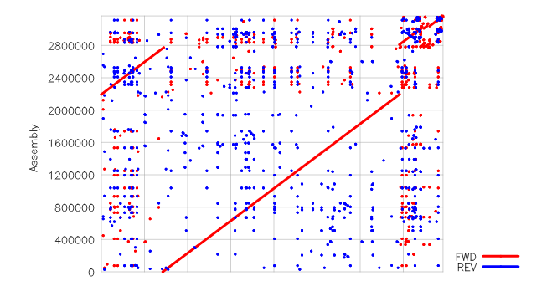
Genome Assembly: result
Number of contigs:
9
Largest contig:
2773702
Total length:
3 164 587 bp
Reference size:
3 168 410 bp
Genome fraction (%): 98.935

Slide 6
Genome Annotation pipeline
Structural Annotation (Prokka)
Functional Annotation (Prokka)
Annotation Evaluation and Synteny Analysis (Artemis)
Evaluation of antibiotic resistance potential (ResFinder)

Slide 7
Genome Annotation: results
Canu Assembly: contigs: 9, bases: 3126531, tmRNA: 1, tRNA: 70, CDS: 3036, rRNA: 18
SPAdes assembly: contigs: 43, bases: 3151876, tmRNA: 1, tRNA: 70, rRNA: 18, CDS: 3060
Hybrid (final) assembly: contigs: 9, bases: 3164587, tRNA: 70, CDS: 3083, rRNA: 18, tmRNA: 1
Reference: <..>the chromosome and plasmids have 3095 predicted coding sequences<..>

Slide 8
Genome Annotation: antibiotic resistance potential (ResFinder)
Aminoglycoside
Resistance gene Identity Query/HSP Contig Position in contig Phenotype Accession no.
aac(6')-Ii 99.64 549/549 tig00000001_pilon 2471910..2472458 L12710
Glycopeptide
Resistance gene Identity Query/HSP Contig Position in contig Phenotype Accession no.
VanH 91.85 969/969 tig00000025_pilon 37402..38370 1_Y15705
VanA 93.51 1032/1032 tig00000025_pilon 38363..39394 Vancomycin resistance (Glycopeptid resistance) 1_Y15704
VanX 96.79 249/249 tig00000025_pilon 39400..39648 1_Y15708
VanHAX 100.00 2607/2607 tig00000025_pilon 4980..7586 M97297
Macrolide, Lincosamide and Streptogramin B
Resistance gene Identity Query/HSP Contig Position in contig Phenotype Accession no.
msr(C) 98.99 1479/1479 tig00000001_pilon 743512..744990 Macrolide, Lincosamide and Streptogramin B resistance AY004350
Trimethoprim
Resistance gene Identity Query/HSP Contig Position in contig Phenotype Accession no.
dfrG 100.00 498/498 NODE_3_length_64343_cov_75.9457 2210..2707 Trimethoprim resistance AB205645

Slide 9
RNA Seq and Tn-Seq pipeline
QC (Fastqc, Trimmomatic)
Read mapping (bowtie2)
Transcript Quantification (htseq)
Differential Expression Analysis (DESeq2)
QC (Fastqc, Trimmomatic)
Read mapping (bowtie2)
Transcript Quantification (htseq)
Differential Expression Analysis (DESeq2)

Slide 10
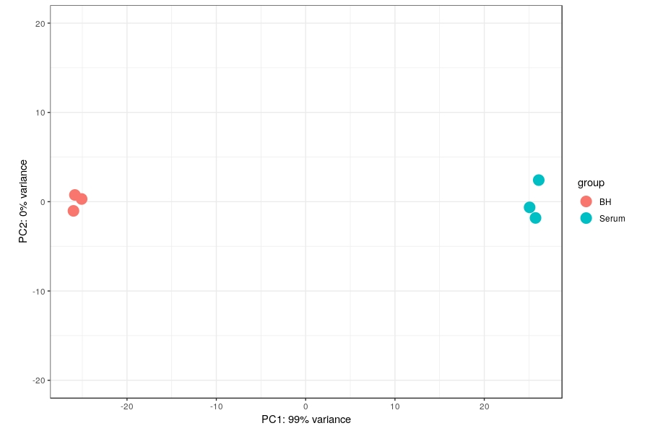
RNA Seq: results

Slide 11
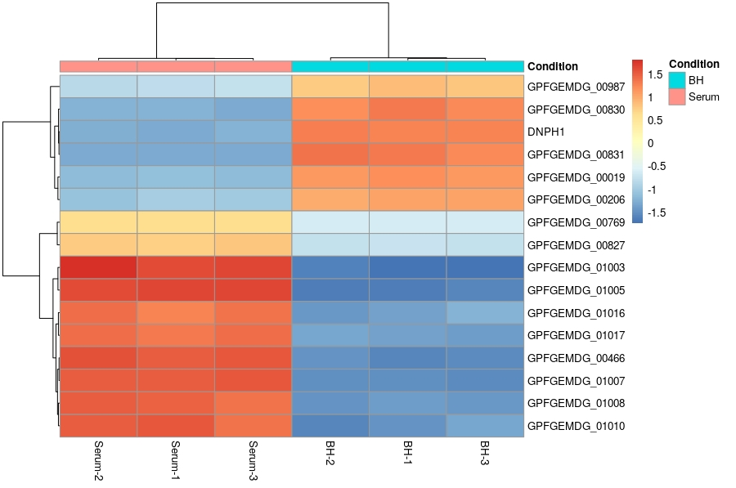
RNA Seq: results

Slide 12
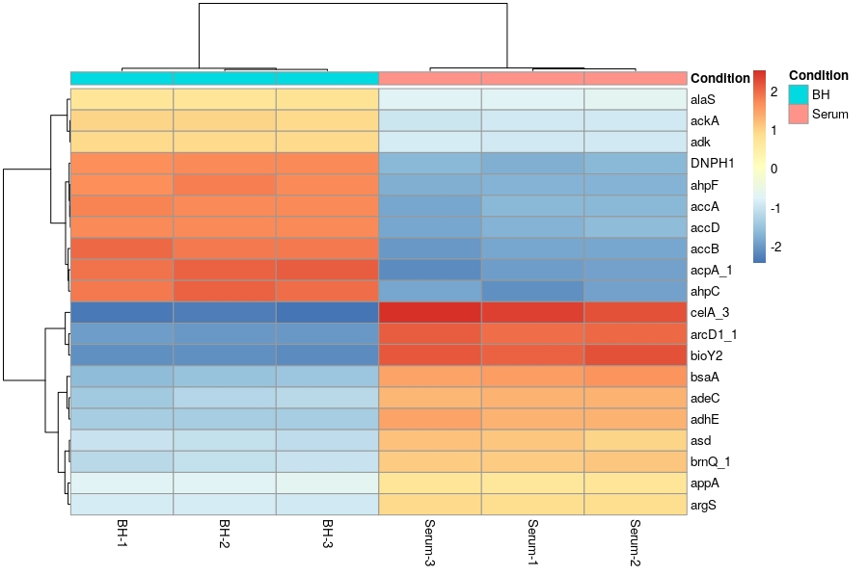
RNA Seq: results

Slide 13
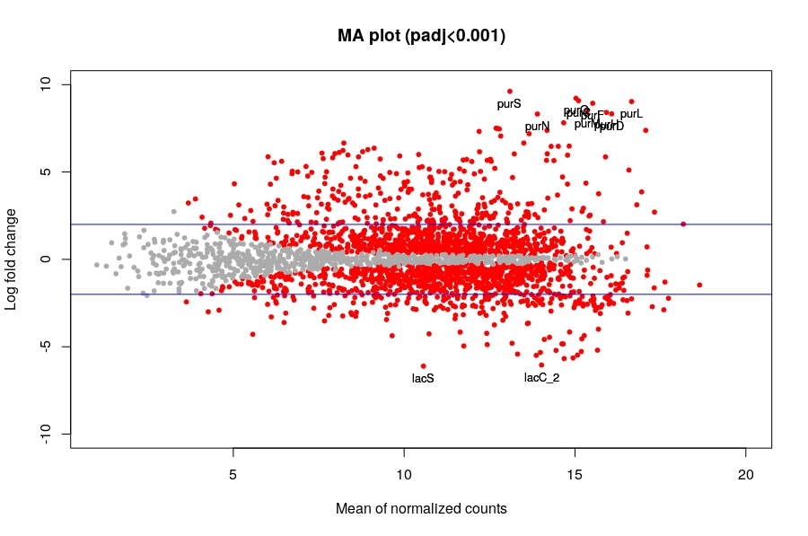

Slide 14
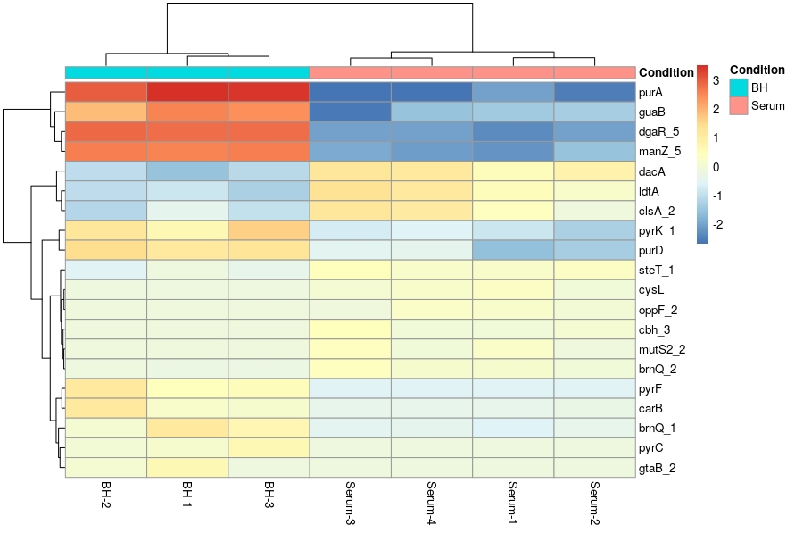
Tn-Seq: results

Slide 15
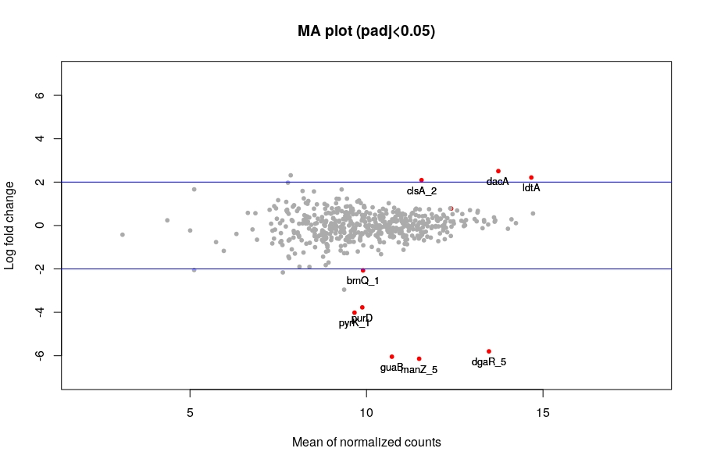

Slide 16
Conclusion
Found 31 candidate genes (37 in paper) of which 20 are hypothetical proteins and 11 have known gene names
Most genes are related to purine metabolism genes (the same finding as in paper), however, there are a few genes that participate in carbohydrate metabolism
One gene that is involved in carbohydrate uptake (manZ_5: part of hosphoenolpyruvate-dependent sugar phosphotransferase system) might be a good candidate for antibiotic targeting, as it is a membrane-associated protein, and a quite distant homolog in primates (huntingtin: 40% homology).

Slide 17
Thank you for your attention.

