Slide 1
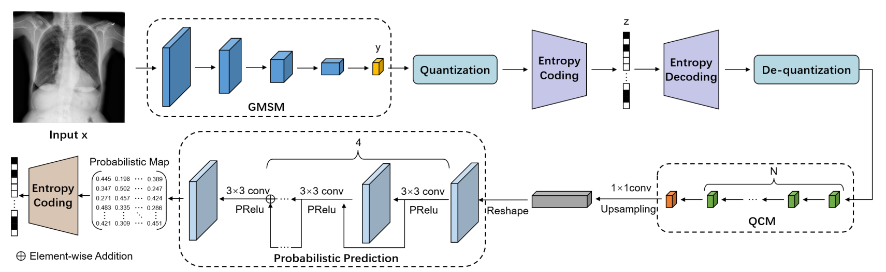
Notes:
2025_MICCAI_LVPNet

Slide 2
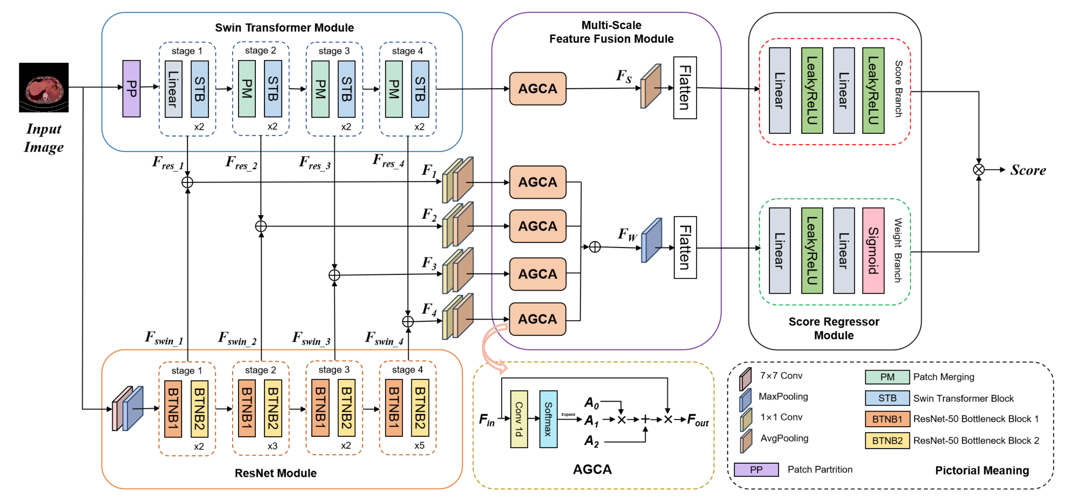
Notes:
2025_MICCAI_MS-IQA

Slide 3
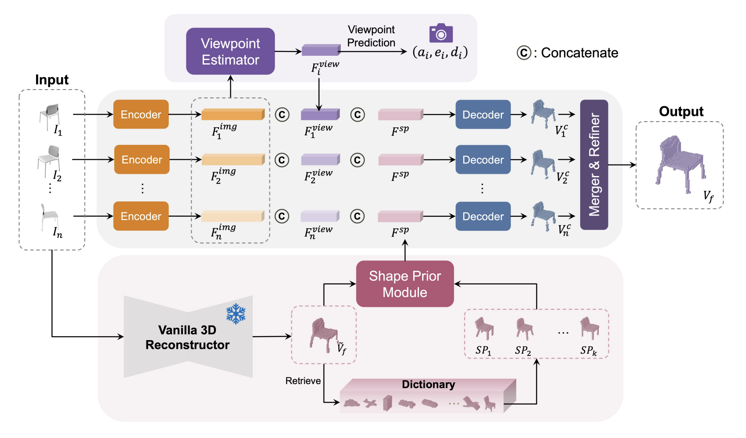
Notes:
2024 ACCV VIPNet

Slide 4
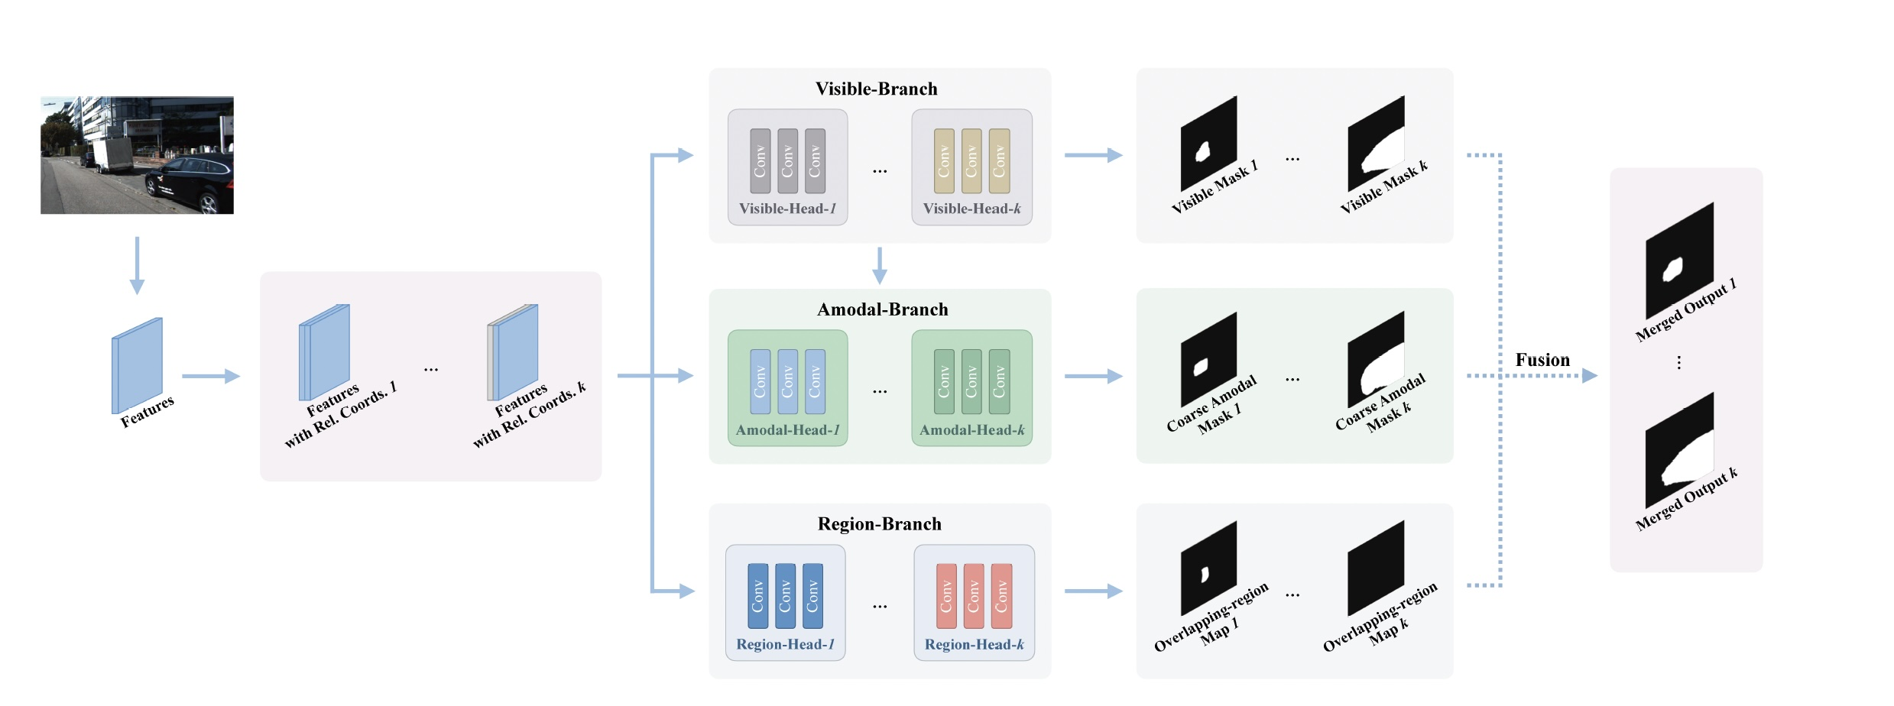

Slide 5
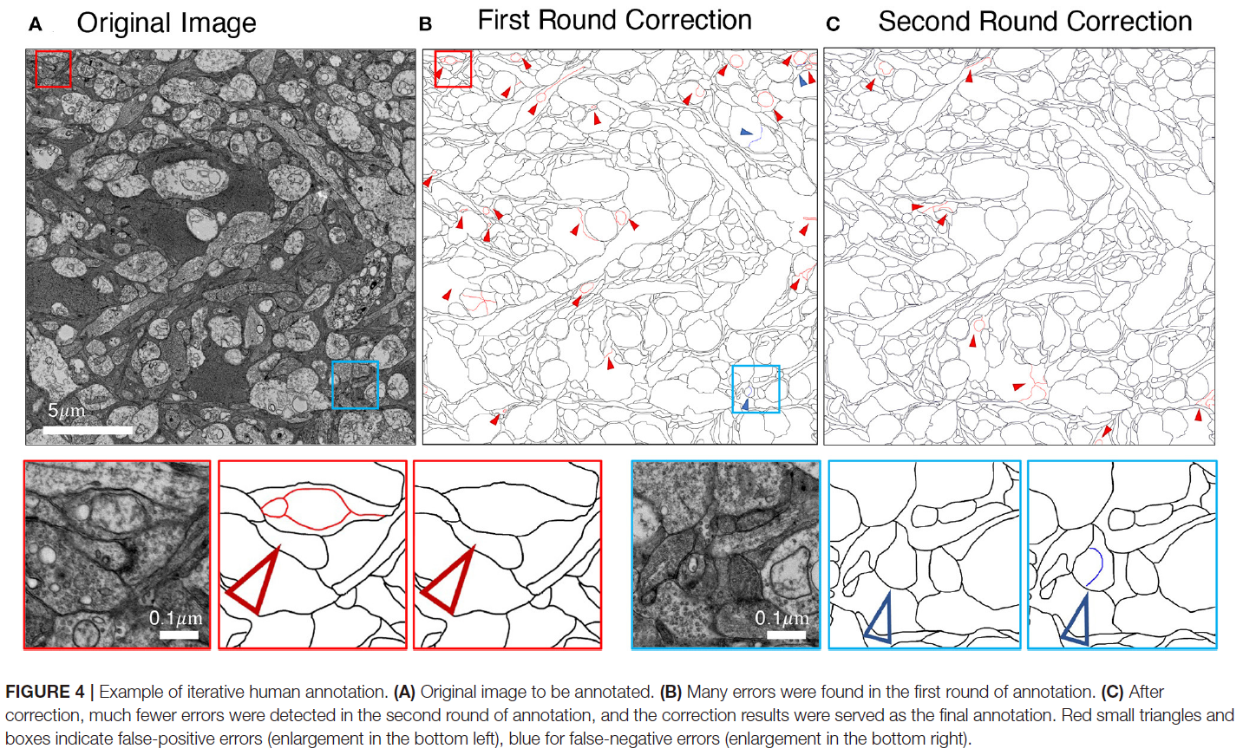
Notes:
2022_Frontiers

Slide 6
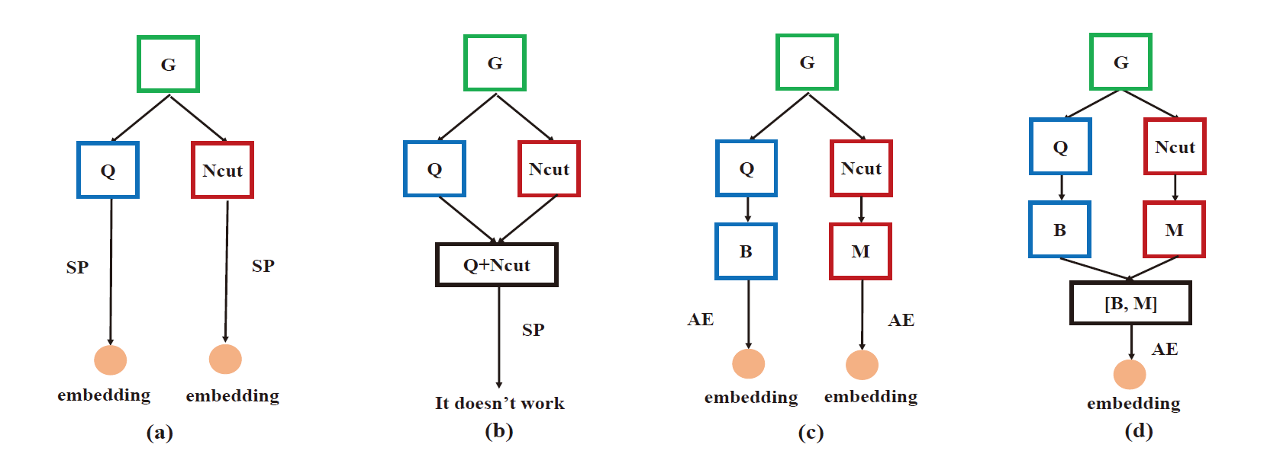
Notes:
2017_ICTAI

