Slide 1
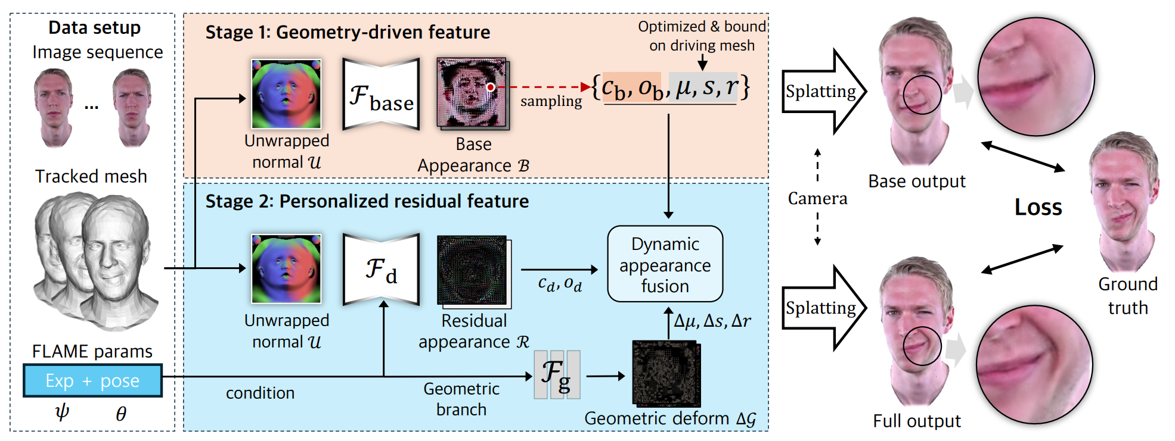
Notes:
2026_AAAI_DipGuava.jpg

Slide 2
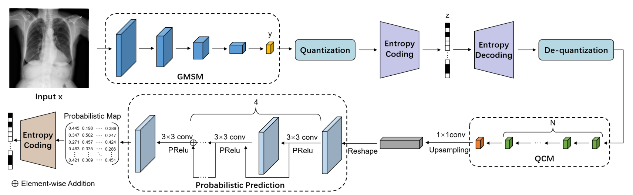
Notes:
2025_MICCAI_LVPNet

Slide 3
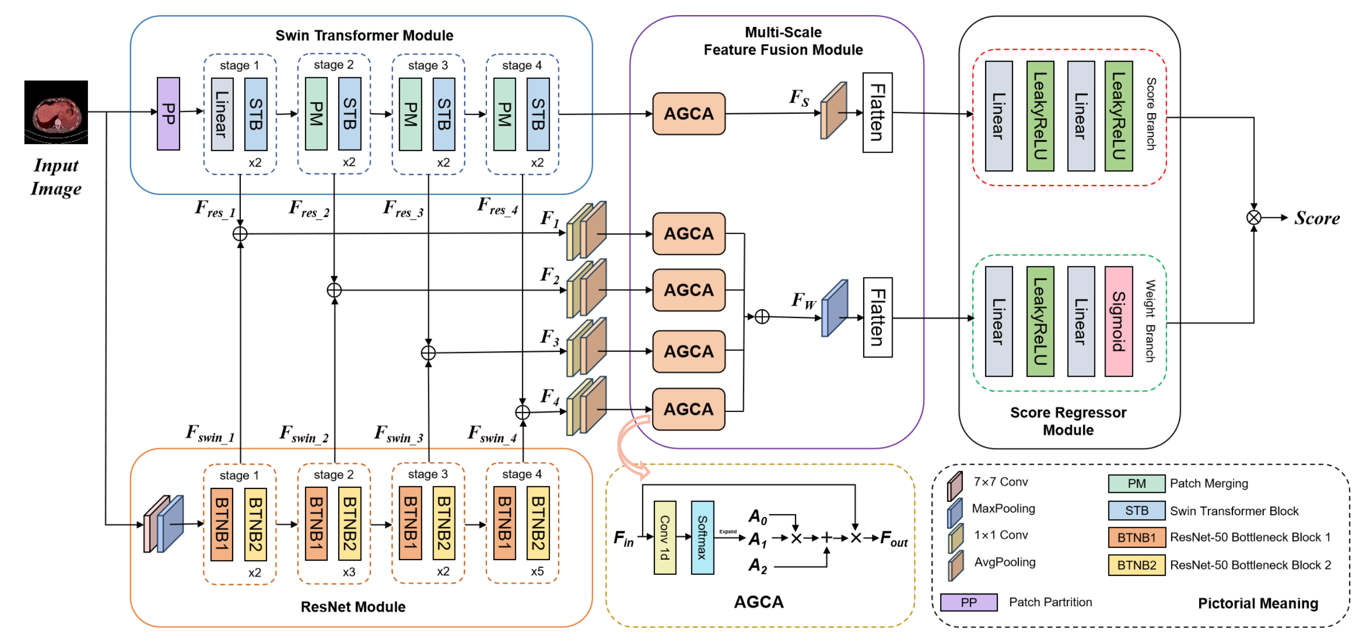
Notes:
2025_MICCAI_MS-IQA

Slide 4
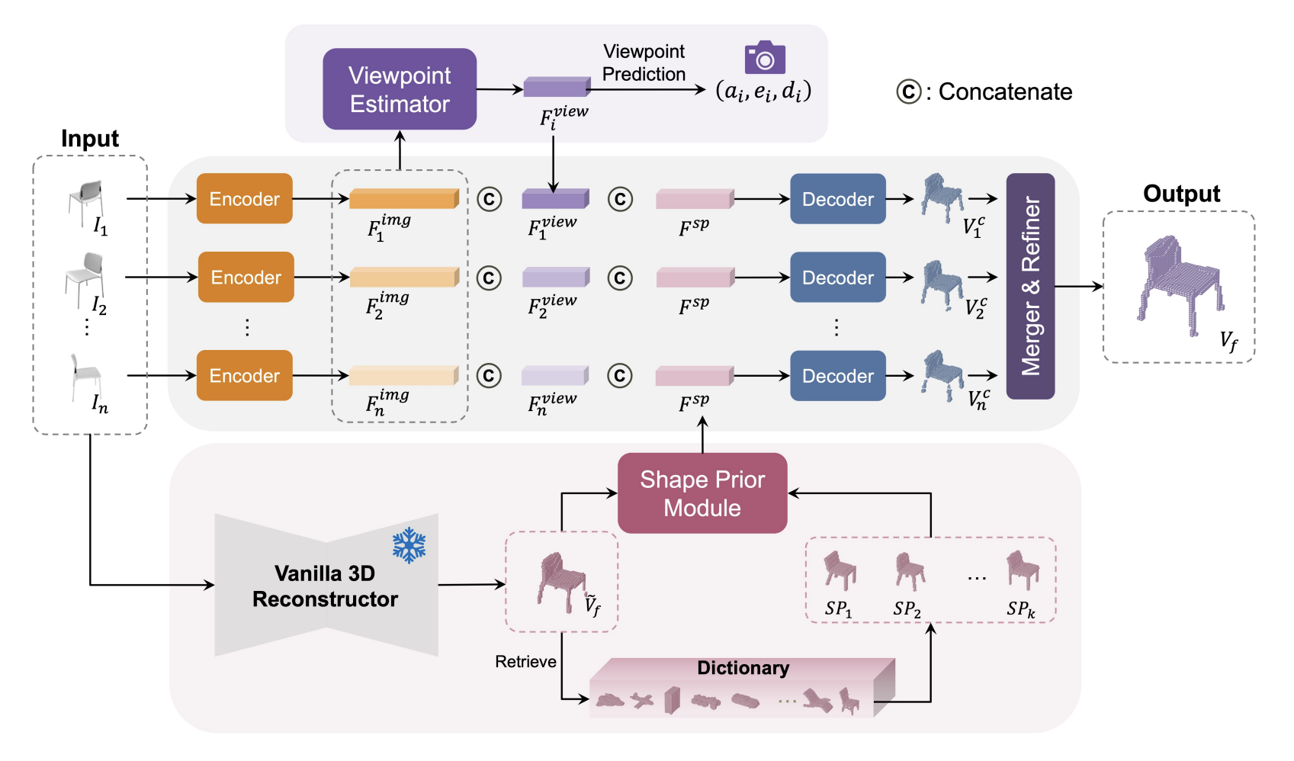
Notes:
2024 ACCV VIPNet

Slide 5
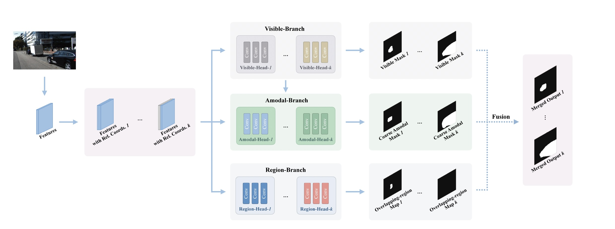

Slide 6
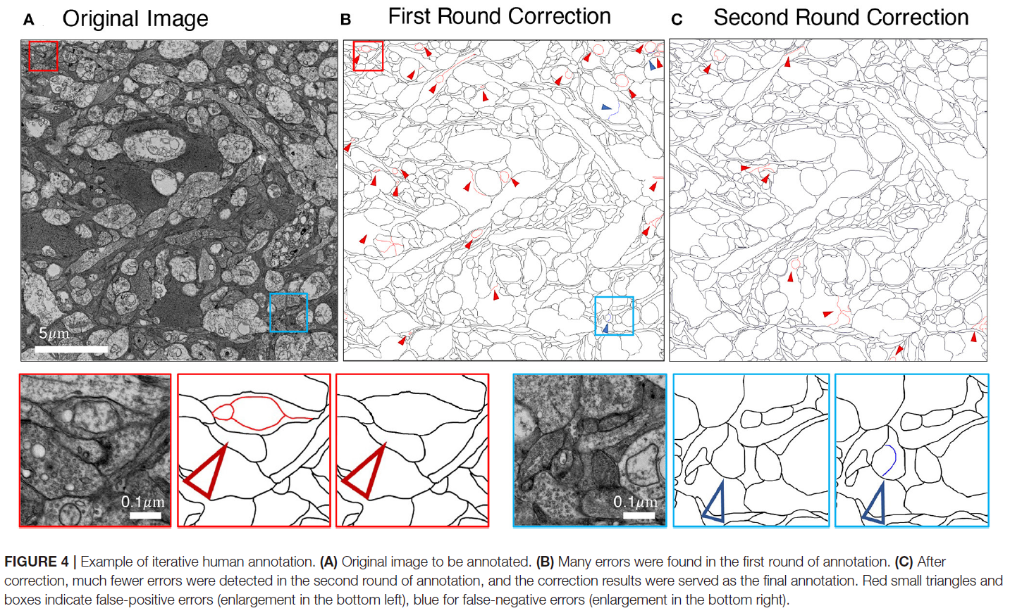
Notes:
2022_Frontiers

Slide 7
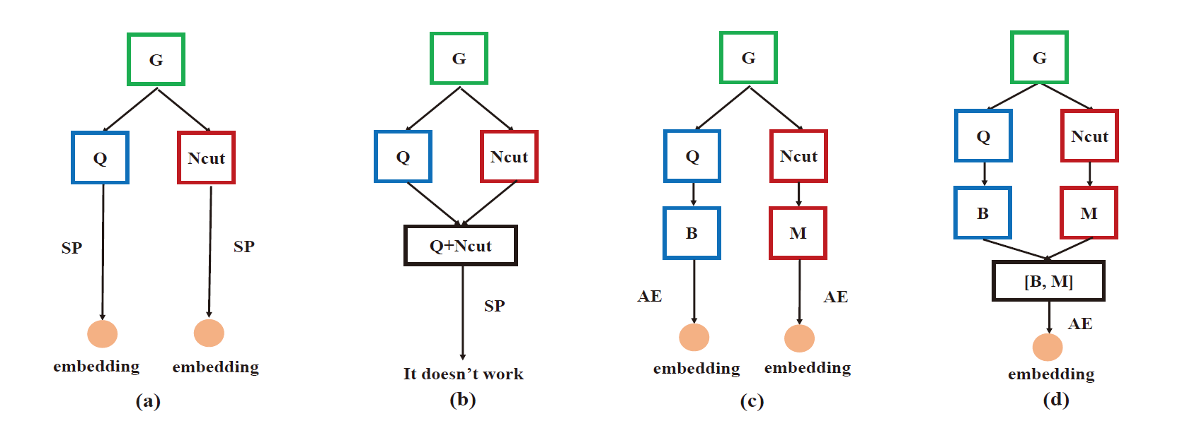
Notes:
2017_ICTAI

