Slide 1
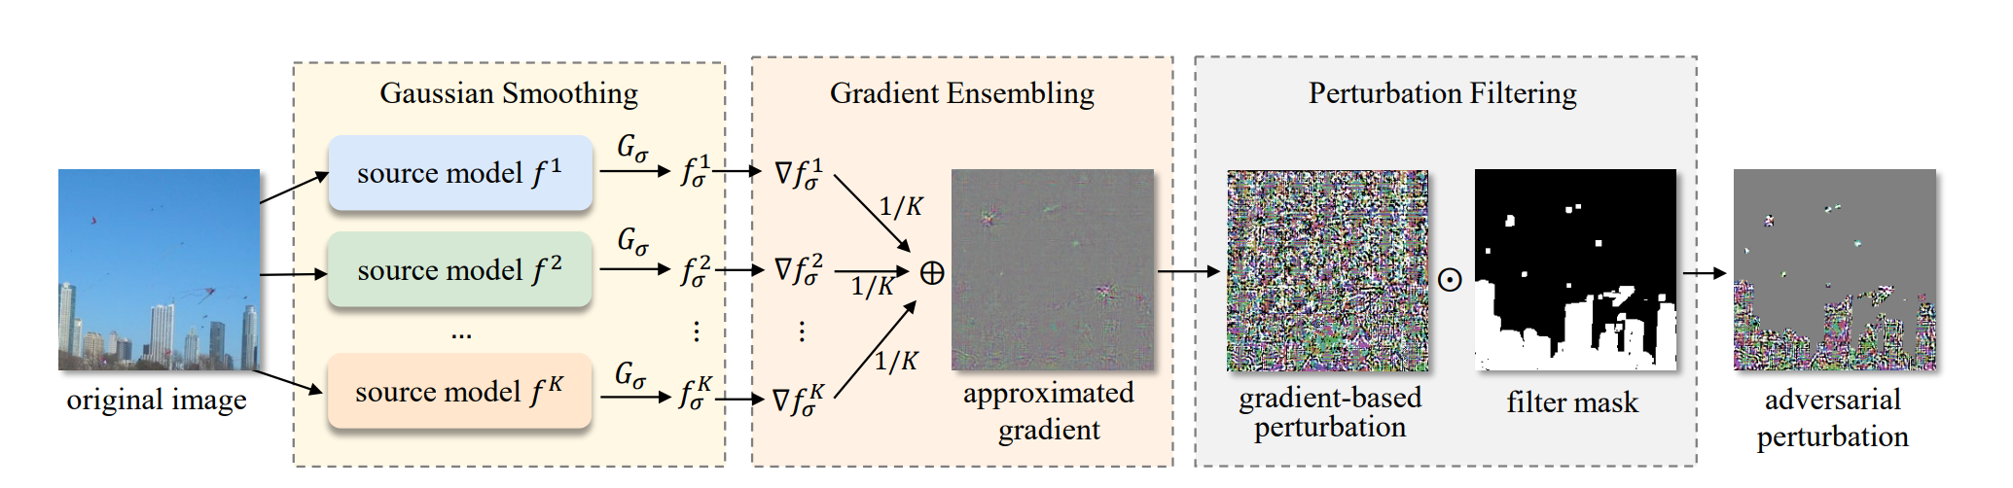
Notes:
2026_TPAMI_SEGA.jpg

Slide 2
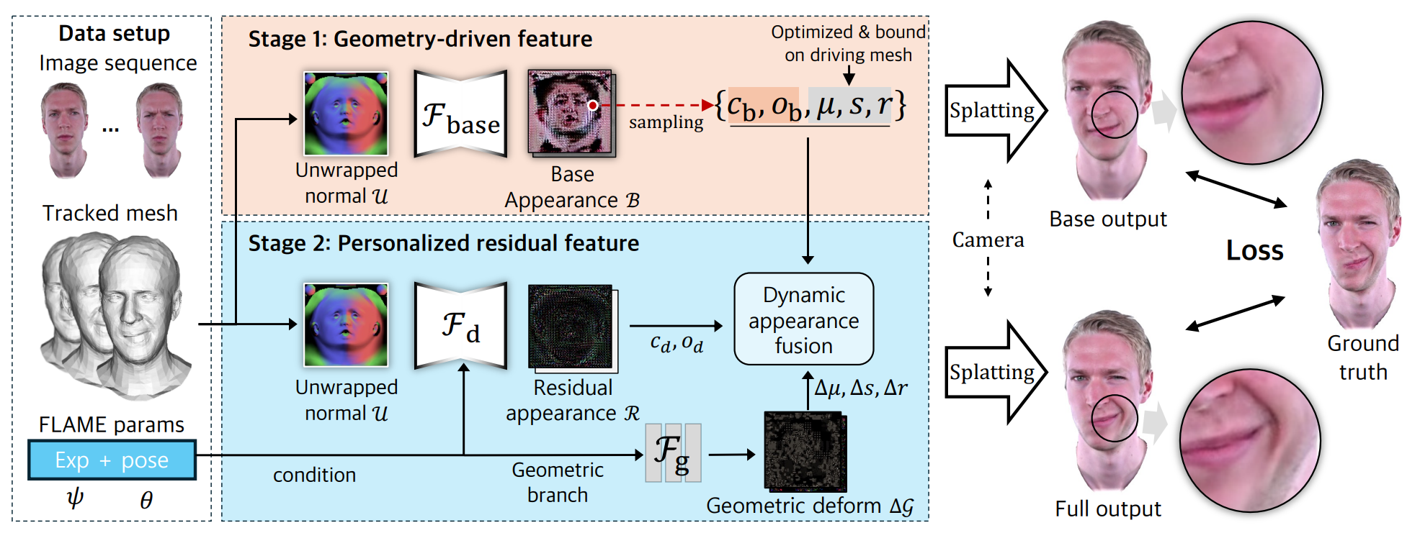
Notes:
2026_AAAI_DipGuava.jpg

Slide 3
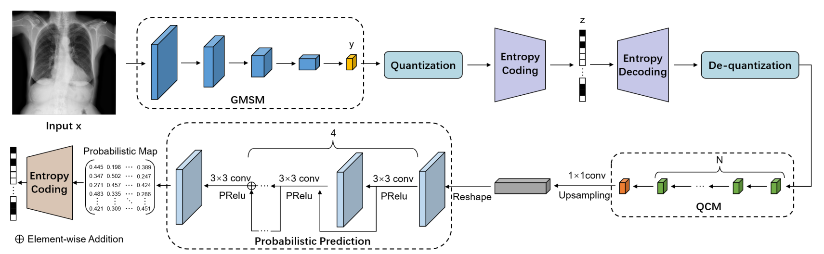
Notes:
2025_MICCAI_LVPNet

Slide 4
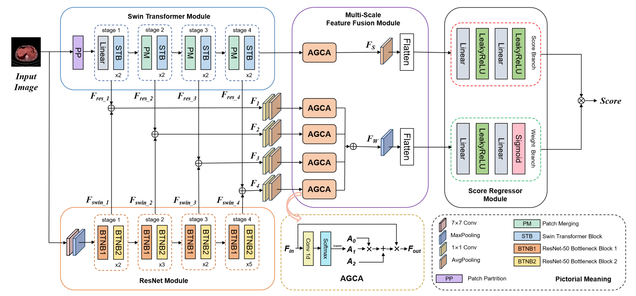
Notes:
2025_MICCAI_MS-IQA

Slide 5
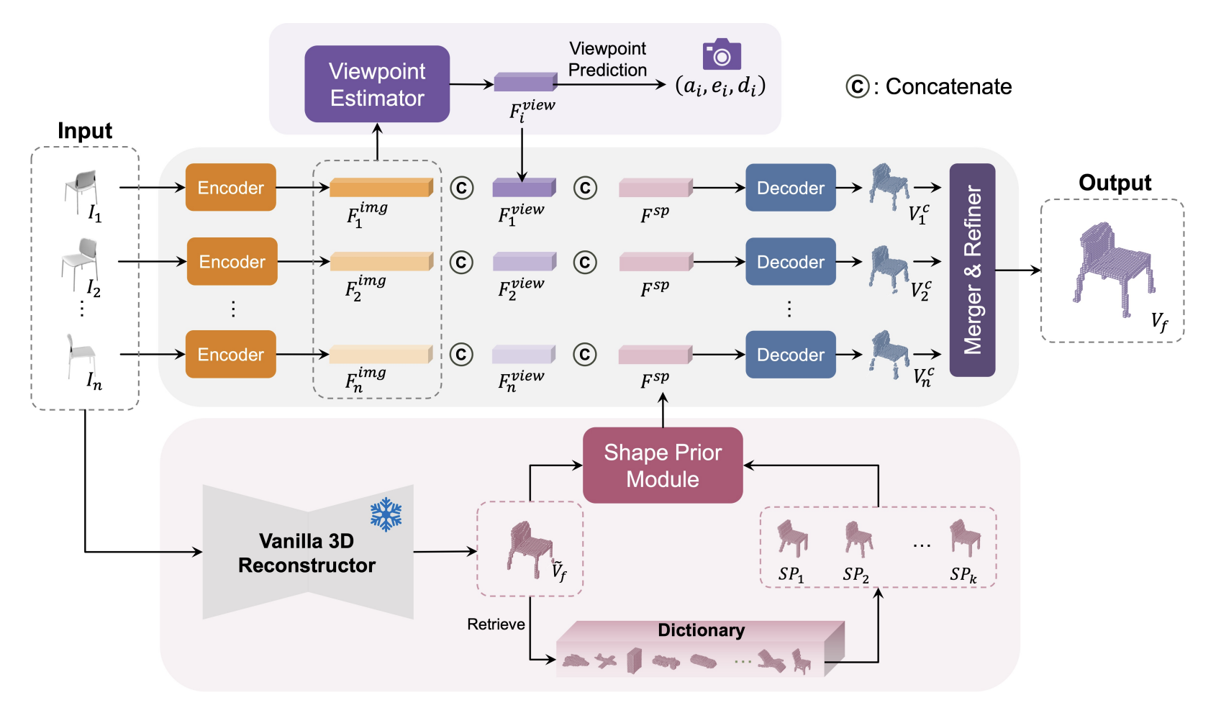
Notes:
2024 ACCV VIPNet

Slide 6
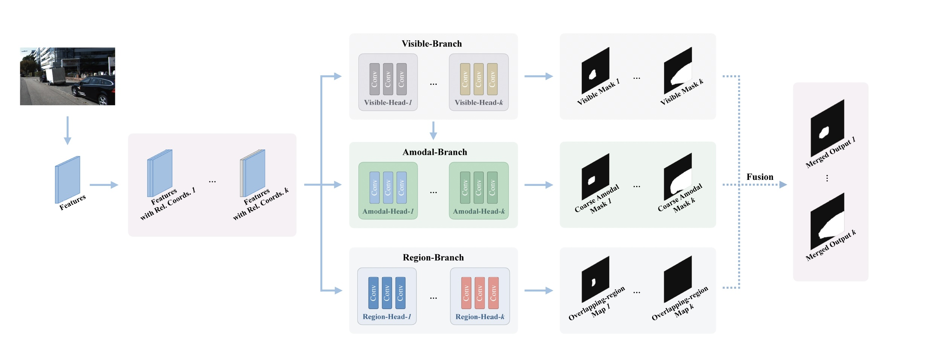

Slide 7
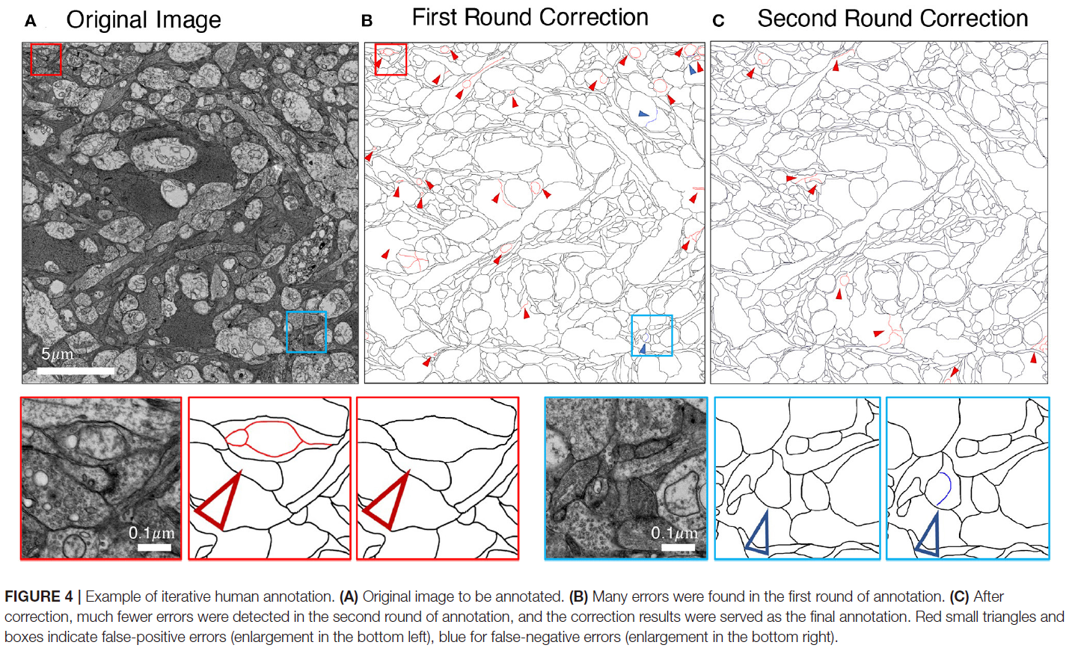
Notes:
2022_Frontiers

Slide 8
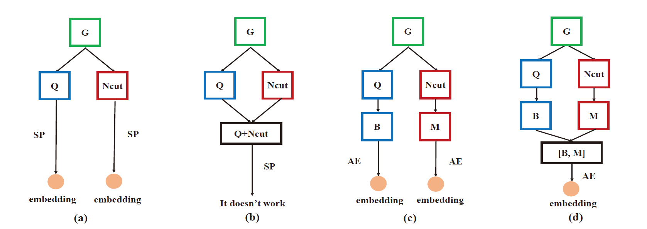
Notes:
2017_ICTAI

