Slide 1
Graph ADT
CSCE 221

Slide 2
Data structure ADT - description
A graph G is a pair (V, E), where V is a set of vertices, and E is a set of edges. Each edge is associated with two vertices, which are endpoints of the edge.
In PA6, we need to implement a not self-looped, undirected an weighted graph data structure.

Slide 3

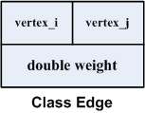
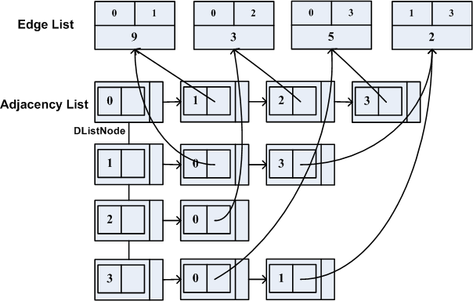
Data structure ADT – description
Class Vertex
Class Edge
Edge List
Adjacency List
0
9
1
5
3
2
3
2

Slide 4
Pa6 Graph Input Format
Line 0: int n, e; // number of vertices, edges
Line 1 – Line n: (for Line k)
int v_{i}, double w_{k,i}, int v_{j}, double w_{k,j}, …, -1
Each line represents an adjacency array of Vertex k. Each line ends with -1.
For example:
4 4
1 9 2 3 3 5 -1
0 9 3 2 -1
0 3 -1
0 5 1 2 -1
0
9
1
5
3
2
3
2

Slide 5
Data structure ADT – Operations
void buildGraph();
void insertEdge(int i, int j, double w);
double getWeight(int i, int j);
void sortEdge();
double MSTAlgo();

Slide 6
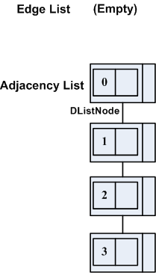
Data structure ADT – Operations
void buildGraph();
Build an empty Edge List and Adjacency List
After this operation:

Slide 7
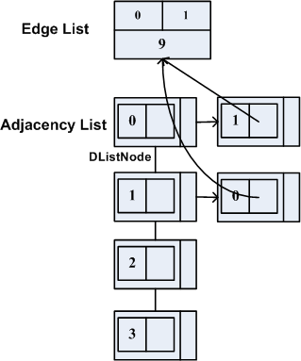
Data structure ADT – Operations
void insertEdge(int i, int j, double w);
Insert a new edge to the Edge List and insert relevant Vertex to the Adjacency List
For example, insertEdge(0, 1, 9):
insertEdge(0, 1, 9)

Slide 8
Data structure ADT – Operations
double getWeight(int i, int j);
Return weight of edge between vertices i and j;
In the right state,
getWeight(0, 1) = 0.

Slide 9
Data structure ADT – Operations
double getWeight(int i, int j);
In this state:
getWeight(0, 1) = 9.

Slide 10
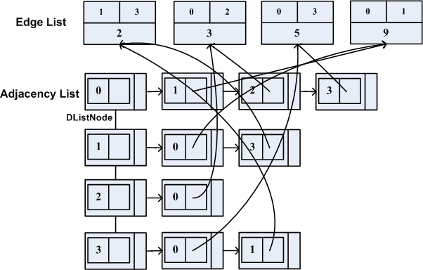
Data structure ADT – Operations
void sortEdge();

Slide 11
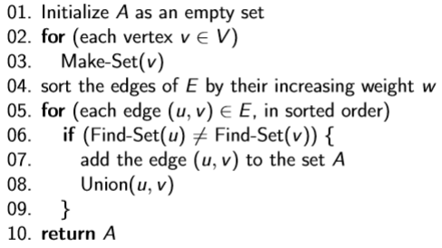
Data structure ADT – Operations
double MSTAlgo();
Kruskal’s algorithm is based on the Generic-MST algorithm.

Slide 12

Data structure ADT – Operations
After the MSTAlgo() function, the MST will store the edges in the spanning tree.
For example:

