Slide 1


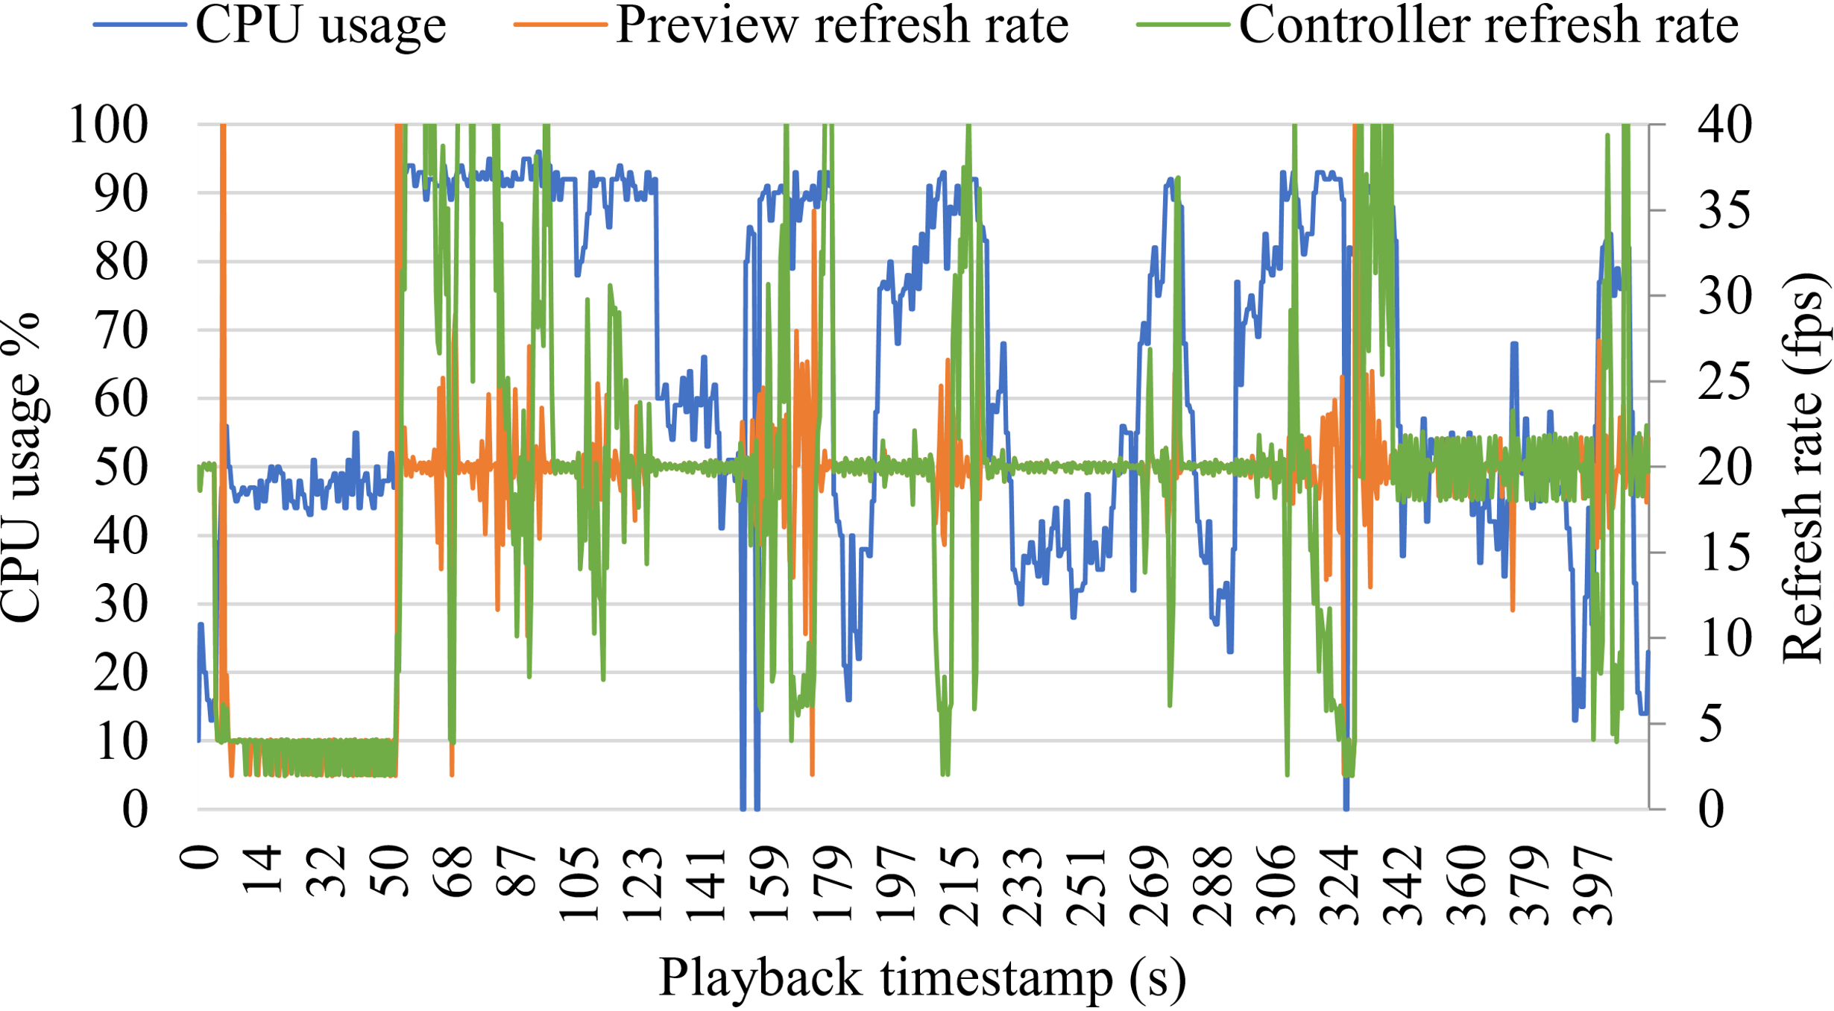
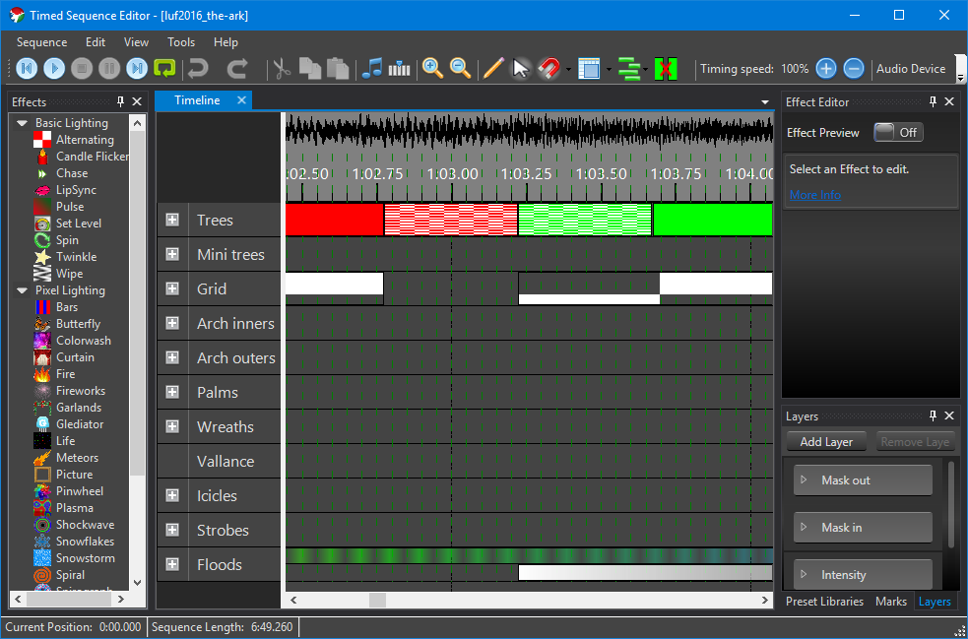
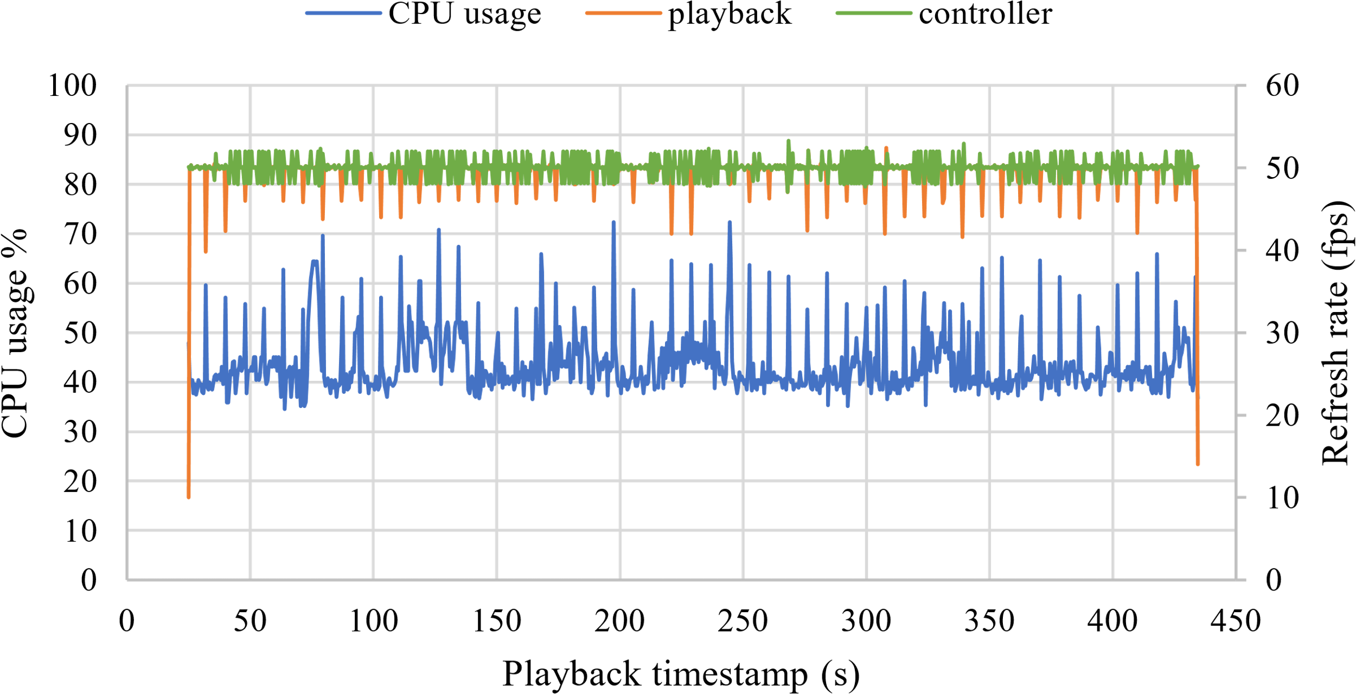
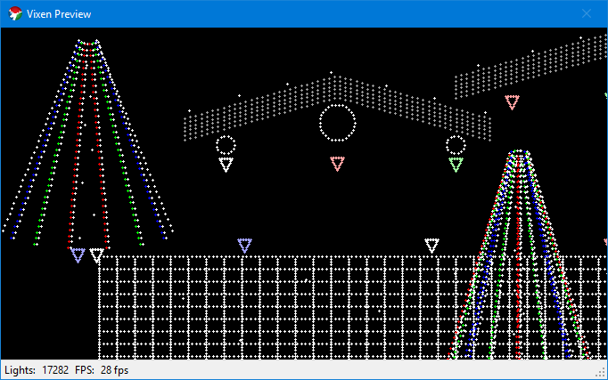

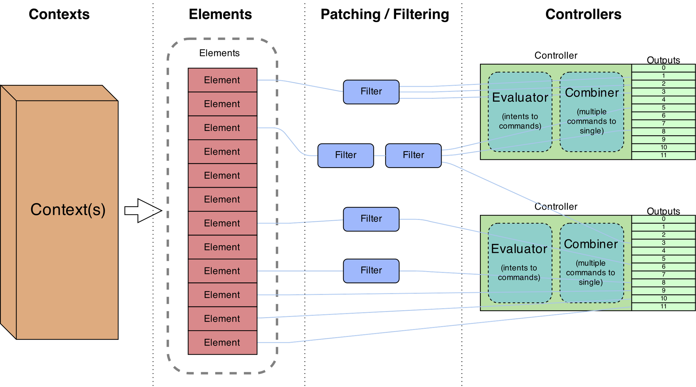
Lightening the Load: A New Playback Engine for Sophisticated Animated Lighting Displays
Yubo Zhi
Department of Electrical and Electronic Engineering, Faculty of Engineering, Imperial College London
Introduction
Performance improvement
Vixen^{[1]} is a lighting display design and control application.
It has a sophisticated lighting effect designer, supports thousands of lighting channels with flexible element mapping.
However, all these flexible but complex mapping routines require a powerful computer to drive the display execution engine during lighting shows.
To resolve this problem, a new simplified playback engine was designed.
As a reference, the figure below shows the performance of the original Vixen execution engine, captured on a mid-range dual-core laptop:
The new playback engine has a remarkable rendering performance compared to the original Vixen engine. It was able to be used on a variety of embedded platforms.
The figure below shows the performance of the new playback engine using the same sequence, captured on a relatively low-end embedded platform, Raspberry Pi B+:
The CPU usage frequently reaches above 90%.
The refresh rates are very unstable around the configured 20 fps.
Vixen application
Load lighting sequences as contexts
Visual-related realistic element grouping, e.g. trees and houses
Interactive sequence editor of display element effects
Live preview with customisable element placement layout
Flexible hardware controller channel mapping
Modular design, supports custom software plugins for additional controllers
Show scheduler for automated lighting shows
The CPU usage was below 50% most of the time.
The refresh rates are quite stable around the configured 50 fps.
Video input format
In addition to exported raw data format, video format was also supported for playback.
For cross-platform compatibility, the popular ffmpeg framework^{[2]} was used.
The new procedure of designing, exporting and playback is very similar to modern video animation designs
Various video encoding algorithms can be used to reduce sequence file size
Sequence data, audio and configurations can be combined into a single video file
Enables easy sharing and management of sequences
Commonly available video processing, editing and analysis tools can be used
Previewing is possible using common media players, without actual lighting setups or dedicated Vixen application
Proposed new playback engine
Pre-rendering (exporting) lighting sequences for all controller channels
Uses manual timing source for exporting
Produces precise frame interval
Actual rendering is independent of exporting machine performance
Removed rendering overheads of:
Loading and preparing sequence designs
Element updates
Filters for channel mapping
Expensive controller data type resolve operations
Still uses modular design for supporting controller plugins
Additional command-line application, optimised for embedded platforms
On Raspberry Pi B+, the CPU usage was increased by 30% when using a video as input. But refresh rates are still stable around 50 fps.
A video-encoded frame, taken from an example sequence:
Original Vixen execution engine pipeline^{[1]}
Future works
Improve code segments for user-friendliness and production release
Improve execution and playback engine integration
Support for element back-mapping and preview display from playback engine
Intuitive video pixel mapping using preview layout and mapping
ACKNOWLEDGEMENTS
Sincere thanks to project supervisor Dr James J. Davis for supporting this project.
New playback engine
REFERENCES
[1] Vixen Team. (2017) Vixen lights. [Online]. Available: http://www.vixenlights.com
[2] Ffmpeg multimedia framework. [Online]. Available: https://ffmpeg.org

