Slide 1
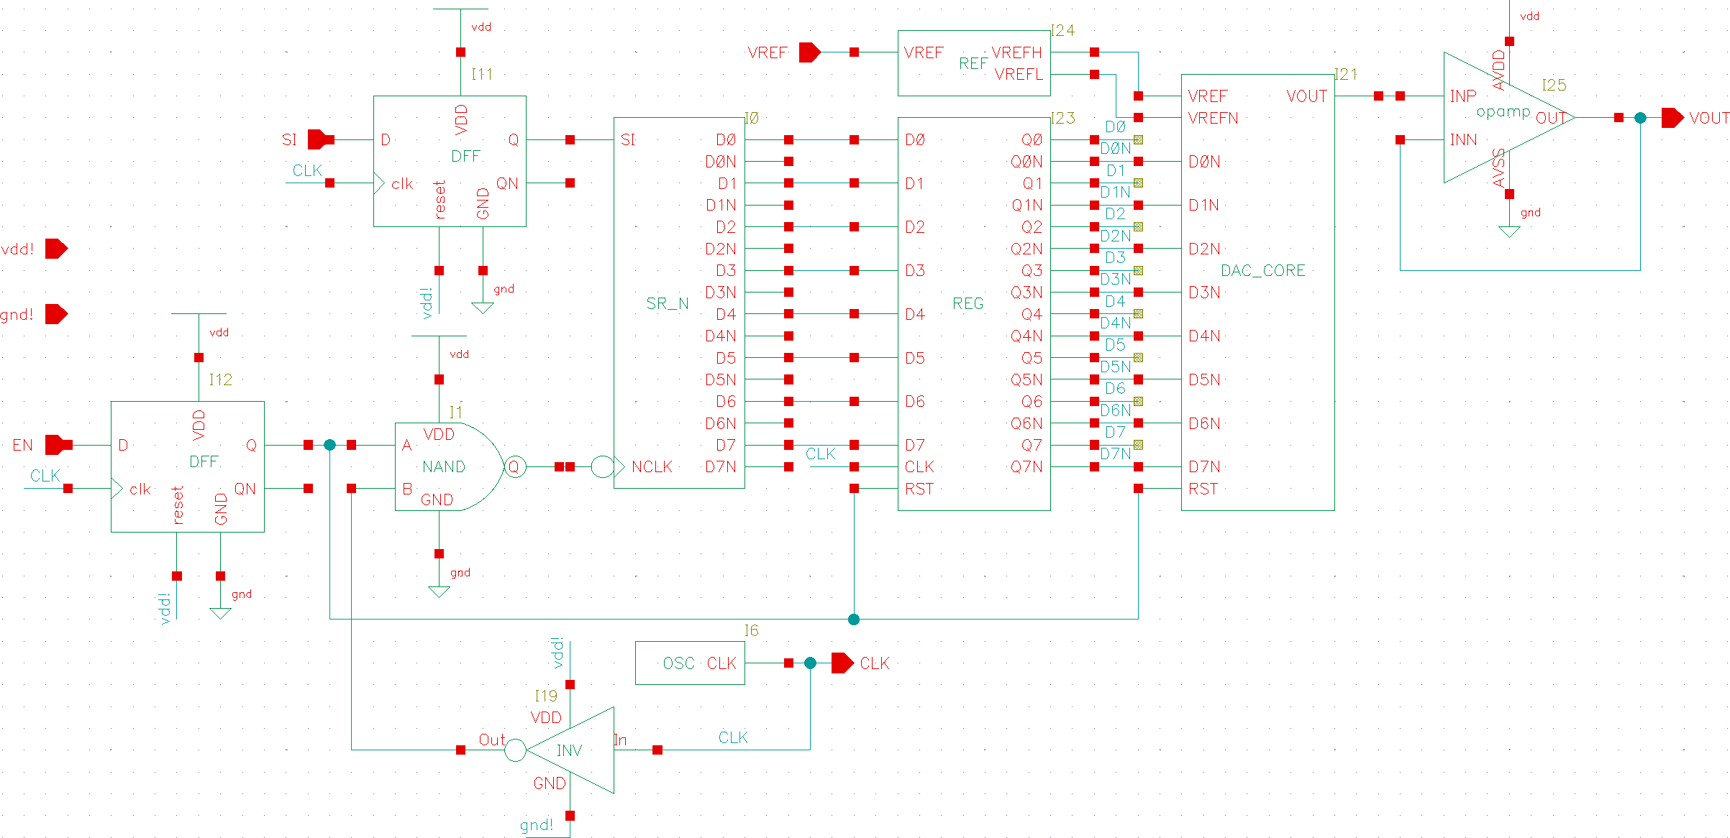
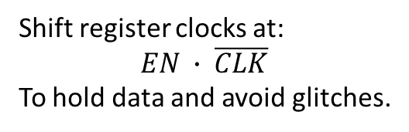
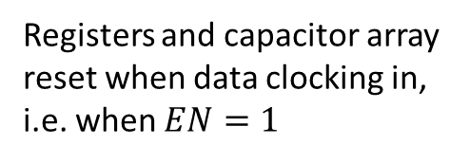
System architecture
0.4V and 1.4V voltage references
Digital input registers:
Register signals at rising edge, stable during clock cycles.
Output buffer / amplifier
Registers and capacitor array reset when data clocking in,
i.e. when $EN=1$
Shift register clocks at:
$$EN ∙ \overline{CLK}$$
To hold data and avoid glitches.
10MHz ring oscillator
Need to be tuned and modified for layout.

Slide 2
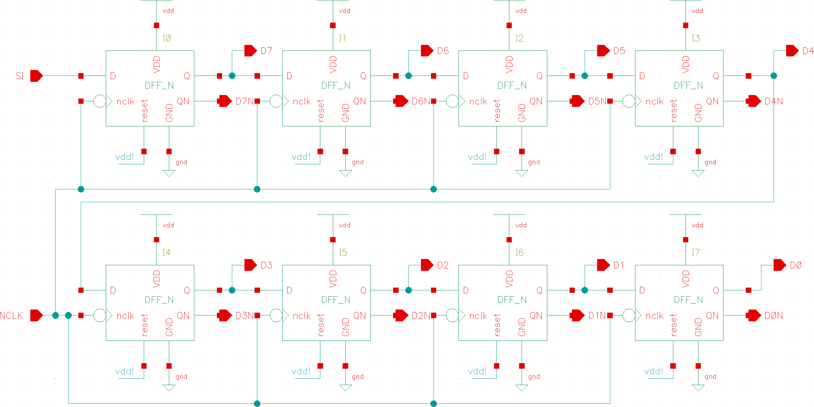
Shift register

Slide 3
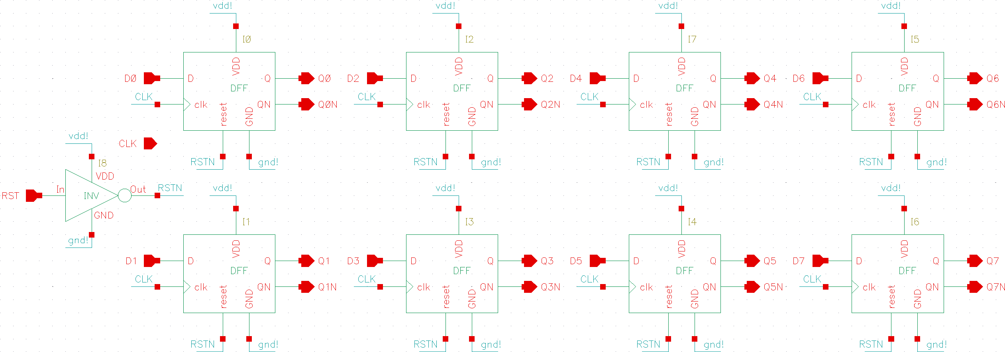
Registers / latches
All output bits will be reset to 0, during data clocking in, for discharge capacitor array.
Inverted outputs available, so that no data inverters needed.

Slide 4
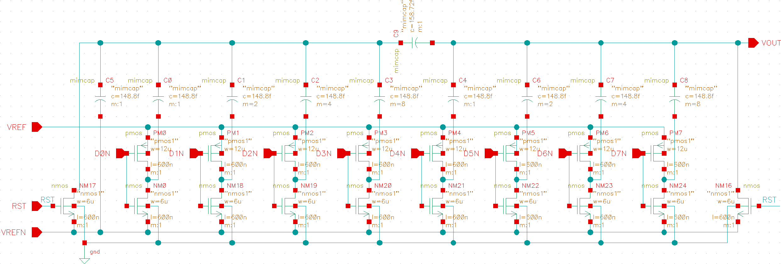
Capacitor array topology
VREF is 1.4V, VREFN is 0.4V.
Generated from the 0.9V voltage reference, by potential dividers and amplifier.

Slide 5
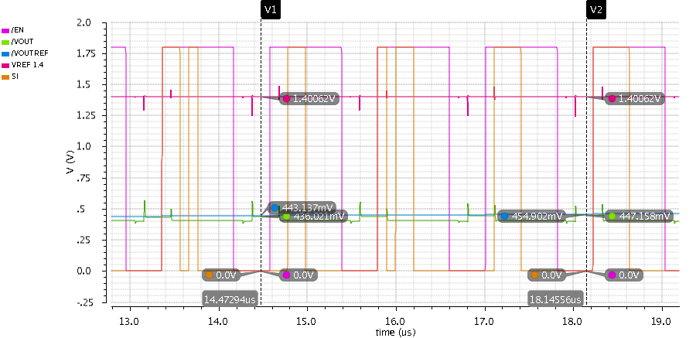
Preliminary simulation results
1.4V reference
00001011
00001100
00001101
00001110
00001111
Error: 1.8%
Offset and gain need to be further tuned to match the specification.

