Slide 1
PRIMARY CONNECTION SCORE `24
Scoring analyst: Zhalgas Zhienbekov
25.07.2024

Slide 2
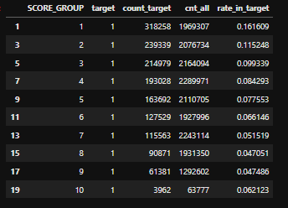
CONNECTION SCORE -2023

Slide 3
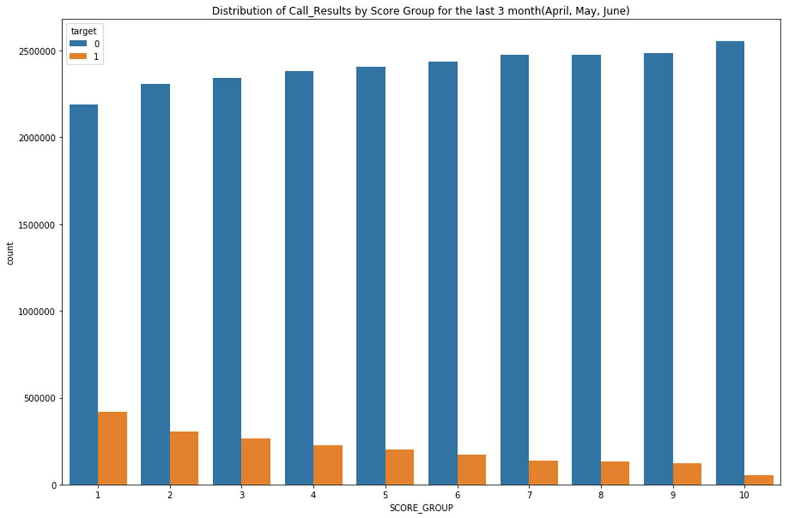
CONNECTION SCORE -2023

Slide 4
RESULTS: PRIMARY CONNECTION SCORE `24

Slide 5
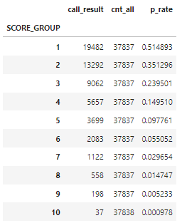
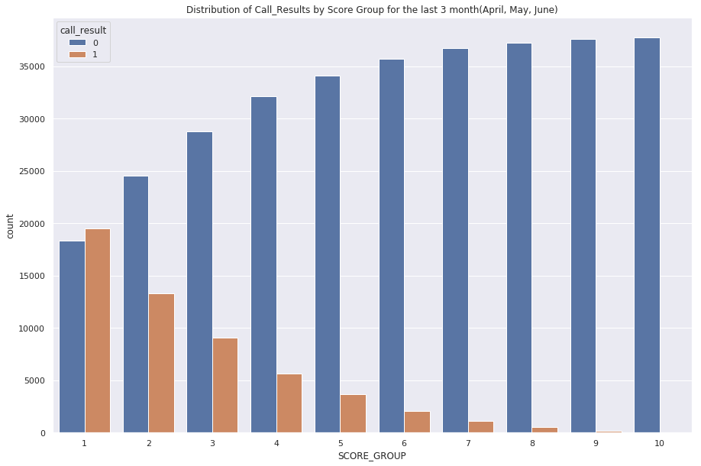
PRIMARY CONNECTION SCORE -2024

Slide 6
PRIMARY CONNECTION SCORE -2024
Predictors | Definition
avg_talk_18m | The average duration of calls made over the past 18 months. This predictor reflects the average call length, providing insight into communication habits over a longer period.
cnt_calls_18m | The total number of calls made in the past 18 months. This indicates overall calling activity during this period.
cnt_calls_1m | The total number of calls made in the past month. This predictor gives a recent snapshot of calling behavior.
cnt_success_sms_6m | The total number of successful SMS messages sent in the past 6 months. This reflects the user's text messaging activity.
last_interaction_type_encoded | An encoded value representing the type of the last interaction (e.g., call, SMS, email). This helps to categorize the most recent interaction.
past_days_last_succ_call | The number of days since the last successful call. This metric indicates how recently the user made a successful call.
rate_out_calls_6m | The ratio of outgoing calls to the total number of calls in the past 6 months. This shows the proportion of calls initiated by the user.
unsuccess_class | A classification of unsuccessful interactions. This predictor helps to identify and categorize unsuccessful communication attempts also no attempts since it consist zero calls as 0

Slide 7
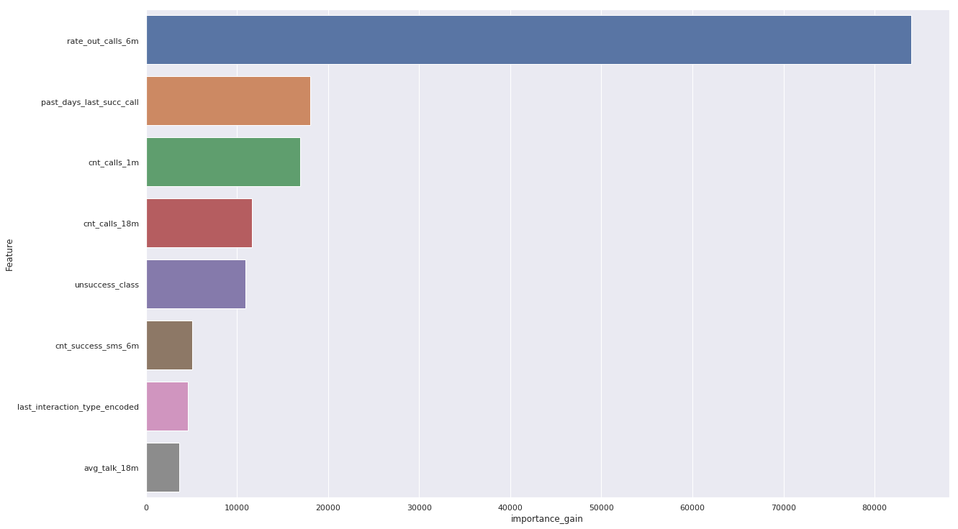
PRIMARY CONNECTION SCORE -2024
Predictors | Marginal contribution LGBM
unsuccess_class | 0.0369411
cnt_calls_18m | 0.230748
cnt_success_sms_6m | 0.503698
t_interaction_type_encoded | 0.673323
past_days_last_succ_call | 1.51589
cnt_calls_1m | 1.69687
rate_out_calls_6m | 4.30638

Slide 8
PRIMARY CONNECTION SCORE -2024
Sample | Gini Mean | Gini std | CI 5% | CI 95%
train | 0.689108 | 0.002309 | 0.685822 | 0.692868
valid | 0.684762 | 0.003984 | 0.677644 | 0.690931
test | 0.682667 | 0.003769 | 0.677133 | 0.688631
oot | 0.715200 | 0.003222 | 0.710116 | 0.719840
hoot | 0.660796 | 0.006409 | 0.650527 | 0.670409

Slide 9
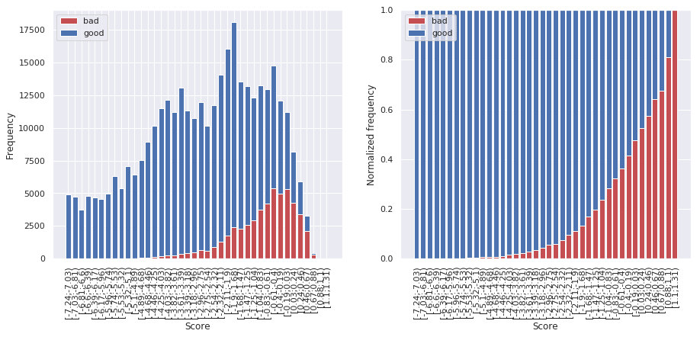
PRIMARY CONNECTION SCORE -2024

Slide 10
RESULTS: CONNECTION SCORE ALL NUMBERS `24

Slide 11
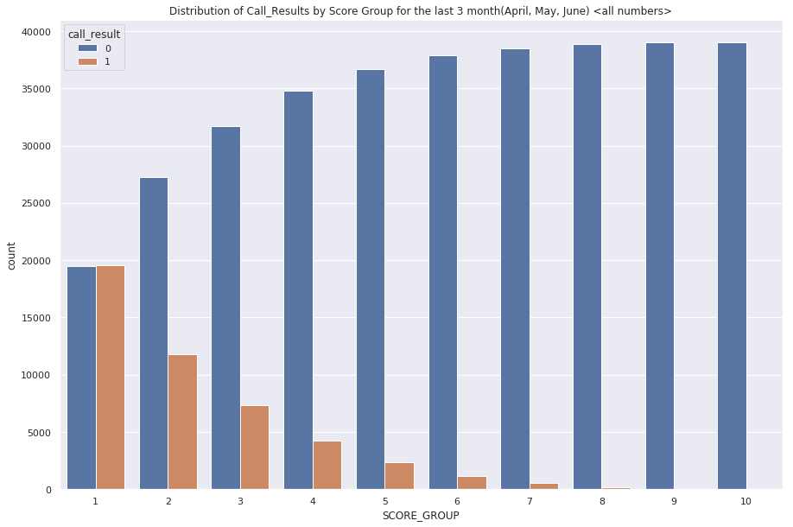
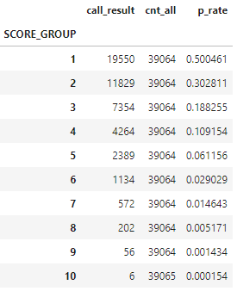
CONNECTION SCORE for ALL Numbers -2024

Slide 12
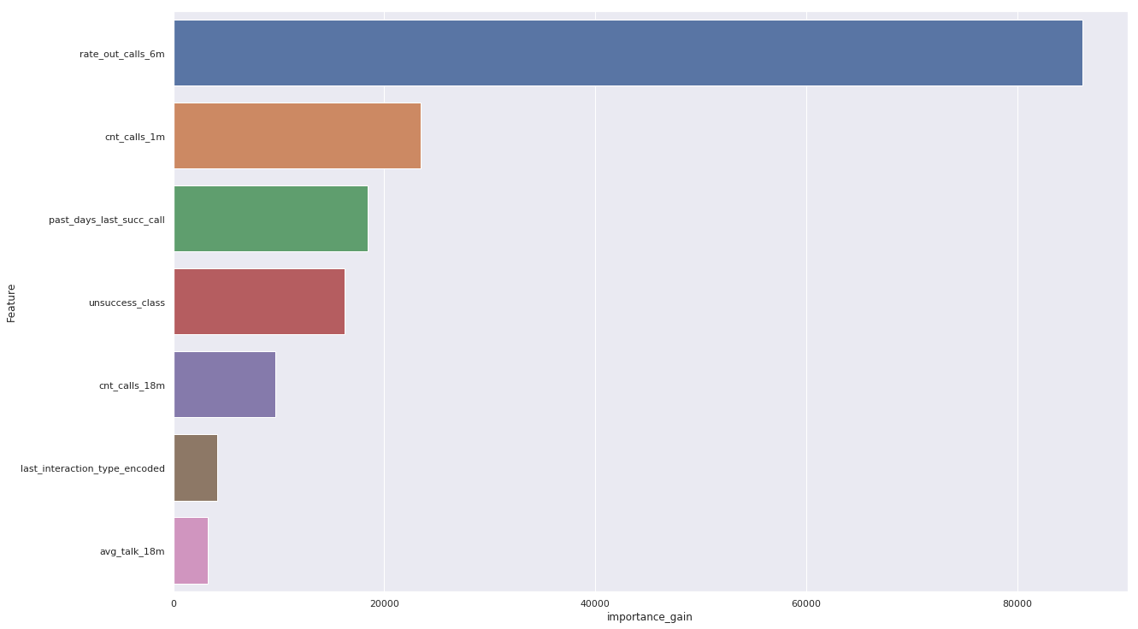
CONNECTION SCORE for ALL Numbers -2024
unsuccess_class | 0.0206188
avg_talk_18m | 0.165367
cnt_calls_18m | 0.201998
last_interaction_type_encoded | 0.586964
past_days_last_succ_call | 1.37231
cnt_calls_1m | 1.43042
rate_out_calls_6m | 3.75129

Slide 13
CONNECTION SCORE for ALL Numbers -2024
Sample | Gini Mean | Gini std | CI 5% | CI 95%
train | 0.742469 | 0.002484 | 0.738875 | 0.746381
valid | 0.730382 | 0.004167 | 0.723758 | 0.736609
test | 0.734725 | 0.003763 | 0.728316 | 0.740339
oot | 0.758849 | 0.003178 | 0.753798 | 0.763779
hoot | 0.758161 | 0.005073 | 0.749926 | 0.766109

Slide 14
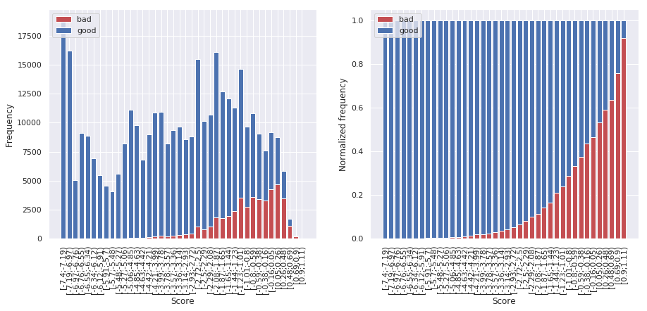
CONNECTION SCORE for ALL Numbers -2024

Slide 15
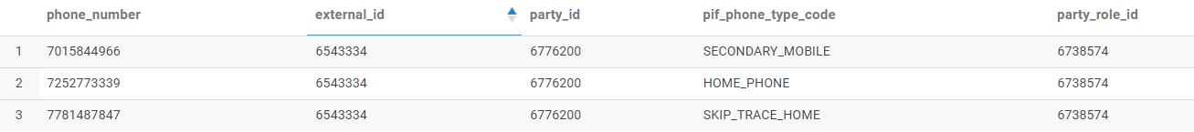

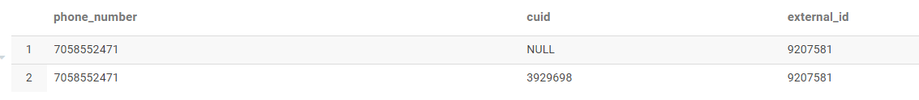

PROBLEMS

