Slide 1
Example Database – CAP Database
CUSTOMERS - A table containing information about customers
  Cid unique identifier for a customer
  Cname Name of a customer
  City City where the customer is located
  Discnt Each customer has a negotiated discount on prices
AGENTS – A table containing information about agent employees
  aid unique identifier for an agent
  Aname last name of agent
  City city where agent is based
  Percent Percentage commission each agent receives on each sale
PRODUCTS –A table contaning information about products for sale
  pid unique identifier for a product
  pname descriptive name of a product
  city city where the product is warehoused

Slide 2
Example Database –CAP Database
  Quantity Quantity on hand for sale,in standard units
  Price Wholesale price of each unit product
ORDERS - A table containing information about orders
  Ordno unique identifier for this order
  Month month the order was placed
  cid This customer…
  aid ..purchased through this agent…
  pid …this specific product…
  Qty …in this total quantity…
  Dollars …at this dollar cost

Slide 3
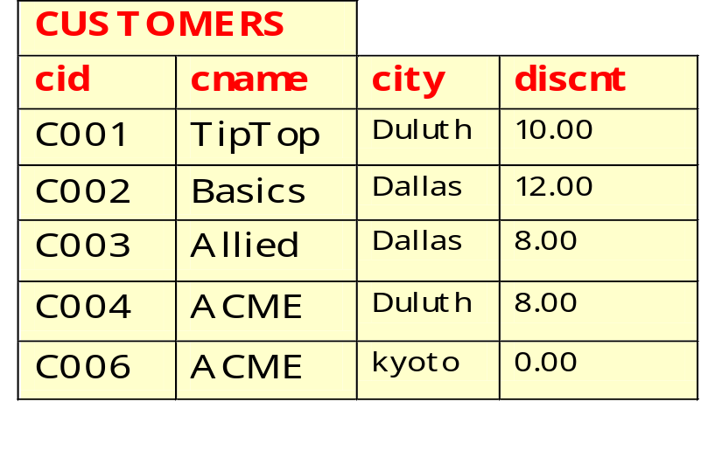
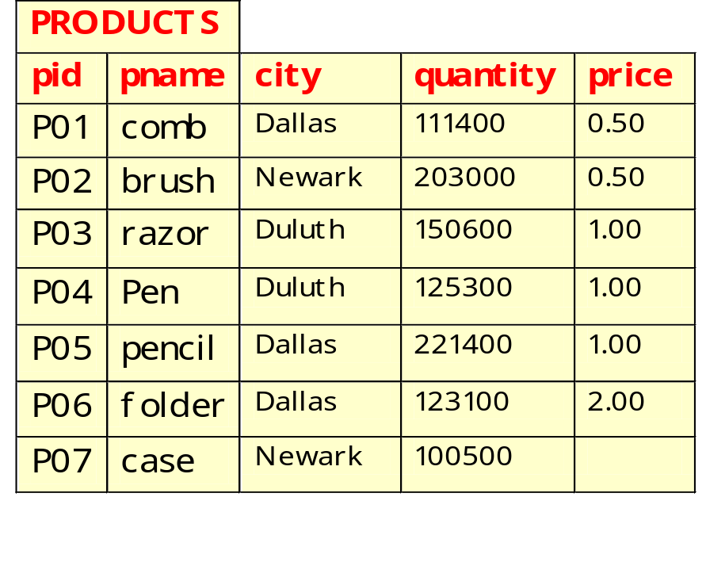
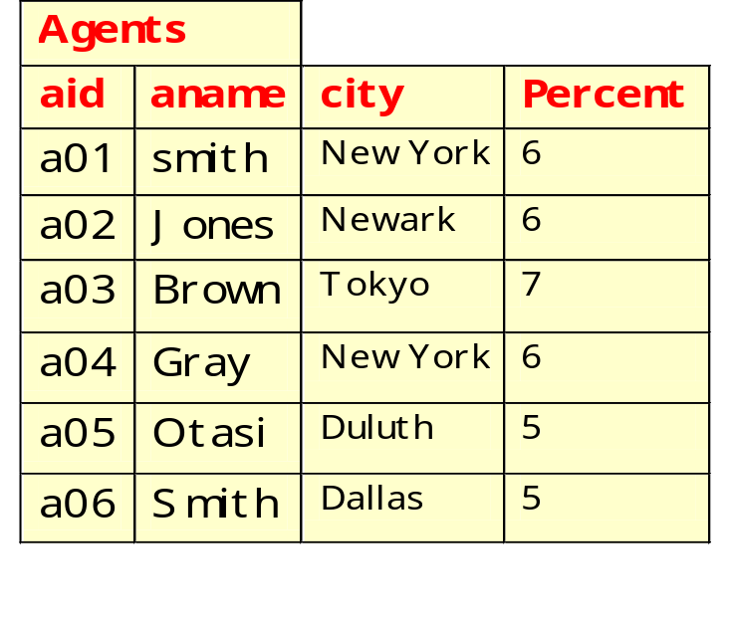
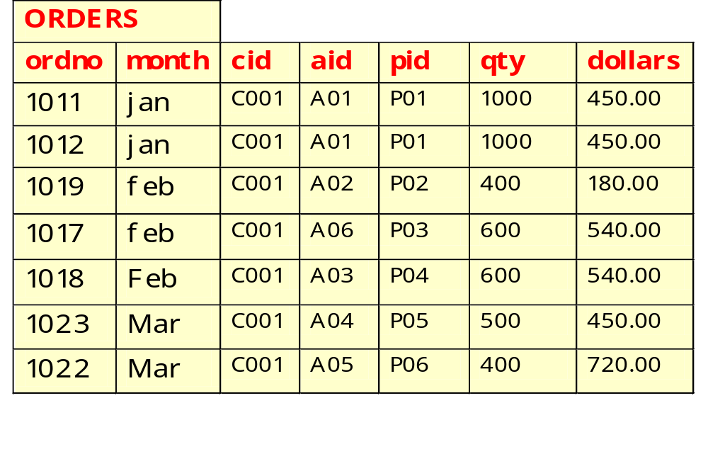

Slide 4
问题
1、列出cid,aid,pid，其中顾客cid、代理商aid和产品pid所在的城市都相同。（三者之间不一定存在购买关系）
2、列出cid,aid,pid，其中顾客cid、代理商aid和产品pid所在的城市都相同。（三者之间存在购买关系）
3、列出cid,aid,pid，其中顾客cid、代理商aid和产品pid所在的城市都相同。（三者之间不存在购买关系）
4、查询通过A03买过商品，但是没有通过A06买过商品的顾客编号。
5、查询只通过一个代理商购买商品的顾客。
6、查询买过C006这个顾客买过的所有商品的顾客的编号。
7、更新Customers表，将订单总金额大于等于2000的顾客的discount值加1。
8、查询没有选修C1，也没有选修C2的学生的学号、课程号和成绩。（数据模型见课件）

