Slide 1
Example Database – CAP Database
CUSTOMERS - A table containing information about customers
  Cid unique identifier for a customer
  Cname Name of a customer
  City City where the customer is located
  Discnt Each customer has a negotiated discount on prices
AGENTS – A table containing information about agent employees
  aid unique identifier for an agent
  Aname last name of agent
  City city where agent is based
  Percent Percentage commission each agent receives on each sale
PRODUCTS –A table contaning information about products for sale
  pid unique identifier for a product
  pname descriptive name of a product
  city city where the product is warehoused

Slide 2
Example Database –CAP Database
  Quantity Quantity on hand for sale,in standard units
  Price Wholesale price of each unit product
ORDERS - A table containing information about orders
  Ordno unique identifier for this order
  Month month the order was placed
  cid This customer…
  aid ..purchased through this agent…
  pid …this specific product…
  Qty …in this total quantity…
  Dollars …at this dollar cost

Slide 3
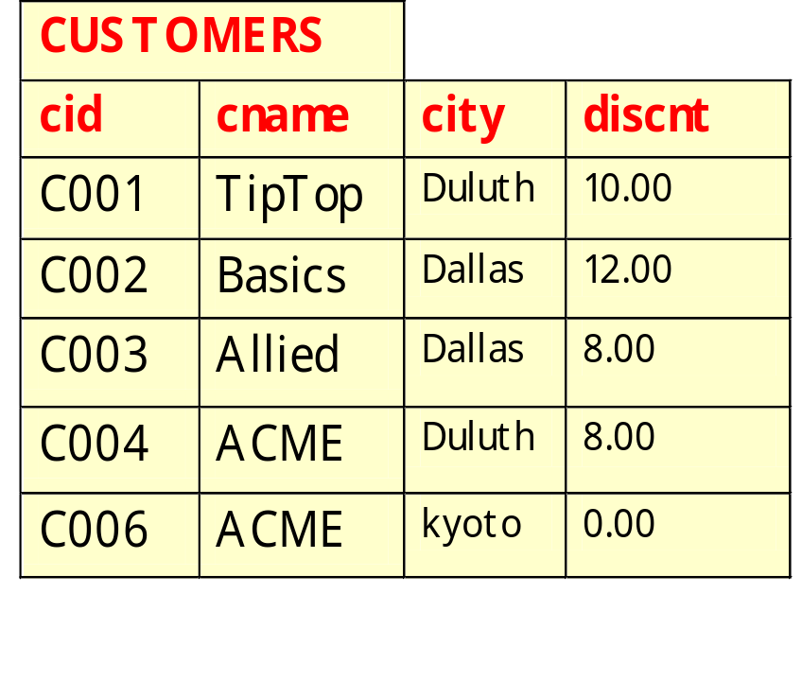
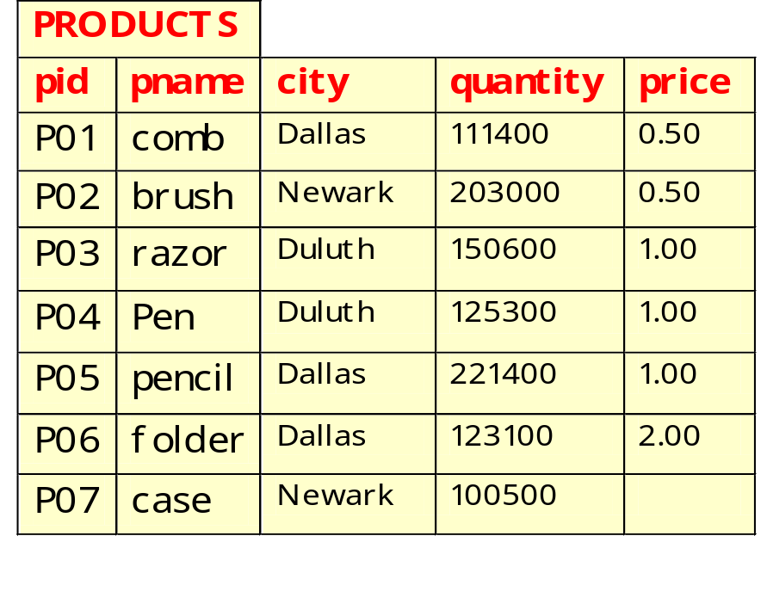
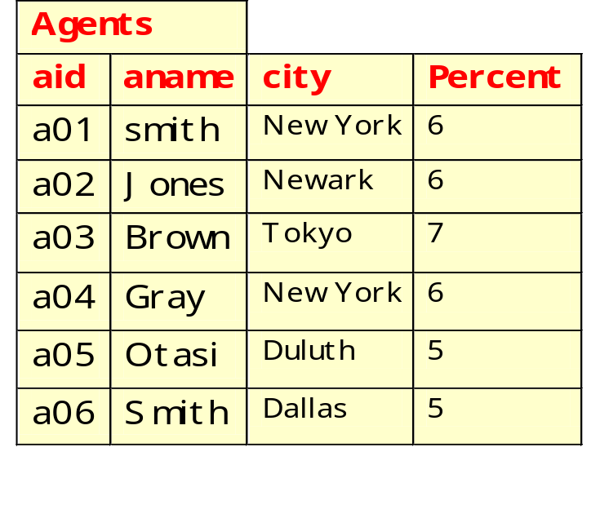
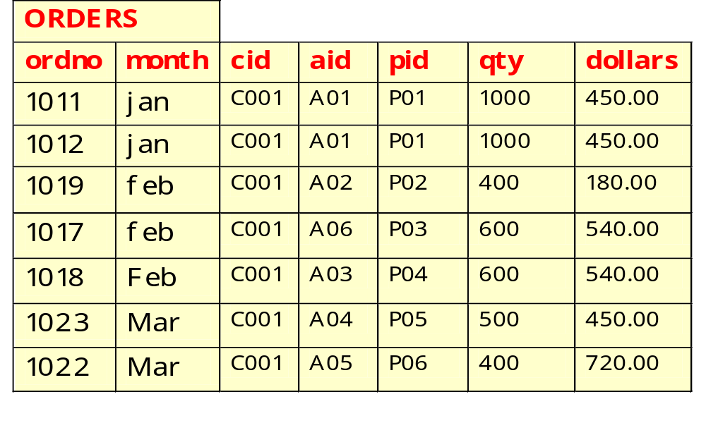

Slide 4
Example–1： Join
ORDERS CUSTOMERS

Slide 5
Example-2：Join
Give all (cname, aname) pairs where the customer places an order through the agent.
Πcname, aname ( (Πcid,cname(C) O) A)

Slide 6

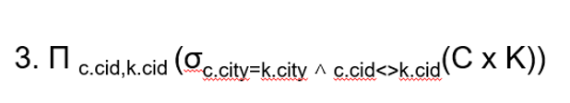
Example-3：Self-Join
Give (cid, cid') pairs of customers who live in the same city.
1.
K:=CUSTOMERS
C:=CUSTOMERS
Notes:
Relational Algebra
Self-Join：自联结

Slide 7
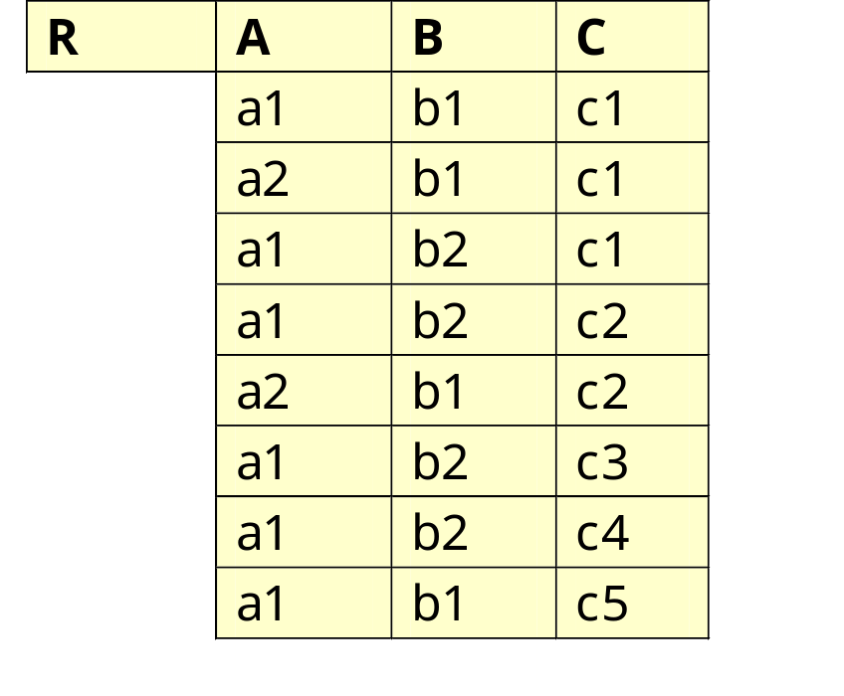
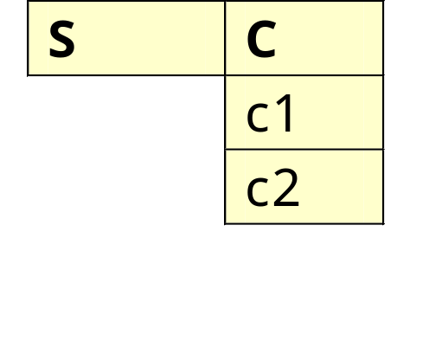
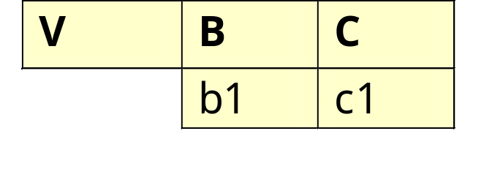
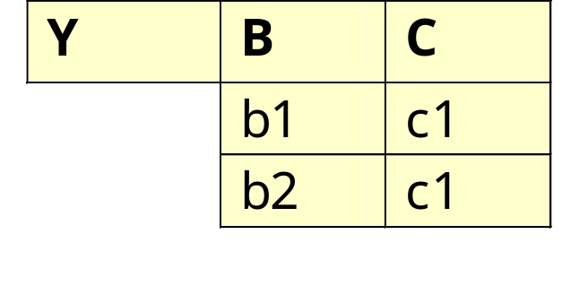
Relational Algebra - Division
Find:
  R ÷ S
  R ÷ V
  R ÷ Y

Slide 8
Example-4: Division
Get names of customers who order all products.
cname( (Πcid, pid（O）÷ Π pid（P）) C)
Π

Slide 9
Example-5: Outer Join
R
A | B
a1 | b1
a2 | b2
a3 | b5
R outer join S
A | B | C
a1 | b1 | c1
a2 | b2 | c2
a3 | b5 | null
null | b3 | c3
null | b4 | c4
S
B | C
b1 | c1
b2 | c2
b3 | c3
b4 | c4
Notes:
Relational Algebra
Outer Join：外联结

Slide 10
Problems
1.Find the names of customers who order at least one product priced at $0.50
2.Find cids of all customers who do not place any order through agent A03.
3.Find all customers who place orders only through agent A03
4. Find the products that have never been ordered by a customer based in New York through an agent based in Boston。
5.Get cids of customers who order all products that anybody orders.

Slide 11
Problem 1
Find the names of customers who order at least one product priced at $0.50
(σ _{price=0.5} （（P O） C））
Πcname

Slide 12
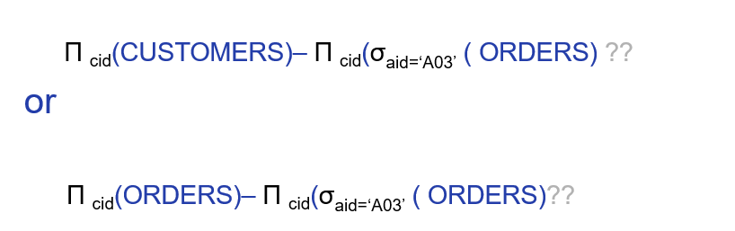
Problem 2
Find cids of all customers who do not place any order through agent A03.
Q: Are the results of the two queries the same?

Slide 13

Problem 3
Find all customers who place orders only through agent A03
Q: Can the ORDERS[cid] be replaced by CUSTOMERS[cid]?

Slide 14
Problem 4
Find the products that have never been ordered by a customer based in New York through an agent based in Boston。
Πpid（Orders）- Πpid（（ σ _{city=‘New York’}(C) O） σ _{city=‘Boston’}(A)）
Πpid（Products）？？？

Slide 15
Problem 5
Get cids of customers who order all products that anybody orders.
Πcid，pid（Orders） ÷ Πpid（Orders）

Slide 16
测试：用关系代数表达下列查询
查询所有既买过产品P01，又买过产品P02的顾客的编号、名字及所在城市。
查询所有曾买过产品P01，或买过产品P02的顾客的编号、名字及所在城市。
查询所有购买过‘pen’这种产品的顾客的编号和名字。
查询代理过顾客C001购买过的所有产品的代理商的编号和名称。
查询买过产品P01的顾客，或者代理过产品P01的代理商所在的城市（city）。
查询从来没有买过名为‘case’的产品的顾客的编号。
查询折扣最大（discnt）的顾客的编号。

