Slide 1
《算法分析与设计》
Analysis and Design of Computer Algorithms
中南大学计算机学院
School of Computer Science and Engineering
Central South University
主讲：李敏
联系方式：limin@mail.csu.edu.cn
15257578@qq.com
课程学习交流群： 1055342934

Slide 2
NP-Completeness Theory
  背包问题
  旅行商/货郎担问题
  独立集问题
  点覆盖问题
  ……

Slide 3
NP-Completeness theory
Role
  Plays fundamental role in the study of optimization problems.
Motivation
  Motivated by the study of computational optimization problems.
  Provide convincing lower bounds on the computational complexity for certain optimization problems.
第<number>页

Slide 4
NP-Completeness theory
Decision problems
  Each input instance only needs to take one of the two possible answers: “Yes” or “No”(Yes-instance or No-instance..
example
  Satisfiability (SAT):optimization
  Given a boolean formula F in the conjunctive(合取）norm form, find an assignment that makes F has value True.
  Satisfiability (SAT):Decision version
  Given a boolean formula F in the conjunctive(合取）norm form, is there an assignment that makes F has value True?
第<number>页

Slide 5
NP-Completeness theory
example2
  Traveling Salesman :optimization
  Given an weighted complete graph G=(V, E), find a traveling tour in G that visits all vertices of G and has minimum weight.
  Traveling Salesman :Decision version
  Given an weighted complete graph G=(V, E), is there a traveling tour in G that visits all vertices of G and has weight bounded by k?
The computational hardness of the decision problem implies the computational hardness for the original optimization problem.
第<number>页

Slide 6
NP-Completeness theory
Algorithm & Problem
  Algorithm A accepts a decision problem Q if on every yes-instance x of Q, the algorithm stops at a “Yes” state (i.e., “accepts” x), while on all other inputs x’, the algorithm A stops at a “no” state(i.e., “rejects” x’)
第<number>页

Slide 7
NP-Completeness theory
P问题：一个问题可以在多项式（O(n^k)）的时间复杂度内解决
  A decision problem Q is in the class P if it can be accepted by a polynomial-time algorithm.
  In a more general sense, a problem Q is in the class P if Q can be solved in polynomial time, even though sometimes the problem Q is not a decision problem.
第<number>页

Slide 8
NP-Completeness theory
Efficient certification
  “Checking algorithm” for a problem X 检查算法
  In order to “check” a solution, we need the input string s of X, as well as a separate “certificate” string t that contains the evidence that s is a “yes” instance of X. 给定问题s和问题的解t, 根据s和t判定结果是否正确
第<number>页

Slide 9
NP-Completeness theory
Efficient certification
  B is an efficient certifier for a problem X
  B is a polynomial-time algorithm that takes two input arguments s and t.
  There is a polynomial function p so that for every string s, we have s ∈X if and only if there exists a string t such that |t|≤p(|s|) and B(s,t) = yes.
  B是有效算法说明多项式内可以有效检查s和t
第<number>页

Slide 10
NP-Completeness theory
NP问题：一个问题的解可以在多项式的时间内被验证
  A decision problem Q is in the class NP if it can be accepted by a polynomial-time algorithm A in the following manner. There is a fixed polynomial p(n) such that:
  (1) if x is a yes-instance for the problem Q, then there is a binary string y of length bounded by p(|x|) such that on input (x,y), the algorithm A stops at a “yes” state;
  (2)If x is not a yes-instance for the problem Q, then for any binary string y of length bounded by p(|x|), on input (x, y), the algorithm A stops at a “no” state.
第<number>页

Slide 11
NP-Completeness theory
NP
  A problem Q is in NP is the one whose yes-instance x can be easily ( in polynomial time) checked (by algorithm A) when a short (p(|x|) proof (y) is given.
  It works in the following manner:
  (1) If the input x is a yes-instance for the problem Q (algorithm A is not known in advance), then with a correct proof ( or hint) y, the algorithm A will be convinced and correctly conclude “yes”;
  (2)If the input x is not a yes-instance for the problem Q, then no matter what hint y is given, the algorithm A cannot be fooled to conclude “yes”.
第<number>页

Slide 12
NP-Completeness theory
  Algorithm A can be regarded as an experienced college professor. If a true theorem x is given together with a correct (and short) proof y, then the professor will conclude the truth for the theorem x.
  On the other hand, if a false theorem x is presented, then no matter what “proof” is provided, the professor would not be fooled to conclude the truth for the theorem x.
第<number>页

Slide 13
NP-Completeness theory
  Algorithm A has no idea how the proof y is derived.
  The class NP can be defined to be the set of those decision problems that can be accepted by nondeterministic polynomial-time algorithm.
第<number>页

Slide 14
NP-Completeness theory
NP
  On an input x that is a yes-instance, the nondeterministic polynomial-time algorithm guesses a correct proof y, checks the pair (x, y), and accepts x;
  while on an input x that is not a yes-instance, with any guessed proof y, the algorithm checking the pair (x,y) would conclude “no”.
第<number>页

Slide 15
NP-Completeness theory
Example2
  Traveling Salesman :Decision version
  Given an weighted complete graph G=(V, E), and k is an integer, is there a traveling tour in G that visits all vertices of G and has weight bounded by k?
  The polynomial-time algorithm A can be designed as follows:
  On input pair (x, y), where x=(G, k), the algorithm A accepts if and only if y represents a tour in G that visits all vertices and has weight not larger than k. If x=(G, k) is a yes-instance, then with a proof y, A will accept the pair (x, y). On the other hand, A rejects the pair (x, y).
第<number>页

Slide 16
NP-Completeness theory
How to easily decide whether a problem is in NP?
  Vertex Cover problem :Decision version
  Given a graph G=(V, E), and k is an integer, is there a subset V’of V, |V’|=k, such that for any edge e∈E, at least one endpoint of e is contained in V’?
  For any subset V1 of V, it is in polynomial time to check whether V1 is a vertex cover for graph G, then Vertex Cover problem is in NP.
第<number>页

Slide 17


NP-Completeness theory
How to understand P NP ?
Polynomial time reduction
  Let Q1 and Q2 be two decision problems. Problem Q1 is polynomial-time reducible to problem Q2, if there is a function r computable in polynomial time such that for any x, x is a yes-instance for Q1 if and only if r(x) is a yes-instance for Q2. (Q1 Q2)
  Lemma. Let Q1 and Q2 be two decision problems. If Q1 Q2 and Q2 is in the class P, then the problem Q1 is also in the class P.
第<number>页

Slide 18
NP-Completeness theory
Reduction from Satisfiability to Independent Set
  Satisfiability (SAT):Decision version
  Given a boolean formula F in the conjunctive(合取）norm form, is there an assignment that makes F has value True?
  Independent Set:
  Given a graph G and an integer k, is there a set S of at least k vertices in G such that no two vertices in S are adjacent?
第<number>页

Slide 19
NP-Completeness theory
Reduction from Satisfiability to Independent Set
  Let F=C1∧C2∧…. ∧ Cm be an instance to the Satisfiability problem, where each Ci is a disjunction Ci=(l_{i,1} ∨ l_{i,2}∨.. . ∨ l_{i,ni}) of boolean literals.
  Construct a graph G_{F} as follows:
  each vertex in G_{F} corresponds to a literal in F
  Two vertices are adjacent if one of following conditions holds: (1) two literals appears in the same clause;
  (2) two literals contradicts to each other.
(G_{F}, m) is an instance of Independent Set problem.
第<number>页

Slide 20





NP-Completeness theory
Example
  F=(x1 ∨x2∨ x3) ∧( ∨x4) ∧ ( ∨ ) ∧ (x2∨ ∨x5) ∧( ∨ x6)
x5
x1
x3
x4
x2
x6
第<number>页

Slide 21
NP-Completeness theory
Cook’s Theorem
  Every decision problem in the class NP is polynomial-time many-one reducible to the Satisfiability problem.
  NP-hard:
  A decision problem Q is NP-hard if every problem in the class NP is polynomial-time many-one reducible to Q.
  NP-complete
  A decision problem Q is NP-complete if Q is in the class NP and Q is NP-hard.
第<number>页

Slide 22
NP-Completeness theory
How do we show the NP-hardness for a given problem?
  Lemma: Let Q1, Q2 and Q3 be three decision problems, if Q1 Q2, and Q2 Q3 , then Q1 Q3.
  Corollary: Let Q1 and Q2 be two decision problems. Suppose that the problem Q1 is NP-hard and that Q1 Q2 , then the problem Q2 is NP-hard.
第<number>页

Slide 23
NP-Completeness theory
Working Conjecture in NP-completeness Theory
  P≠NP, that is, there are problems in NP that are not solvable in polynomial time.
第<number>页

Slide 24
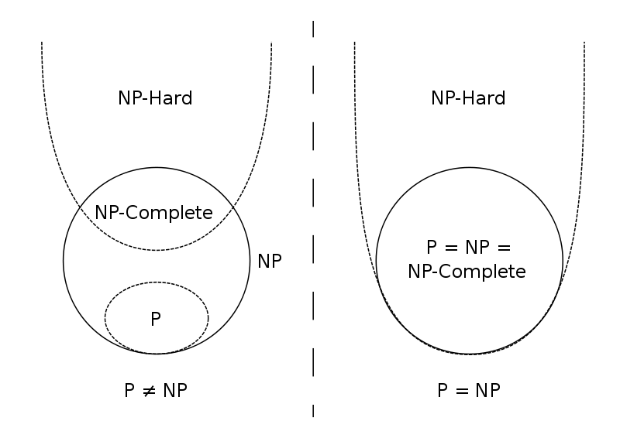
P, NP, NP-hard, NP-complete
第<number>页

Slide 25


NP完全理论
哪些问题是NP-难的, 但不是属于NP?
停机问题(Halting Problem)
判断任意一个给定程序是否会在有限的时间之内结束运行。
哪些问题属于NP, 介于P与NP-完全之间?
图同构问题(Graph isomorphism)
给定图G和H，判断G和H是否同构？
整数分解(Integer factorization)
给定整数N和M，判断N是否有一个比M小的因子?
第<number>页

