Slide 1
The Human Trafficking
人口拐卖
Human trafficking makes people into slaves, forcing or them manipulating in a situation of no escape, where they need to work against their own will.
汇报人：19 张子洋
18 李文 2023.12.11

Slide 2
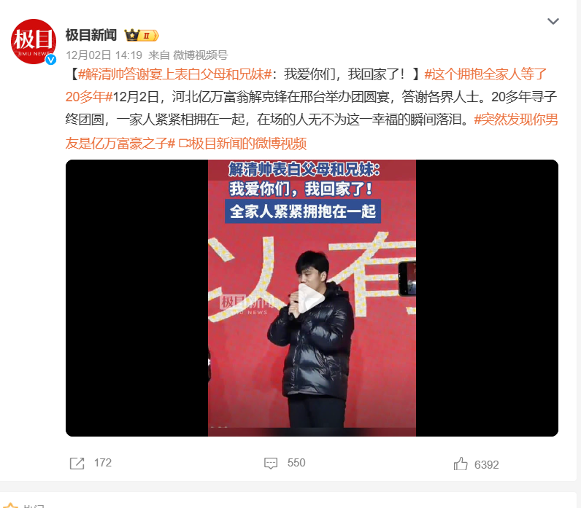
Human trafficking has become a hot topic recently. A family seeker in Hebei found his son who had been missing for more than 20 years. Many people are attracted by the The Word Billionaire. To be honest, many people are still on the road to finding their families, and most of them do not receive such widespread attention. Should we focus more on lost children?

Slide 3
CONTENTS
01
What is Human Trafficking?
02
The situation of Human Trafficking in our country
03
The causes of Human Trafficking
04
How to find the lost people

Slide 4
01
What is Human Trafficking?

Slide 5
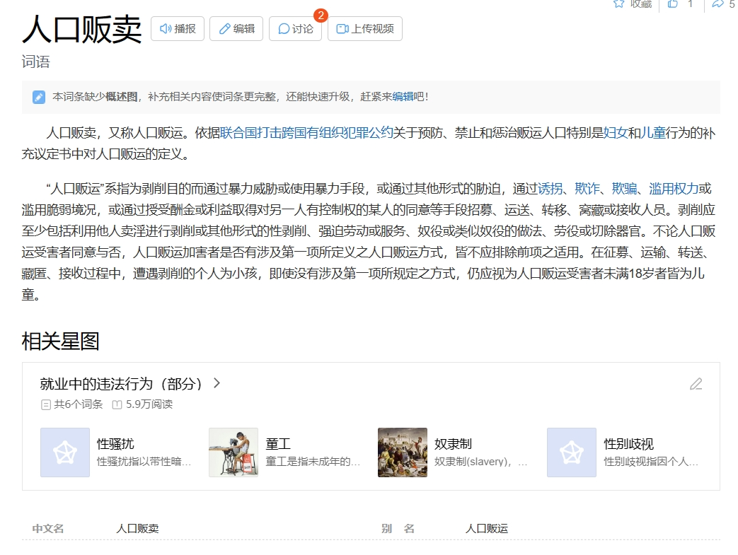
In Human trafficking, victims are forced into prostitution or organ trading through forced labor, sex slavery, or traffickers. Many of them come from countries that are poor or have few job opportunities. On December 18, 2013, the United Nations General Assembly passed a resolution to designate July 30 as World Day to Combat Human Trafficking, in order to raise awareness of the situation and promote and protect the victims’ rights.

Slide 6
02
The situation of Human Trafficking
in our country

Slide 7
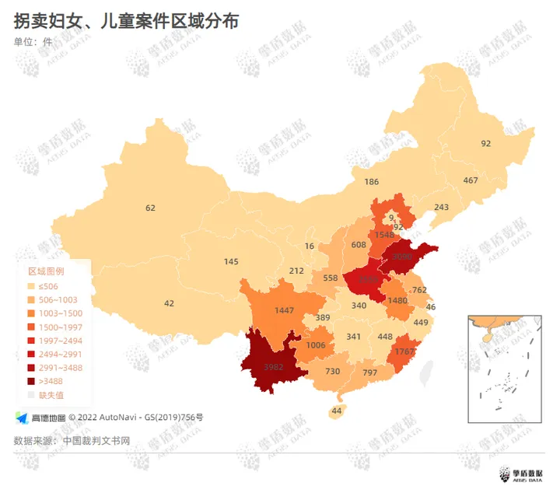
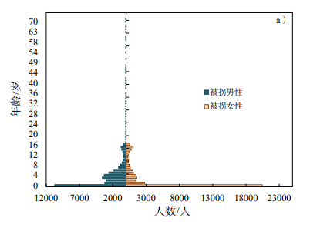
Abductors and traffickers are concentrated in children under the age of 14, accounting for 93.6% of the total. Among them, children aged 0 account for 47.9%, while those aged 14 and above only account for 6.4%, mainly female.
Human trafficking cases are widely distributed geographically. The central and southwestern regions are key areas where trafficking cases occur. According to the 2019 Human Trafficking Report, China is the second largest victim of human trafficking in the world.

Slide 8
03
The causes of Human Trafficking

Slide 9

Question1:
Why do you think human trafficking exists?
Causes of human trafficking:
1. The demand for labor force due to population migration.
2. The need to "marry a wife" under the patriarchal concept.
3. The pension security is not perfect.

Slide 10
04
How to find the lost people

Slide 11
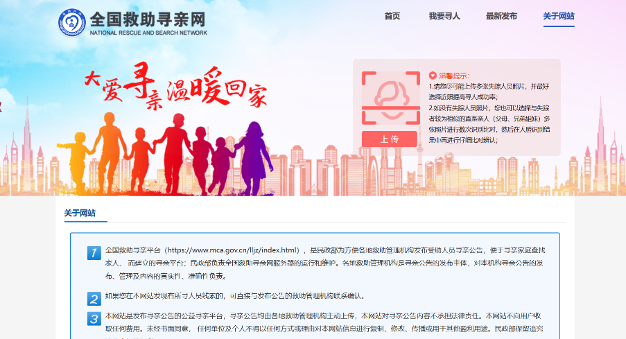
Question2:
What methods do you know about finding relatives?
Methods:
1. Use the power of the Internet to publish family-searching information to major social networking sites, media, and specialized family-searching websites.

Slide 12
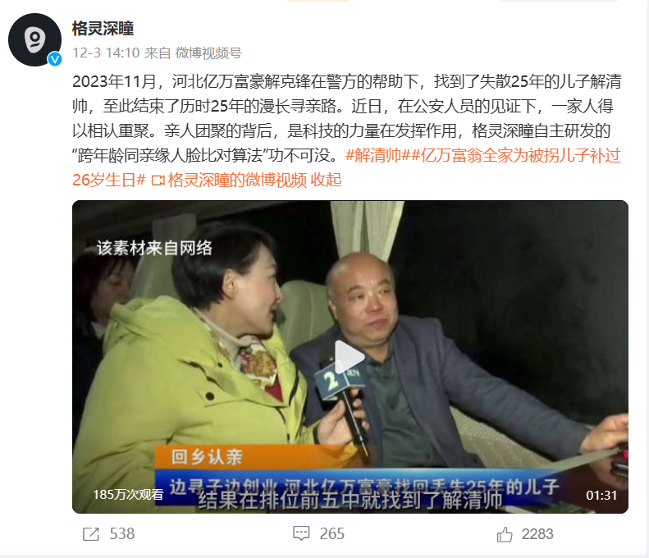
2.The anti-trafficking DNA database is a nationwide collection of DNA samples collected by local responsible agencies from parents who report missing children, and from minors who are begging on the streets and organized to engage in illegal and criminal activities.
3.The power of technology is at work, and the company’s self-developed “cross-age and relative face comparison algorithm” is indispensable.

Slide 13
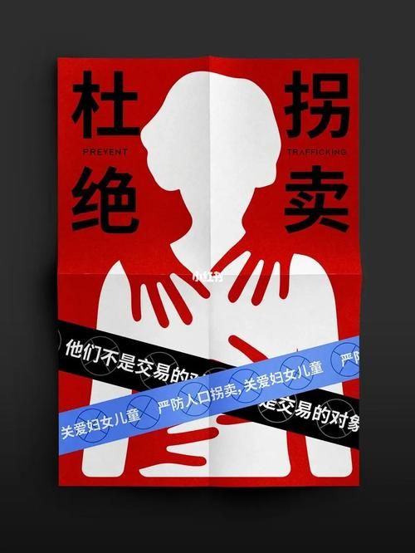
Conclusion:
Human trafficking cannot be ignored. We hope that similar illegal activities will become fewer and fewer in the future, and we also hope that more families can reunite.

Slide 14
Thanks for your listenning!

