Slide 1
软件工程原理与实践 Software Engineering
软件工程模型和方法

Slide 2
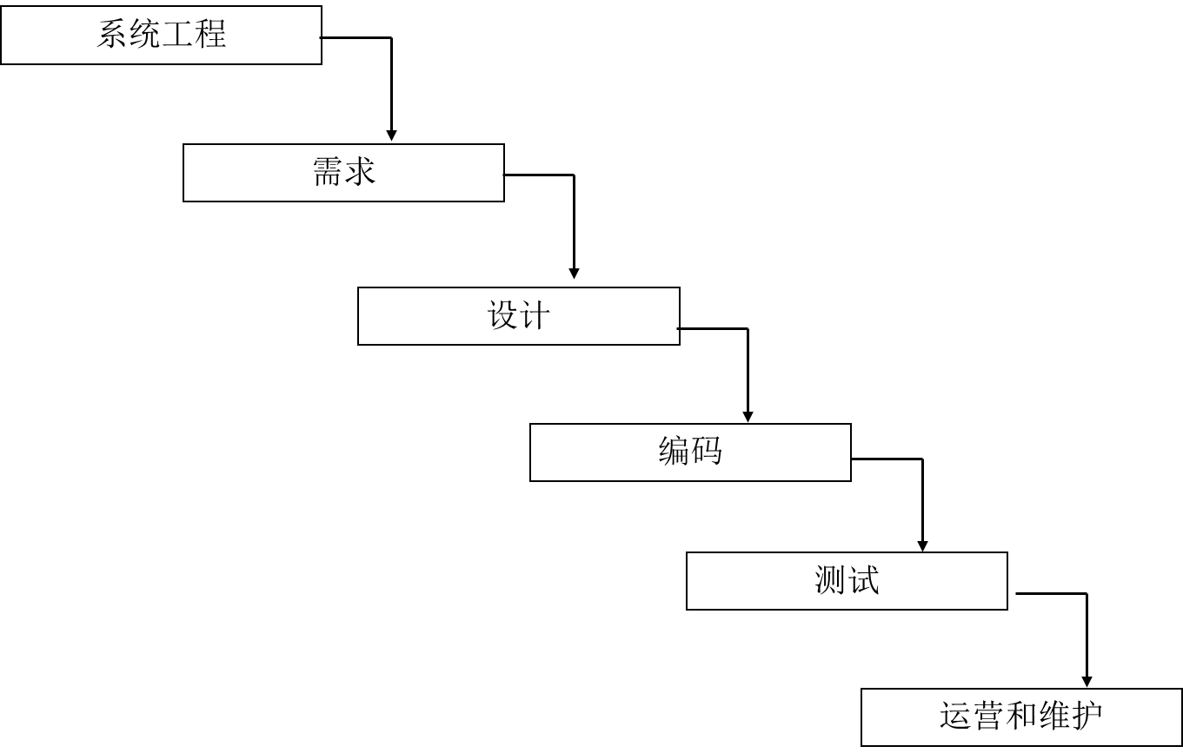
软件建模是软件工程的核心技术
人
技术
管理
过程

Slide 3
01-什么是模型
02-软件建模方法
03-面向对象方法概述
@第3章.教材

Slide 4

思考
什么是模型？
为什么要建模？
软件模型有哪几种？

Slide 5

波音747
超过6百万个零件，仅机尾就有上百个零件
能承载上百个旅客
能不停地飞行上千公里

Slide 6
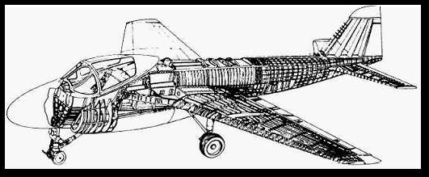
波音747
当波音在60年代开始生产747的时候，一共画了75，000张工程图
为什么？
因为他们正在生产一个极其复杂的系统，
而且不能出哪怕是一点点的差错

Slide 7
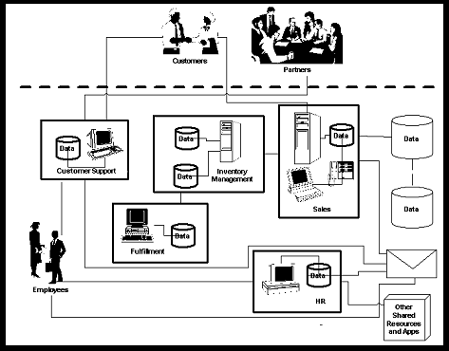
软件开发也同样复杂
人与系统的交互
系统安全
交易，存储
模型
可靠性，可扩展性
子系统，模块， 分布式
成千上万行程序

Slide 8
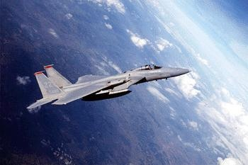
什么是模型?
A model is a simplification of reality.

Slide 9
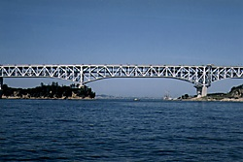
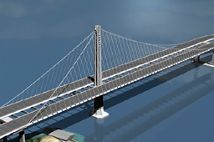
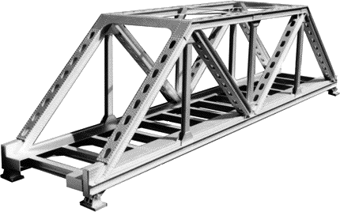
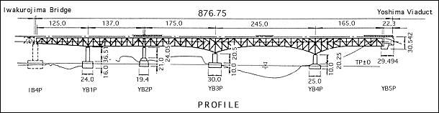
工程师们这样做…
他们在建造实际的物体之前...
…首先建立模型
…然后在模型的基础上进行研究和改进
❒
✓
❒

Slide 10
模型的功能
在正式启动工程项目之前发现设计中的错误和遗漏之处
通过(形式化的)分析和实验，降低工程的风险
研究和比较不同的解决方案
用来和项目的所有者进行交流
客户、用户、实现者、测试者、开发文档管理员，等等.
促进工程的实现

Slide 11
建模的重要性
Less Important
More Important
Paper Airplane
Fighter Jet
Notes:
Emphasize that complex projects outside of the software industry require models.
It’s inconceivable that a defense contractor would build an airplane as complex as a fighter jet without modeling the airplane first. Why? Because unlike building paper airplanes, the cost of failure is significant.
As a general rule, modeling becomes more important as the complexity and expense rises.

Slide 12
有用模型的特征
抽象性
突出重点方面，去除无关紧要的细节
可理解性
模型的表达方式能被模型的观察者很容易地理解
精确性
忠实地表达被建模的系统
说明性
能够被用来对被建模系统进行直观地分析，并得出正确的结论
经济性
模型的建立和分析比被建模系统更廉价，更经济
作为有用的工程模型, 必需具备以上所有特征!

Slide 13
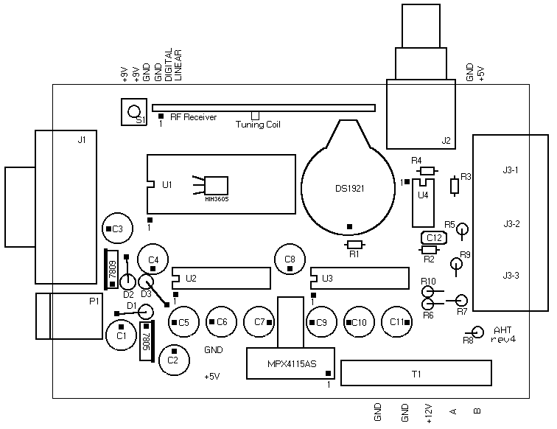
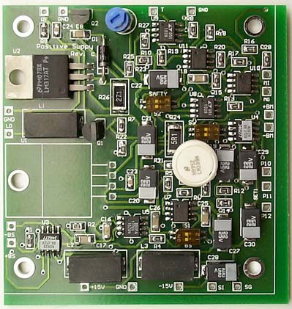
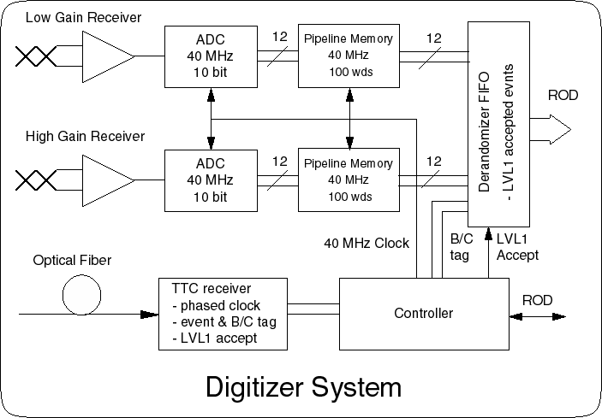
模型的多个视图
物理布局 视图
功能 视图

Slide 14
举例：UML 的软件模型视图
这些视图相互集成
需求:
用例图 Use Case diagram
结构:
本体论: 类图 Class diagram
实例: 对象图 Object diagram
行为
状态图 Statechart diagram
活动图 Activity diagram
交互：顺序图和协作图 Sequence diagram & Collaboration diagram
实现:
构件图 Component diagram
部署图 Deployment diagram
构成一个完整的模型

Slide 15
软件的三种模型
Computation- Independent
Model (CIM)
More Abstract
Platform- Independent
Model (PIM)
Platform- Specific
Model (PSM)
More Specific

Slide 16

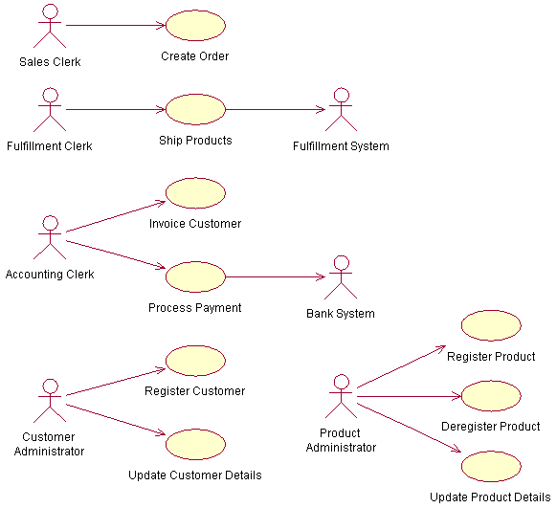
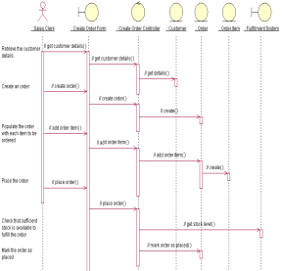
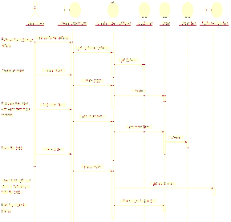
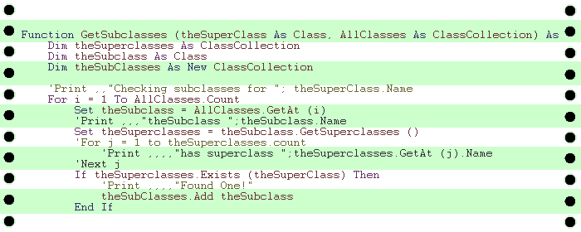
模型间的转换
计算无关模型
CIM
业务模型
平台无关模型
PIM
分析模型
平台有关模型
PSM
设计模型
代码
实现模型
系统工程
需求
设计
编码
测试
测试模型

Slide 17
01-什么是模型
02-软件建模方法
03-面向对象方法概述

Slide 18
软件建模的方法
结构化方法 (Structured Method)
面向对象方法 (Object Oriented Method)
基于构件的软件开发方法 (Component Based Software Development)
面向服务方法 ( Service Oriented Method)
模型驱动的开发方法 (Model-Driven Development)
形式化方法 (Formal Method)
……

Slide 19
结构化方法
核心: 数据和处理
手段: 自顶向下，逐步求精、模块化
常用建模工具:
需求建模：
DFD(数据流图) 、 DD(数据字典)、ERD(实体关系图)、STD(状态图)
设计建模：
结构图（SC）
流程图、 N-S图、PAD图、伪代码

Slide 20
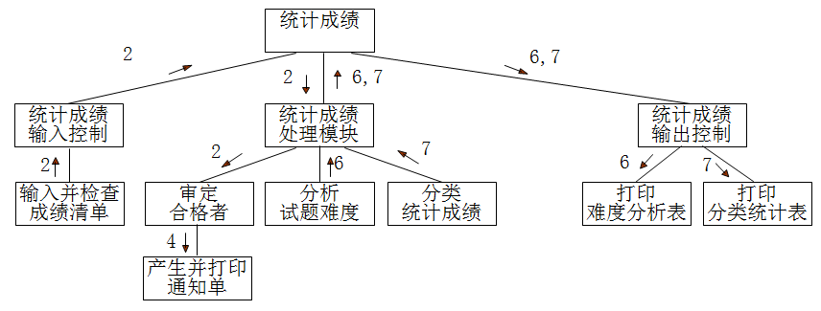
结构化设计的系统示例

Slide 21
面向对象方法示例：销售订单
Order
Product
Ship via

Slide 22
销售订单的类图
Sale
seller
buyer
item sold
shipping mechanism
Salesperson
Customer
Product
Vehicle
Corporate
Individual
Truck
Train

Slide 23
需求变更的影响
假定你需要增加新的运输工具 ...
Sale
seller
buyer
item sold
shipping mechanism
Salesperson
Customer
Product
Vehicle
Corporate
Individual
Truck
Train
Airplane
增加一个新的子类

Slide 24
面向对象方法
九十年代以来的主流开发方法
符合人们对客观世界的认识规律
开发的系统结构易于理解、易于维护
继承机制有力支持软件复用
常见的面向对象方法
Booch method 1994
Coad and Yourdon method 1991
Rambaugh method -- OMT 1991
Jacobson method – OOSE 1992
Wirfs-Brock method 1990
……
国际标准统一建模语言 UML 1997

Slide 25
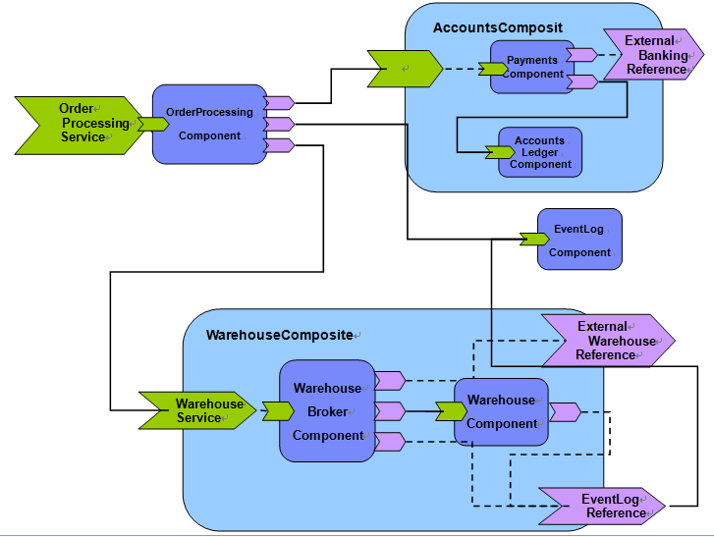
基于构件的软件系统示例

Slide 26
构件
构件是软件复用的重要手段，是核心和基础
构件由构件规约与构件实现两部分组成
Component interface
Component implementation

Slide 27
基于构件的开发
A3
R
A1
A4
A2
基础构件
A
B
C
D
D
B2
B4
B1
B3
A1
B1
A1
A2
B1
B2
C2
C1
D1
功能构件
C1
A2
C1
C2
B2
应用系统
A3
A4
B3
B4
D2
应用构架库
接口构件
应用系统
D1
D2
组装车间
应用构架
提取车间
界面构件
构件库
构件生产车间
标准规范 与 质量保证

Slide 28
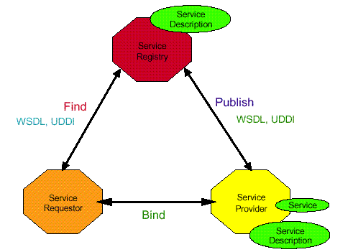
面向服务的方法
服务的抽象性（基于接口的编程）
服务的自治性（实现分布式应用）
服务间的松耦合式绑定，基于标准化消息进行通信
服务的自描述性（支持动态发现与延迟绑定）
服务的粗粒度（支持基于业务逻辑的积木式装配）

Slide 29
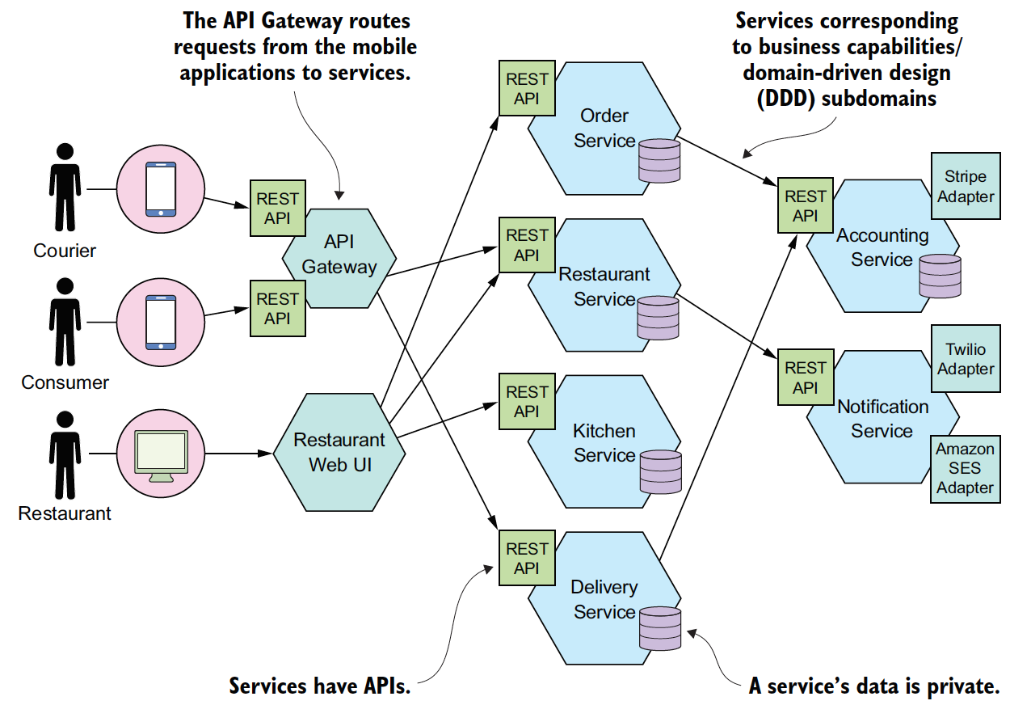
面向服务的系统示例 (基于微服务架构的网络订餐系统）

Slide 30
模型驱动的软件开发 (MDD)
以模型为中心（相对于以代码为中心）的软件开发方法
基于以下两种久经考验的技术
(1) 抽象
(2) 自动化
«sc_module» producer
«sc_module» producer
建模语言
start
out1
start
out1
建模工具
SC_MODULE(producer)
{sc_inslave<int> in1;
int sum; //
void accumulate (){
sum += in1;
cout << “Sum = “ << sum << endl;}
SC_MODULE(producer)
{sc_inslave<int> in1;
int sum; //
void accumulate (){
sum += in1;
cout << “Sum = “ << sum << endl;}

Slide 31
模型间的(半)自动转换
计算无关模型
CIM
业务模型
平台无关模型
PIM
分析模型
平台有关模型
PSM
设计模型
代码
实现模型
系统工程
需求
设计
编码
测试
测试模型

Slide 32
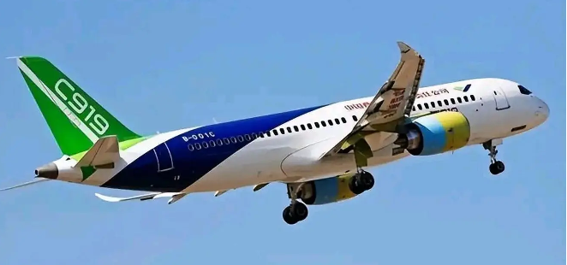
形式化方法
形式化方法是基于数学的技术开发软件，如集合论、模糊逻辑、函数。
形式化方法的好处：
无二义性
一致性
正确性
完整性
形式化验证
形式化开发
国产替代
安全可信

Slide 33
举例
--------AddBlock-----------------
△BlockHandler
Ablocks？： P BLOCKS
---------------------------------
Ablocks？⊆ used
BlockQueue'=BlockQueue⌒〈Ablocks？〉
used'=used∧
free'=free
加一个块集合到队列的尾部, 采用Z语言

Slide 34
形式化方法的不足
形式化规约主要关注于功能和数据，而问题的时序、控制和行为等方面却更难于表示。此外，有些问题元素(如，人机界面)最好用图形技术来刻划。
使用形式化方法来建立规约比其他方法更难于学习，并且对某些软件实践者来说它代表了一种重要的“文化冲击”。
难以支持大的复杂系统。
尚未成为主流的开发方法，实践和应用较少

Slide 35
Review：软件建模的方法
结构化方法 (Structured Method)
面向对象方法 (Object Oriented Method)
基于构件的软件开发方法 (Component Based Software Development)
面向服务方法 ( Service Oriented Method)
模型驱动的开发方法 (Model-Driven Development)
形式化方法 (Formal Method)
……

Slide 36
01-什么是模型
02-软件建模方法
03-面向对象方法概述

Slide 37
Object Technology
What Is Object Technology?
A set of principles (abstraction, encapsulation, polymorphism) guiding software construction, together with languages, databases, and other tools that support those principles.
The Strengths of Object Technology
Reflects a single paradigm
Facilitates architectural and code reuse
Reflects real world models more closely
Encourages stability
Is adaptive to change
Notes:
Provide a high-level definition of object technology. Keep in mind that this is all new to most of your students.
Share with the students your excitement about OO. Object technology is not simply the use of an object-oriented language like Java or C++. It is based on the principles of abstraction, modularity, hierarchy, and encapsulation.
If an organization is to successfully implement object technology, they must use more than a language. They must also use process, a modeling language (UML), data modeling techniques, and so on.

Slide 38
The History of Object Technology
Major object technology milestones
Simula
C ++
UML
Future
1967
Late 1980s
1996
1972
1991
2003
???
Smalltalk
Java
MDA
Notes:
Review these milestones with the students so that they garner a perspective on object technology’s history.
This slide was included to show students that object technology is not new. It has been around for a long time and is a proven and fairly mature technology.

Slide 39

UML （Unified Modeling Language)
UML 2.5
(2017)
UML 2.0
(2003)
UML
Partners’
Expertise
UML 1.0
(Jan. ‘97)
UML 0.9
(June ‘96)
and
UML 0.91
(Oct. ‘96)
Public
Feedback
Unified Method 0.8
(OOPSLA ’95)
Booch ’93
OMT - 2
Other
Methods
OOSE
Booch ‘91
OMT - 1

Slide 40
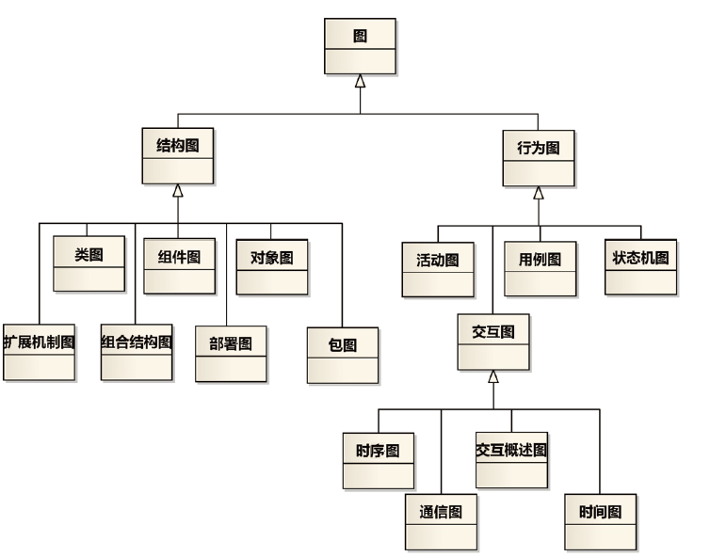
UML模型
Multiple views
Precise syntax and semantics
Notes:
The UML provides a graphical language for representing models but provides little or no guidance on when and how to use these diagrams. This is an area in which the RUP helps. It describes the kinds of project artifacts needed, including diagrams, and puts them in the context of an overall project plan.

Slide 41
UML建模工具
IBM Rhapsody 和RSA
Sparx Systems EA
Sybase PowerDesigner
Borland Together
Microsoft Visio
StarUML 开源
ArgoUML 开源
…

Slide 42
Where Is Object Technology Used?
Client/Server Systems and Web Development
Real-time Systems
Embedded System
Multimedia System
Middleware
……
Notes:
Demonstrate that object technology is used in many client/server applications today.
If you have a “war-story” or an experience that you had working on a Web or client-server application that successfully used object technology, share it here.
This is not just for traditional 2-tier client/server systems, but also N-tier systems such as large scale Web applications.

Slide 43
What Is an Object?
Informally, an object represents an entity, either physical, conceptual, or software.
Physical entity
Conceptual entity
Software entity
Truck
Chemical Process
Linked List
Notes:
Stress that objects can represent anything. Remember, most of your students do not know what an object is.

Slide 44

A More Formal Definition
An object is an entity with a well-defined boundary and identity that encapsulates state and behavior.
State is represented by attributes and relationships.
Behavior is represented by operations, methods, and state machines.
Attributes
Object
Operations
Notes:
Emphasize that state, identity and behavior are the key characteristics of an object.
Take a moment to explain the graphic on this slide.
Attributes are documented on the inside of the doughnut.
Operations are documented on the borders, which become clearer to the student as you discuss topics like encapsulation.
Note that the doughnut is not part of the UML notation. UML notation is discussed later.

Slide 45
Representing Objects in the UML
An object is represented as a rectangle with an underlined name.
J Clark :
Professor
Named Object
: Professor
Professor J Clark
Anonymous Object
Notes:
Demonstrate how an object is modeled in UML.
Many of your students may now wonder, “Hey, what is a class?” Classes are defined on the next slide.

Slide 46
Basic Principles of Object Orientation
Object Orientation
Abstraction
Encapsulation
Modularity
Hierarchy
Notes:
Introduce the four basic principles of OO.
Be sure the students understand objects before you begin this next section.
You’ve introduced objects first to help students better apply each of these principles.

Slide 47
What Is Abstraction?
The essential characteristics of an entity that distinguishes it from all other kinds of entities.
Defines a boundary relative to the perspective of the viewer.
Is not a concrete manifestation, denotes the ideal essence of something.
Course Offering (9:00 a.m.,
Monday-Wednesday-Friday)
Student
Professor
Course (e.g. Algebra)
Notes:
Explain the concept of abstraction to the students.
A car (“a mobile, powered vehicle for transporting people from place to place”) is an example of an abstraction if it suppresses less important details.
The abstract use of car is not concrete. However, if you describe the car as a 1995 Blue Ford Mustang, then it becomes a concrete manifestation and not an abstraction.
Discuss the makings of a good abstraction.
Concise
Single coherent concept
Abstraction removes the unnecessary details to make something easier to understand.

Slide 48
What Is Encapsulation?
Hides implementation from clients.
Clients depend on interface.
Improves Resiliency
Notes:
Define the concept of encapsulation to the students.
Encapsulation is putting the “data bits” and operations that manipulate them in the same place.
Encapsulation does NOT allow direct manipulation of things that have been encapsulated without using the supplied interface.
An example is a car’s accelerator. Generally speaking, you put your foot down and the car goes faster. You don’t worry about the cables, electronics, engine, and the rest.

Slide 49
Encapsulation Illustrated
Professor Clark needs to be able to teach four classes in the next semester.
Professor Clark
AcceptCourseOffering()
SubmitFinalGrades()
Name: J Clark
Employee ID: 567138
HireDate: 07/25/1991
Status: Tenured
Discipline: Finance
MaxLoad:4
SetMaxLoad(4)
SetMaxLoad()
TakeSabbatical()
Notes:
Point out that the requesting object does not need to know the structure of the Professor object to request a state change.
The object that owns the attributes is the only one allowed to change its own attributes.
Note that encapsulation can also be illustrated using interfaces. However, the scope of this course does not include this discussion.

Slide 50
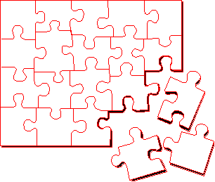
What Is Modularity?
Breaks up something complex into manageable pieces.
Helps people understand complex systems.
Notes:
Explain the concept of modularity to the students.
Modularity supports a separation of concerns.

Slide 51
Example: Modularity
For example, break complex systems into smaller modules.
Billing
System
Course
Catalog
System
Course Registration System
Student
Management
System
Notes:
A car is an example of modularity. It is made of up of a body, chassis, engine, wheels, and so on.

Slide 52
What Is Hierarchy?
Increasing
abstraction
Asset
BankAccount
Security
RealEstate
Decreasing
abstraction
Savings
Checking
Stock
Bond
Elements at the same level of the hierarchy should be at the same level of abstraction.
Notes:
Explain the concept of hierarchy to the students.
Hierarchy is a taxonomic organization. The use of hierarchy makes it easy to recognize similarities and differences.
A taxonomic organization is one that represents an orderly classification. For example, plants and animals are classified taxonomically.
Note that this is not part of the UML notation. UML notation is discussed later.

Slide 53
What Is a Class?
A class is a description of a set of objects that share the same attributes, operations, relationships, and semantics.
An object is an instance of a class.
A class is an abstraction in that it
Emphasizes relevant characteristics.
Suppresses other characteristics.
Notes:
Explain what a class is to the students. Remember, many of your students are not familiar with this term.
The course introduces objects before classes because objects are the things that actually do most of the work. Classes are the templates for the objects.

Slide 54
Representing Classes in the UML
A class is represented using a rectangle with three compartments:
The class name
The structure (attributes)
The behavior (operations)
Professor
- name
- employeeID : UniqueId
- hireDate
- status
Visibility:
Public: +
Private: -
Protected: #
- discipline
- maxLoad
+ submitFinalGrade()
+ acceptCourseOffering()
+ setMaxLoad()
+ takeSabbatical()
+ teachClass()
Notes:
Demonstrate how a class is modeled in UML.
Tell them that the UML represents public visibility with a plus (+) symbol and private visibility with a minus (-) symbol. Do not discuss protected visibility.

Slide 55
The Relationship between Classes and Objects
A class is an abstract definition of an object.
It defines the structure and behavior of each object in the class.
It serves as a template for creating objects.
Classes are not collections of objects.
Professor
Professor Torpie
Professor Meijer
Professor Allen
Notes:
Show how classes and objects are related.
Classic example: A class is to an object what a cookie cutter is to a cookie.

Slide 56
What Is a Package?
Modularity
A general purpose mechanism for organizing elements into groups.
A model element that can contain other model elements.
A package can be used:
To organize the model under development.
As a unit of configuration management.
University
Artifacts
Notes:
Introduce the term package to the students.
A package is a “virtual bag.” You can place just about anything inside of it that you would like.
Packages allow us to organize our models into bits and pieces that make sense. They support the concept of modularity.

Slide 57
Package 示例
The package, University Artifacts, contains one package and five classes.
Student
Artifacts
Professor
University
Artifacts
Course
Schedule
Student
CourseOffering
Notes:
Explain how packages and classes are related to one another.
Make sure students understand that packages are a higher level of abstraction than a class.
Everything in your model must reside in a package. Therefore, it is assumed that, at the top level of your model, there is one owning package.

Slide 58
面向对象方法的步骤
面向对象分析
Object Oriented Analysis, OOA
面向对象设计
Object Oriented Design, OOD
面向对象编程
Object Oriented Programming, OOP
面向对象测试
Object Oriented Testing, OOT

