Slide 1
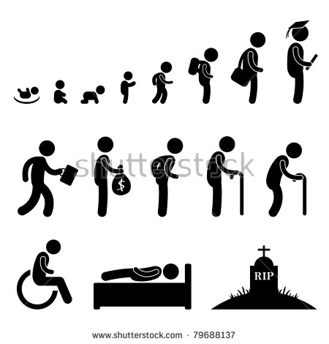
Be a scientist or baseball player?
Be a baseball player?
Be a baseball player?
Probably not.
Both cool!
What?
0
10
20
30
40
50
60
70
Age
Career Selection

