Slide 1



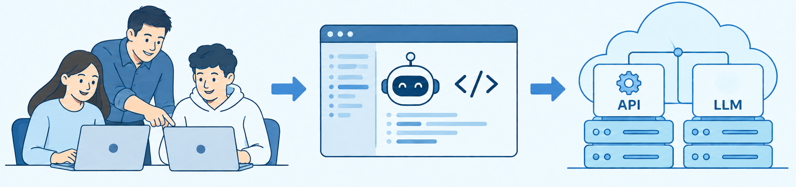






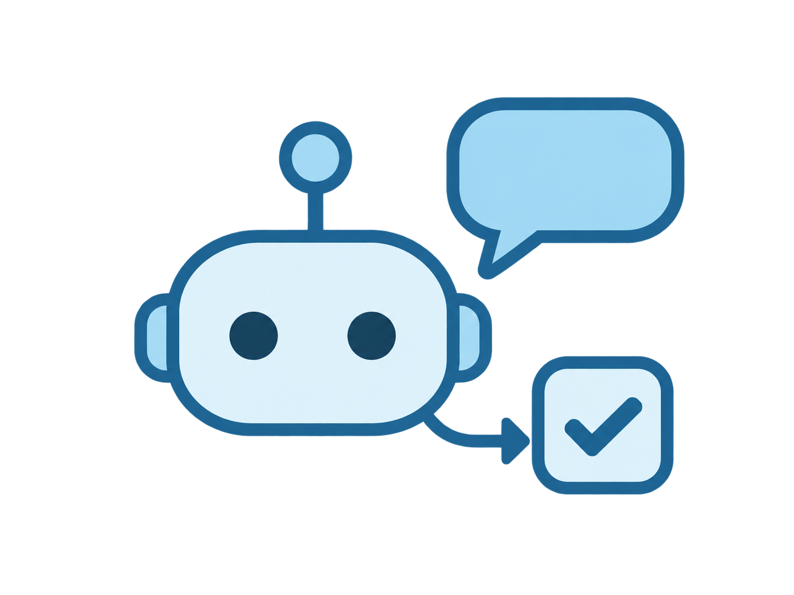

POLYGATE AGENT CHALLENGE
ALL PROGRAMMES WELCOME
STUDENT ORGANISERS WANTED
AI AGENT DESIGN COMPETITION
STAGE 1: ORGANISE
STAGE 2: COMPETE
Mock APIs + platform setup
Design AI agents
THIS RECRUITMENT
ENTRANT RECRUITMENT LATER
YOUR TASK
ISOLATED SANDBOX
MENTORED PRACTICE
STUDENT TEAM + COACH
AGENT-NATIVE APIs
DEPLOY TO PLATFORM
YOUR SUPPORT
Weekly
1:1 coaching
3 technical
workshops
YOUR REWARDS
COMPLETION
CERTIFICATE
COMPUTE
ACCESS
RESEARCH
CONNECTIONS
Recognised contribution
For your own projects
AI agent researchers
YOUR GROWTH
AI & AGENTS
COMPUTE SERVICES
Agents
LLMs
Prompting
Docker
Automation
Deployment
POLYU STUDENTS
8-12 PLACES PLANNED
STAGE 1: 4-WEEK SPRINT + 1-WEEK READINESS REVIEW
JOIN THE ORGANISING TEAM
Help organise the PolyGate Agent Challenge: build agent-native mock APIs and deploy APIs and LLMs with Docker in a sandbox isolated from ITS production systems. Develop AI and computing skills with coaching and workshops, and gain a certificate, compute access for your own projects and research connections. All PolyU programmes welcome. Competition entrants will be recruited separately for Stage 2. Dates to follow.
QR CODE
PLACEHOLDER
github.com/zhiyuanGH/polygate-mock-api-suite
ENQUIRIES & APPLICATIONS
APPLICATION FORM
[email address]
Notes:
Recruitment content supplied by the organising team.
Official logo sources, accessed 17 September 2026:
PolyU: https://www4.comp.polyu.edu.hk/~labimcl/fig/polyu2.png
IHERD: https://www.polyu.edu.hk/iherd/-/media/department/iherd/setting/iherd-logo.png?bc=ffffff&h=192&mw=1050&rev=1b5054d0ff254651abe205bf47715c4a&hash=9A87D8CB79571F413B81B4558707B760
IMCL: https://www4.comp.polyu.edu.hk/~labimcl/fig/slogan.png
New team/coach/API/deployment illustration: AI-generated with the built-in image generation tool. Local asset: assets/team-coach-agent-api-deployment.png.
The new illustration replaces the earlier single student and agent/API/LLM diagram. The new short captions and all recruitment copy remain native editable text. API and LLM inside the illustration are part of the raster artwork.
The two smaller growth illustrations are also AI-generated. All logos and illustrations remain independent movable image objects.
Two-stage overview: Stage 1 prepares the competition environment and is the subject of this organiser recruitment. Stage 2 is the agent design competition, with separate later recruitment for entrants. Stage labels, rules and sequence arrow are native editable PowerPoint objects. The four-week sprint and one-week review refer to Stage 1 only. No competition dates have been added.
LLM icon revision: the brain symbol was removed with the built-in image editing tool. The official black OpenAI Blossom is a separate unmodified PNG over the LLM module. Source: https://openai.com/brand/ and https://cdn.openai.com/brand/OpenAI-Logos-2025.zip, file OpenAI-logos(new)/PNGs/OpenAI-black-monoblossom.png. OpenAI owns the logo. Used as a user-requested illustrative model brand, not an assertion of sponsorship or a confirmed deployment choice. All recruitment copy and the two-stage diagram are unchanged.
Coach revision: the standing mentor is now depicted as a contemporary Chinese university coach at the user's request. This is an AI-generated fictional character, not a portrait of an identified person. The built-in image editing tool updated the mentor's head and face. Asset: assets/team-coach-agent-api-deployment-chinese-coach.png. The image placement, separate OpenAI logo, all other images, recruitment copy and two-stage diagram remain unchanged.
Layout revision: body sections now read YOUR TASK, YOUR SUPPORT, YOUR REWARDS, YOUR GROWTH. Three AI-generated blue-and-white reward spot illustrations represent the completion certificate, compute access for personal projects and connections with AI agent researchers. These are illustrations, not photographs. The source images are assets/reward-certificate-blue.png, assets/reward-compute-blue.png and assets/reward-research-blue.png. All existing institutional logo and OpenAI asset citations are retained.
Current LLM icon revision: the earlier OpenAI Blossom has been replaced by an original AI-generated blue microchip containing a white speech bubble and two text lines. The current poster uses no brand mark to represent LLMs. No brain-shaped imagery is used. The icon is a separate movable transparent PNG at assets/llm-language-chip-blue.png, generated with the built-in image generation tool. This note supersedes earlier descriptions of the LLM icon; historical source citations remain for provenance. All other poster artwork, text and section ordering are unchanged.
Support illustration revision: two original AI-generated pale-blue spot illustrations now accompany weekly 1:1 coaching and three technical workshops. A mentor with one student at a laptop represents coaching, while a code presentation board and laptop represent workshops. These are illustrations, not photographs. Assets: assets/support-coaching-blue.png and assets/support-workshops-blue.png. Generated using the built-in image generation tool. Support text remains native editable text, reflowed onto two lines. All other poster text, artwork, section order and positions remain unchanged.
Contact placeholders: the join section now reserves a square area marked QR CODE / PLACEHOLDER for a future application-form QR. This is an editable placeholder, not a scannable QR code. The contact area reads ENQUIRIES & APPLICATIONS and [email address]. No real email address, mailto link, application URL or QR destination has been invented. Replace both placeholders before publication. The footer introduction is condensed to make space, while the original recruitment terms remain elsewhere on the poster. The GitHub link is retained. All content above the join section and all illustrations are unchanged.

