Slide 1

CMPT 413/713: Natural Language Processing
Word Embeddings
Zhiyun (Richard) Peng
2026-10-3
Adapted from slides from Angel Chang, Anoop Sarkar, Danqi Chen and Karthik Narasimhan
Notes:
http://demo.clab.cs.cmu.edu/NLP/

Slide 2
How to represent words?
In traditional NLP, we regard words as discrete symbols:
hotel, conference, motel — a localist representation
Words can be represented by one-hot vectors:
one 1, the rest 0’s
Each word is one dimension!
hotel = [0 0 0 0 0 0 0 0 0 0 0 1 0 0 0 0]
motel = [0 0 0 1 0 0 0 0 0 0 0 0 0 0 0 0]
Vector dimension = number of words in vocabulary (e.g., 500,000)
There is no way to encode similarity of words in these vectors!
Notes:
Why word embeddings?

Slide 3
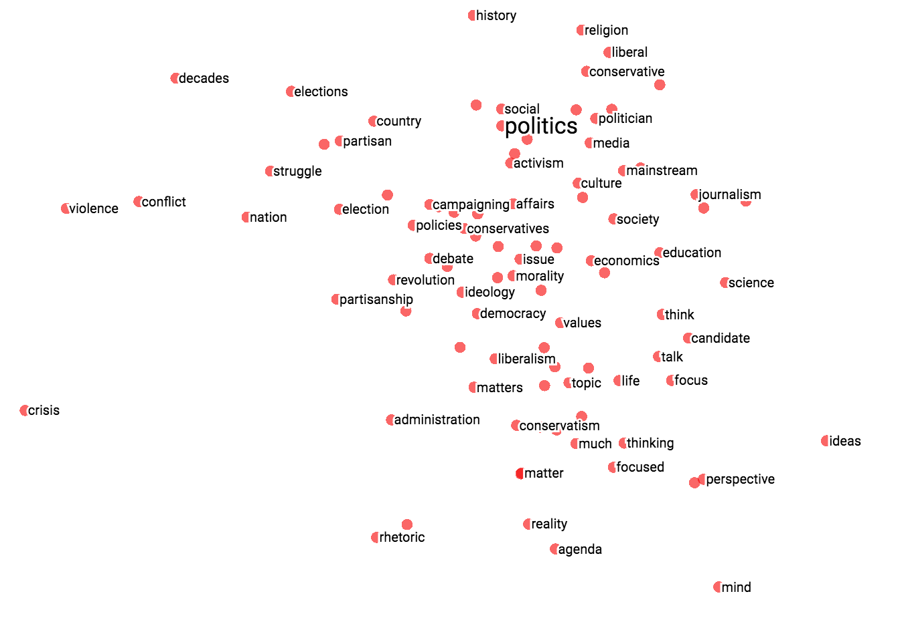
Representing words
Representing meaning as vectors
common representation space
enables information sharing
can be learned from data
One-hot vectors
Continuous embeddings
cat = [0 0 0 1 0 0 0]
dog = [0 0 0 0 0 1 0]
cat = [0.04 1.79 -1.79 1.07 0.48]
dog = [0.61 1.84 -1.12 0.52 0.53]
kitten
Distributed representation
(Meaning not isolated to one dimension)
cat
dog
Continuous space for words:
Similar words closer to each other

Slide 4
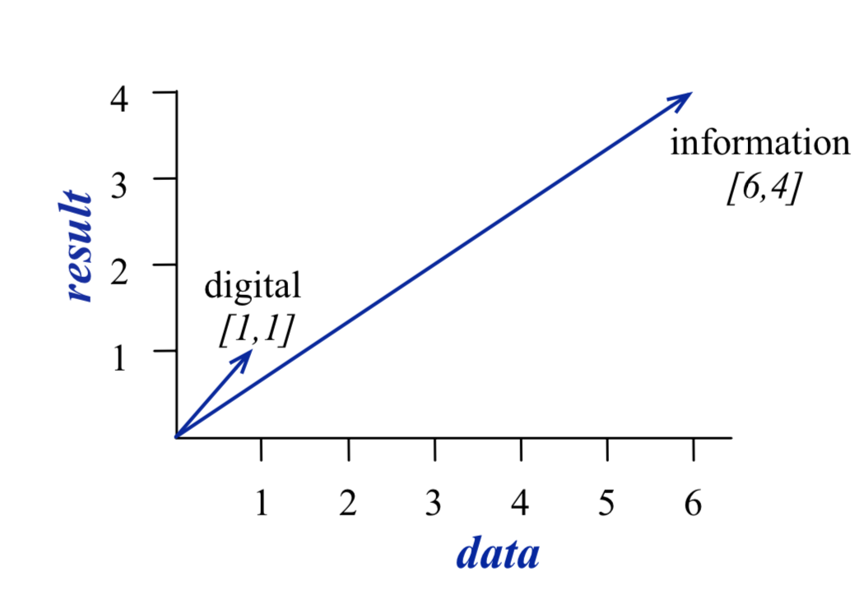
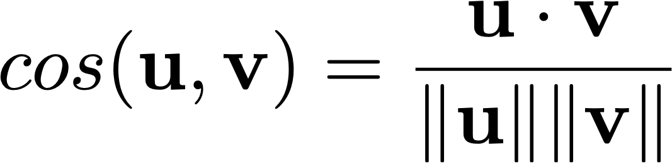
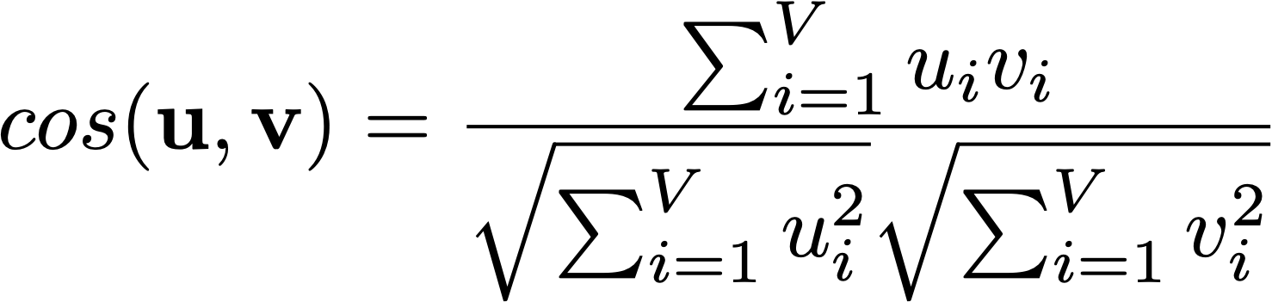
Can measure similarity of words

Slide 5
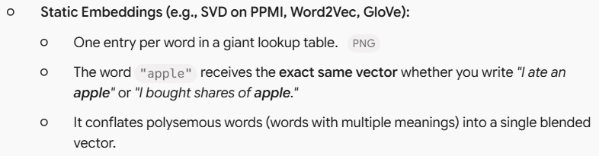
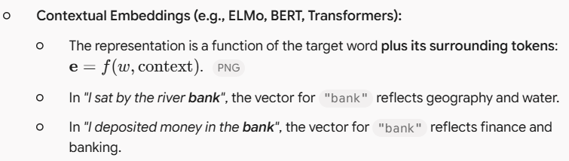
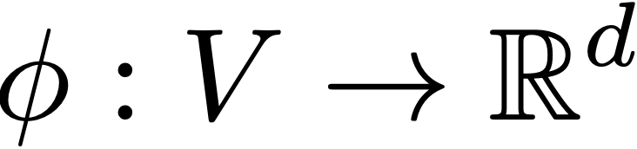
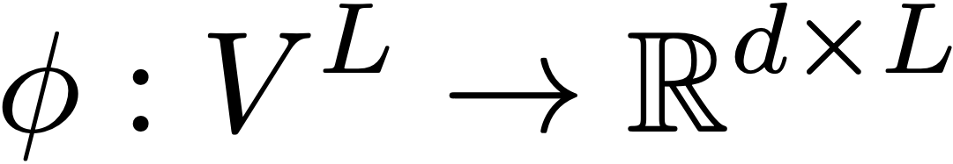




Representing words
One-hot vectors
Static embeddings
Contextual embeddings
  Token embedding depend on other tokens
cat = [0 0 0 1 0 0 0]
dog = [0 0 0 0 0 1 0]
"river bank" vs. "bank account"
Context-independent (fixed per vocabulary entry)
cat = [0.04 1.79 -1.79 1.07 0.48]
dog = [0.61 1.84 -1.12 0.52 0.53]
Context-dependent (varies with surrounding sentence)
L: sequence length (the number of tokens/words in the sentence or context window)
"river bank" vs. "bank account"

Slide 6
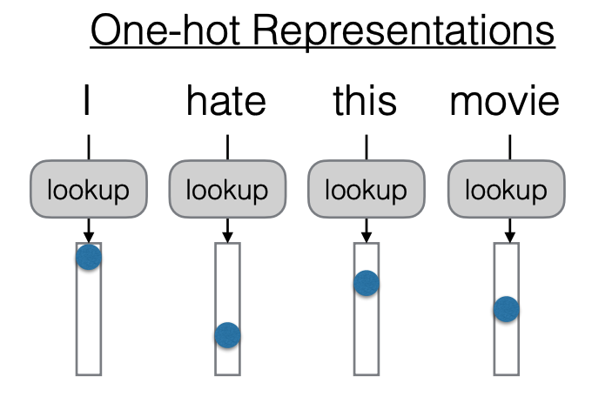
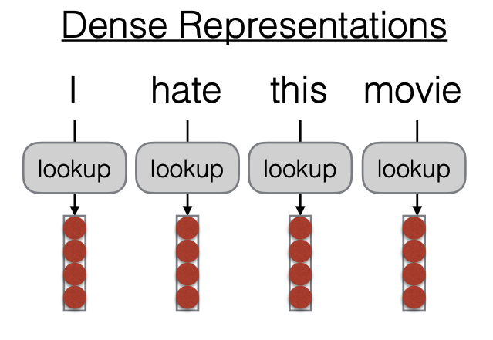

Words in sentences
  Neural network that produces contextual embeddings
https://phontron.com/class/anlp2024/assets/slides/anlp-02-wordrep-textclass.pdf

Slide 7
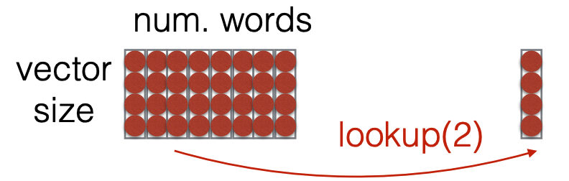
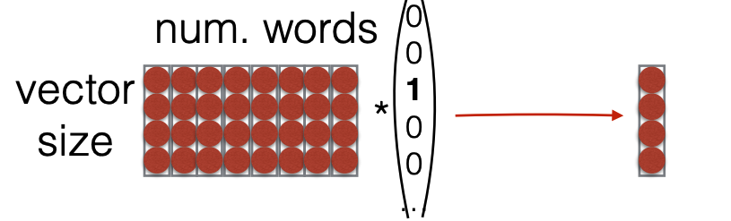
Looking up embeddings
  Lookup: grabbing a vector from a big matrix of word embeddings
Typically faster
  Can also view lookup as multiplying by a “one-hot” vector
https://phontron.com/class/anlp2024/assets/slides/anlp-02-wordrep-textclass.pdf

Slide 8
Where do these word embeddings come from?

Slide 9
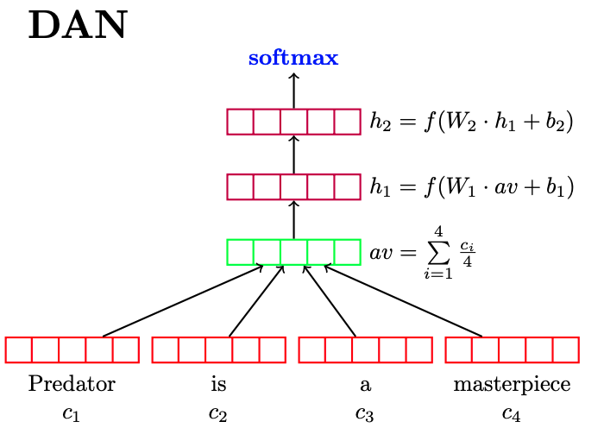
Task specific training
Assume you have annotated data specific to a task
Initialize with random vectors
Lookup table from word to vector
Train your classifier
  Classifier parameters are updated during training
  These parameters include the word vectors!
  After training, you get word vectors that are good for your task!

Slide 10
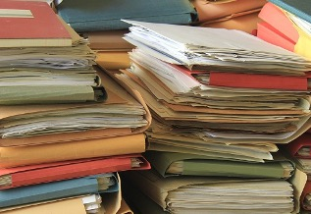

Pretraining and task-specific fine-tuning
Pretraining
Big pile of unlabeled text data!
Lots of resources to train!
Task-specific fine-tuning
Annotated data specific to a task (usually small)
Initialize with pre-trained model

Slide 11
Summary of three options
Random + train - Initialize with random embeddings and learn them when you train your classifier.
Pretrain + fixed - Initialize with pretrained embeddings + keep them fixed
Pretrain + fine-tune - Initialize with pretrained embeddings and then allow embedding weights to change as classifier is trained

Slide 12
Neural Networks with
Word Embeddings

Slide 13
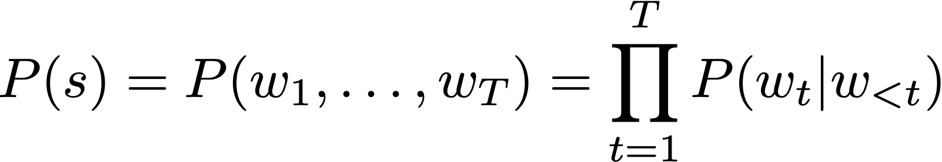
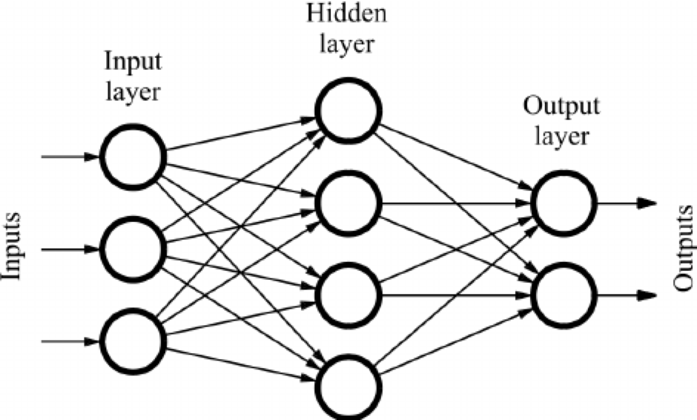
Estimating the probability of the next word
Statistical LM (n-grams) - used from 1990s to early 2010s
Neural LM: introduced in 2003, popularized in 2010s
Large language models (2020s):
  train with large amount of data (2020s)
Use neural network to encode the history and then estimate the probability of the next word
Word representations
- continuous vector representations
- learned from lots of data
Notes:
10:15?

Slide 14
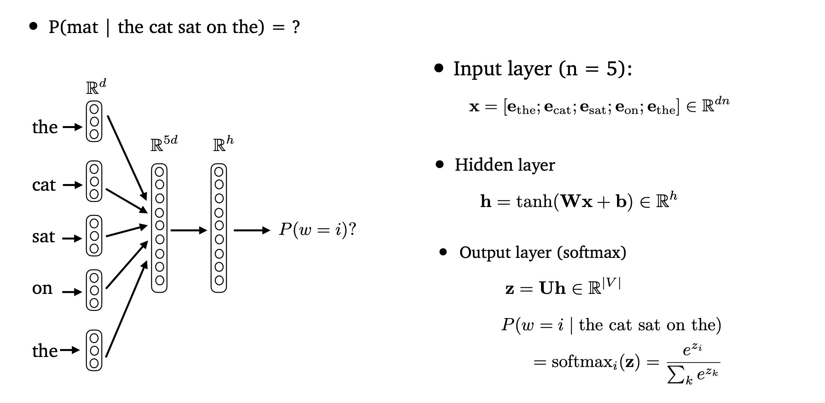



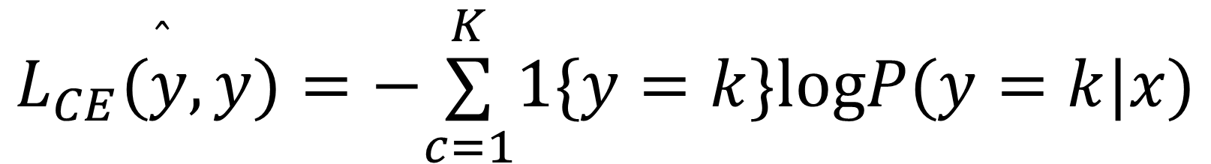
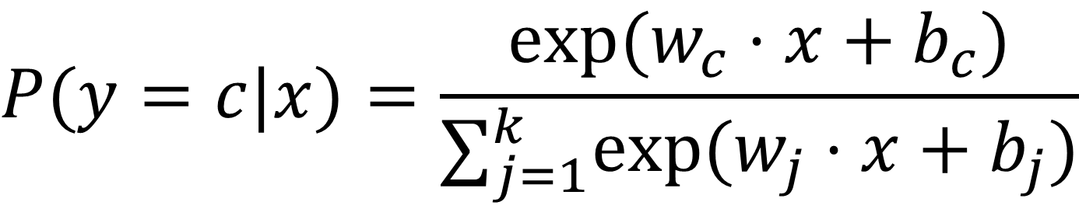

Language modelling with neural networks
Words are represented as continuous word embeddings
Parameters are weights of the neural network
Train to predict the next word given the previous words
  For each word: classification problem over the entire vocabulary
  Recall: use softmax to model probability of output class and cross-entropy loss for classification
P(mat | the cat sat on the) = ?
$$P(y=c|x)=\frac{exp(w_{c}⋅x+b_{c})}{∑_{j=1}^{k}exp(w_{j}⋅x+b_{j})}$$
  softmax
$$L_{CE}(\overset{̂}{y},y)=−\overset{K}{\underset{c=1}{∑}}1\{y=k\}logP(y=k|x)$$
A Neural Probabilistic Language Model [Bengio et al. 2003]
Notes:
Keep to 5 minutes for FFNs

Slide 15
Neural Bag-of-Words (NBOW)
Deep Averaging Networks (DAN) for Text Classification
averaging
word embeddings
(Iyyer et 2015): Deep Unordered Composition Rivals Syntactic Methods for Text Classification

Slide 16


Feedforward Neural LMs
Input layer (context size n = 5):
concatenate word embeddings
Hidden layer
Output layer (softmax)
(Bengio et 2003): A Neural Probabilistic Language Model

Slide 17
Language modelling with neural networks
Words are represented as continuous word embeddings
Parameters are weights of the neural network
Train to predict the next word given the previous words
  For each word: classification problem over the entire vocabulary
  Recall: use softmax to model probability of output class and cross-entropy loss for classification
P(mat | the cat sat on the) = ?
Different neural network architectures
  FFNs
  RNNs
  Transformers
Sliding Window
A Neural Probabilistic Language Model [Bengio et al. 2003]
Notes:
Keep to 5 minutes for FFNs

Slide 18
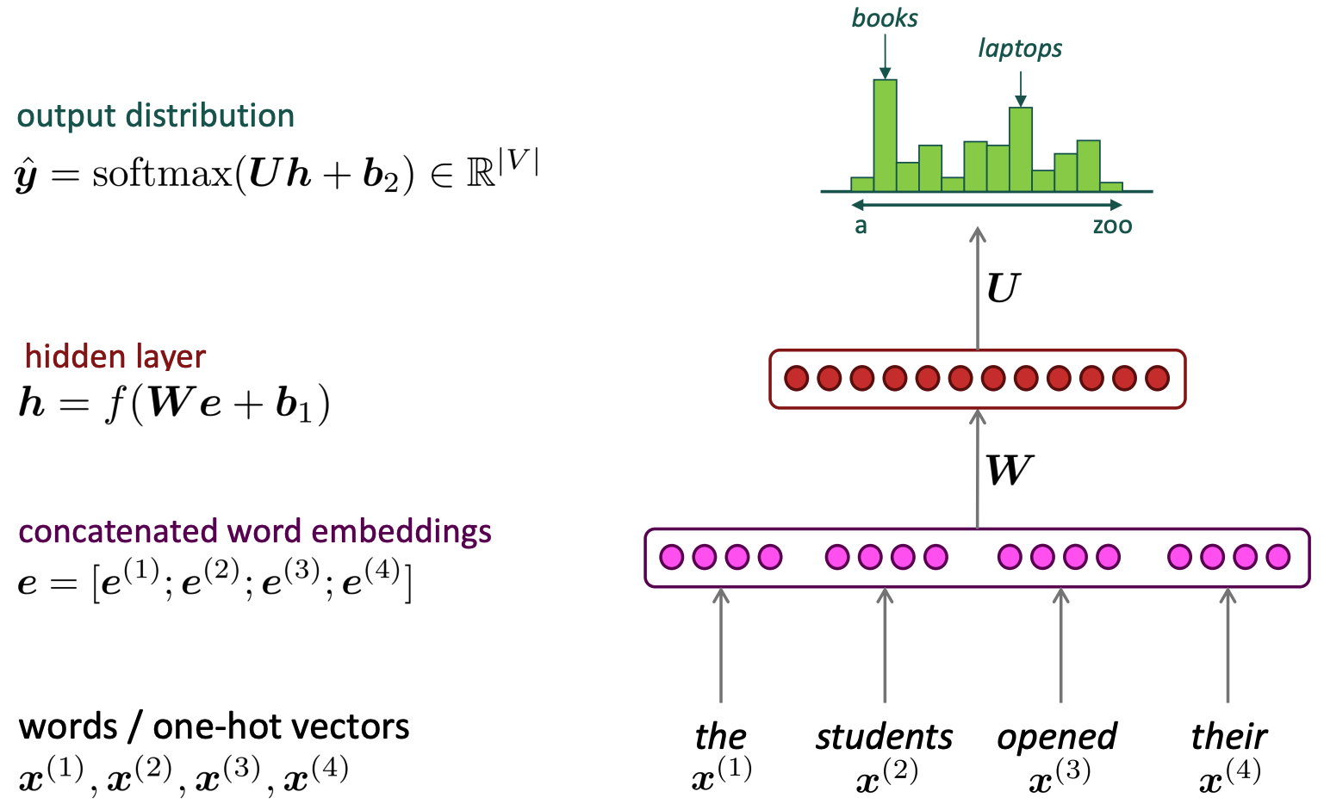
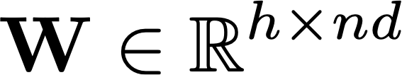
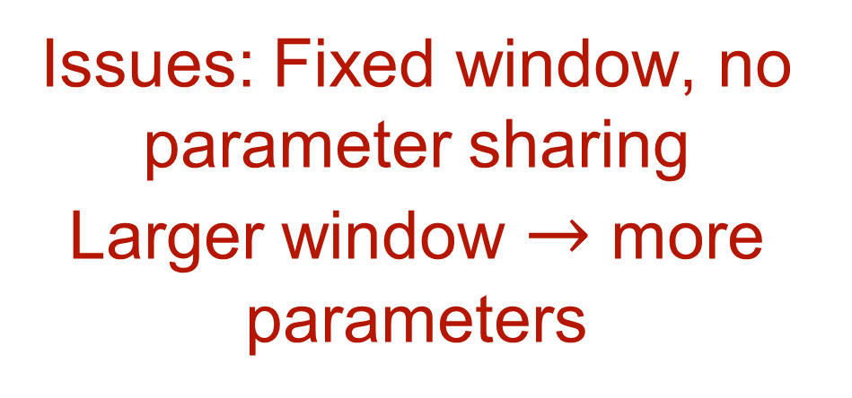

Feedforward Neural Language Model
(Neural BOW LM)
Issues: Fixed window, no parameter sharing
Larger window $→$ more parameters
Slide credit: Chris Manning
Notes:
\mathbf{h} = f(\mathbf{W} \mathbf{e} + \mathbf{b}_1)

Slide 19
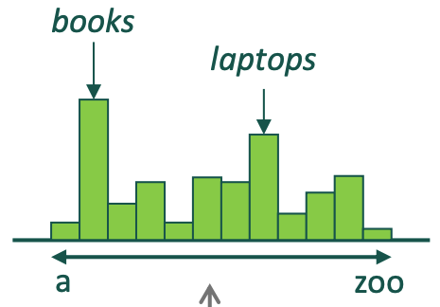
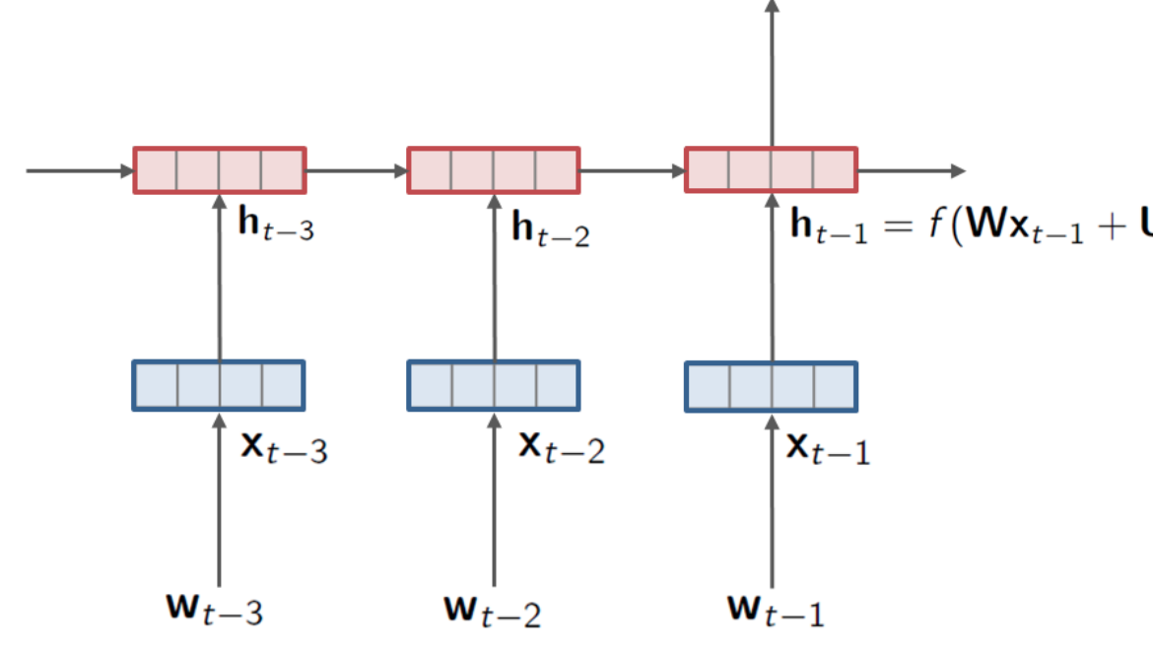
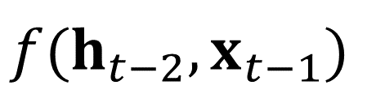
RNNs for Language Modeling
Use a RNN to
capture the history of the previous words as a hidden state
use hidden state to estimate the probability of the next word
$$f(h_{t−2},x_{t−1})$$
$$P(w_{t}|w_{1},…,w_{t−1})=P(w_{t}|h_{t−1})$$
Notes:
Keep to 5 minutes for RNNs

Slide 20



Learning contextualized word embeddings with RNNs: ELMo
Train two stacked LSTM-based language model on some large corpus. Bi-direction.
Use the hidden states of the LSTM for each token to compute a vector representation of each word
Contextual embeddings
Static embeddings
Let’s stick to
in this skit
(figure credit: Jay Alammar
http://jalammar.github.io/illustrated-bert/)
Deep contextualized word representations [Peter et al. 2018]

Slide 21
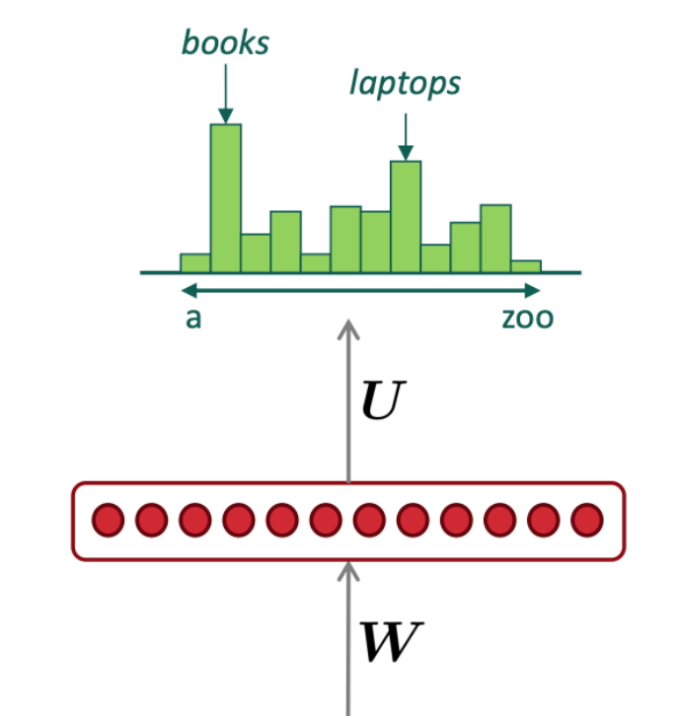


Transformers for Language Modeling
Contextual embeddings
Transformer
Static embeddings
SOS
the
students
opened
Notes:
10:30-10:40

Slide 22
How does the pretraining work?
Big pile of unlabeled text data! Learn using language modelling!

Slide 23
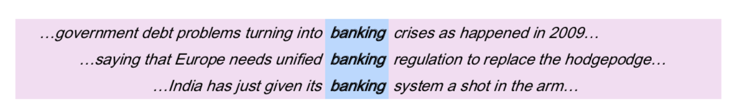
Representing words by their context
Distributional hypothesis: words that occur in similar contexts tend to have similar meanings
J.R.Firth 1957
“You shall know a word by the company it keeps”
One of the most successful ideas of modern statistical NLP!
These context words will represent banking.
Notes:
John Rupert Firth

Slide 24
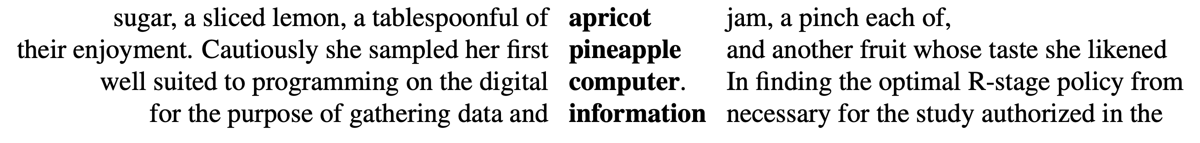
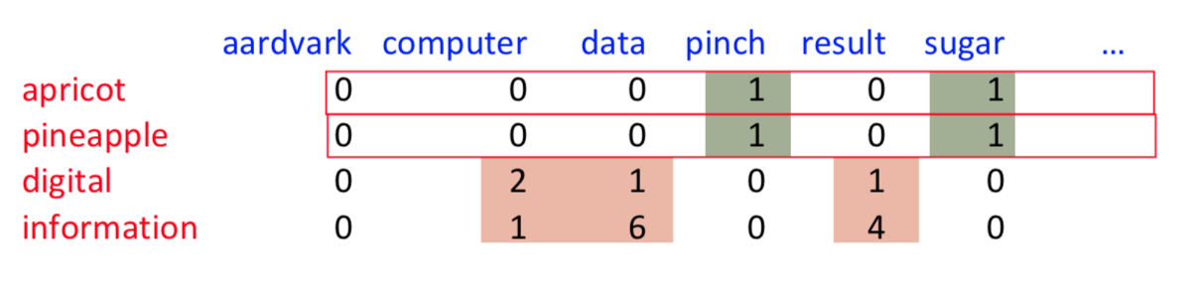
Representing words as vectors
  What we are aiming for:
    Each word is a vector
    Similar words are “nearby in space”
    Our first solution: use context vectors to represent the meaning of words
Eg: k-Word Neighbor Example, where k=1:
[w_{-1}, w, w_{+1}].
    word-word (term-context) co-occurrence matrix
Example from: Dan Jurafsky
Notes:
Aardvark 土豚 (tǔ tún) or 非洲食蚁兽
Apricot 杏

Slide 25
Problem with raw frequencies
    Problem: using raw frequency counts is not always very good.
  if sugar appears a lot near apricot, that's useful information.
  But overly frequent words like the, it, or they are not very informative about the context
    Solution: let’s weight the counts!
      TF-IDF = Traditional method used in document retrieval
      PPMI = Positive Pointwise Mutual Information

Slide 26
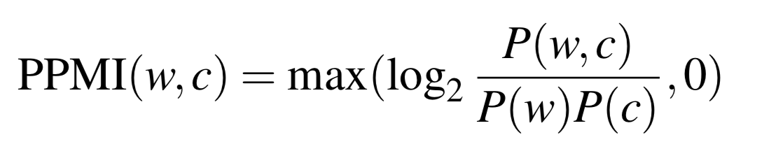
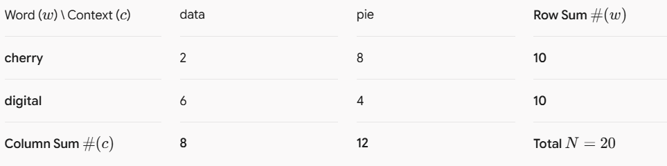
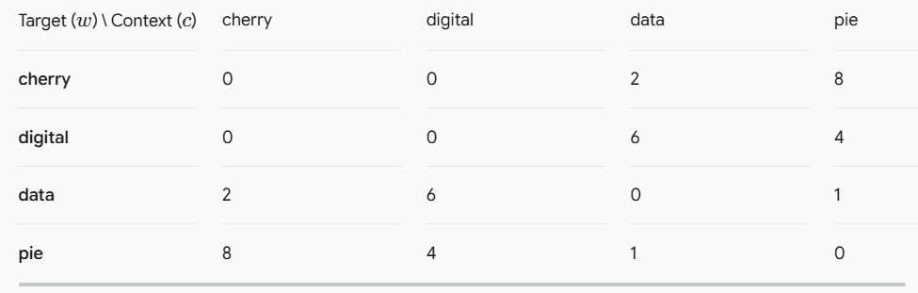







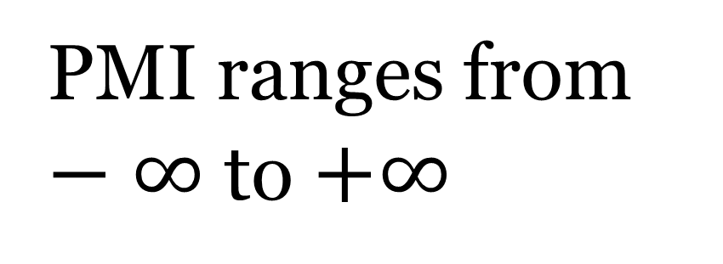

PPMI
Do two events co-occur more than if they were independent?
        PPMI = Positive Pointwise Mutual Information
Joint probability
Marginals
Negative values are problematic so cap bottom to 0
Reduce
PMI ranges from $−∞$ to $+∞$
Negative if co-occurs less than if independent

Slide 27
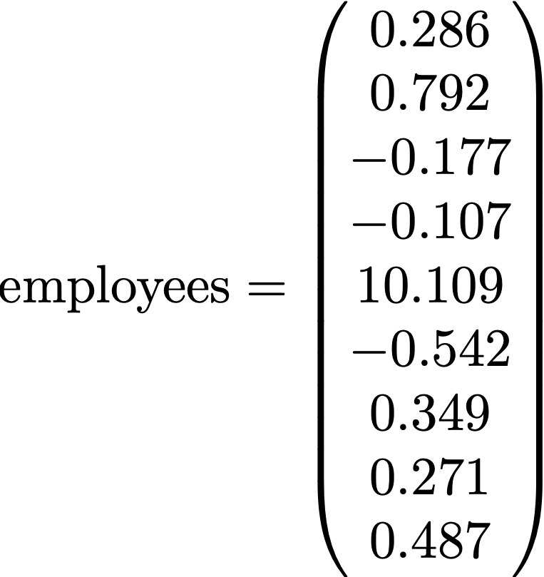


Sparse vs dense vectors
Vectors we get from word-word (term-context) co-occurrence matrix are
long (length |V|= 20,000 to 50,000)
sparse (most elements are zero)
True for both one-hot and PPMI vectors
Alternative: we want to represent words as
short (50-300 dimensional)
dense (real-valued) vectors
Distributed representation
More memory efficient and easier to work with
Capture similarity between words better

Slide 28
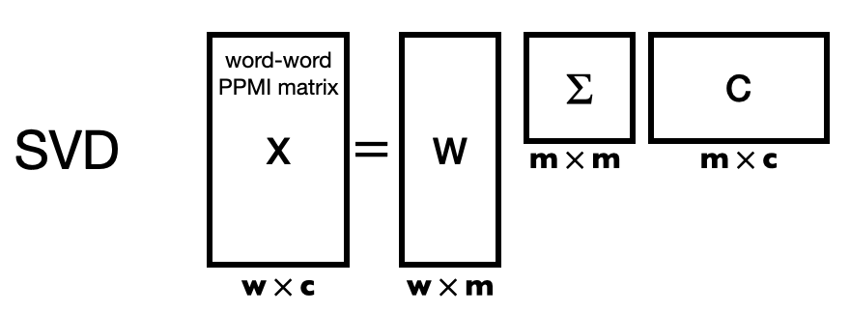
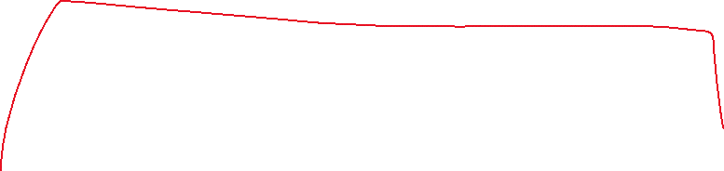
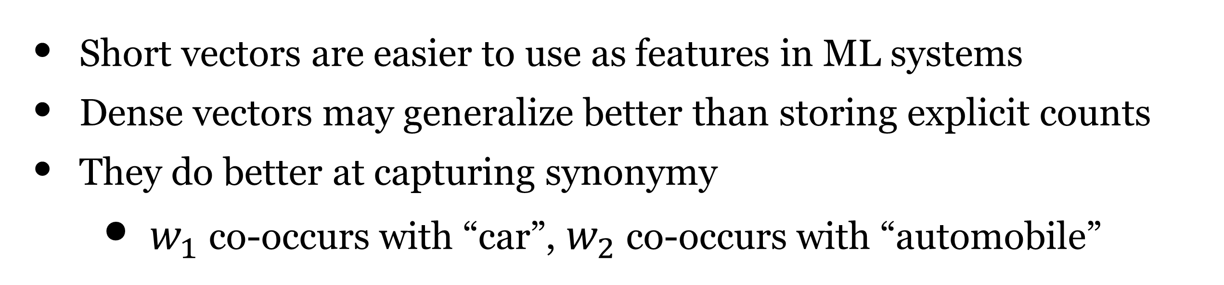


Why dense vectors?
Short vectors are easier to use as features in ML systems
Dense vectors may generalize better than storing explicit counts
They do better at capturing synonymy
    $w_{1}$ co-occurs with “car”, $w_{2}$ co-occurs with “automobile”
Different methods for getting dense vectors:
    Singular value decomposition (SVD)
    word2vec and friends: “learn” the vectors!
Count based method
(known since the 1990s)

Slide 29
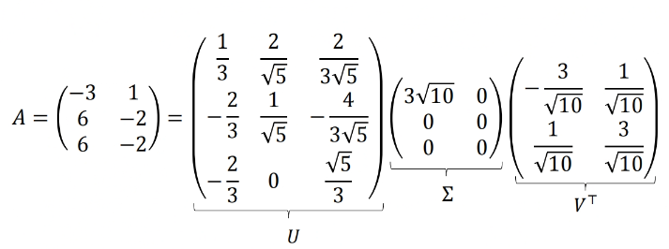
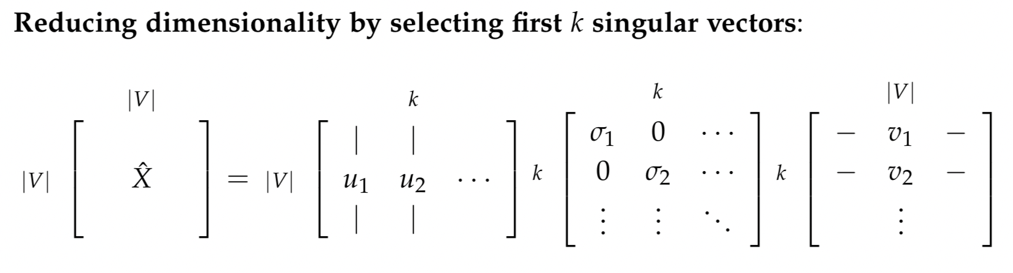
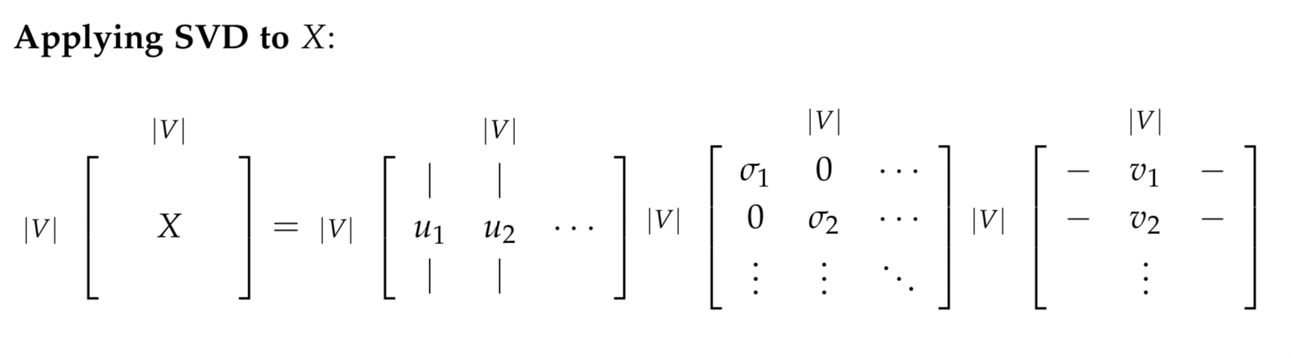
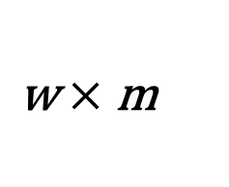


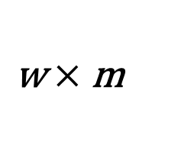




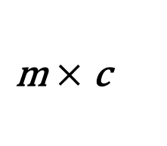
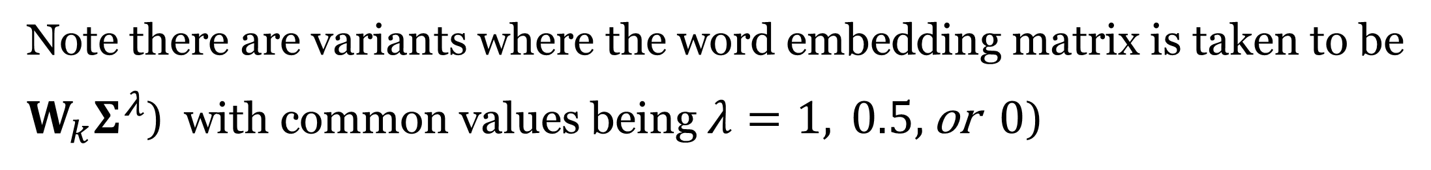
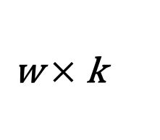
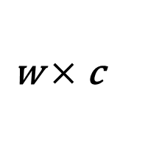
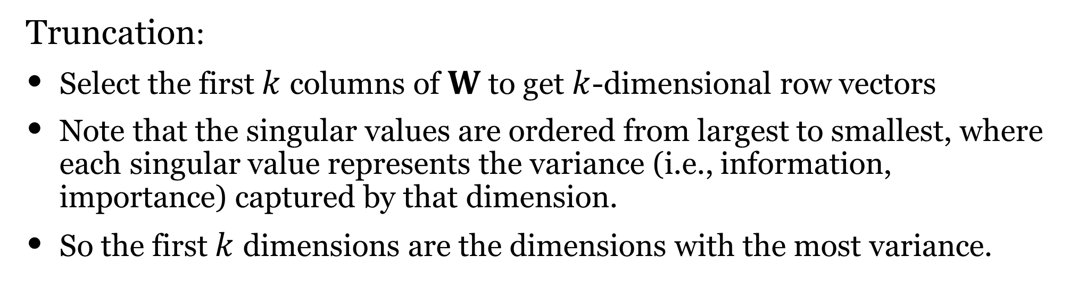

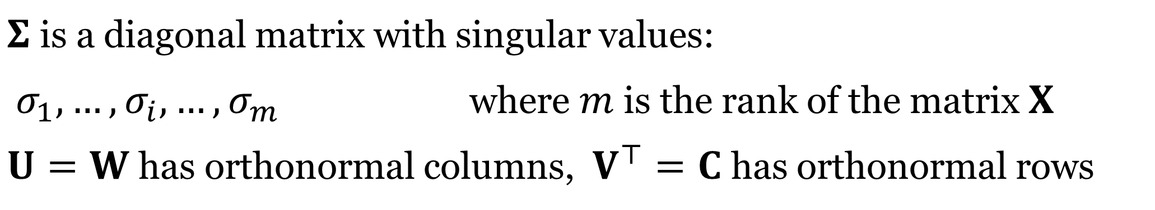








Using compact SVD for obtaining dense vectors
Recall in ML:
Orthogonal matrix
SVD = Singular value decomposition
Orthogonal matrix
$$X=UΣV^{⊤}$$
$Σ$ is a diagonal matrix with singular values:
  $σ_{1},…,σ_{i},…,σ_{m}$ where $m$ is the rank of the matrix $X$
  $U=W$ has orthonormal columns, $V^{⊤}=C$ has orthonormal rows
X
W
$$Σ$$
C
word-word
PPMI matrix
1) SVD
$\text{m}×\text{m}$
$\text{m}×\text{c}$
$$=$$
E.g., m = 10
word
$\text{w}×\text{c}$
$\text{w}×\text{m}$
E.g., w = 1,000
context
W
$$Σ$$
C
Truncation:
Select the first $k$ columns of $W$ to get $k$-dimensional row vectors
Note that the singular values are ordered from largest to smallest, where each singular value represents the variance (i.e., information, importance) captured by that dimension.
So the first $k$ dimensions are the dimensions with the most variance.
E.g., c = 100
2) Truncation
$\text{m}×\text{m}$
$\text{m}×\text{c}$
$$≈$$
k
k
k
$\text{w}×\text{m}$
E.g., k = 8
k
$$1.....\text{k}$$
3) Embeddings
1
2
.
.
i
.
w
Wk
$$Σ$$
C
Finally, we take $i$-th row of $W_{k}$ as the embedding of word $i$
Note there are variants where the word embedding matrix is taken to be
$W_{k}Σ^{λ}$ (with common values being $λ=1, 0.5,\text{or} 0$)
embedding for word i
$\text{w}×\text{k}$
traditional
Notes:
This idea originates from Latent Semantic Analysis (Deerwester et al., 1990) (applied on word-document matrix)
Orthogonal matrix

Slide 30

What is wrong with using SVD?
Computational complexity is high: $O(|V|^{3})$
Cannot be trained as part of a larger model
  Not a component that can be part of a larger neural network
Cannot be trained discriminatively for a particular task

Slide 31

Why dense vectors?
Short vectors are easier to use as features in ML systems
Dense vectors may generalize better than storing explicit counts
They do better at capturing synonymy
    $w_{1}$ co-occurs with “car”, $w_{2}$ co-occurs with “automobile”
Different methods for getting dense vectors:
    Singular value decomposition (SVD)
    word2vec and friends: “learn” the vectors!

Slide 32
Many different ways to learn the representations
From context words, predict target word (Masked LM)
A bottle of ___ is on the table.
From target word, predict other context words.
What words go with “tejuino”?
From previous words, predict next (target) word (Traditional LM)
A bottle of ___
A bottle of tejuino is on the ___

Slide 33
Many different ways to learn the representations
Different architectures and models to learn the representations
Get sentence embeddings by combining word embeddings
Two types of word embeddings
  Static - mapping of word to embedding
  Contextual - embedding of word changes based on the context

Slide 34
Summary
Representing words as vectors
  One-hot vectors vs vectors built using context
  Cosine similarity for measuring similarity between words
Using context to represent words
  Distributional hypothesis:
  words that occur in similar contexts tend to have similar meanings
Co-occurrence matrix
  Raw counts
  TF-IDF (term-frequency inverse-document-frequency)
  PPMI (positive pointwise mutual information)
Dense vectors via SVD or learned by predicting the missing word

