Slide 1

Word Embeddings
CMPT 413/713: Natural Language Processing
Spring 2026
2026-01–21
Adapted from slides from Dan Jurafsky, Chris Manning, Danqi Chen and Karthik Narasimhan

Slide 2

CMPT 413/713: Natural Language Processing
Word Embeddings
Zhiyun (Richard) Peng
2026-09-25
Adapted from slides from Angel Chang, Anoop Sarkar, Danqi Chen and Karthik Narasimhan
Notes:
http://demo.clab.cs.cmu.edu/NLP/

Slide 3
How to represent words?
In traditional NLP, we regard words as discrete symbols:
hotel, conference, motel — a localist representation
Words can be represented by one-hot vectors:
one 1, the rest 0’s
Each word is one dimension!
hotel = [0 0 0 0 0 0 0 0 0 0 0 1 0 0 0 0]
motel = [0 0 0 1 0 0 0 0 0 0 0 0 0 0 0 0]
Vector dimension = number of words in vocabulary (e.g., 500,000)
There is no way to encode similarity of words in these vectors!
Notes:
Why word embeddings?

Slide 4
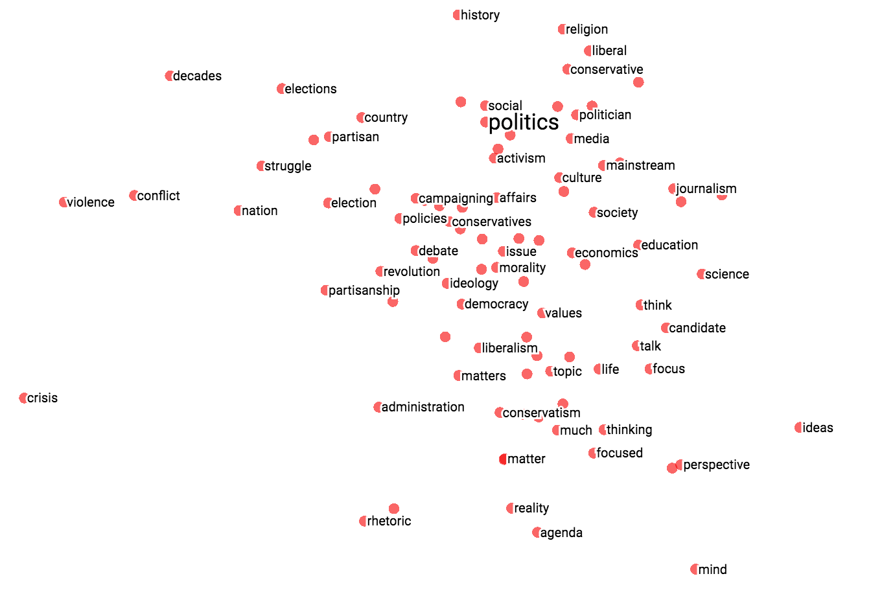
Representing words
Representing meaning as vectors
common representation space
enables information sharing
can be learned from data
One-hot vectors
Continuous embeddings
cat = [0 0 0 1 0 0 0]
dog = [0 0 0 0 0 1 0]
cat = [0.04 1.79 -1.79 1.07 0.48]
dog = [0.61 1.84 -1.12 0.52 0.53]
kitten
Distributed representation
(Meaning not isolated to one dimension)
cat
dog
Continuous space for words:
Similar words closer to each other

Slide 5
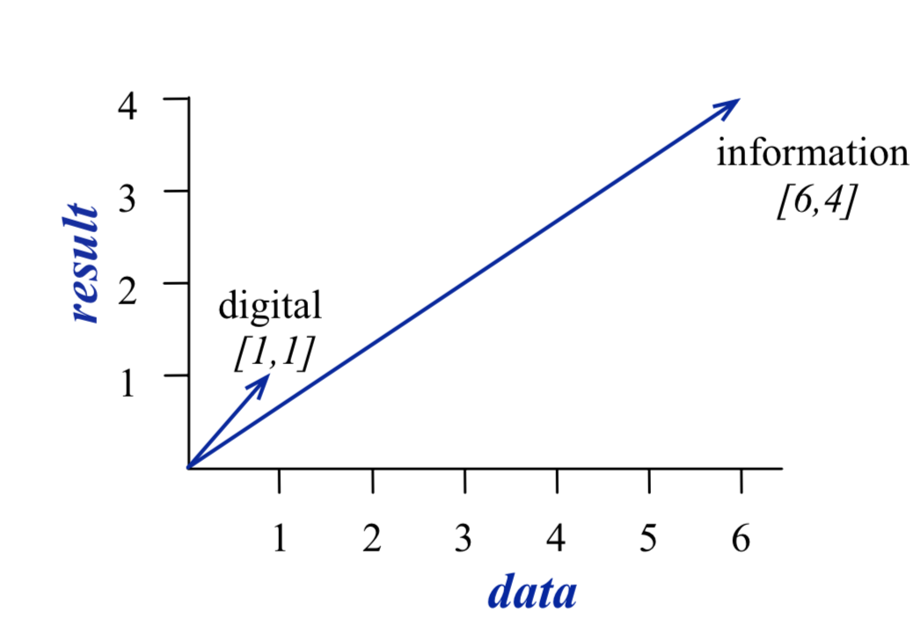
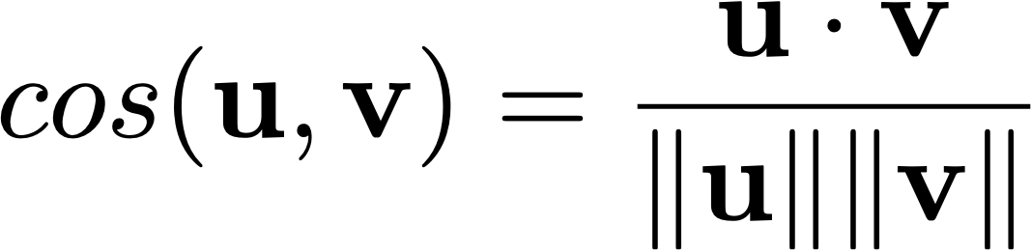
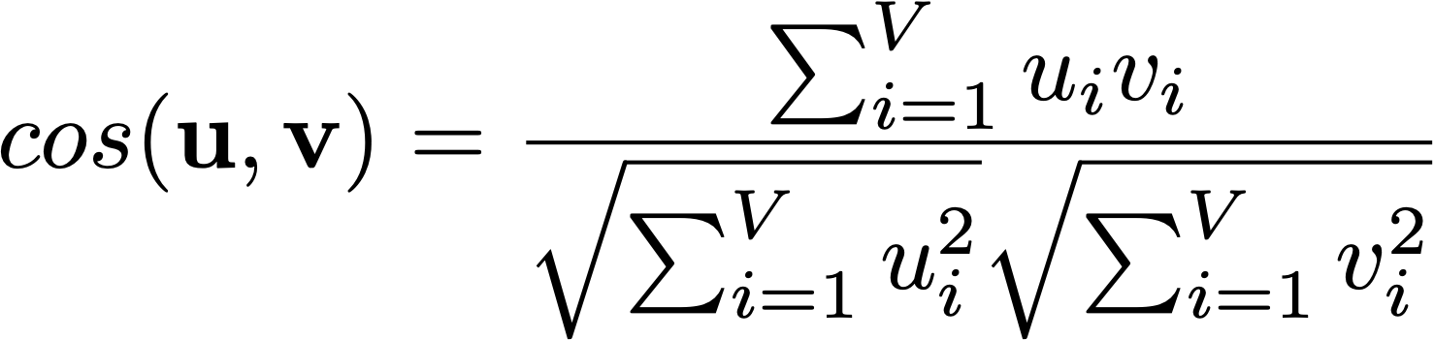
Can measure similarity of words

Slide 6
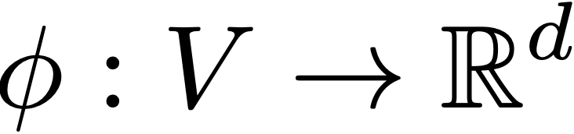
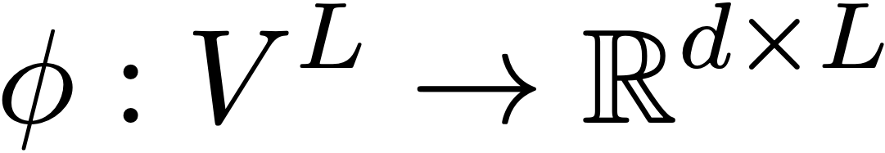




Representing words
One-hot vectors
Static embeddings
Contextual embeddings
  Token embedding depend on other tokens
cat = [0 0 0 1 0 0 0]
dog = [0 0 0 0 0 1 0]
"river bank" vs. "bank account"
Context-independent (fixed per vocabulary entry)
cat = [0.04 1.79 -1.79 1.07 0.48]
dog = [0.61 1.84 -1.12 0.52 0.53]
Context-dependent (varies with surrounding sentence)
"river bank" vs. "bank account"

Slide 7
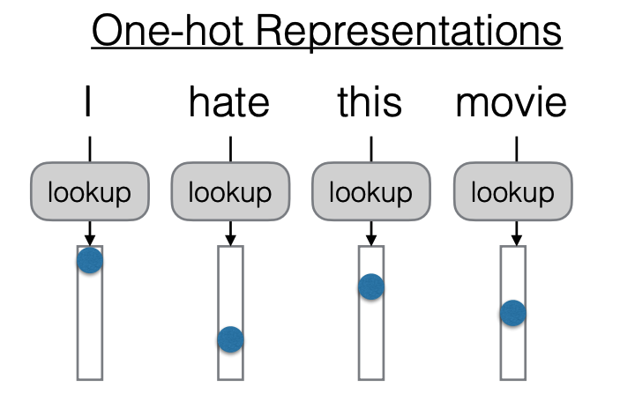
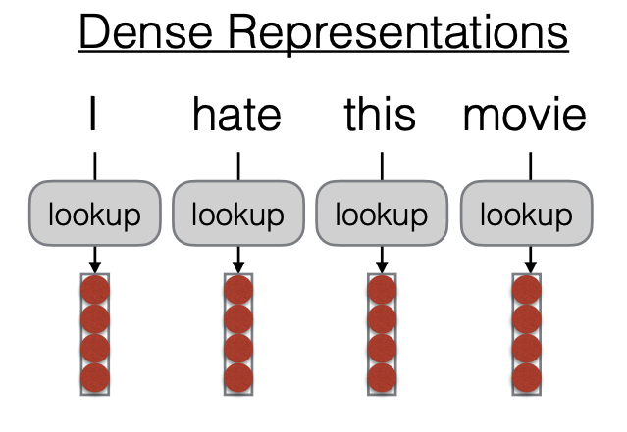

Words in sentences
  Neural network that produces contextual embeddings
https://phontron.com/class/anlp2024/assets/slides/anlp-02-wordrep-textclass.pdf

Slide 8
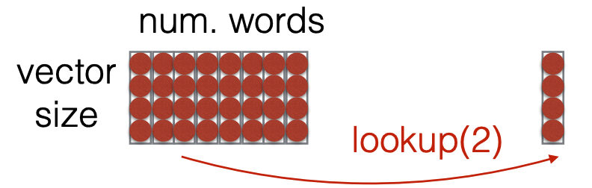
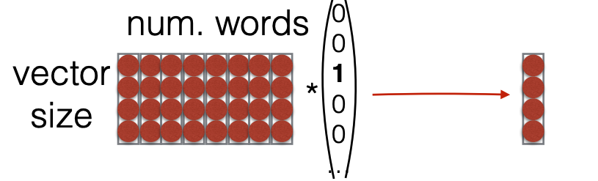
Looking up embeddings
  Lookup: grabbing a vector from a big matrix of word embeddings
Typically faster
  Can also view lookup as multiplying by a “one-hot” vector
https://phontron.com/class/anlp2024/assets/slides/anlp-02-wordrep-textclass.pdf

Slide 9
Where do these word embeddings come from?

Slide 10
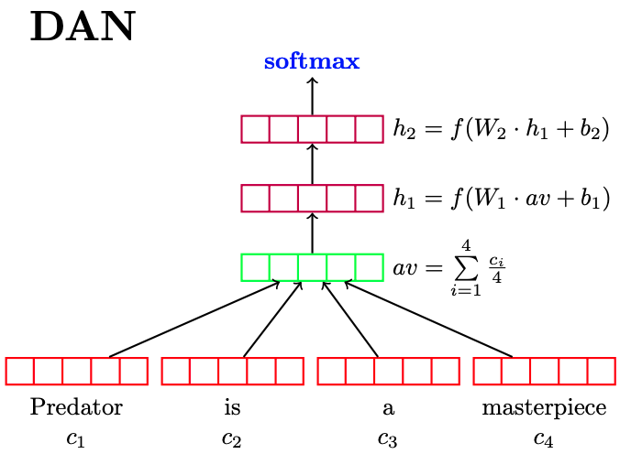
Task specific training
Assume you have annotated data specific to a task
Initialize with random vectors
Lookup table from word to vector
Train your classifier
  Classifier parameters are updated during training
  These parameters include the word vectors!
  After training, you get word vectors that are good for your task!

Slide 11
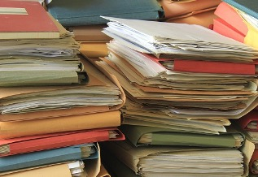

Pretraining and task-specific fine-tuning
Pretraining
Big pile of unlabeled text data!
Lots of resources to train!
Task-specific fine-tuning
Annotated data specific to a task (usually small)
Initialize with pre-trained model

Slide 12
Summary of three options
Random + train - Initialize with random embeddings and learn them when you train your classifier.
Pretrain + fixed - Initialize with pretrained embeddings + keep them fixed
Pretrain + fine-tune - Initialize with pretrained embeddings and then allow embedding weights to change as classifier is trained

Slide 13
Neural Networks with
Word Embeddings

Slide 14
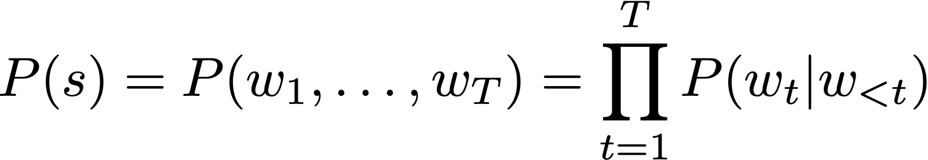
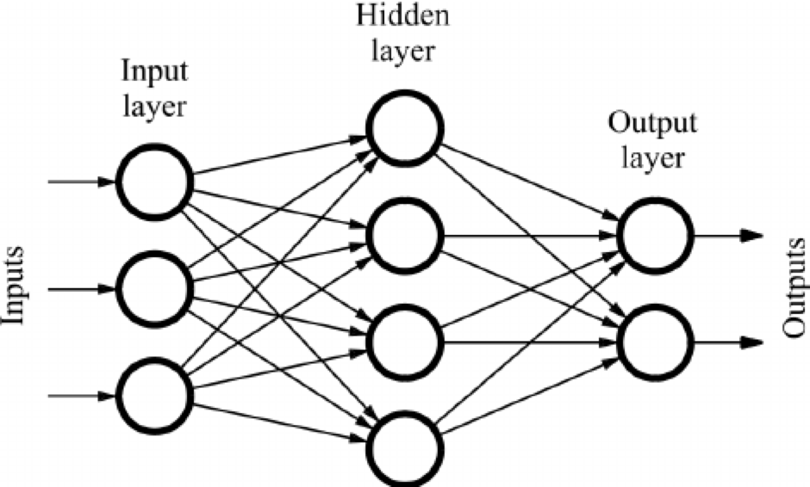
Estimating the probability of the next word
Statistical LM (n-grams) - used from 1990s to early 2010s
Neural LM: introduced in 2003, popularized in 2010s
Large language models (2020s):
  train with large amount of data (2020s)
Use neural network to encode the history and then estimate the probability of the next word
Word representations
- continuous vector representations
- learned from lots of data
Notes:
10:15?

Slide 15
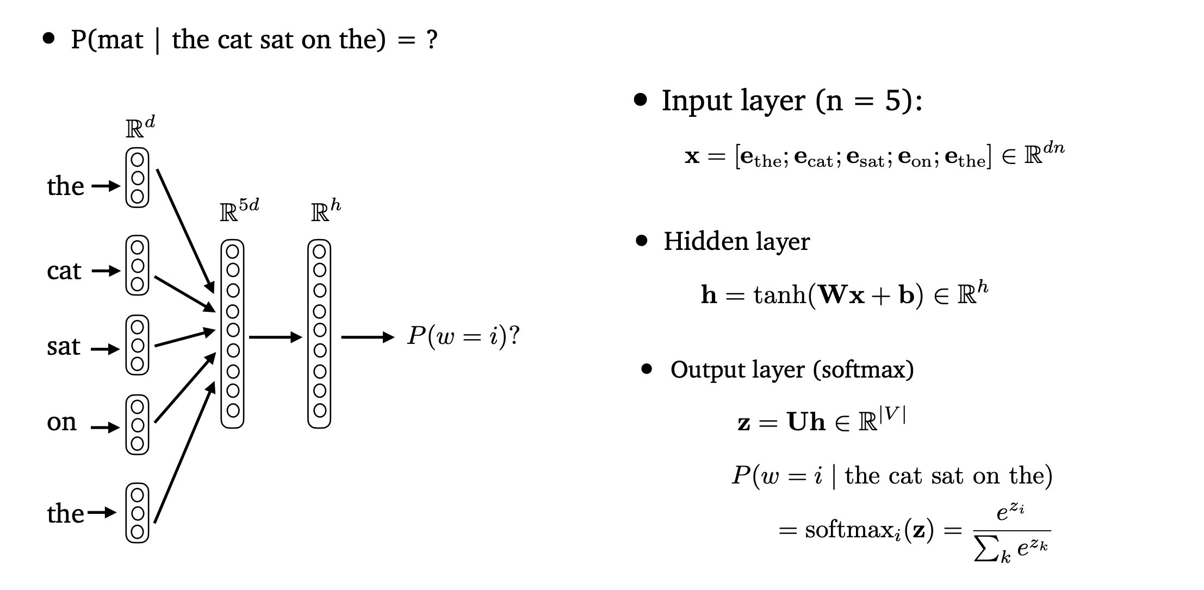



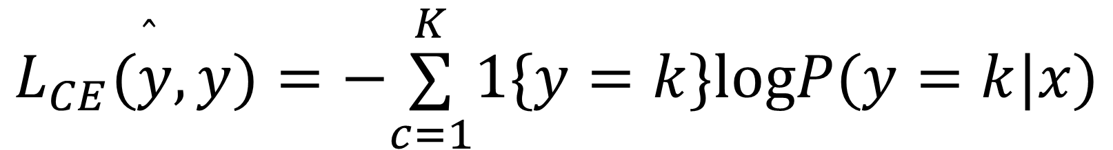
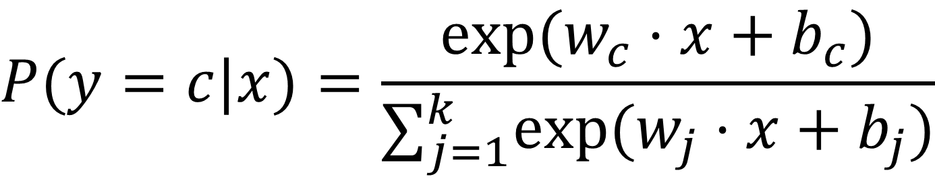

Language modelling with neural networks
Words are represented as continuous word embeddings
Parameters are weights of the neural network
Train to predict the next word given the previous words
  For each word: classification problem over the entire vocabulary
  Recall: use softmax to model probability of output class and cross-entropy loss for classification
P(mat | the cat sat on the) = ?
$$P(y=c|x)=\frac{exp(w_{c}⋅x+b_{c})}{∑_{j=1}^{k}exp(w_{j}⋅x+b_{j})}$$
  softmax
$$L_{CE}(\overset{̂}{y},y)=−\overset{K}{\underset{c=1}{∑}}1\{y=k\}logP(y=k|x)$$
A Neural Probabilistic Language Model [Bengio et al. 2003]
Notes:
Keep to 5 minutes for FFNs

Slide 16
Neural Bag-of-Words (NBOW)
Deep Averaging Networks (DAN) for Text Classification
averaging
word embeddings
(Iyyer et 2015): Deep Unordered Composition Rivals Syntactic Methods for Text Classification

Slide 17


Feedforward Neural LMs
Input layer (context size n = 5):
concatenate word embeddings
Hidden layer
Output layer (softmax)
(Bengio et 2003): A Neural Probabilistic Language Model

Slide 18
Language modelling with neural networks
Words are represented as continuous word embeddings
Parameters are weights of the neural network
Train to predict the next word given the previous words
  For each word: classification problem over the entire vocabulary
  Recall: use softmax to model probability of output class and cross-entropy loss for classification
P(mat | the cat sat on the) = ?
Different neural network architectures
  FFNs
  RNNs
  Transformers
A Neural Probabilistic Language Model [Bengio et al. 2003]
Notes:
Keep to 5 minutes for FFNs

Slide 19
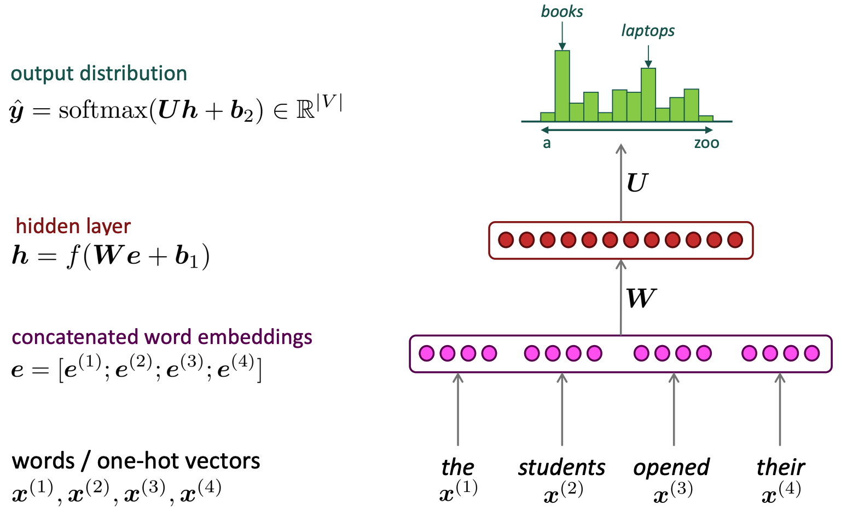
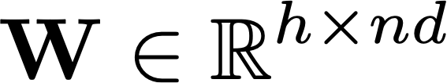
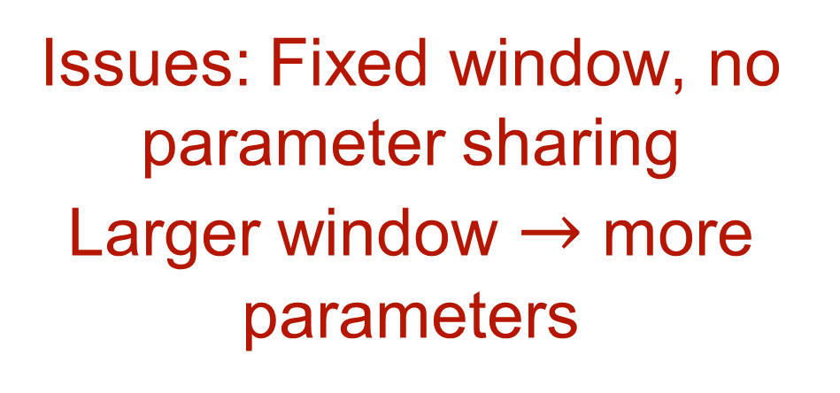
Feedforward Neural Language Model
(Neural BOW LM)
Issues: Fixed window, no parameter sharing
Larger window $→$ more parameters
Slide credit: Chris Manning
Notes:
\mathbf{h} = f(\mathbf{W} \mathbf{e} + \mathbf{b}_1)

Slide 20
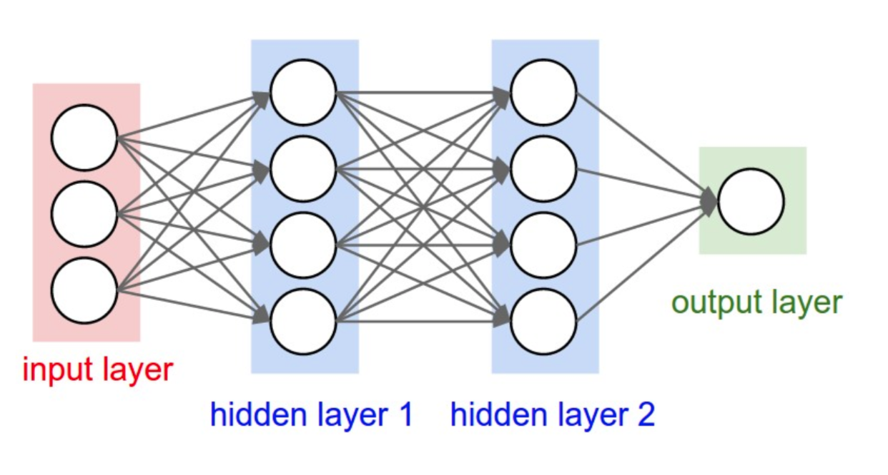
Neural networks
The neurons are connected to each other, forming a network
The output of a neuron may feed into the inputs of other neurons
Feed forward network (FFN)
Fully connected network (FCN)

Slide 21
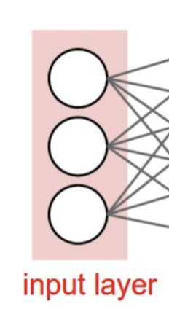
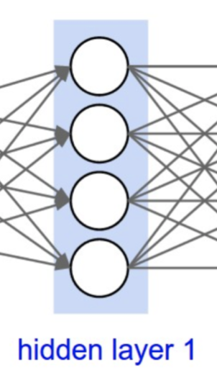
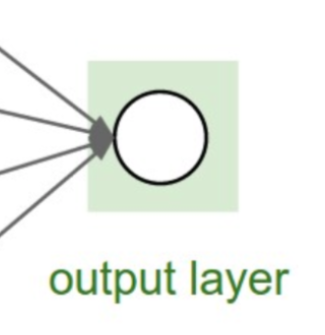
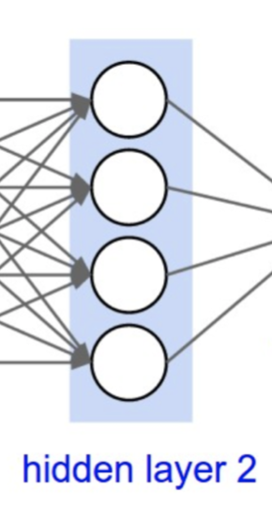
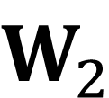










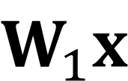








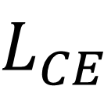


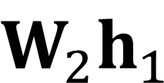
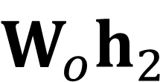

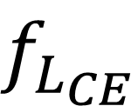

Computational graph
$$x$$
$$W_{1}x$$
$$z_{1}$$
$$⋅$$
$$+$$
$$f_{1}$$
$$h_{1}$$
$$W_{2}h_{1}$$
$$z_{2}$$
$$⋅$$
$$+$$
$$f_{2}$$
$$h_{2}$$
$$W_{o}h_{2}$$
$$z_{o}$$
$$W_{1}$$
$$b_{1}$$
$$+$$
$$σ$$
$$⋅$$
$$y$$
$$W_{2}$$
$$b_{2}$$
$$f_{L_{CE}}$$
$$W_{o}$$
$$b_{o}$$
Focus on computation
Nodes represent operations
Edges are values from one operator to the next
$$y^{∗}$$
$$L_{CE}$$
Forward pass: compute function value
Backward pass: gradient using chain rule

Slide 22

























Simplified example
Forward pass: compute function value
$$x$$
$$Wx$$
$$z$$
$$y$$
$$⋅$$
$$+$$
$$σ$$
$$f_{L}$$
$$L$$
$$W$$
$$b$$
Backward pass: gradient using chain rule
$$\frac{∂L}{∂y}$$
$$\frac{∂L}{∂L}$$
$$\frac{∂L}{∂Wx}$$
$$\frac{∂L}{∂z}$$
$$\frac{∂L}{∂y}$$
$$x$$
$$x$$
$$f_{L}$$
$$+$$
$$f_{L}$$
$$+$$
$$L$$
$$σ$$
$$L$$
$$⋅$$
$$σ$$
$$⋅$$
Good news is that modern automatic differentiation tools did all for you!
$$\frac{∂L}{∂W}$$
$$\frac{∂L}{∂b}$$
Implementing backprop by hand is like programming in assembly language.
$$b$$
$$W$$
$$b$$
$$W$$

Slide 23
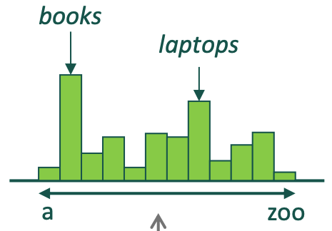
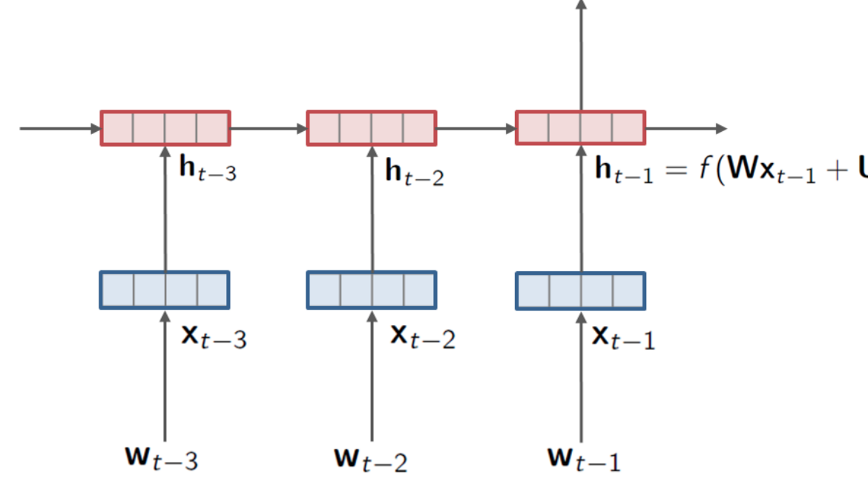
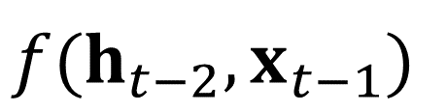
RNNs for Language Modeling
Use a RNN to
capture the history of the previous words as a hidden state
use hidden state to estimate the probability of the next word
$$f(h_{t−2},x_{t−1})$$
$$P(w_{t}|w_{1},…,w_{t−1})=P(w_{t}|h_{t−1})$$
Notes:
Keep to 5 minutes for RNNs

Slide 24
Learning contextualized word embeddings with RNNs: ELMo
Train two stacked LSTM-based language model on some large corpus
Use the hidden states of the LSTM for each token to compute a vector representation of each word
Contextual embeddings
Static embeddings
Let’s stick to
in this skit
(figure credit: Jay Alammar
http://jalammar.github.io/illustrated-bert/)
Deep contextualized word representations [Peter et al. 2018]

Slide 25
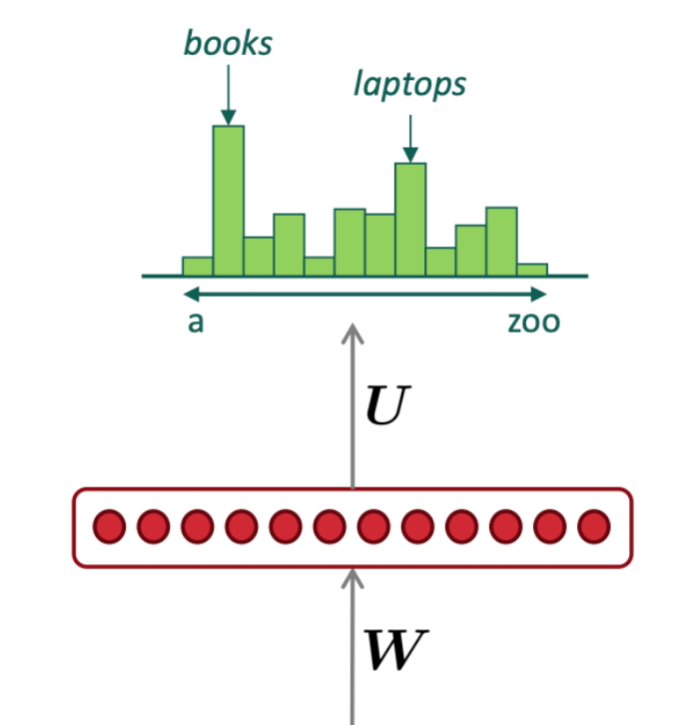
Transformers for Language Modeling
Contextual embeddings
Transformer
Static embeddings
SOS
the
students
opened
Notes:
10:30-10:40

Slide 26
How does this pretraining work?
Big pile of unlabeled text data! Learn using language modelling!

Slide 27
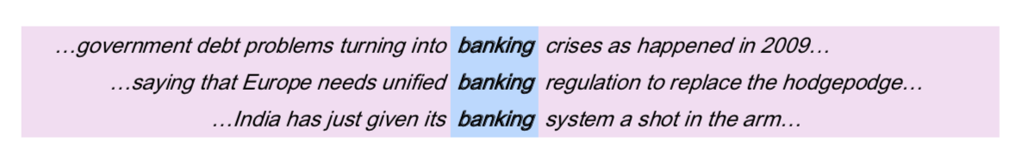
Representing words by their context
Distributional hypothesis: words that occur in similar contexts tend to have similar meanings
J.R.Firth 1957
“You shall know a word by the company it keeps”
One of the most successful ideas of modern statistical NLP!
These context words will represent banking.
Notes:
John Rupert Firth

Slide 28
Distributional hypothesis
“tejuino”
C1: A bottle of ___ is on the table.
C2: Everybody likes ___.
C3: Don’t have ___ before you drive.
C4: We make ___ out of corn.

Slide 29
Distributional hypothesis
“words that occur in similar contexts tend to have similar meanings”
 | C1 | C2 | C3 | C4
tejuino | 1 | 1 | 1 | 1
loud | 0 | 0 | 0 | 0
motor-oil | 1 | 0 | 0 | 0
tortillas | 0 | 1 | 0 | 1
choices | 0 | 1 | 0 | 0
wine | 1 | 1 | 1 | 0
C1: A bottle of ___ is on the table.
C2: Everybody likes ___.
C3: Don’t have ___ before you drive.
C4: We make ___ out of corn.
Use as context: other words that appear in a span around the target word
Notes:
Note that this idea can be extended to other modalities as well

Slide 30
How are these embeddings learned?
Get embeddings by counting or by predicting (i.e. training a classifier)!
 | C1 | C2 | C3 | C4
tejuino | 1 | 1 | 1 | 1
loud | 0 | 0 | 0 | 0
motor-oil | 1 | 0 | 0 | 0
tortillas | 0 | 1 | 0 | 1
choices | 0 | 1 | 0 | 0
wine | 1 | 1 | 1 | 0
C1: A bottle of ___ is on the table.
C2: Everybody likes ___.
C3: Don’t have ___ before you drive.
C4: We make ___ out of corn.
Use as context: other words that appear in a span around the target word
“words that occur in similar contexts tend to have similar meanings”
Notes:
Note that this idea can be extended to other modalities as well

Slide 31
How are these embeddings learned?
Get embeddings by counting or by predicting (i.e. training a classifier)!
 | C1 | C2 | C3 | C4
tejuino | 1 | 1 | 1 | 1
loud | 0 | 0 | 0 | 0
motor-oil | 1 | 0 | 0 | 0
tortillas | 0 | 1 | 0 | 1
choices | 0 | 1 | 0 | 0
wine | 1 | 1 | 1 | 0
C1: A bottle of ___ is on the table.
C2: Everybody likes ___.
C3: Don’t have ___ before you drive.
C4: We make ___ out of corn.
Use as context: other words that appear in a span around the target word
“words that occur in similar contexts tend to have similar meanings”
Notes:
Note that this idea can be extended to other modalities as well

Slide 32
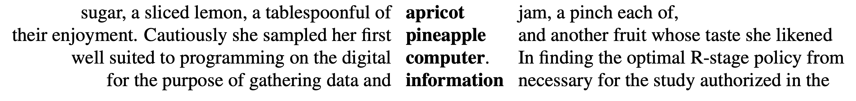
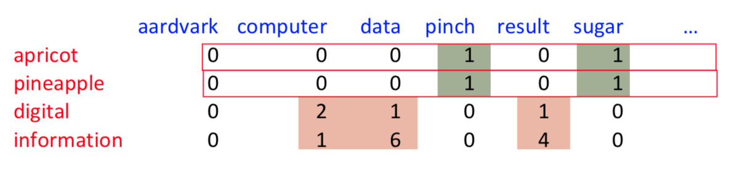
Representing words as vectors
  What we are aiming for:
    Each word is a vector
    Similar words are “nearby in space”
    Our first solution: use context vectors to represent the meaning of words
    word-word (term-context) co-occurrence matrix
Example from: Dan Jurafsky

Slide 33
Problem with raw frequencies
    Problem: using raw frequency counts is not always very good..
  if sugar appears a lot near apricot, that's useful information.
  But overly frequent words like the, it, or they are not very informative about the context
    Solution: let’s weight the counts!
      TF-IDF = Traditional method used in document retrieval
      PPMI = Positive Pointwise Mutual Information

Slide 34
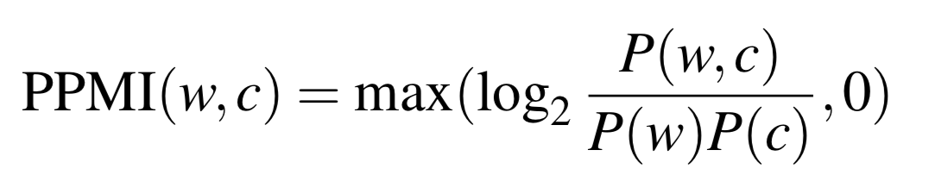
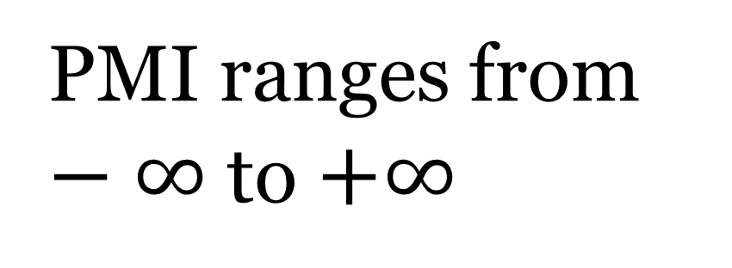
PPMI
Do two events co-occur more than if they were independent?
        PPMI = Positive Pointwise Mutual Information
Joint probability
Marginals
Negative values are problematic so cap bottom to 0
PMI ranges from $−∞$ to $+∞$
Negative if co-occurs less than if independent

Slide 35
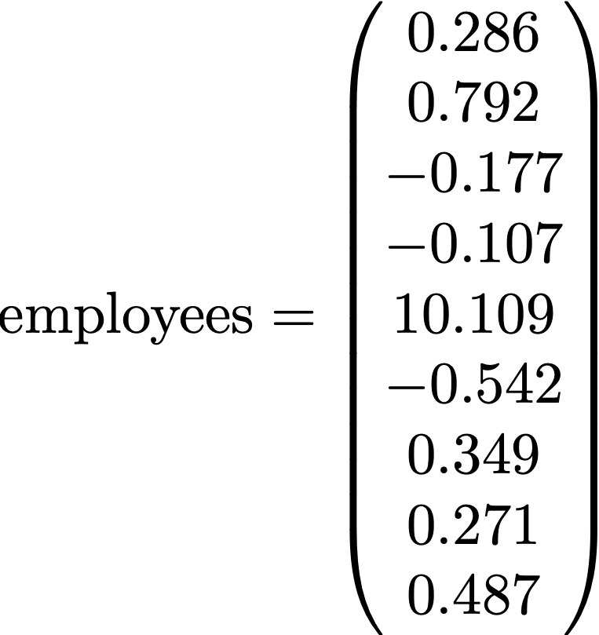
Sparse vs dense vectors
Vectors we get from word-word (term-context) co-occurrence matrix are
long (length |V|= 20,000 to 50,000)
sparse (most elements are zero)
True for both one-hot and PPMI vectors
Alternative: we want to represent words as
short (50-300 dimensional)
dense (real-valued) vectors
Distributed representation
More memory efficient and easier to work with
Capture similarity between words better

Slide 36
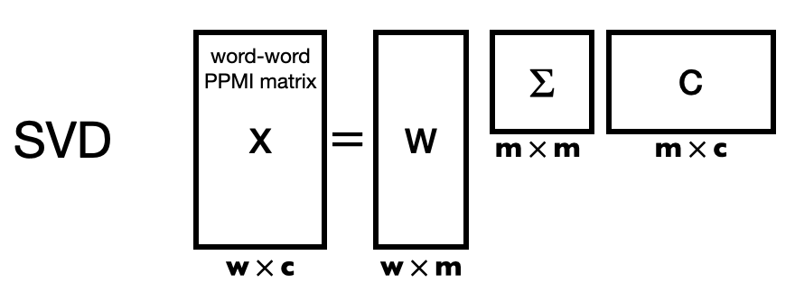
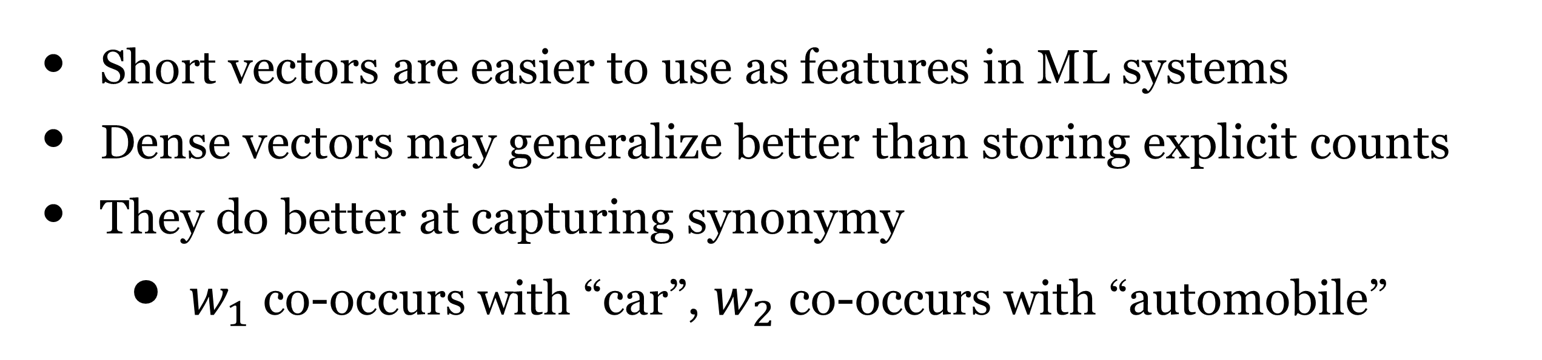
Why dense vectors?
Short vectors are easier to use as features in ML systems
Dense vectors may generalize better than storing explicit counts
They do better at capturing synonymy
    $w_{1}$ co-occurs with “car”, $w_{2}$ co-occurs with “automobile”
Different methods for getting dense vectors:
    Singular value decomposition (SVD)
    word2vec and friends: “learn” the vectors!
Count based method
(known since the 1990s)

Slide 37
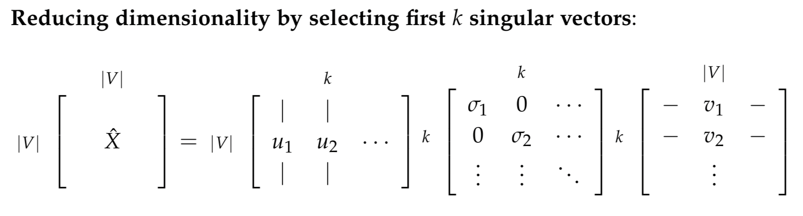
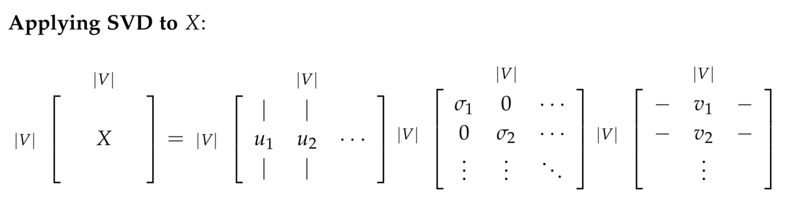

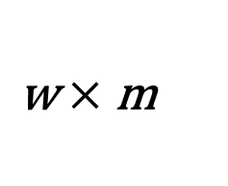

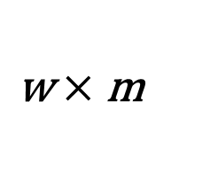




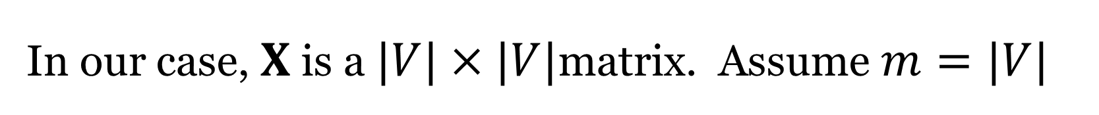










Using SVD for obtaining dense vectors
SVD = Singular value decomposition
$$X=UΣV^{⊤}$$
$Σ$ is a diagonal matrix with singular values:
  $σ_{1},…,σ_{i},…,σ_{m}$ where $m$ is the rank of the matrix $X$
  $U=W$ has orthonormal columns, $V^{⊤}=C$ has orthonormal rows
X
W
$$Σ$$
C
word-word
PPMI matrix
1) SVD
$\text{m}×\text{m}$
$\text{m}×\text{c}$
$$=$$
In our case, $X$ is a $|V|×|V|$matrix. Assume $m=|V|$
$\text{w}×\text{c}$
$\text{w}×\text{m}$
W
$$Σ$$
C
Truncation:
Select the first $k$ columns of $W$ to get $k$-dimensional row vectors
Note that the singular values are ordered from largest to smallest, which each singular value representing the variance captured by that dimension
So the first $k$ dimensions are the dimensions with the most variance
2) Truncation
$\text{m}×\text{m}$
$\text{m}×\text{c}$
$$≈$$
k
k
k
$\text{w}×\text{m}$
k
$$1.....\text{k}$$
3) Embeddings
1
2
.
.
i
.
w
Wk
$$Σ$$
C
Finally, we take $i$th row of $W_{k}$ as the embedding of word $i$
Note there are variants where the word embedding matrix is taken to be
$W_{k}Σ^{λ}$ (with common values being $λ=1, 0.5,\text{or}0$)
embedding for word i
$\text{w}×\text{k}$
traditional
Notes:
This idea originates from Latent Semantic Analysis (Deerwester et al., 1990) (applied on word-document matrix)

Slide 38

What is wrong with using SVD?
Computational complexity is high: $O(|V|^{3})$
Cannot be trained as part of a larger model
  Not a component that can be part of a larger neural network
Cannot be trained discriminatively for a particular task

Slide 39
Why dense vectors?
Short vectors are easier to use as features in ML systems
Dense vectors may generalize better than storing explicit counts
They do better at capturing synonymy
    $w_{1}$ co-occurs with “car”, $w_{2}$ co-occurs with “automobile”
Different methods for getting dense vectors:
    Singular value decomposition (SVD)
    word2vec and friends: “learn” the vectors!

Slide 40
How are these embeddings learned?
Learn predictor to fill in the blank!
 | bottle | likes | before | make | corn
tejuino | 1 | 1 | 1 | 1 | 1
loud | 0 | 0 | 0 | 0 | 0
motor-oil | 1 | 0 | 0 | 0 | 0
tortillas | 0 | 1 | 0 | 1 | 1
choices | 0 | 1 | 0 | 0 | 0
wine | 1 | 1 | 1 | 0 | 0
C1: A bottle of ___ is on the table.
C2: Everybody likes ___.
Represent each word as a vector
Train classifier to predict word using context words.
During training, the word vector is updated so that it is possible to predict the center word using the context words
C3: Don’t have ___ before you drive.
C4: We make ___ out of corn.
Use as context: other words that appear in a span around the target word
“words that occur in similar contexts tend to have similar meanings”
Notes:
Note that this idea can be extended to other modalities as well

Slide 41
Many different ways to learn the representations
From context words, predict target word (Masked LM)
A bottle of ___ is on the table.
From target word, predict other context words.
What words go with “tejuino”?
From previous words, predict next (target) word (Traditional LM)
A bottle of ___
A bottle of tejuino is on the ___

Slide 42
Many different ways to learn the representations
Different architectures and models to learn the representations
Get sentence embeddings by combining word embeddings
Two types of word embeddings
  Static - mapping of word to embedding
  Contextual - embedding of word changes based on the context

Slide 43
Summary
Representing words as vectors
  One-hot vectors vs vectors built using context
  Cosine similarity for measuring similarity between words
Using context to represent words
  Distributional hypothesis:
  words that occur in similar contexts tend to have similar meanings
Co-occurrence matrix
  Raw counts
  TF-IDF (term-frequency inverse-document-frequency)
  PPMI (positive pointwise mutual information)
Dense vectors via SVD or learned by predicting the missing word

Slide 45
Notes on count based word vectors

Slide 46
Representing words as vectors
  What we are aiming for:
    Each word is a vector
    Similar words are “nearby in space”
    Our first solution: use context vectors to represent the meaning of words
    word-word (term-context) co-occurrence matrix
Example from: Dan Jurafsky

Slide 47





Example
Q: What is the range of $cos(⋅)$?
 | large | data | computer
apricot | 1 | 0 | 0
digital | 0 | 1 | 2
information | 1 | 6 | 1
Which pair of words is more similar?
cos(apricot, information) =
cos(digital, information) =
cos(apricot, digital) =

Slide 48
Problem with raw frequencies
    Problem: using raw frequency counts is not always very good..
  if sugar appears a lot near apricot, that's useful information.
  But overly frequent words like the, it, or they are not very informative about the context
    Solution: let’s weight the counts!
      TF-IDF = Traditional method used in document retrieval
      PPMI = Positive Pointwise Mutual Information

Slide 49
Problem with raw frequencies
    Problem: using raw frequency counts is not always very good..
  if sugar appears a lot near apricot, that's useful information.
  But overly frequent words like the, it, or they are not very informative about the context
    Solution: let’s weight the counts!
      TF-IDF = Traditional method used in document retrieval
      PPMI = Positive Pointwise Mutual Information

Slide 50


Tf-idf
Term-document matrix
$\text{count}(t,d)$ = count of times term $t$ occurred in document $d$
Documents are represented by the column vectors

Slide 51

Tf-idf
Term-document matrix
$\text{count}(t,d)$ = count of times term $t$ occurred in document $d$
Documents are represented by the column vectors
Words are represented by row vectors
Tf-idf: re-weighing scheme for information retrieval
Down-weighs frequent words such as this, that, the

Slide 52



Tf-idf combine two factors
tf: term frequency. frequency count (usually log-transformed):
idf: inverse document frequency:
There are variations on the exact
formulation of tf and idf
Words like “the” or “it” will have very low idf
+1 (avoid 0 in denominator)
tf-idf value for word t in document d

Slide 53


Raw counts vs tf-idf
Raw Counts
Tf-idf
37 plays total
Common words
are down weighted

Slide 54
Tf-idf summary
Tf-idf: term-frequency inverse-document frequency
Re-weighing scheme originally designed for information retrieval
  Down-weighs frequent words such as this, that, the
Can be used to
  measure the similarity between words
  measure the similarity between documents
  measure the similarity between a query (mini-document) and a document
  as features for classifiers
Useful to know about (good baseline method)
But not typically used for word embeddings

Slide 55
Problem with raw frequencies
    Problem: using raw frequency counts is not always very good..
  if sugar appears a lot near apricot, that's useful information.
  But overly frequent words like the, it, or they are not very informative about the context
    Solution: let’s weight the counts!
      TF-IDF = Traditional method used in document retrieval
      PPMI = Positive Pointwise Mutual Information

Slide 56
PPMI
Do two events co-occur more than if they were independent?
        PPMI = Positive Pointwise Mutual Information
Joint probability
Marginals
Negative values are problematic so cap bottom to 0
PMI ranges from $−∞$ to $+∞$
Negative if co-occurs less than if independent

Slide 57







Computing PPMI on a term-context matrix
Matrix $F$ with $W$ rows (words) and $C$ columns (contexts)
$f_{ij}$ is # of times $w_{i}$ occurs in context $c_{j}$
Joint probability
Marginals

Slide 58











Computing PPMI on a term-context matrix
count(wi, contextj)
Total count N
$$p(w=\text{information},c=\text{data})$$
$$=6/19=0.32$$
$$p(w=\text{information})$$
$$=11/19=0.58$$
$$p(c=\text{data})$$
$$=7/19=0.37$$

Slide 59
Computing PPMI on a term-context matrix
count(wi, contextj)
Total count N
$$p(w=\text{information},c=\text{data})$$
$$=6/19=0.32$$
$$p(w=\text{information})$$
$$=11/19=0.58$$
$$p(c=\text{data})$$
$$=7/19=0.37$$

Slide 60




$$pmi(w=\text{information},c=\text{data})$$
$$=\log_{2}\frac{0.32}{0.37×0.58}=0.58$$
Actually 0.57 using full precision

Slide 61
Issues with PMI
PMI is biased toward infrequent events
  Very rare words have very high PMI values
Two solutions:
Weighted PMI: Give rare words slightly higher probabilities
Use add-one smoothing (which has a similar effect)

Slide 62





Weighting PMI
Give rare context words slightly higher probability
Raise the context probabilities to $α=0.75$:
$P(c)$ is low, so PPMI is high
Higher $P_{α}(c)$ $→$ lower ${\text{PPMI}}_{α}$
This helps because $P_{α}(c)>P(c)$ for rare $c$
Consider two events, $P(a)=.99$ and $P(b)=.01$

Slide 63

Smoothed PPMI (add-2)
Use Laplace smoothing
Alternative to using weighted PPMI

Slide 64

PPMI versus add-2 smoothed PPMI

Slide 65


Building word vectors by counting
Build word-word (term-context) co-occurrence matrix
Raw counts
Positive pointwise
mutual information
Practically, use smoothed/weighted PPMI to help with rare words having very high PMI values
Vectors are very long, sparse. How to get short dense vectors?

Slide 66
Sparse vs dense vectors
Vectors we get from word-word (term-context) co-occurrence matrix are
long (length |V|= 20,000 to 50,000)
sparse (most elements are zero)
True for both one-hot and PPMI vectors
Alternative: we want to represent words as
short (50-300 dimensional)
dense (real-valued) vectors
Distributed representation
More memory efficient and easier to work with
Capture similarity between words better

Slide 67
Why dense vectors?
Short vectors are easier to use as features in ML systems
Dense vectors may generalize better than storing explicit counts
They do better at capturing synonymy
    $w_{1}$ co-occurs with “car”, $w_{2}$ co-occurs with “automobile”
Different methods for getting dense vectors:
    Singular value decomposition (SVD)
    word2vec and friends: “learn” the vectors!
Count based method
(known since the 1990s)

Slide 68






Using SVD for obtaining dense vectors
SVD = Singular value decomposition
$$X=UΣV^{⊤}$$
$Σ$ is a diagonal matrix with singular values:
  $σ_{1},…,σ_{i},…,σ_{m}$ where $m$ is the rank of the matrix $X$
  $U=W$ has orthonormal columns, $V^{⊤}=C$ has orthonormal rows
X
W
$$Σ$$
C
word-word
PPMI matrix
1) SVD
$\text{m}×\text{m}$
$\text{m}×\text{c}$
$$=$$
In our case, $X$ is a $|V|×|V|$matrix. Assume $m=|V|$
$\text{w}×\text{c}$
$\text{w}×\text{m}$
W
$$Σ$$
C
Truncation:
Select the first $k$ columns of $W$ to get $k$-dimensional row vectors
Note that the singular values are ordered from largest to smallest, which each singular value representing the variance captured by that dimension
So the first $k$ dimensions are the dimensions with the most variance
2) Truncation
$\text{m}×\text{m}$
$\text{m}×\text{c}$
$$≈$$
k
k
k
$\text{w}×\text{m}$
k
$$1.....\text{k}$$
3) Embeddings
1
2
.
.
i
.
w
Wk
$$Σ$$
C
Finally, we take $i$th row of $W_{k}$ as the embedding of word $i$
Note there are variants where the word embedding matrix is taken to be
$W_{k}Σ^{λ}$ (with common values being $λ=1, 0.5,\text{or}0$)
embedding for word i
$\text{w}×\text{k}$
traditional
Notes:
This idea originates from Latent Semantic Analysis (Deerwester et al., 1990) (applied on word-document matrix)

Slide 69
What is wrong with using SVD?
Computational complexity is high: $O(|V|^{3})$
Cannot be trained as part of a larger model
  Not a component that can be part of a larger neural network
Cannot be trained discriminatively for a particular task

Slide 70
Why dense vectors?
Short vectors are easier to use as features in ML systems
Dense vectors may generalize better than storing explicit counts
They do better at capturing synonymy
    $w_{1}$ co-occurs with “car”, $w_{2}$ co-occurs with “automobile”
Different methods for getting dense vectors:
    Singular value decomposition (SVD)
    word2vec and friends: “learn” the vectors!

Slide 71
How are these embeddings learned?
Learn predictor to fill in the blank!
 | bottle | likes | before | make | corn
tejuino | 1 | 1 | 1 | 1 | 1
loud | 0 | 0 | 0 | 0 | 0
motor-oil | 1 | 0 | 0 | 0 | 0
tortillas | 0 | 1 | 0 | 1 | 1
choices | 0 | 1 | 0 | 0 | 0
wine | 1 | 1 | 1 | 0 | 0
C1: A bottle of ___ is on the table.
C2: Everybody likes ___.
Represent each word as a vector
Train classifier to predict word using context words.
During training, the word vector is updated so that it is possible to predict the center word using the context words
C3: Don’t have ___ before you drive.
C4: We make ___ out of corn.
Use as context: other words that appear in a span around the target word
“words that occur in similar contexts tend to have similar meanings”
Notes:
Note that this idea can be extended to other modalities as well

Slide 72
Summary
Representing words as vectors
  One-hot vectors vs vectors built using context
  Cosine similarity for measuring similarity between words
Using context to represent words
  Distributional hypothesis:
  words that occur in similar contexts tend to have similar meanings
Co-occurrence matrix
  Raw counts
  TF-IDF (term-frequency inverse-document-frequency)
  PPMI (positive pointwise mutual information)
Dense vectors via SVD or learned by predicting the missing word

Slide 73
Summary
Use as input embeddings in neural networks
  Start with pretrained
    Keep frozen - just train other parts of the network
    Better to also fine-tune (train) the embeddings as well

Slide 74
Next time
Dense vectors vs sparse vectors
Learning word embeddings by predicting vs counting
Word2vec (Skip-gram with negative sampling)

