Slide 1

CMPT 413/713: Natural Language Processing
Adapting LLMs for tasks
Prompting and fine-tuning LLMs
Zhiyun (Richard) Peng
2026-11-6
Adapted from slides from Angel Chang, Anoop Sarkar, Danqi Chen, Karthik Narasimhan, and Justin Johnson, Chris Manning, Abigail See, Andrej Karpathy, Graham Neubig
Notes:
http://demo.clab.cs.cmu.edu/NLP/

Slide 2
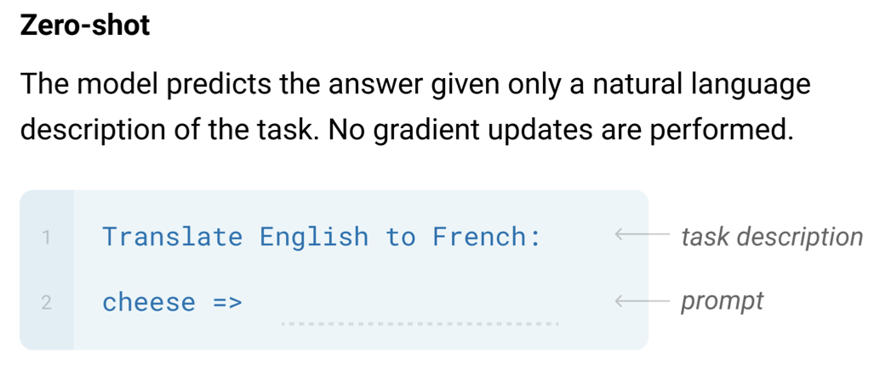
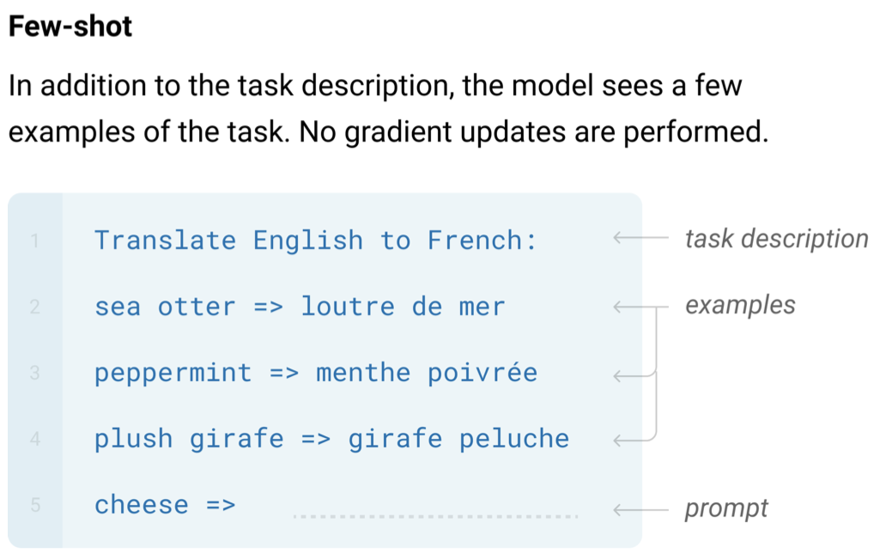
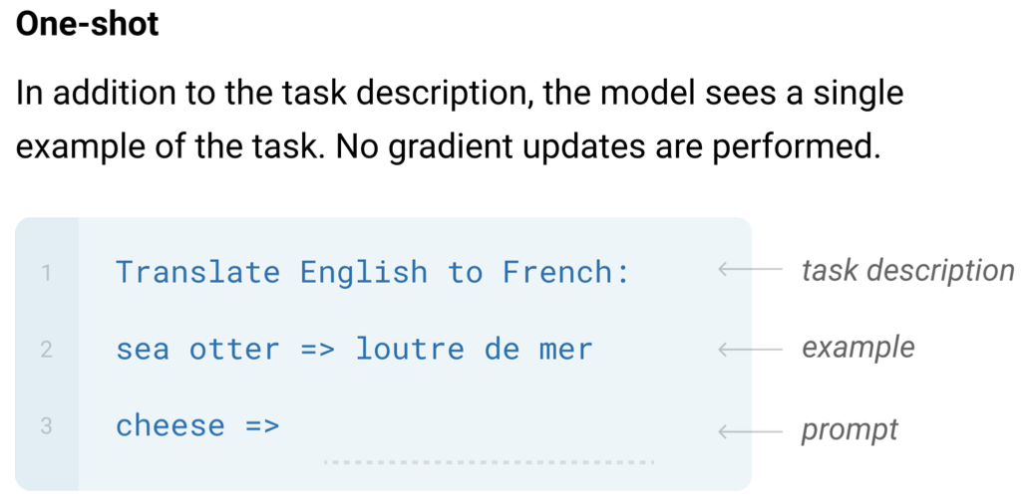
in-context learning

Slide 3
Prompting strategies

Slide 4
Prompting
LLM responses depend on prompt provided
Many different types of prompt designs
  Direct prompting
  Prompting with examples: few-shot
    What examples will be most effective?
  Prompting with roles and templates
  Prompting for reasoning: chain-of-thought
  Prompting to reflect to check consistency and correctness
  Prompting with multiple steps: breaking it down
  Prompting with retrieval: RAG
https://www.promptingguide.ai/

Slide 5
Basic prompting
Provide textual string as input and ask the LM to complete it
Example input
When a dog sees a squirrel, it will usually
GPT-2 small
be afraid of anything unusual. As an exception, that's when a squirrel is usually afraid to bite.
GPT-2 XL
lick the squirrel. It will also touch its nose to the squirrel on the tail and nose if it can
Example Credit: CMU CS11-711, Graham Neubig

Slide 6
Prompt templates and roles
Models are now often trained as chatbots
Example template from Salesforce
Example with roles (OpenAI messages format)
You’re a copywriter at <User.CompanyName__Merge_Field> and you need to
create an account description for <account.Name__Merge_Field>.
When I ask you to create the account description, you must strictly follow my instructions below.
Instructions:
"""
Write a description no longer than 500 characters.
"""
Now create the account description.
messages=[
  { "role": “system",
  "content": “Please classify movie reviews as 'positive' or ‘negative'." },
  { "role": “user",
  "content": "This movie is a banger.” },
  ]
Roles:
“system”: message provided to the system to influence behavior
“user”: message input by the user
“assistant”: message output by the system
Example Credit: CMU CS11-711, Graham Neubig

Slide 7
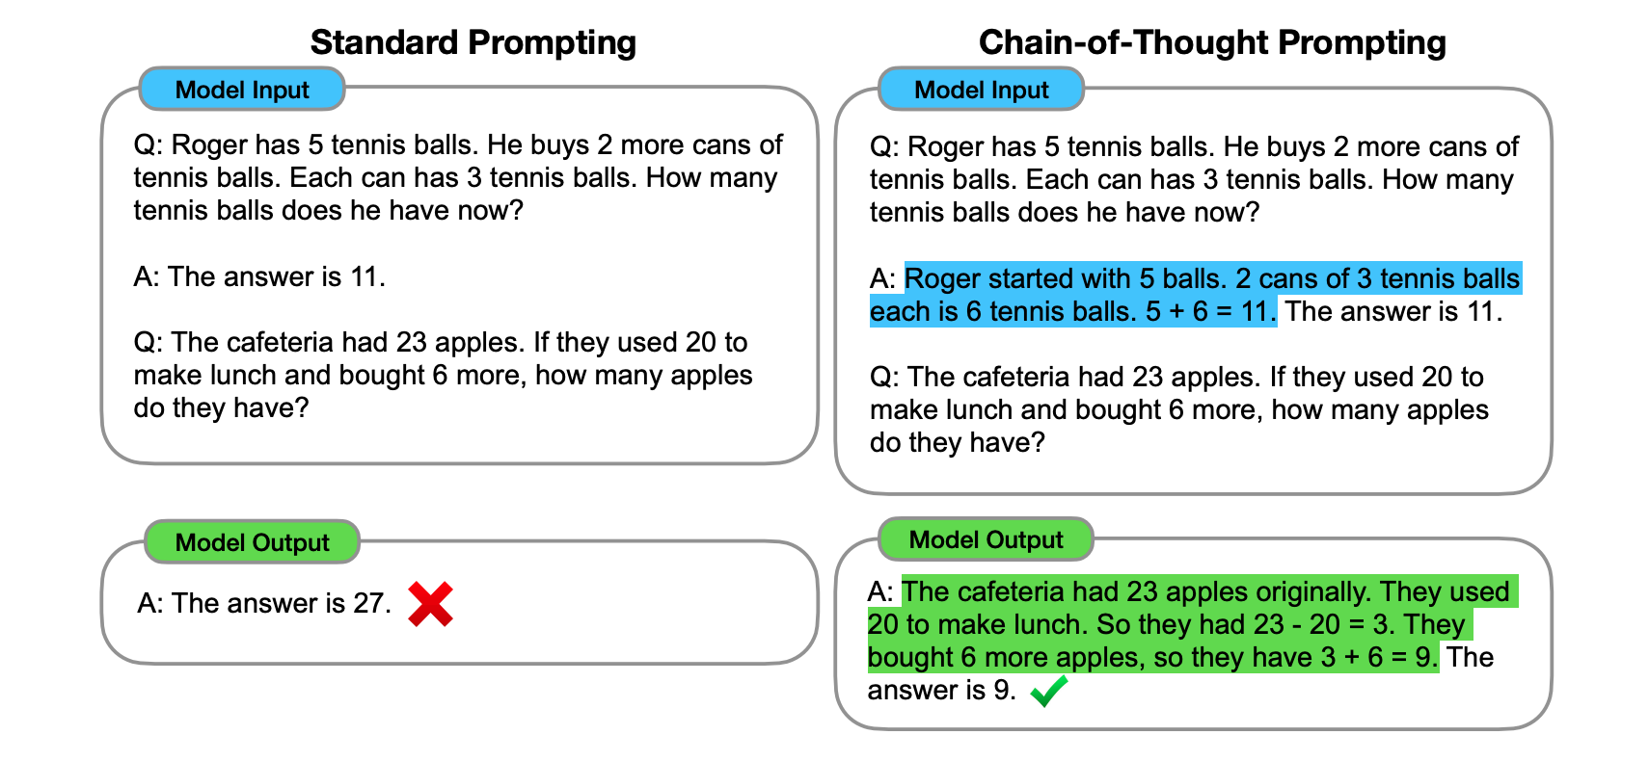
Chain of thought prompting
Chain-of-Thought Prompting Elicits Reasoning in Large Language Models [Wei et al, 2022]
How you prompt matters.
For more complex problems, may need to provide prompts that illustrate the reasoning you expect

Slide 8
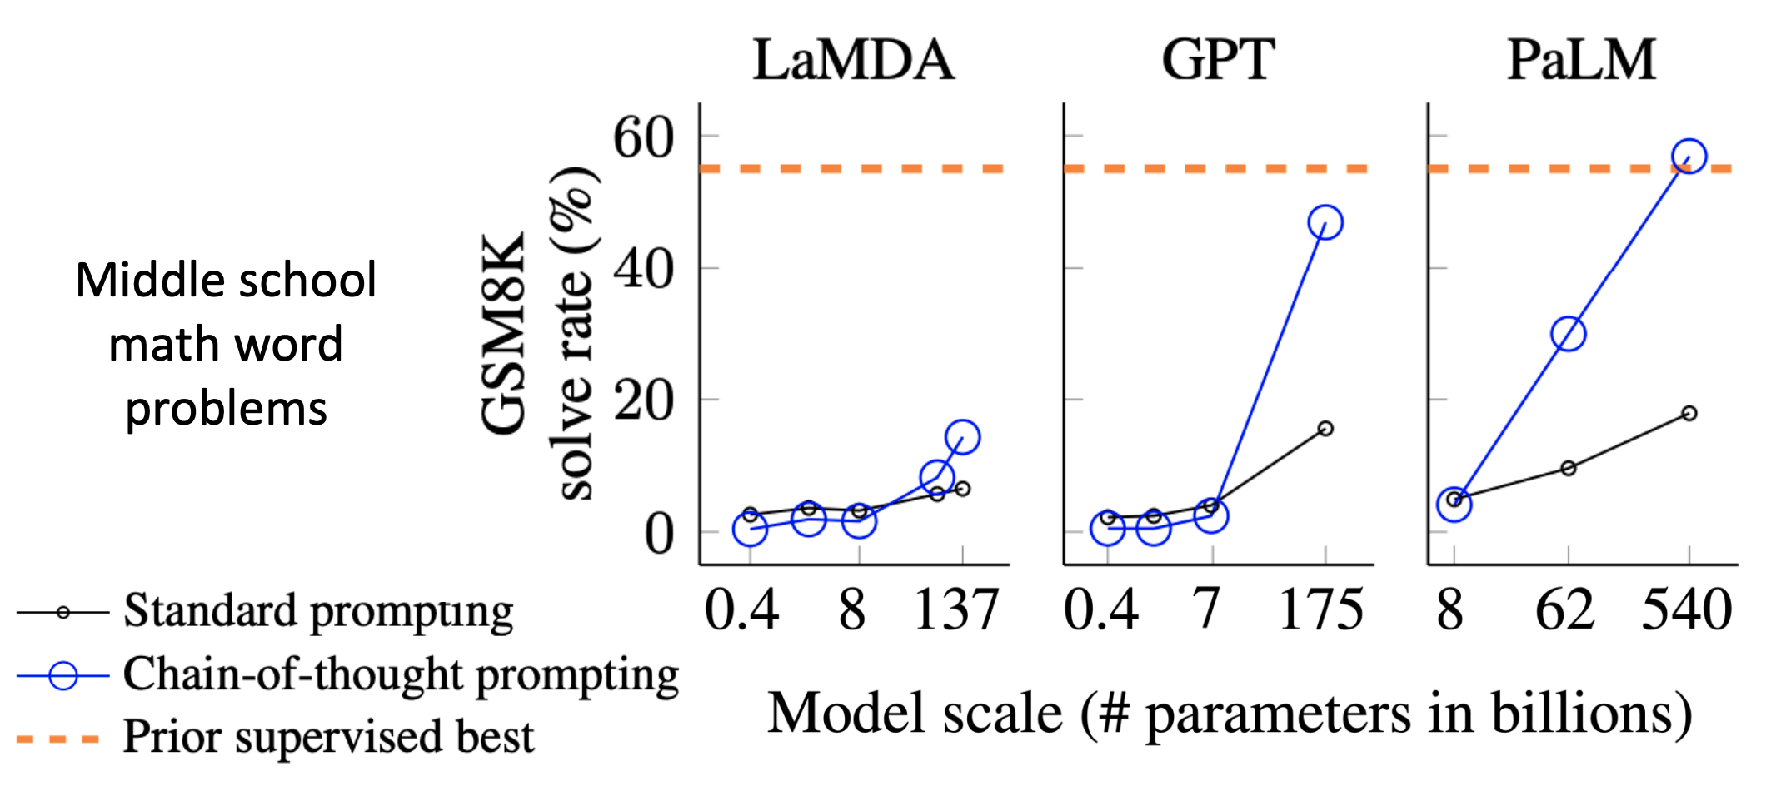
Chain of thought prompting
Chain-of-Thought Prompting Elicits Reasoning in Large Language Models [Wei et al, 2022]
Slide Credit: Stanford CS224n, Jesse Mu
Notes:
Emergent property of model scale

Slide 9
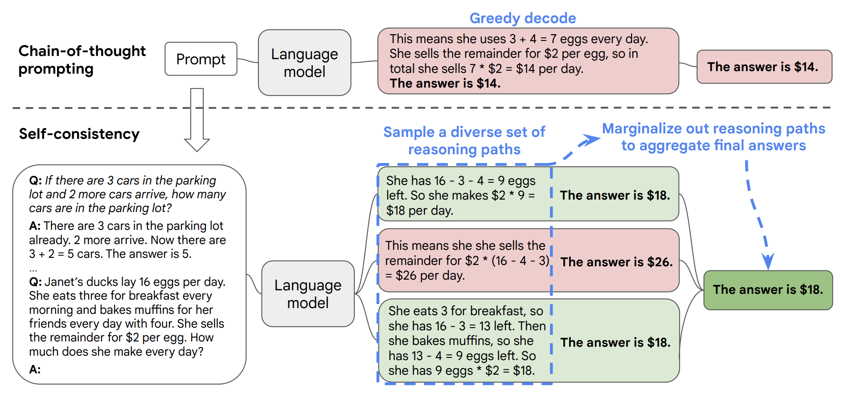
Self-consistency
Self-Consistency Improves Chain of Thought Reasoning in Language Models [Wang et el. 2023]
Sample multiple paths
Select solution based on majority vote
Notes:
Node in the tree - state (partial solution)
Decompose process into “thought” steps - how to generate potential thoughts from each state, how to evaluate state, what search algorithm to use

Slide 10
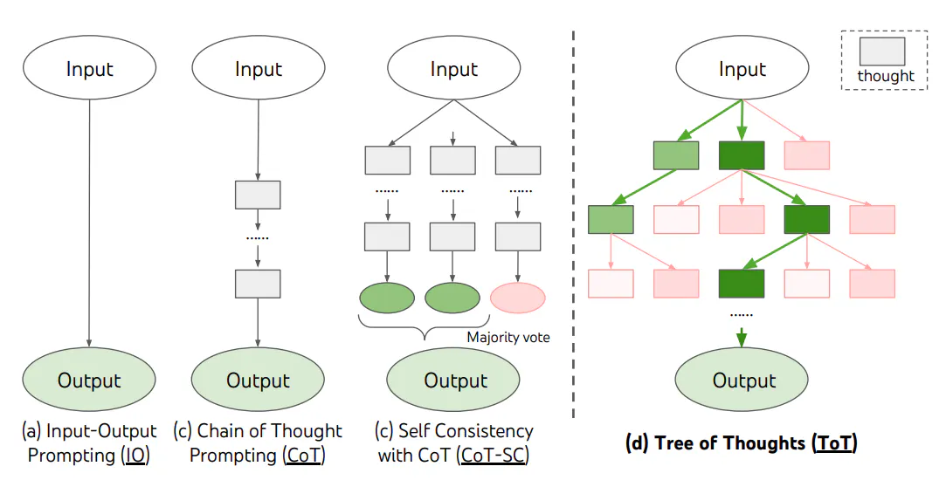
Tree of thoughts
Tree of Thoughts: Deliberate Problem Solving with Large Language Models [Yao et al, 2023]
Large Language Model Guided Tree-of-Thought [Long 2023]
Decision making by considering multiple paths of reasoning
Consider different “thoughts” expressed in language
Use to solve different types of problems
Notes:
Node in the tree - state (partial solution)
Decompose process into “thought” steps - how to generate potential thoughts from each state, how to evaluate state, what search algorithm to use

Slide 11
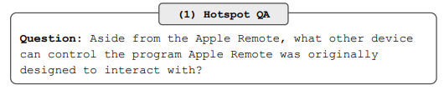
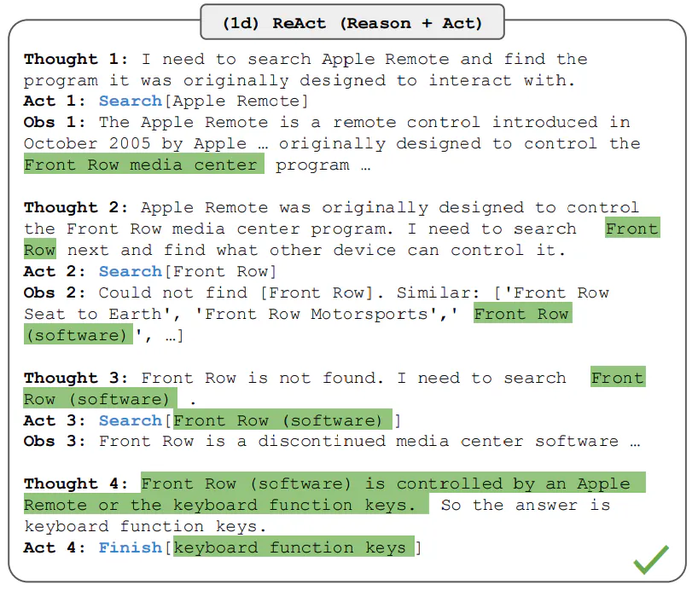
Self-Reflection
ReAct: interleave thought, action, and observation
Prompting to combine reasoning with actions
ReAct: Synergizing Reasoning and Acting in Language Models [Yao et al. 2022]

Slide 12
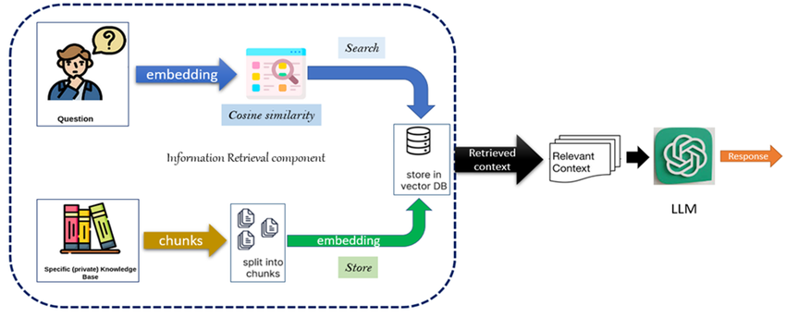
Retrieval augmented generation (RAG)
Augment text generation (often using LLM) with retrieved context from an external database
Allows for incorporation of external information together with pretrained LLM
  Up-to-date, current information
  Specialized knowledge (e.g. company or domain specific information)
Figure credit: Semantic Embeddings for Arabic Retrieval Augmented Generation (ARAG) [Abdelazim et al. 2023]

Slide 13
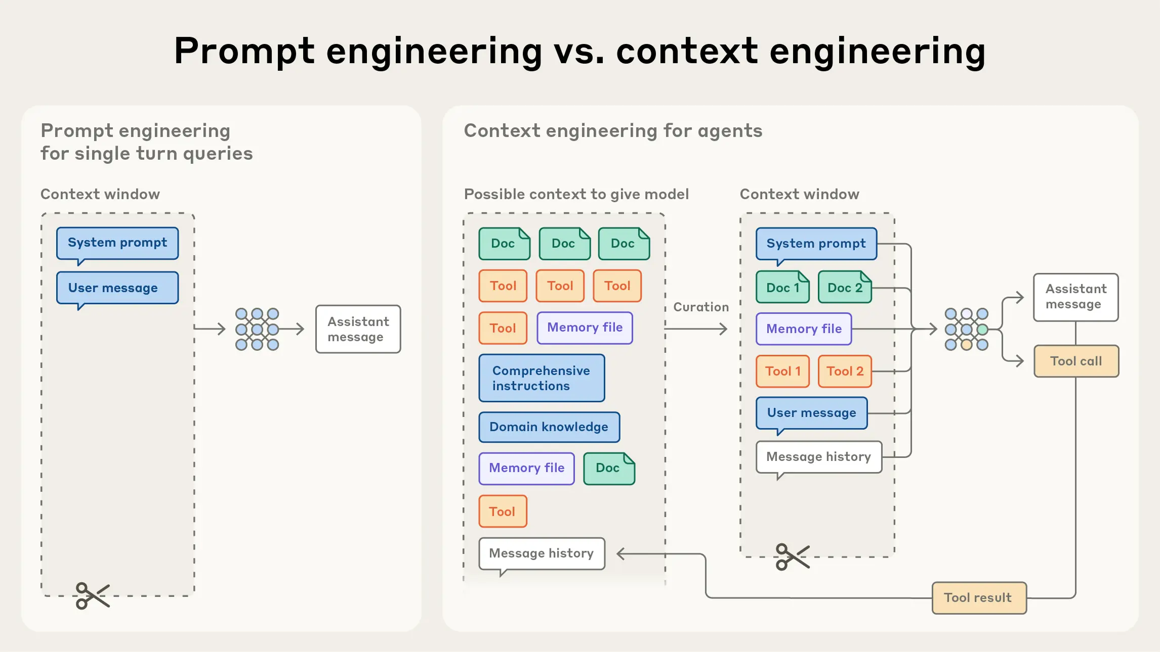


the top-level instruction set
provided by the application developer
https://www.anthropic.com/engineering/effective-context-engineering-for-ai-agents

Slide 14
Use LLMs to do prompt engineering for you.
E.g., from Gemini, to Antigravity.

Slide 15
Use sandbox.

Slide 16
Prompt Engineering Guides
https://www.promptingguide.ai/
OpenAI: https://developers.openai.com/api/docs/guides/prompt-engineering/
Google: https://cloud.google.com/discover/what-is-prompt-engineering
Anthropic (Claude): https://platform.claude.com/docs/en/build-with-claude/prompt-engineering/overview

Slide 17
CMPT 413/713: Natural Language Processing
Modern LLM Architecture
Zhiyun (Richard) Peng
2026-11-6
Adapted from slides from Angel Chang, Anoop Sarkar, Danqi Chen, Karthik Narasimhan, and Justin Johnson, Chris Manning, Abigail See, Andrej Karpathy, Graham Neubig
Notes:
http://demo.clab.cs.cmu.edu/NLP/

Slide 18
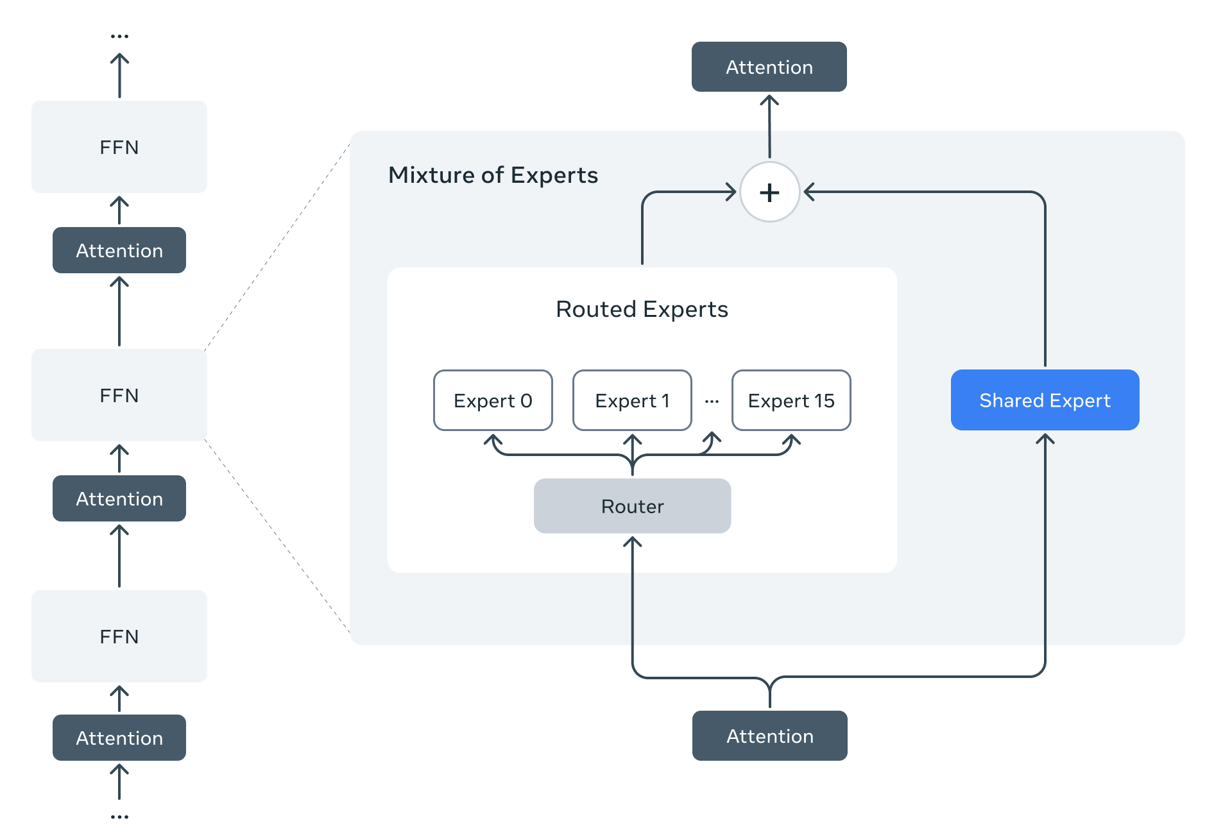
Mixture of Experts
LLama 4 - 17B active parameters, 400B total parameters
Alternating dense and MoE layers
MOE layer: 128 routed expert, 1 shared
Allows for large capacity with low computational cost per token
Router that selects which expert (individual neural networks) to use
https://ai.meta.com/blog/llama-4-multimodal-intelligence/

Slide 19
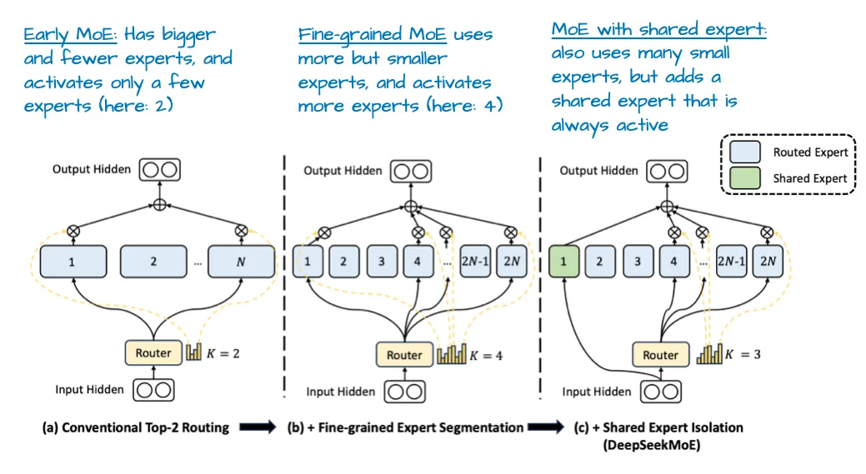
Mixture of experts over time
DeepSeekMoE: Towards Ultimate Expert Specialization in Mixture-of-Experts Language Models [Dai et al. 2024]
(Annotated version from https://magazine.sebastianraschka.com/p/the-big-llm-architecture-comparison)

Slide 20
Resources
LLM architectures
  https://magazine.sebastianraschka.com/p/the-big-llm-architecture-comparison
  https://magazine.sebastianraschka.com/p/a-dream-of-spring-for-open-weight
Andrej Karpathy - NanoGPT journey
  https://github.com/karpathy/nanochat/discussions/481

Slide 21
CMPT 413/713: Natural Language Processing
Post-training: instruction fine-tuning
Zhiyun (Richard) Peng
2026-11-6
Adapted from slides from Angel Chang, Anoop Sarkar, Danqi Chen, Karthik Narasimhan, and Justin Johnson, Chris Manning, Abigail See, Andrej Karpathy, Graham Neubig
Notes:
http://demo.clab.cs.cmu.edu/NLP/

Slide 22
From LLMs to Helpful Assistants
How to build chatGPT from an LLM base model
https://www.youtube.com/watch?v=bZQun8Y4L2A

Slide 23
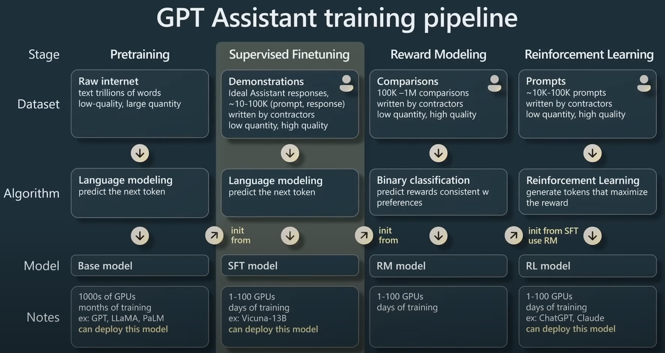

Slide 24
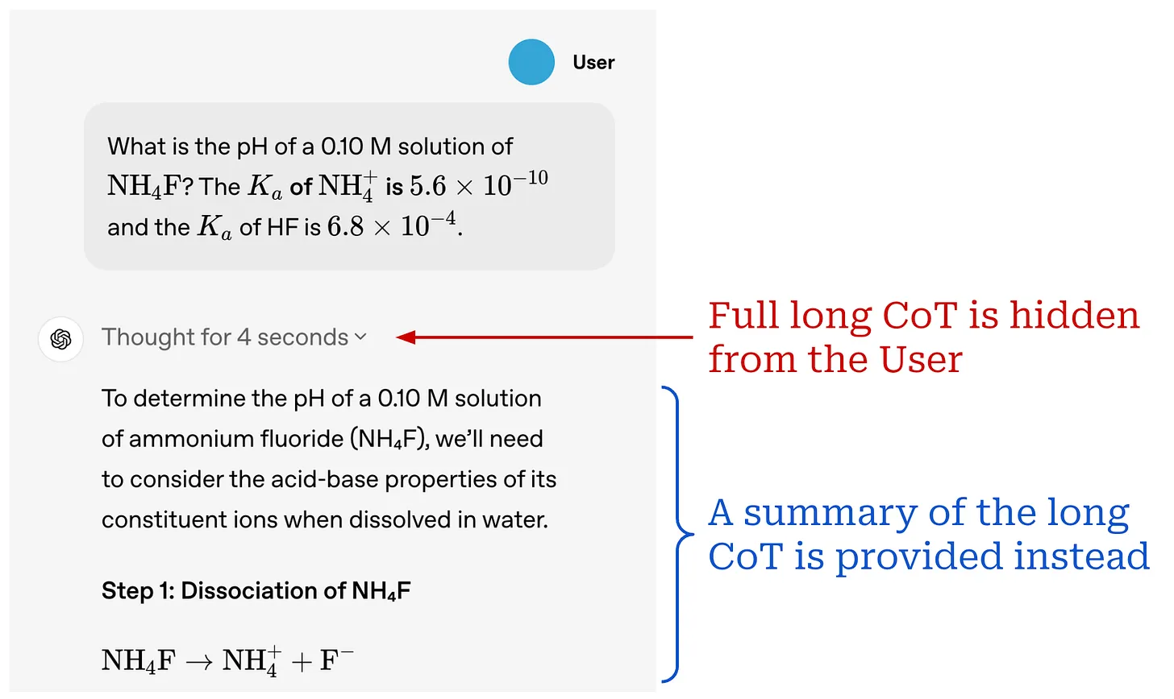
Reasoning models
Think before responding with the answer
Reasoning problems requires decomposing the problem into multiple steps (think step-by-step)
Typically math, coding problems
GSM8K

