Slide 1

CMPT 413/713: Natural Language Processing
Recurrent Neural Networks
How to model sequences using neural networks?
Zhiyun (Richard) Peng
2026-10-16
Adapted from slides from Angel Chang, Anoop Sarkar, Danqi Chen, Karthik Narasimhan, and Justin Johnson, Chris Manning, Abigail See, Andrej Karpathy
Notes:
http://demo.clab.cs.cmu.edu/NLP/

Slide 2
Overview
What is a recurrent neural network (RNN)?
Simple RNNs
Backpropagation through time
Applications
Variants: Stacked RNNs, Bidirectional RNNs

Slide 3
What are recurrent neural networks?

Slide 4
Recurrent neural networks (RNNs)
How can we model sequences using neural networks?
  DT
NN
VBD
IN
  DT
NN
VBD
IN
The
cat
sat
on
The
cat
sat
on
Recurrent neural networks = A class of neural networks used to model sequences, allows for handling of variable length inputs.
Very crucial in NLP problems (different from images) because sentences/paragraphs are variable-length, sequential inputs.
HMM
MEMM

Slide 5

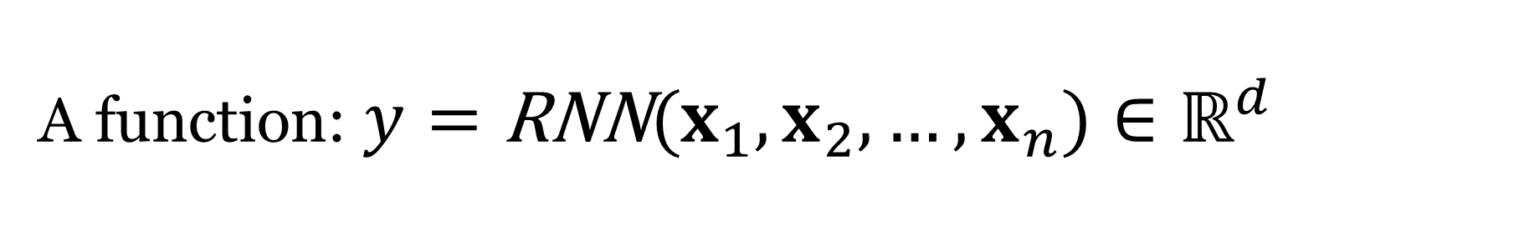
Recurrent neural networks (RNNs)
A class of neural networks allowing to handle variable length inputs
A function: $y=\text{RNN}(x_{1},x_{2},…,x_{n})∈ℝ^{d}$
where $x_{1},…,x_{n}∈ℝ^{d_{in}}$
Core idea: apply the same weights repeatedly at different positions

Slide 6
RNNs vs Feedforward NNs

Slide 7
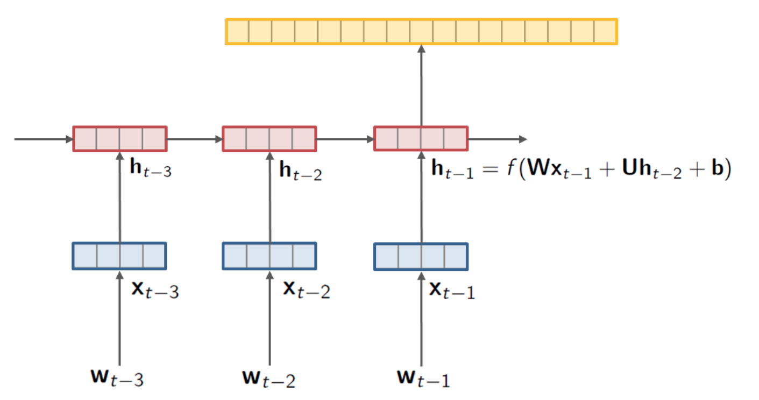

Recurrent neural networks (RNNs)
Proven to be an highly effective approach to language modeling, sequence tagging as well as text classification tasks:
Language modeling
Sequence tagging
Text classification
👎
$$f(h_{t−2},x_{t−1})$$
The
movie
sucks
.
Form the basis for the modern approaches to machine translation, question answering and dialogue:

Slide 8
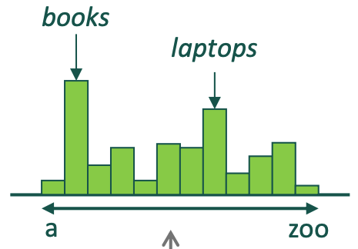
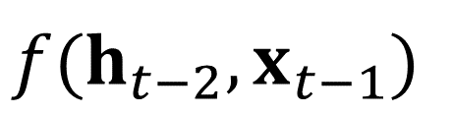
RNNs for Language Modeling
Use a RNN to
capture the history of the previous words as a hidden state
use hidden state to estimate the probability of the next word
$$f(h_{t−2},x_{t−1})$$
$$P(w_{t}|w_{1},…,w_{t−1})=P(w_{t}|h_{t−1})$$

Slide 9
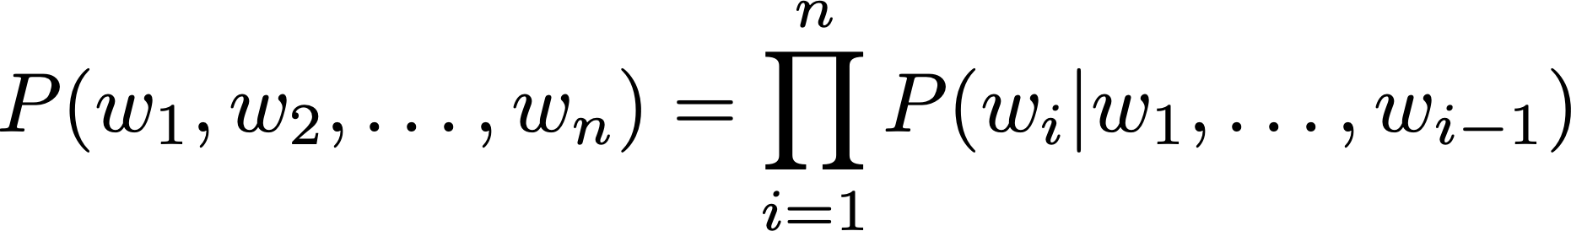
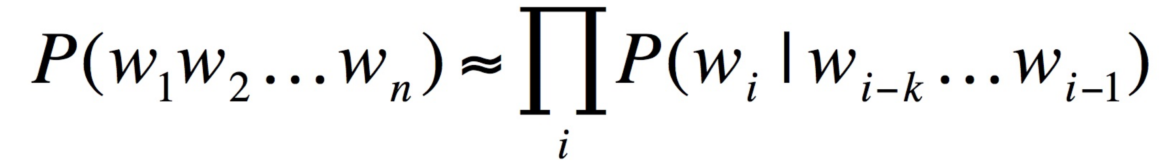

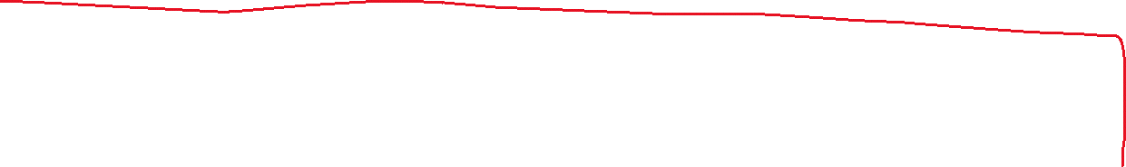
Recall: Language Models
Model the probability of a sequence of words
kth order Markov assumption
joint probability
N-grams
Bigram (1st order)
Trigram (2nd order)

Slide 10
Issues with traditional n-grams
Consider:
As the proctor started the clock, the students opened their __________
For a 4-gram, the probability of the next word would be estimated by
As the proctor started the clock, the students opened their __________
$$P(w|\text{students} \text{opened} \text{their})=\frac{\text{count}(\text{students} \text{opened} \text{their}, w)}{\text{count}(\text{students} \text{opened} \text{their})}$$
Small n: not enough context for long range dependencies

Slide 11
Issues with traditional n-grams
Example generation from trigram model
today the price of gold per ton , while production of shoe lasts and shoe industry , the bank intervened just after it considered and rejected an imf demand to rebuild depleted european stocks , sept 30 end primary 76 cts a share .
Surprisingly grammatical!
But incoherent. Need to consider longer history to model language well.
Why can’t we just increase n?
Sparsity issues when n is large
Model size (number of parameters) increases exponentially with n
  Takes up a lot of memory to store all those probabilities

Slide 12
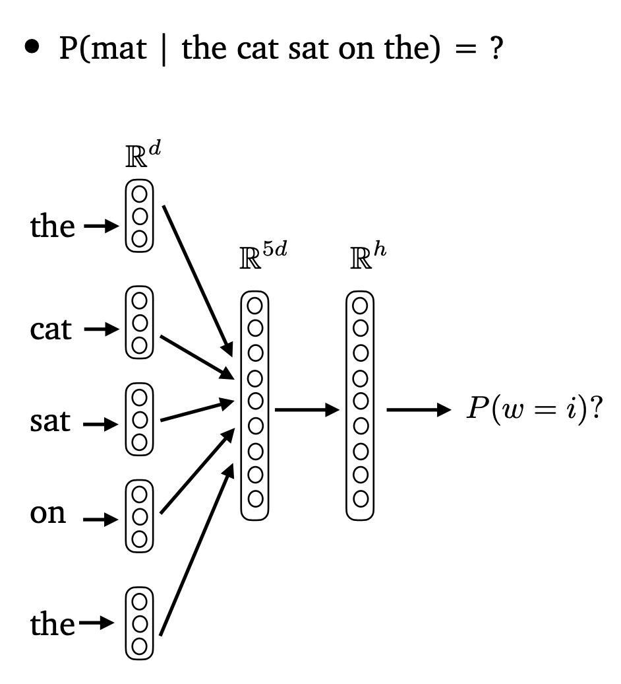


Feedforward Neural Language Model
Input layer (context size n = 5):
concatenate word embeddings
Hidden layer
Output layer (softmax)
(Bengio et 2003): A Neural Probabilistic Language Model

Slide 13
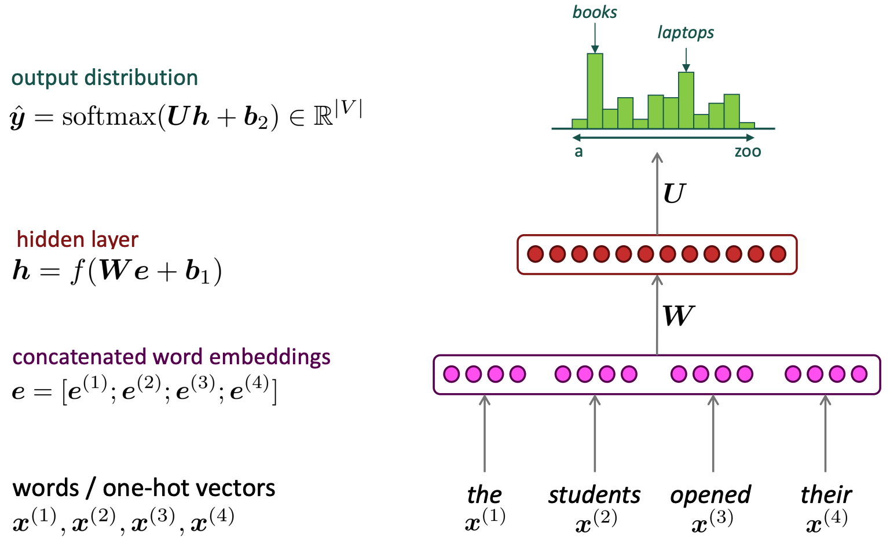
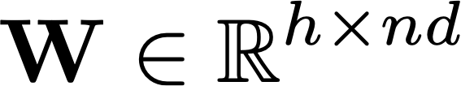




Feedforward Neural Language Model
Fixed window LM
Slide credit: Chris Manning
Notes:
\mathbf{h} = f(\mathbf{W} \mathbf{e} + \mathbf{b}_1)

Slide 14
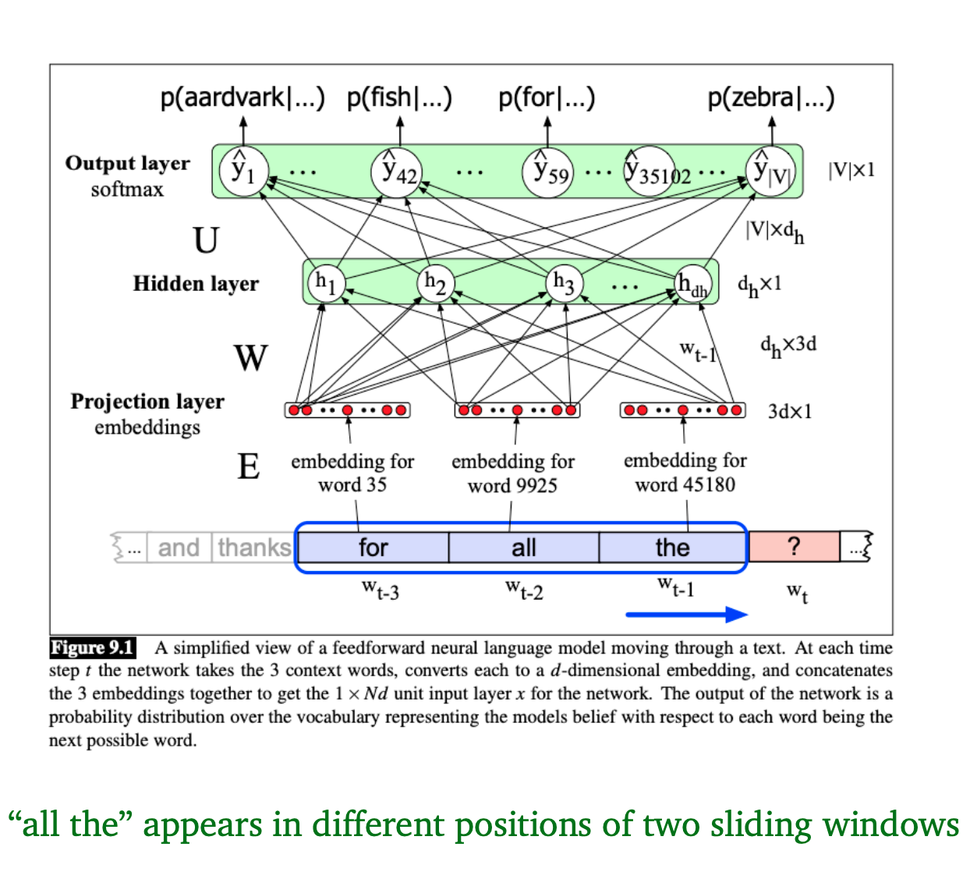
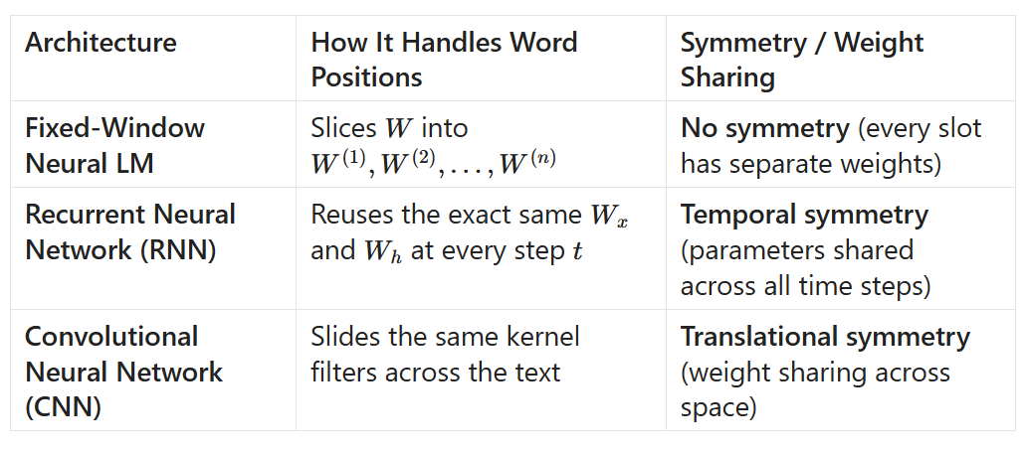

Issues with fixed-window neural LM
Improvements over n-gram LMs
  No sparsity problem
  Don’t need to store all observed n-grams
Remaining issues
Fixed window is still limited in size (too small)
Enlarging window increases parameters:
Each word in the window is multiplied by a different set of weights
  No symmetry in how the inputs are processed
What we really want:
Neural network to handle input sequences of arbitrary length!

Slide 15
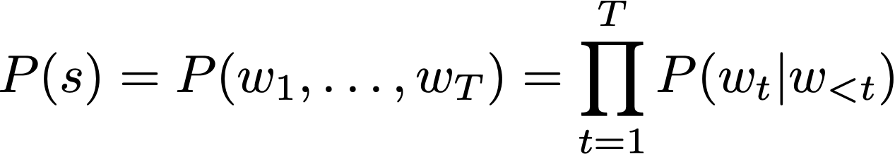
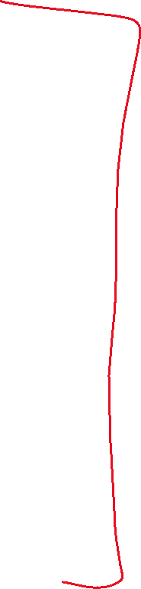
Language Modeling
Predict probability of sequence of words
with neural networks
with fixed window
with RNNs
with n-grams
with HMMs

Slide 16
Simple RNNs

Slide 17
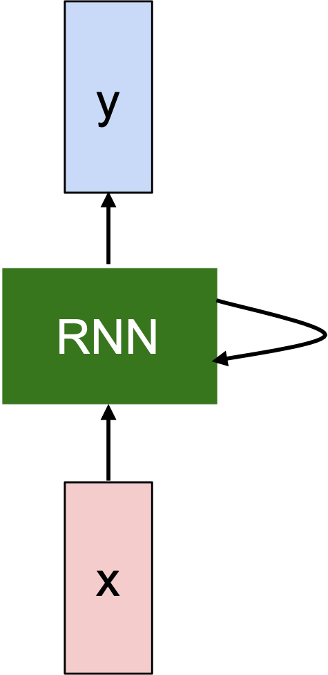



Components of RNN cells
is an initial state
$$h_{0}∈ℝ^{d}$$
function with weights W
$$h_{t}=f_{W}(h_{t−1},x_{t})∈ℝ^{d}$$
new state
old state
input at time t
: hidden states which store information from $x_{1}$ to $x_{t}$
$$h_{t}$$
Output label for each time step: Denote ${\overset{̂}{y}}_{t}=\text{softmax}(W_{o}h_{t})$, $W_{o}∈ℝ^{|L|×d}$

Slide 18
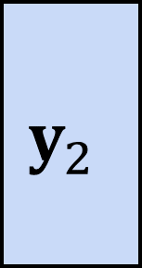
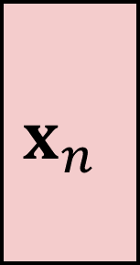
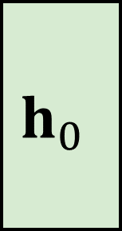
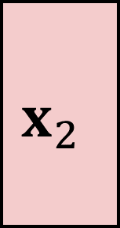
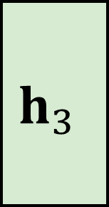

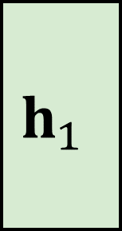

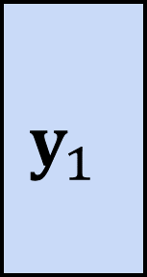
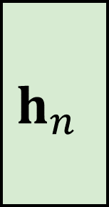
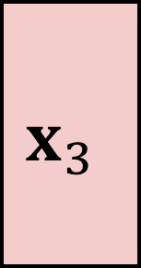

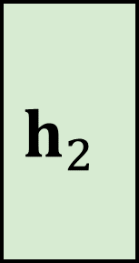
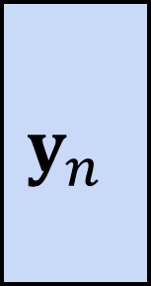
Unrolling the RNN
$$y_{1}$$
$$y_{2}$$
$$y_{3}$$
$$y_{n}$$
$$h_{0}$$
$$h_{1}$$
$$h_{2}$$
$$h_{3}$$
$$h_{n}$$
$$…$$
$$x_{1}$$
$$x_{2}$$
$$x_{3}$$
$$x_{n}$$
Structure of cell and weights are shared across time steps

Slide 19
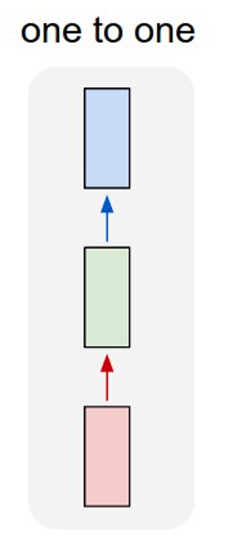
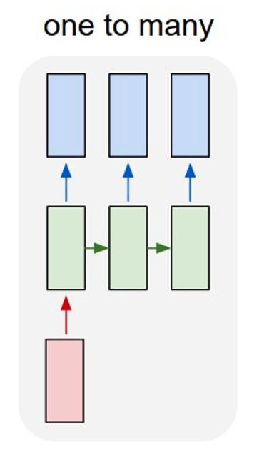
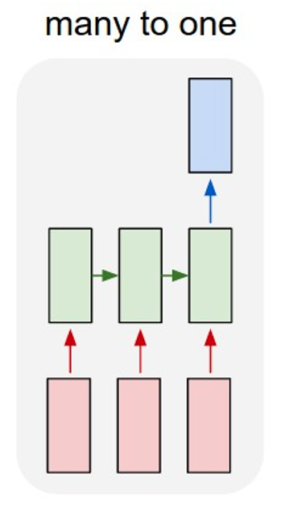
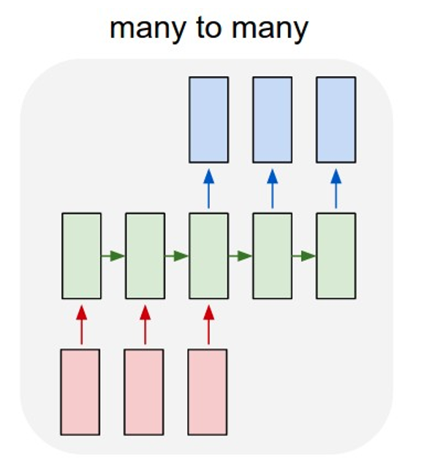
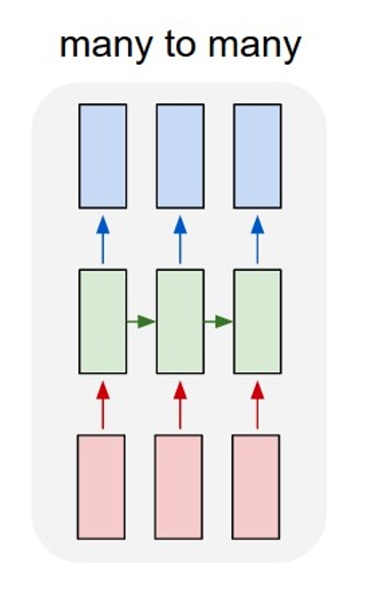
Types of sequence processing problems
Vanilla Neural Networks
Text Classification
Neural Machine Translation
Sequence Tagging
Text Generation

Slide 20
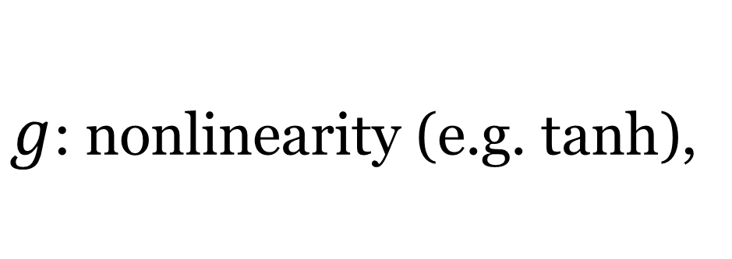
Simple (vanilla) RNNs
is an initial state
$$h_{0}∈ℝ^{d}$$
function with weights W
$$h_{t}=f_{W}(h_{t−1},x_{t})∈ℝ^{d}$$
new state
old state
input at time t
: hidden states which store information from $x_{1}$ to $x_{t}$
L: the set of all possible output labels
|L|: the size of the label set
$$h_{t}$$
Output label for each time step: Denote ${\overset{̂}{y}}_{t}=\text{softmax}(W_{o}h_{t})$, $W_{o}∈ℝ^{|L|×d}$
Simple (vanilla) RNNs:
$$h_{t}=g(W_{h}h_{t−1}+W_{x}x_{t}+b)∈ℝ^{d}$$
$g$: nonlinearity (e.g. tanh),
$$W_{h}∈ℝ^{d×d},W_{x}∈ℝ^{d×d_{in}},b∈ℝ^{d}$$

Slide 21
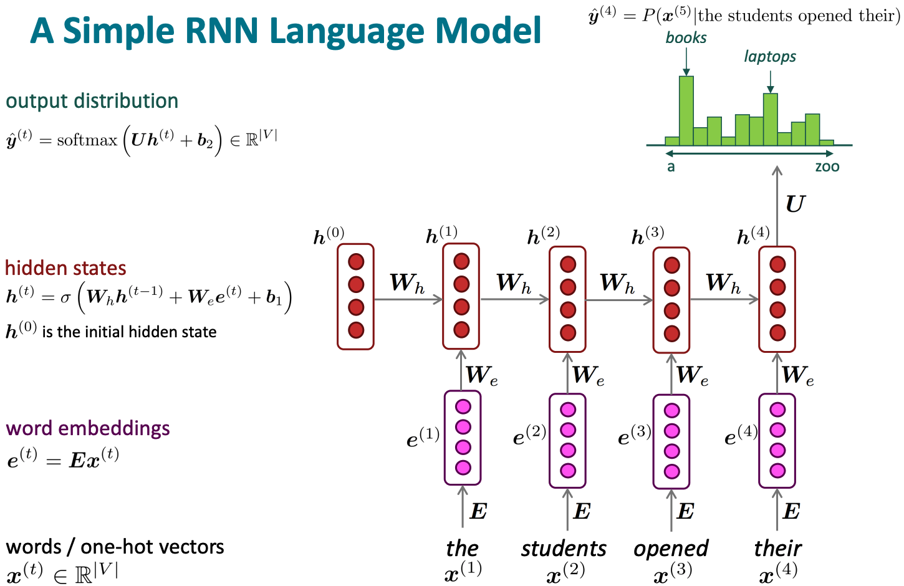
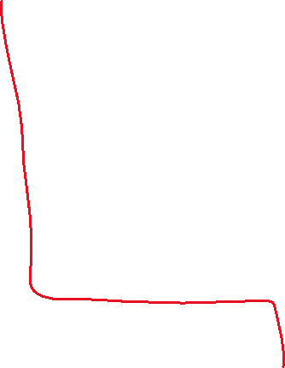
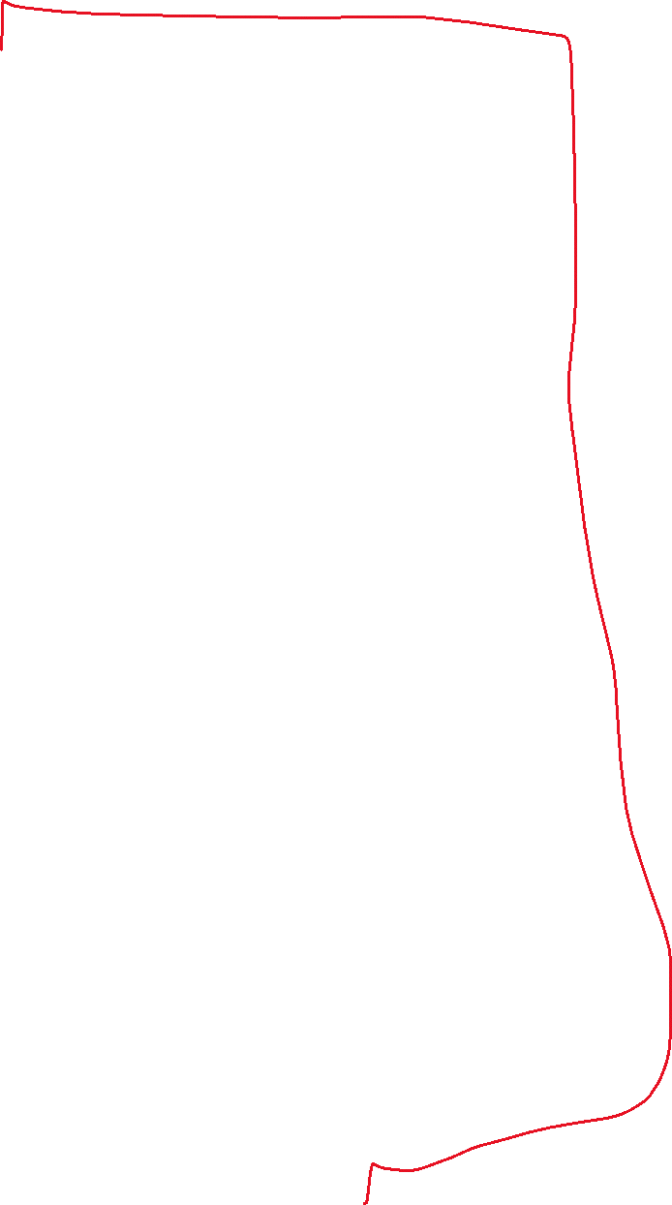
RNN Language Model
Output label size: |V|
Use word embeddings
Slide credit: Chris Manning

Slide 22

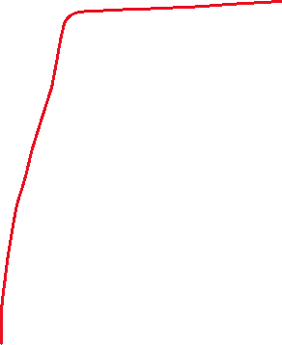
RNNs: pros and cons
Recall P14
Advantages:
  Can process any length input
  Computation for step t can (in theory) use information from many steps back
  Model size doesn’t increase for longer input context
  Same weights applied on every timestep (symmetry in how inputs are processed)
Disadvantages:
  Recurrent computation is slow (can’t parallelize)
  In practice, difficult to access information from many steps back
Can parallelize with transformers!

Slide 23
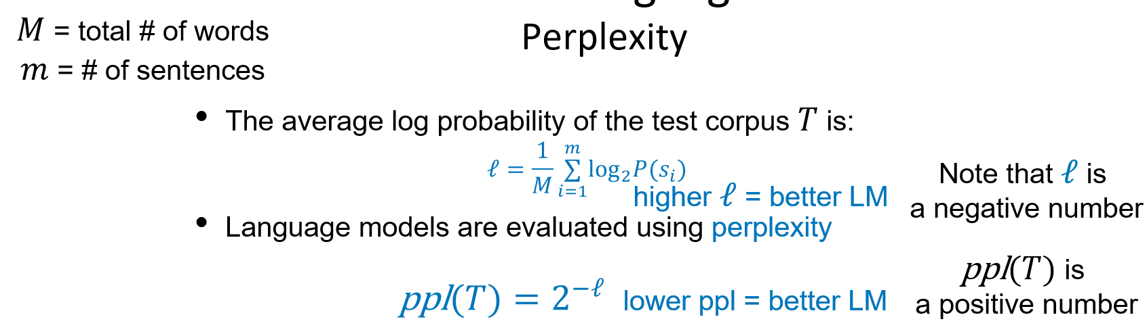
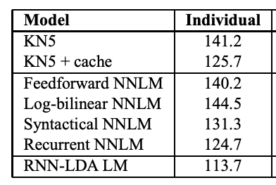
Progress on language models
On the Penn Treebank (PTB) dataset
Recall L1b P42:
Metric: perplexity
KN5: Kneser-Ney 5-gram
(Mikolov and Zweig, 2012): Context dependent recurrent neural network language model

Slide 24
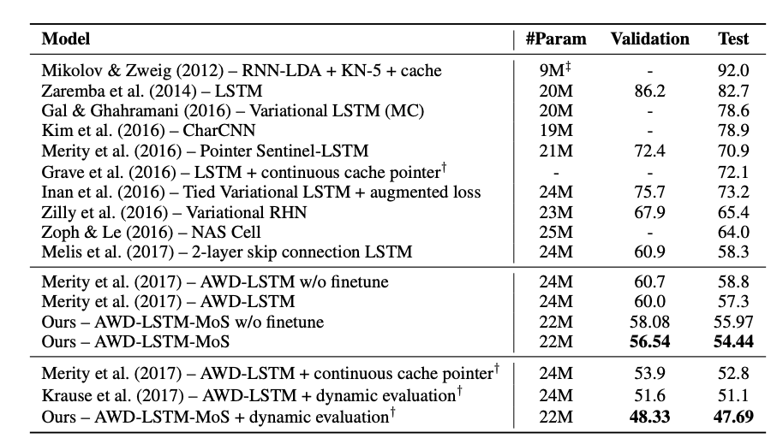
Progress on language models
On the Penn Treebank (PTB) dataset
Metric: perplexity
(Yang et al, 2018): Breaking the Softmax Bottleneck: A High-Rank RNN Language Model

Slide 25
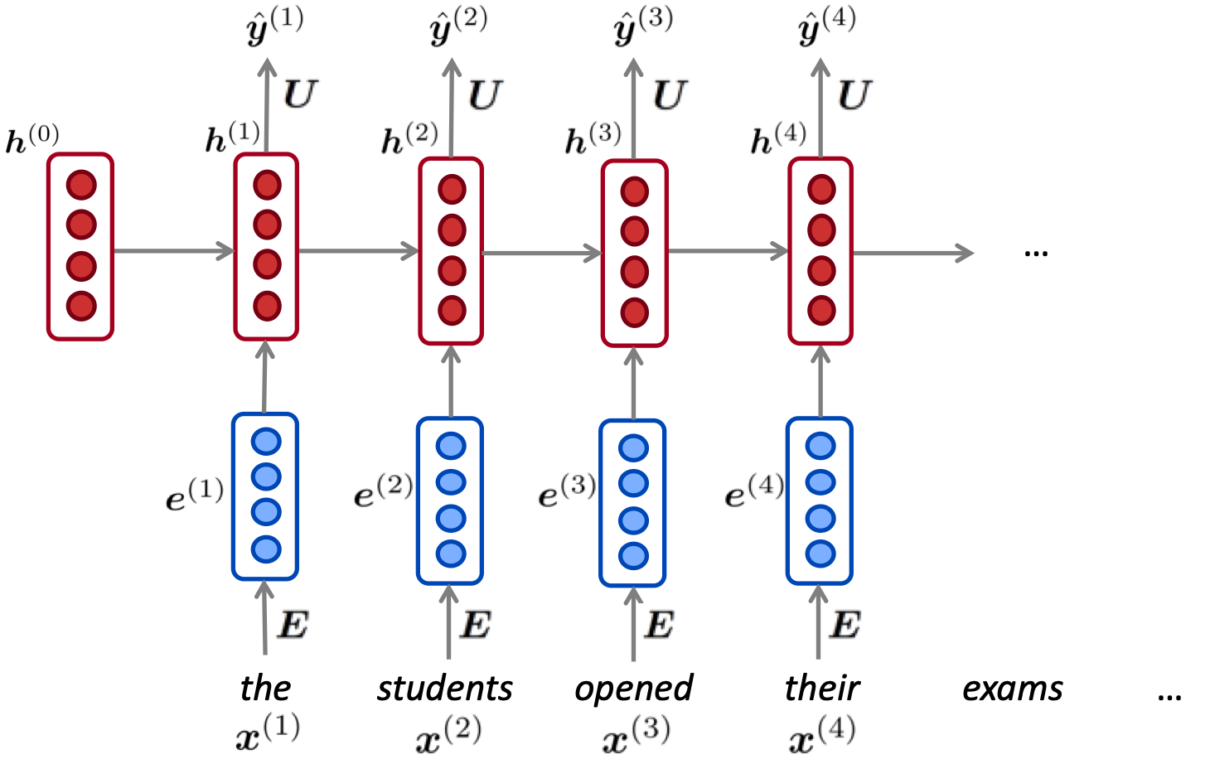
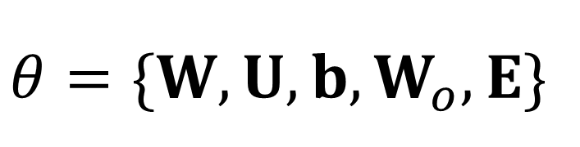
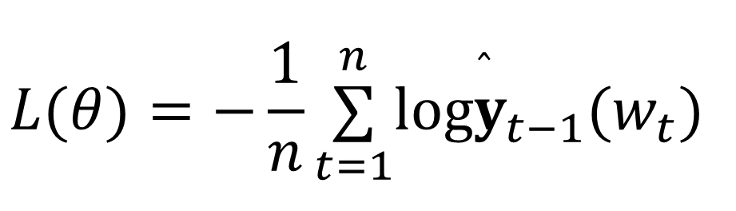
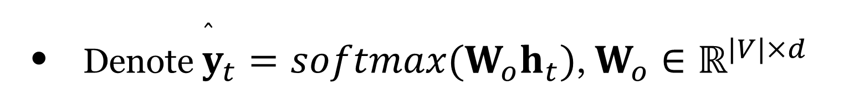
Recurrent Neural Language Models (RNNLMs)
$$P(w_{1},w_{2},…,w_{n})=P(w_{1})×P(w_{2}∣w_{1})×P(w_{3}∣w_{1},w_{2})×…×P(w_{n}∣w_{1},w_{2},…,w_{n−1})$$
$$=P(w_{1}∣h_{0})×P(w_{2}∣h_{1})×P(w_{3}∣h_{2})×…×P(w_{n}∣h_{n−1})$$
Denote ${\overset{̂}{y}}_{t}=softmax(W_{o}h_{t})$, $W_{o}∈ℝ^{|V|×d}$
Cross-entropy loss:
$$L(θ)=−\frac{1}{n}\overset{n}{\underset{t=1}{∑}}log{\overset{̂}{y}}_{t−1}(w_{t})$$
$$θ=\{W,U,b,W_{o},E\}$$

Slide 26
Training the RNN

Slide 27
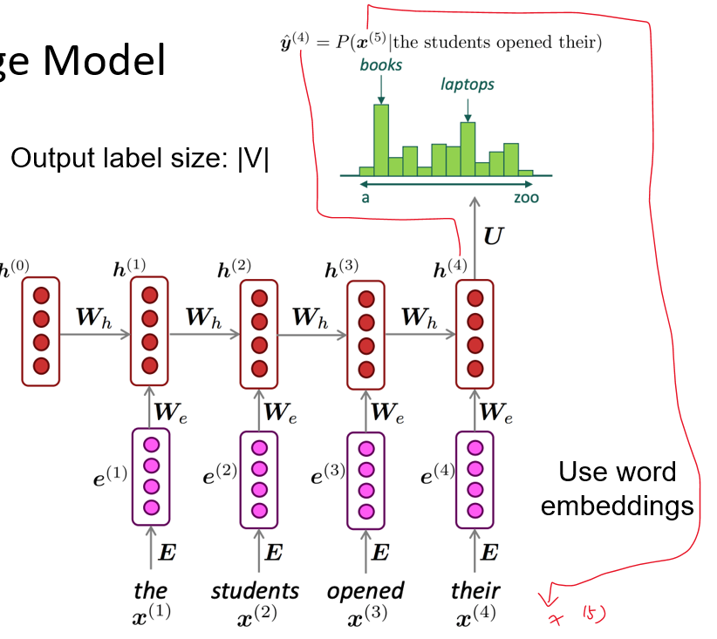
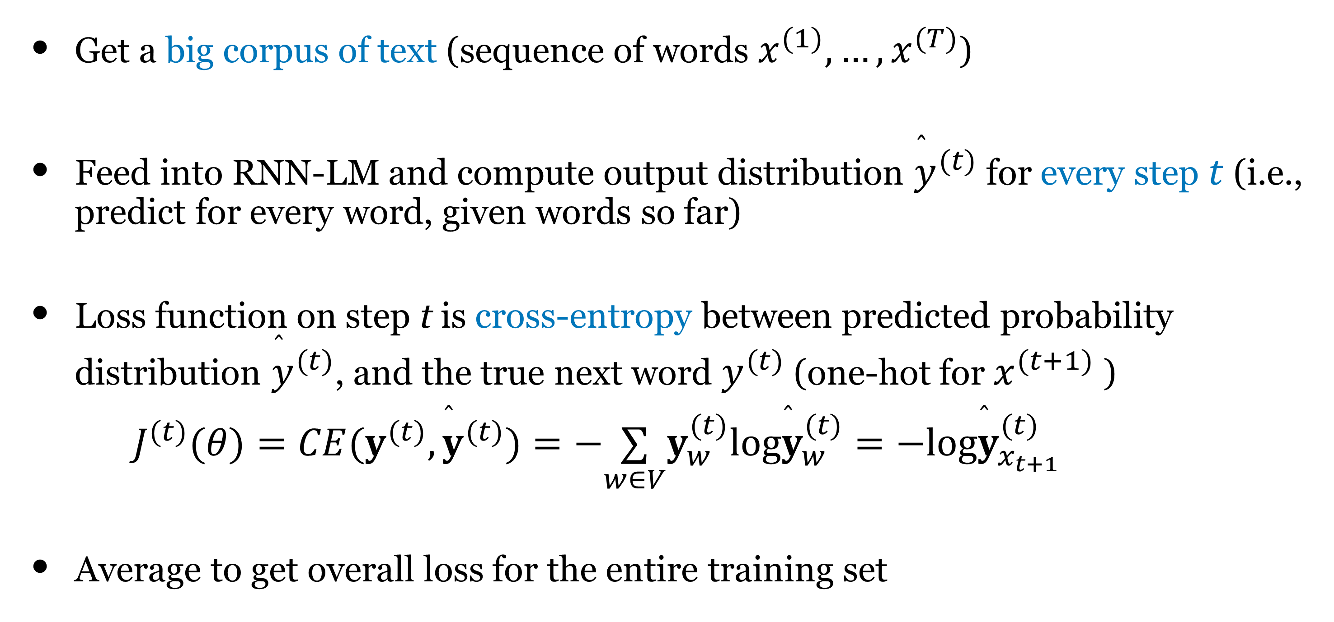

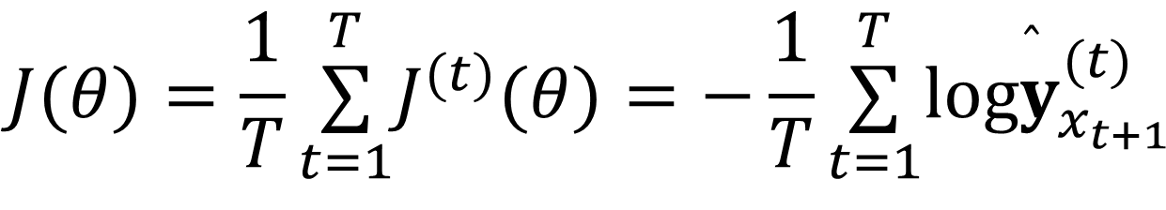
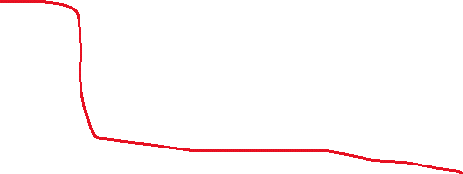
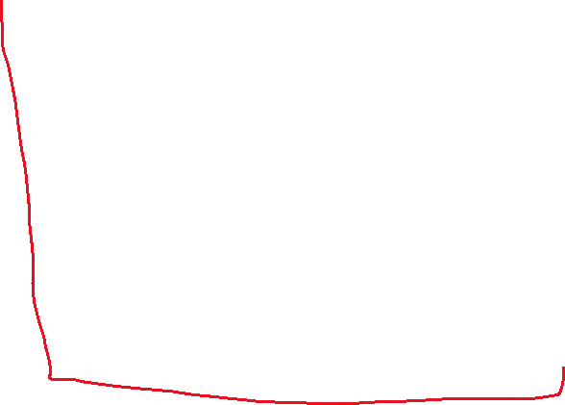


Training an RNN Language Model
Get a big corpus of text (sequence of words $x^{(1)},…,x^{(T)}$)
Feed into RNN-LM and compute output distribution ${\overset{̂}{y}}^{(t)}$ for every step $t$ (i.e., predict for every word, given words so far)
Loss function on step t is cross-entropy between predicted probability distribution ${\overset{̂}{y}}^{(t)}$, and the true next word $y^{(t)}$ (one-hot for $x^{(t+1)}$ )
$J^{(t)}(θ)=CE(y^{(t)},{\overset{̂}{y}}^{(t)})=−\underset{w∈V}{∑}y_{w}^{(t)}log{\overset{̂}{y}}_{w}^{(t)}=−log{\overset{̂}{y}}_{x_{t+1}}^{(t)}$
Average to get overall loss for the entire training set
Recall P24
$$J(θ)=\frac{1}{T}\overset{T}{\underset{t=1}{∑}}J^{(t)}(θ)=−\frac{1}{T}\overset{T}{\underset{t=1}{∑}}log{\overset{̂}{y}}_{x_{t+1}}^{(t)}$$

Slide 28
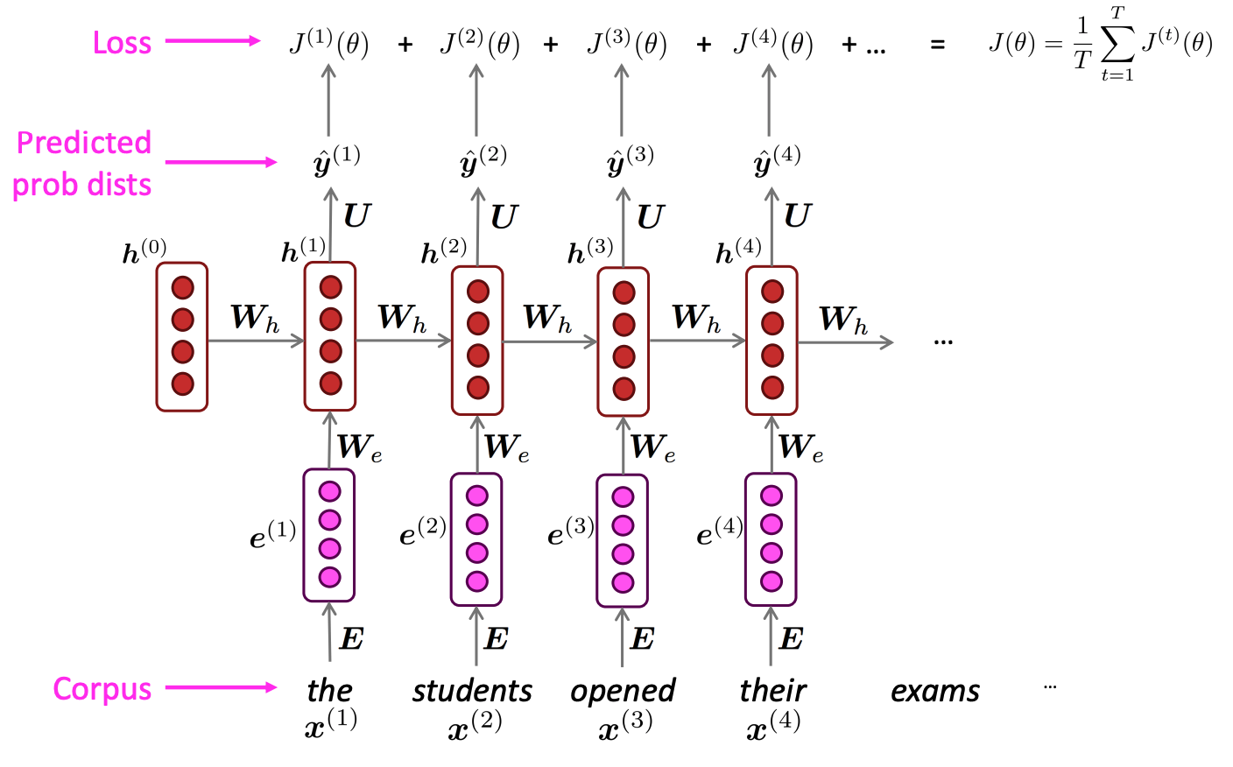
Training an RNN Language Model
=negative log prob
of “students”
Slide credit: Chris Manning

Slide 29
Training an RNN Language Model
=negative log prob
of “opened”
Slide credit: Chris Manning

Slide 30
Training an RNN Language Model
=negative log prob
of “their”
Slide credit: Chris Manning

Slide 31
Training an RNN Language Model
=negative log prob
of “exams”
Slide credit: Chris Manning

Slide 32
Training an RNN Language Model
Final Loss
Slide credit: Chris Manning

Slide 33
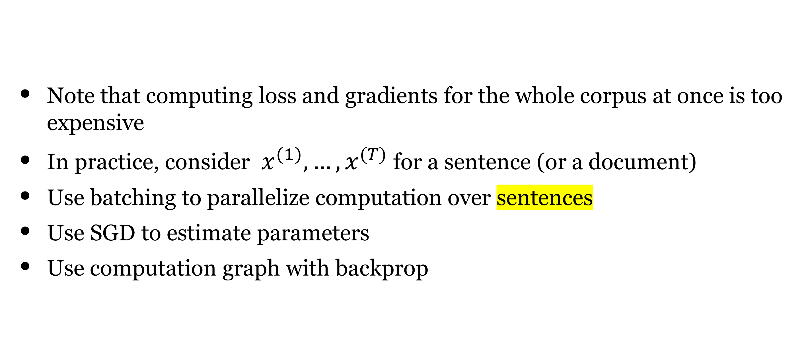
Training an RNN language Model
Note that computing loss and gradients for the whole corpus at once is too expensive
In practice, consider $x^{(1)},…,x^{(T)}$ for a sentence (or a document)
Use batching to parallelize computation over sentences
Use SGD to estimate parameters
Use computation graph with backprop

Slide 34

RNN Computation Graph
Slide credit: Justin Johnson

Slide 35

RNN Computation Graph
Slide credit: Justin Johnson

Slide 36

RNN Computation Graph
Slide credit: Justin Johnson

Slide 37

RNN Computation Graph
Slide credit: Justin Johnson

Slide 38

RNN Computation Graph
Slide credit: Justin Johnson

Slide 39

RNN Computation Graph

Slide 40

Training RNNLMs
Backpropagation? Yes, but not that simple!
The algorithm is called Backpropagation Through Time (BPTT).
Slide credit: Justin Johnson

Slide 41

Backpropagation through time
Forward through entire sequence to compute loss, then backward through entire sequence to compute gradient

Slide 42

Truncated backpropagation through time
Backpropagation is very expensive if you handle long sequences
Run forward and backward through chunks of the sequence instead of whole sequence
Carry hidden states forward in time forever, but only backpropagate for some smaller number of steps

Slide 43





Let’s consider the gradient wrt the weight matrix
Recall P30:
Gradient wrt a repeated weight is the sum of the gradient wrt each time it appears
$$\frac{∂J}{∂W_{h}}=\frac{1}{n}\overset{n}{\underset{t=1}{∑}}\frac{∂J^{(t)}}{∂W_{h}}$$
$$\frac{∂J^{(t)}}{∂W_{h}}=\overset{t}{\underset{i=1}{∑}}\frac{∂J^{(t)}}{∂W_{h}}|_{(i)}$$

Slide 44


Recall: Gradient sum at branches
Multivariate Chain Rule
https://www.khanacademy.org/math/multivariable-calculus/multivariable-derivatives/differentiating-vector-valued-functions/a/multivariable-chain-rule-simple-version

Slide 45


Recall: Gradient sum at branches

Slide 46























BPTT: Example for t=3
$$\frac{∂J^{(t)}}{∂W_{h}}=\overset{t}{\underset{i=1}{∑}}\frac{∂J^{(t)}}{∂W_{h}}|_{(i)}$$
$$L_{t}=J^{(t)}$$
$$h_{1}=g(W_{h}h_{0}+W_{x}x_{1}+b)$$
If $i$ and $t$ are far away, the gradients are likely to grow/shrink exponentially (called the exploding or vanishing gradient problem)
$$h_{2}=g(W_{h}h_{1}+W_{x}x_{2}+b)$$
$$h_{3}=g(W_{h}h_{2}+W_{x}x_{3}+b)$$
$$L_{3}=−log{\overset{̂}{y}}_{3}(w_{4})$$
You should know how to compute: $\frac{∂L_{3}}{∂h_{3}}$
$$\frac{∂L_{3}}{∂W_{h}}=\frac{∂L_{3}}{∂h_{3}}\frac{∂h_{3}}{∂W_{h}}+\frac{∂L_{3}}{∂h_{3}}\frac{∂h_{3}}{∂h_{2}}\frac{∂h_{2}}{∂W_{h}}+\frac{∂L_{3}}{∂h_{3}}\frac{∂h_{3}}{∂h_{2}}\frac{∂h_{2}}{∂h_{1}}\frac{∂h_{1}}{∂W_{h}}$$
$$\frac{∂L}{∂W_{h}}=−\frac{1}{n}\overset{n}{\underset{t=1}{∑}}\overset{t}{\underset{i=1}{∑}}\frac{∂L_{t}}{∂h_{t}}\left(\prod_{j=i+1}^{t}{\frac{∂h_{j}}{∂h_{j−1}}}\right)\frac{∂h_{i}}{∂W_{h}}$$

Slide 47










Slide 48











Vanishing/exploding gradients
(advanced)
Consider the gradient of $L_{t}$ at step $t$, with respect to the hidden state $h_{k}$ at some previous step $k$ ($k<t$):
$$\frac{∂L_{t}}{∂h_{k}}=\frac{∂L_{t}}{∂h_{t}}\left(\prod_{t≥j>k}{\frac{∂h_{j}}{∂h_{j−1}}}\right)$$
$$=\frac{∂L_{t}}{∂h_{t}}×\underset{t≥j>k}{∏}\left(\text{diag}\left(g^{′}(Wh_{j−1}+Ux_{j}+b)\right)W\right)$$
(Pascanu et al, 2013) showed that if the largest eigenvalue of $W$ is less than 1 for $g=\text{tanh}$, then the gradient will shrink exponentially. This problem is called vanishing gradients.
In contrast, if the gradients are getting too large, it is called exploding gradients.

Slide 49


Gradient flow through Vanilla RNN cell
First, using matrix notation
Bengio et al, “Learning long-term dependencies with gradient descent is difficult”, IEEE Transactions on Neural Networks, 1994
Pascanu et al, “On the difficulty of training recurrent neural networks”, ICML 2013

Slide 50


Exploding and Vanishing Gradients
Largest singular value > 1: Exploding gradients
Largest singular value < 1: Vanishing gradients
Computing gradient of $h_{0}$ involves many factors of $W$
(and repeated tanh)
Difficult for model to converge!

Slide 51

Why is exploding gradient a problem?
Gradients become too big and we take a very large step in SGD.
Difficult for model to converge!
Solution: Gradient clipping — if the norm of the gradient is greater than some threshold, scale it down before applying SGD update.

Slide 52

Exploding and Vanishing Gradients
Gradient clipping:
Scale gradient if its norm is too big
Computing gradient of $h_{0}$ involves many factors of $W$
(and repeated tanh)
Largest singular value > 1: Exploding gradients
Largest singular value < 1: Vanishing gradients

Slide 53
Exploding and Vanishing Gradients
Computing gradient of $h_{0}$ involves many factors of $W$
(and repeated tanh)
Largest singular value > 1: Exploding gradients
Largest singular value < 1: Vanishing gradients
Can’t capture long distance dependencies.

Slide 54



Vanishing gradients
Simple RNN
(Figure credit: Abigail See)
Notes:
If too large, it will be difficult for the model to converge
If too small, the model can’t capture long-term dependencies
If too small, the model may capture a recent wrong dependency

Slide 55

Vanishing Gradients
Can’t capture long distance dependencies.
Focus more on recent past.
(Figure credit: Abigail See)

Slide 56
Exploding and Vanishing Gradients
Largest singular value > 1: Exploding gradients
Largest singular value < 1: Vanishing gradients
Gradient clipping:
Scale gradient if its norm is too big
Computing gradient of $h_{0}$ involves many factors of $W$
(and repeated tanh)
Change RNN architecture

Slide 57

Why is vanishing gradient a problem?
If the gradients becomes vanishingly small over long distances (step $k$ to step $t$), then we can’t tell whether:
    We don’t need long-term dependencies
    We have wrong parameters to capture the true dependency
the dogs in the neighborhood are ___
Still difficult to predict “barking”
How to fix vanishing gradient problem?
  LSTMs: Long short-term memory networks
  GRUs: Gated recurrent units

